Slide 1
Third Year Communication Sciences University of Mohamed Seddik Ben Yahia, Jijel Teacher: MANSOUR A.
Lecture 01: An Introduction to Oral Communication

Slide 2
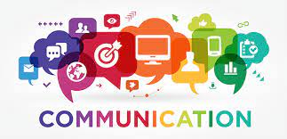
Communication generally refers to the art and process of creating and sharing ideas. For Gaber (1957), it is a social interaction through messages. It is done with the intention of influencing the audience. It can be either oral or written. This course is devoted for enhancing students’ oral communication skills.

Slide 3
1 Definition of Oral communication
“Oral communication is the process of sharing information and creating meaning through the use of spoken language, including both formal and informal interactions.” Julia T. Wood

Slide 4
Oral communication has been described as the process of exchanging information, thoughts, and ideas through spoken words. It allows individuals to interact, express themselves, and convey messages directly to others using speech as medium.
This form of communication covers various aspects, including speaking, listening, and understanding. Effective oral communication skills are vital in personal and professional settings as they enable individuals to express themselves, listen actively, and respond appropriately to the others’ needs.

Slide 5
2.Modes of oral communication
2.1 Intrapersonal communication: It refers to the mode of communication that occurs within an individual’s own mind. It involves the internal exchange and processing of thoughts and ideas.
2.2 Interpersonal communication: It involves communication between two or more people in a face-to-face interaction, with each person taking turns to speak and listen. It can be either formal or informal .

Slide 6
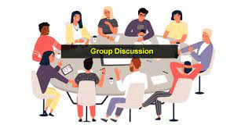
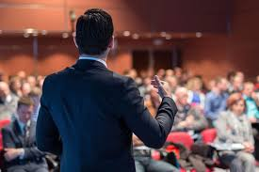
3 . Types of oral communication

Slide 7
3.1 Group discussion involves multiple participants engaging in an exchange of ideas, opinions, and perspectives on a specific topic. This type of oral communication enhances collaboration, problem-solving, and decision-making within a team.
3.2 Public Speaking: Public speaking involves one individual speaking to a large group of people. It is often used for informative or persuasive purposes.

Slide 8
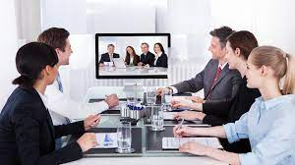
3.3 Interviewing: This type of communication involves one individual asking questions to another individual.
3.4 Video Conferencing: This form of communication is similar to face-to-face communication but takes place over video conferencing software.
3.5 Telephonic Communication: It involves two or more participants communicating over the phone. Telephonic communication is useful for situations where face-to-face communication is not possible or practical, such as in long-distance relationships or business negotiations.

Slide 9
3.6 Informal Conversations: They occur when individuals engage in casual and unplanned discussions with each other. Informal conversations occur in everyday settings such as social gatherings, family interactions, and friendly conversations.

Slide 10
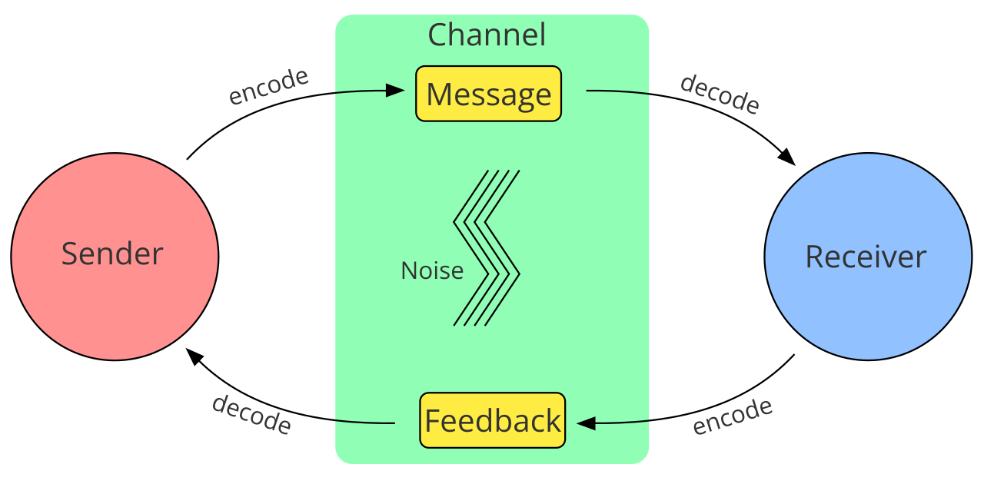
4 . Elements of Oral Communication
Here are 8 elements that are essential to successful communication.
A-Speaker
B-Message
C-Listener
D-Feedback
E-Channel
F-Context
G- Noise/ Interference
H-Purpose
Figure 1. The communication process

Slide 11
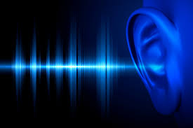
G- Noise/ Interference
Whatever happens that causes the interruption of communication:
Internal noise: when a sender makes a mistake encoding a message or a receiver makes a mistake decoding the message (misspelling a word).
External noise: when something external (not in the control of sender or receiver) impedes the message.

Slide 12
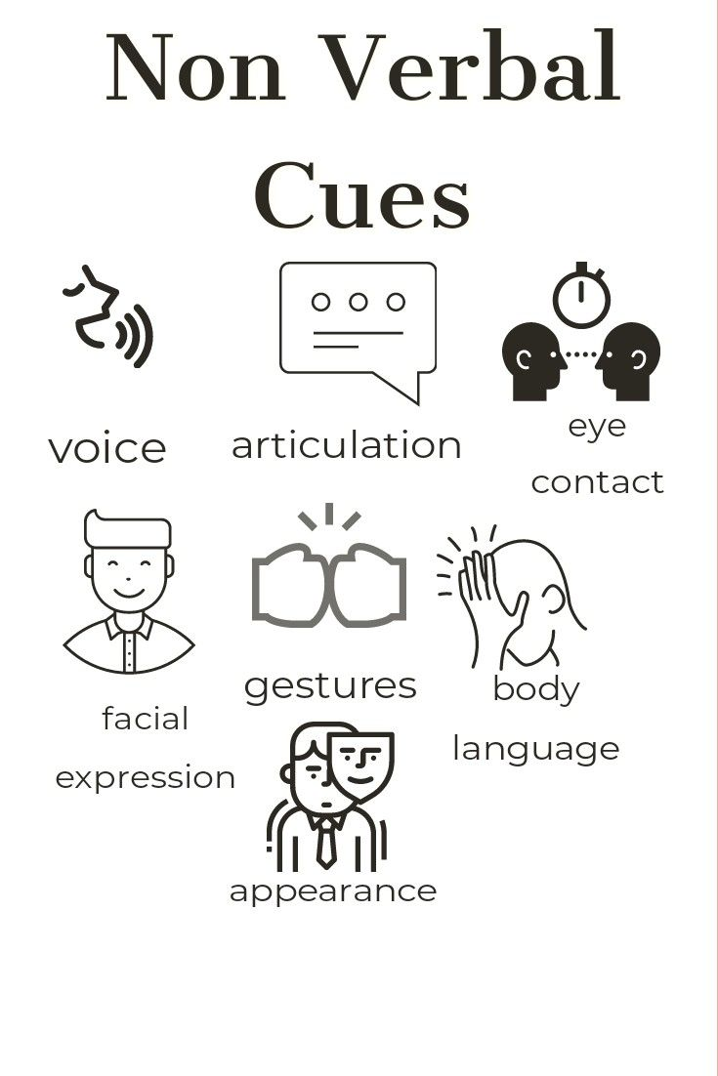
5 . Characteristics of Oral Communication
a-Dynamic and interactive(a two-way exchange of information)
b- Verbal and nonverbal cues
c- Less formal
d- Spoken Words (the primary medium)
e- Contextual and Situational
Factors such as the audience, purpose, and cultural background influence the language, tone, and style used by the speaker.

Slide 13
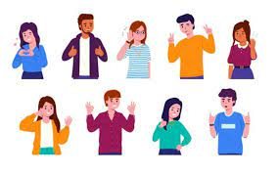
Interpersonal communication involves not only the words used, but also various elements of non-verbal communication.
Examples of non-verbal communication

Slide 14
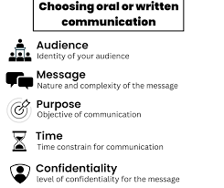
6 . Factors to consider while choosing oral communication
Purpose and Audience: Clearly define the purpose of the communication and identify the target audience.
Clarity: Focus on clarity and simplicity in your message.
Content and Structure: Determine the key points and information to be delivered.
Delivery Style: Consider the appropriate delivery style based on the nature of the message, audience, and context.
Timing: Consider the appropriate timing for your communication.
Technology and Visual Aids: Assess the need for technology or visual aids to enhance your oral communication.

Slide 15
7 . Oral communication skills
1/ Active Listening skills: They involve fully focusing on and understanding the speaker’s message, responding appropriately, and providing feedback when necessary.
2/ Presentation Skills: Presentation skills involve effectively delivering information to an audience in a well-organized manner. They encompass organizing content, using visual aids effectively, maintaining audience engagement, and delivering a confident and impactful presentation.
3/ Flexibility and Adaptability skills: They involve being open to different communication styles, cultural differences, and unexpected changes in the communication context.
Oral communication skills refer to the abilities and competencies that enable individuals to effectively convey their ideas, thoughts, and messages through spoken words.

Slide 16
4/ Conversation Skills: Conversation skills refer to the ability to engage in meaningful and productive conversations with others. This involves initiating and maintaining conversations and showing interest in others’ contributions.
5/ Discussion Skills: It involves participating in structured group discussions. It involves contributing ideas, listening to others, and providing feedback or responses.

Slide 17
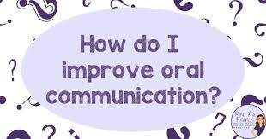
8 . How to improve oral communication skills
Seek feedback and practice: Actively seek feedback from trusted individuals.
Collaboration and teamwork: They enable individuals to exchange ideas, provide feedback, and work together towards common goals.
Practice Active Listening: Practice focusing your attention on the speaker, avoiding distractions can help you improve your oral communication skills.
Use Visualization Techniques: Visualize yourself speaking confidently and effectively.
Expand Vocabulary: Enhancing your vocabulary can improve your ability to express ideas accurately and precisely.
Use appropriate tone and pitch: Adapt your tone and pitch to match the context and audience.
Seek Opportunities for Conversations and Discussions: Engage in conversations and discussions with others as much as possible.

Slide 18
THANK YOU
☺

