Slide 1
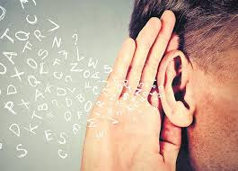
Third Year Communication Sciences University of Mohamed Seddik Ben Yahia, Jijel Teacher: MANSOUR A.
Lecture Four: The Art of Listening

Slide 2
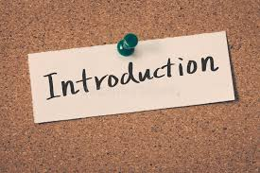
Good listeners are rare these days. Studies have shown that most listeners retain less than 50% of what they hear. Imagine what that means when it comes to a conversation that you might have with your boss, a colleague, or a customer.
Listening is one of the most vital skills that you need if you want to communicate effectively. Listening allows you to ‘decode’ the messages that you are receiving, but it also allows you to help others communicate better. When you are not certain of the message that you have heard the first time, listening well allows you to ask the questions that will clarify the message.
Hear with ears but listen with the mind. Without effective listening, message may be misunderstood and communication may be unsuccessful.

Slide 4
1-Why do we LISTEN?
Listening is important in more arenas than in the work place. We listen for multiple reasons:
To build relationships
To understand others
To be entertained
To learn
To show empathy
To gather information

Slide 5
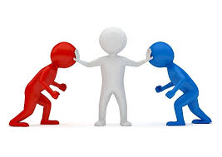
With as much as listening can do for us, it is obvious that we can all benefit from improving our listening skills. We can become more productive at work, more connected in our relationships, and more efficient in everything that we do. But listening also helps us to persuade and negotiate with others. It can help us avoid misunderstandings and can just make life more conflict-free in general. All of these are very good reasons for learning more about how to be a better listener.

Slide 6
2- Basic Listening Skills
2-1 Self-Awareness
An important tool for becoming a good listener is becoming aware of your own behavior, feelings, and habits when listening. Do you know whether or not you are a good listener? Are you only a good listener in certain situations, like when listening to a friend who is upset? Or can you also listen in a tense situation when you have to communicate with someone who is angry, stressed, or expressing an opposing opinion to your own?

Slide 7
At work, at home, with friends, with strangers, or with other groups that you communicate with, notice the following:
Your body language – how are you standing or sitting? Are you tense or relaxed? In an open position or a closed one?
Do you make eye contact? Do you keep it? Or do you look away, look down, or turn your eyes to other people or things in your environment?
Are you following every word? Could you repeat what was just said verbatim? Or is your mind wandering off to lunch, that email you need to write, or that phone call you just had?
Are you planning what you will say in return?
Being self-aware will let you self-correct and get better and better at listening to others.

Slide 8
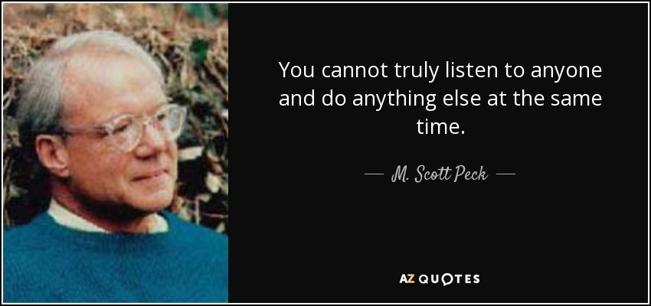

Slide 9
2-1 Active Listening
Active listening means being as attentive and involved in the conversation during the times that you are listening as when you are speaking. You must learn to be consciously attentive to the words that are being said, but in addition, to the whole message that the other person is attempting to relay to you. In order to do this, you must pay close attention to the speaker.

Slide 10
Becoming an Active Listener
There are five key aspects of becoming an active listener.
a- Pay close attention
Look the speaker in the eyes
Stop any mental chatter
Don’t start preparing your response or rebuttal while the other person is talking
Make sure your environment doesn’t distract you
Notice the speaker’s body language and tone of voice – what are the non-verbal messages telling you?
If you are in a group, avoid side conversation
With this step, you learn to give the speaker your undivided attention. But you also let the speaker know that you are listening by using acknowledgements – types of verbal and non-verbal tools that help add proof that you are truly listening.

Slide 11
b- Demonstrate physically that you are listening
Use non-verbal and verbal signals that you are listening to the speaker attentively.
Nod from time to time, when appropriate
Use appropriate facial expressions
Monitor your own body language. Be sure you remain open and relaxed rather than closed and tense.
Use small comments like uh-huh, yes, right.

Slide 12
c- Check for understanding
Use reflecting and paraphrasing. Check that you heard the message correctly by saying things like “what I hear you saying is….” or “If I’m hearing you correctly, you’re saying…..” or “I think you’re talking about….”.
Ask questions that will help clarify the speaker’s meaning. Suggestions include things like, “Can you tell me more about…..?” or “What did you mean when you said…?” or “I think you’re saying… is that right?”
Summarize what you’ve heard occasionally – don’t wait until the end or you might not remember exactly what was said.
Our personal experiences, our perceptions, and our feelings can all influence the way that we hear. It is possible for the message to get mistranslated or misinterpreted, so that we hear a message that was not intended. Before responding, it is important to check for understanding using these tools. .

Slide 13
d- Don’t interrupt!
There is nothing good that comes from interrupting the speaker. You will only be limiting your chance of understanding the message because you will not hear it all – and because the speaker will get frustrated!

Slide 14
e- Respond Appropriately
When expressing your thoughts:
• Be honest and open
• Be respectful
• Be thorough
When you are actively listening, you are showing your respect for the speaker, as well as gaining the information that you need to form your response. Once you have that information and have clarified it, it is time to form your reply.
Remember too that you are modeling excellent behavior for others when you use active listening.

Slide 15
2- Listening in Difficult Situations
If possible, suggest that you move the discussion to a private location with no distractions.
If tension is high, start by agreeing on what your goal of the discussion will be. Are you resolving a problem? Learning about what happened in a difficult situation? Deciding roles in an important project?
While listening, remind yourself of the active listening guidelines. Breathe slowly in and out in order to remain calm.
If you can’t seem to pay attention, try repeating to yourself in your mind every word that the other person says. Then you are ‘hearing’ the message twice and it has a better chance of getting through.
Listening is particularly difficult when you are in a heated or emotionally charged situation. In order for your communication to be successful and productive, you may need to employ some additional tools in order to listen to others and to allow for the exchange of information despite your feelings. Some tips include:

Slide 16
