Slide 1
TOPOGRAPHIC MAPS: The basics
Key Vocabulary:
-Topographic Map -Contour Map -Map -Contour Line
-Cardinal Direction -Contour Interval
-Longitude -Slope
-Latitude -Relief
-Elevation

Slide 2
What is a map?
Map: a flat representation of earth’s surface
Maps include 4 main features:
Title: tells us what the map shows
Scale: shows us what the distance is in real life
Legend: identifies symbols on a map
Compass rose: shows directions on a map
Notes:
Teacher Actions: Direct students to record information on the RH side of their notebook
Student Actions: Students record notes

Slide 3
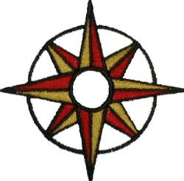
What are the cardinal directions?
Cardinal directions: North, South, East, West
N
W
E
S
Notes:
Teacher Actions: Direct students to record information on the RH side of their notebook
Student Actions: Students record notes

Slide 4
What are the intermediate directions?
Cardinal directions: Northeast, Southeast, Northwest, Southwest
NW
NE
SW
SE
Notes:
Teacher Actions: Direct students to record information on the RH side of their notebook
Student Actions: Students record notes

Slide 5
What is a topographic map?
The topographic map is a two-dimensional representation of the Earth’s three-dimensional landscape. The most frequently used topographic map is at the scale of 1:50 000.

Slide 6
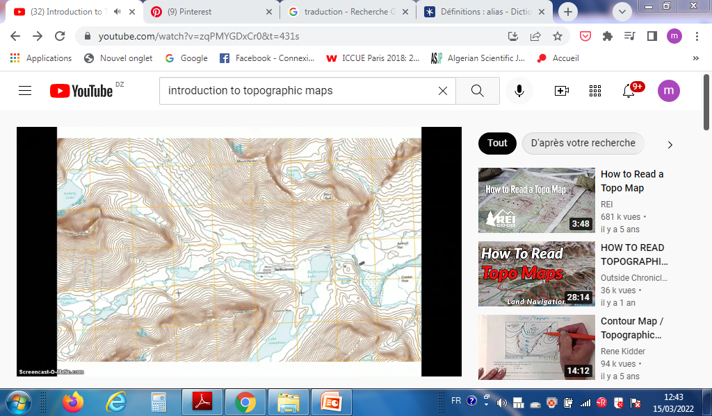

Slide 7
What information is on a topographic map?
Topographic maps identify numerous ground features, which can be grouped into the following categories:
Relief: mountains, valleys, slopes, depressions
Relief : montagnes, vallées, pentes, dépressions

Slide 8
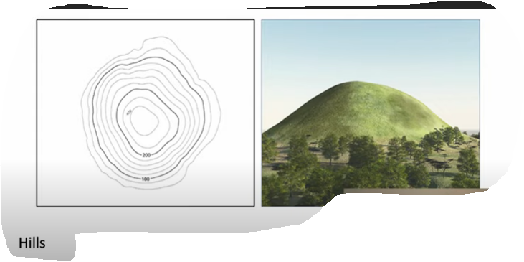

monticule collines montagne
hills

Slide 9
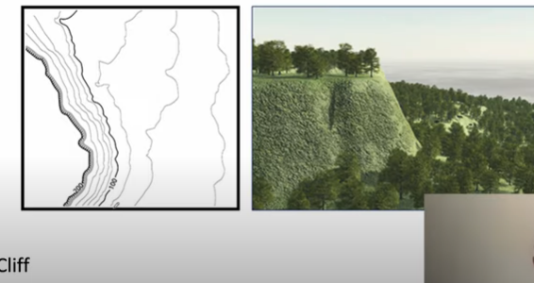
Cliff _falaise

Slide 10
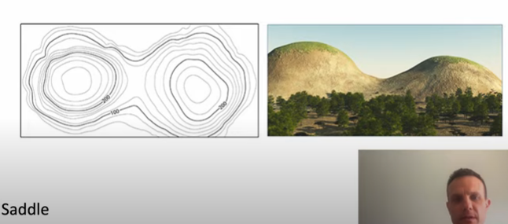
Saddle _selle

Slide 11
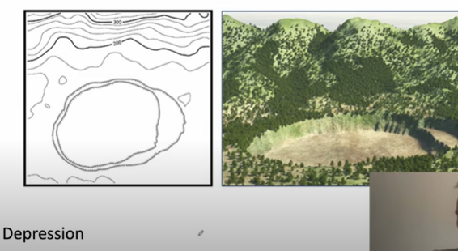
Depression _dépression

Slide 12
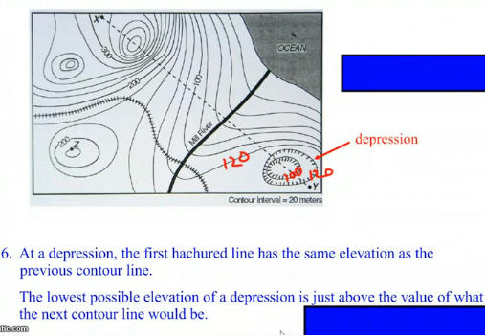

Slide 13
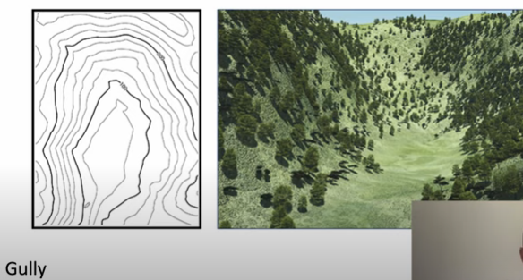
gully _ravin

Slide 14
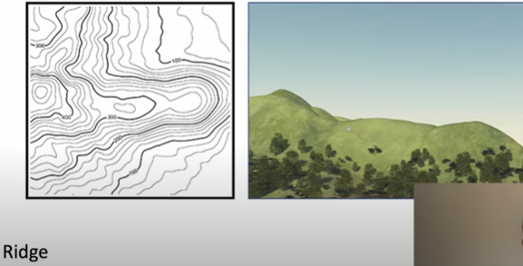
Ridge _crête

Slide 15
Hydrography: lakes, rivers, streams, swamps, falls
lacs, rivières, ruisseaux, marécages, chutes
Vegetation: wooded areas (bois)
Transportation: roads, trails, railways, bridges, airports (routes, sentiers, voies ferrées, ponts, aéroports

Slide 16
Culture: buildings, urban development, power transmission line, pipelines, towers
bâtiments, développement urbain, ligne de transmission électrique, pipelines, tours
Boundaries: international,provincial/territorial, administrative, recreational, geographical
(international, provincial/territorial, administratif, récréatif, géographique

Slide 17
Toponymy: place names, water feature names, landform names, boundary names
noms de lieux, noms de plans d'eau, noms de formes de relief, noms de limites
Refer to the map legend for a complete listing of all features and their corresponding symbols. find the map scale and other important information about the map such as the year, the edition

Slide 18
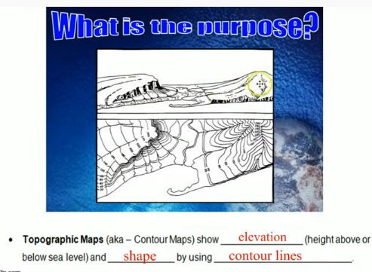

Slide 19
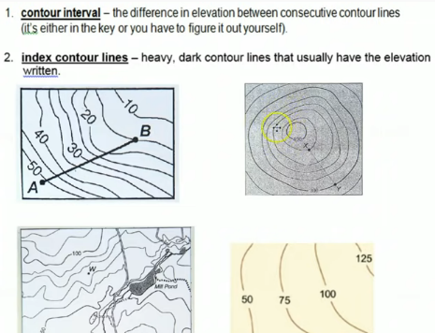

Slide 20
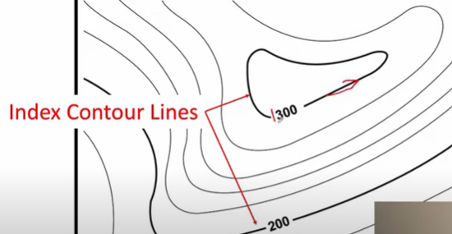
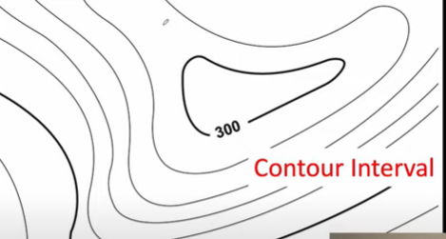
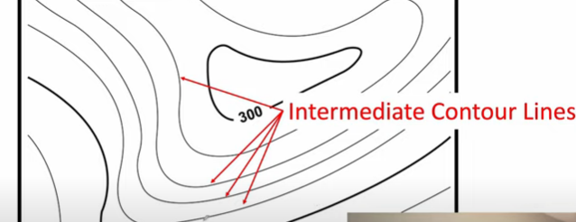

Slide 21
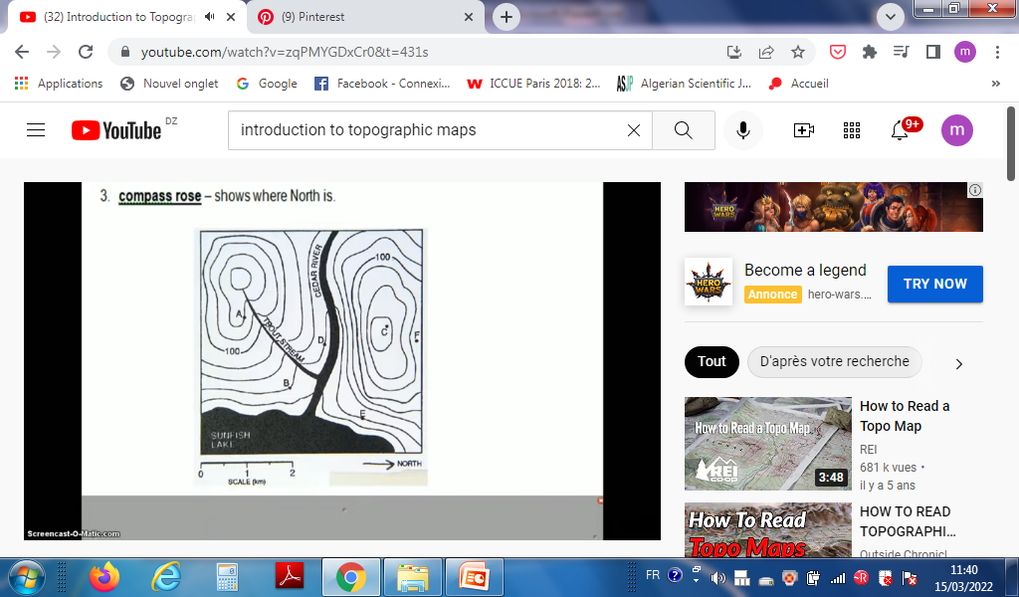
rose des Vents

Slide 22
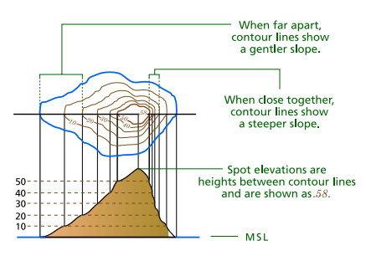

Slide 23
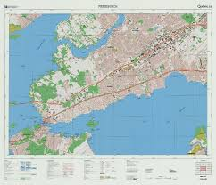
Map margins
title

Slide 24
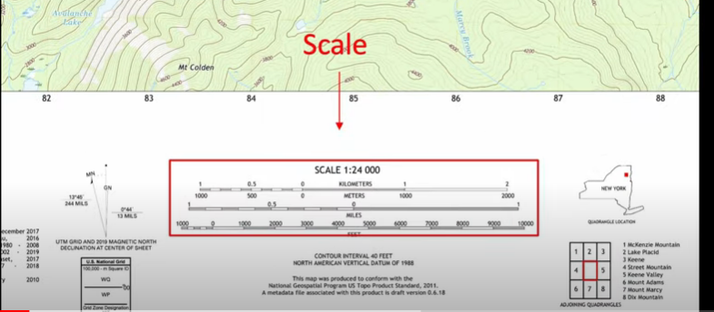
L’echelle

Slide 25
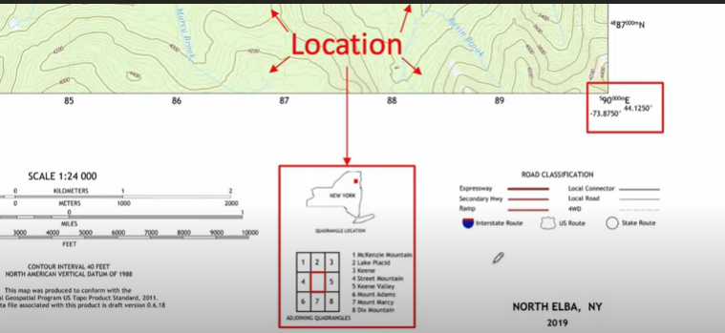
La localisation

Slide 26
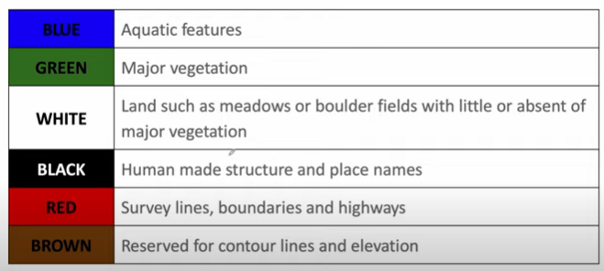
Colors les couleurs
Milieu aquatique
La végétation
La terre (prairies rocher )
Structure humaine et nom des lieux
Limites autoroute
Courbe de niveaux et élévation

