Slide 1
CHAPTER 2: INTERNAL GEODYNAMICS
2.1. Internal structure of the globe and the geoid :
2.1.1 Introduction:
The terrestrial globe is not homogeneous; it is made up of a succession of concentric layers of varying composition and thickness. There are layers separated by discontinuities highlighted by seismology:
1 Earth's crust
2 Mantle
3 Core

Slide 2
Figure13: The internal structure of the globe

Slide 3
The Earth's interior is thus made up of a number of superimposed layers, distinguished by their solid, liquid or plastic state, as well as by their density.
How do we know this? A kind of echography of the Earth's interior, based on the behavior of seismic waves during earthquakes. Seismologists Mohorovicic, Gutenberg and Lehmann were able to determine the state and density of the layers by studying the behavior of these seismic waves.

Slide 4
The speed at which seismic waves propagate depends on the state and density of the material.
Some types of wave propagate equally well in liquids, solids and gases, while others propagate only in solids. When an earthquake occurs on the surface of the globe, waves are emitted in all directions.

Slide 5
There are two main areas of wave propagation: surface waves, which propagate on the earth's surface, in the earth's crust, and cause all the damage associated with earthquakes, and volume waves, which propagate inside the earth and can be recorded at several points around the globe.
Volume waves are of two main types: shear waves or S-waves, and compressional waves or P-waves.

Slide 6
2.1.2. Volume seismic waves :
The P-wave moves along creating successive zones of expansion and compression. Particles move forward and backward in the direction of wave propagation, like a "slinky". This type of wave can be likened to a sound wave. In the case of S waves, the particles oscillate in a vertical plane, at right angles to the direction of wave propagation.

Slide 7
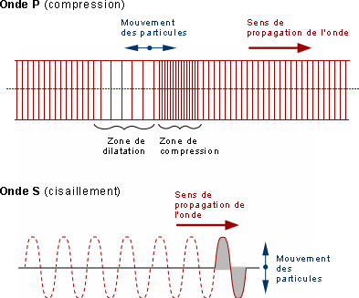
Figure 14: Volume waves

Slide 8
The Earth's internal structure, as well as the state and density of matter, have been deduced from analysis of the behavior of seismic waves. P waves propagate in solids, liquids and gases, while S waves propagate only in solids. We also know that the propagation speed of seismic waves is proportional to the density of the material in which they propagate.

Slide 9
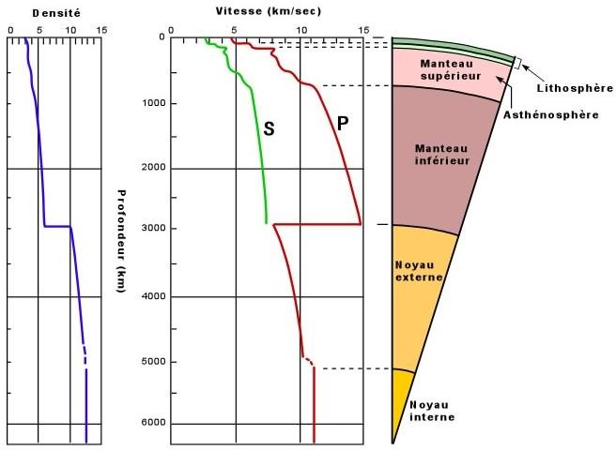
Figure 15: Seismic wave propagation

Slide 10
The abrupt interruption in S-wave propagation at the boundary between mantle and core indicates a transition from solid (lower mantle) to liquid (outer core). The gradual increase in P- and S-wave velocity in the mantle indicates an increase in material density as we move deeper into the mantle. The sudden drop in P-wave velocity at the mantle-core contact is linked to the change in material state (from solid to liquid), but relative velocities continue to rise, indicating an increase in densities.

Slide 11
In more detail, at the lithosphere- contact asthenosphere, there is a slight drop in P and S wave propagation speeds, corresponding to the transition from solid material (lithosphere) to plastic material (asthenosphere).

Slide 12
The composition of the Earth's crust is fairly well known from the study of the rocks that make up the Earth's surface, and also from numerous boreholes. Our knowledge of the mantle and core is, however, more limited. Despite our best efforts, no borehole has yet penetrated the MOHO.

Slide 13
2.1.3. The crust :
The crust, the surface part of the earth, is made up of :
- Oceanic crust
- Continental crust

Slide 14
1.1.3.1 Oceanic crust :
From top to bottom, under a layer of water averaging 4.5 km in depth (Fig.), the following layers can be distinguished
Layer 1: Composed of sediments, it is thickest near the ridges and a few kilometers thicker near the continents. It averages 300 m; velocity VP is 2 km/s; density varies between 1.93 and 2.3.
Layer 2: Basaltic bedrock, 1.7± 0.8 km thick, VP speed between 4 and 6 km/s, density 2.55
Layer 3: Oceanic layer, formed by gabbros, 4.8 km thick, VP speed 6.7 km/s, density 2.95

Slide 15
1.1.3.2. Continental crust :
The continental crust extends over 30 to 70 km (maximum thickness is reached beneath mountainous regions) and has near-surface average granite composition. The continental crust is characterized by the presence of sedimentary and metamorphic rocks and the Conrad discontinuity. Density is 2.7 (Fig. ).
The Mohorovicic discontinuity marks the boundary between crust and mantle.

Slide 16
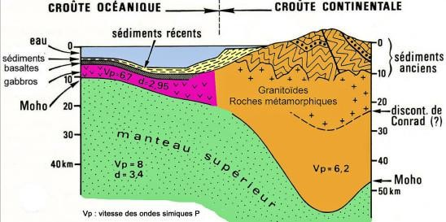
Figure 16: Earth's crust

Slide 17
2.1.4. The lithosphere :
This is the earth's most superficial envelope, with an average thickness of 100 km. It comprises the crust and the upper part of the upper mantle up to a very special zone known as the LVZ (low velocity zone). This zone divides the upper mantle into two parts, is located around 100 km below the surface and extends to a depth of 230 km. The speed of seismic waves is greatly reduced here, hence its name. In this zone of lower velocity, materials are more ductile, giving the lithospheric plates mobility over a more rigid zone: the asthenosphere (Fig. 6).

Slide 18
- The mantle: this is a large rocky envelope extending to depths of between 50 and 2,900 km, representing 2/3 of the earth's mass. It is basic in nature (peridotite, ophiolite). In the upper mantle, between 100 and 400 km, there is a viscous, plastic zone, animated by convection movements, which explains the mobility of lithospheric plates: the asthenosphere.

Slide 19
The mantle is subdivided into two parts: the upper mantle, density 3 - 4, and the lower mantle or mesosphere, density 4 - 5.
The mantle rises to the surface at mid-ocean ridges, in the form of basaltic lava, which cools and forms the oceanic crust.

Slide 20
2.1.5. Asthenosphere :
Between 100 km and 670 km deep. This is the lower part of the upper mantle. Materials here are once again more rigid, and wave velocities are higher. These two zones are also separated by a 1300° C isotherm, which marks the lower limit of the lithosphere (Fig.6).

Slide 21
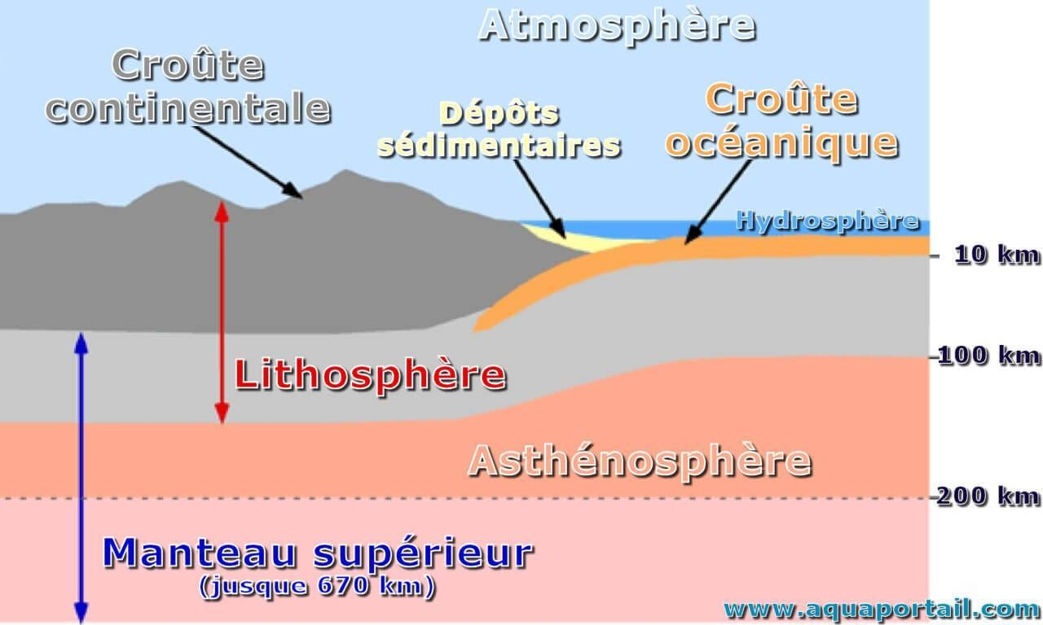
Figure 17: Lithosphere and Asthenosphere (www.aquaportail.com)

Slide 22
2.1.6. The mesosphere :
This refers to the lower mantle, with its high density and very high temperature.

Slide 23
2.1.7. The core :
The core is divided into an outer core and an inner core. They account for 15% of the Earth's volume.

Slide 24
2.1.7.1. Outer core :
The outer core (8) is liquid. It is essentially composed of 80-85% iron, around 10-12% of a light element not yet determined from among sulfur, oxygen, silicon and carbon (or a mixture of all four)1,2, and around 5% nickel. Its viscosity is estimated at between 1 and 100 times that of water, its average temperature reaches 4,000 degrees Celsius and its density 10. The Gutenberg discontinuity (13) marks the transition between the mantle and the core.

Slide 25
This enormous quantity of molten metal is stirred up by convection, mainly thermal (secular cooling of the planet), and to a lesser extent compositional (phase separation, demixing). These movements interact with the planet's movements, mainly daily rotation and, on a longer time scale, precession of the globe.

Slide 26
The conductive nature of iron allows the development of variable electric currents that give rise to magnetic fields, which in turn reinforce these currents, creating a dynamo effect by sustaining each other. This explains why the liquid core is the source of the Earth's magnetic field. The source of energy needed to maintain this dynamo most likely lies in the latent heat of crystallization of the seed.

Slide 27
2.1.8.1. Inner core: Earth's seed.
The solid inner core (9) (also known as the "seed") is essentially metallic (mainly iron and nickel alloys, in proportions of around 80%-20%) and is formed by progressive crystallization of the outer core. The pressure of 3.5 million bars (350 gigapascals) maintains it in a solid state, despite a temperature in excess of 6,000°C3 and a density of around 13.

Slide 28
The Lehmann discontinuity (not shown) marks the transition between the outer and inner core.
The inner core is still an active subject of geological research. Various observations suggest that the inner core is in motion. The exact nature of the inner core remains a matter of debate. Others suggest a liquid core, or even a two-part core.

Slide 29
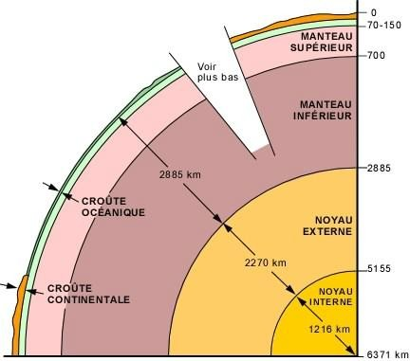
Figure 18: Earth's internal structure (u.laval.can).

Slide 30
Two major discontinuities separate crust, mantle and core: the Mohorovicic discontinuity (MOHO), which marks a density contrast between the Earth's crust and mantle, and the Gutenberg discontinuity, which also marks a significant density contrast between mantle and core. A third discontinuity separates the inner and outer cores, the Lehmann discontinuity (Fig. ).

Slide 31
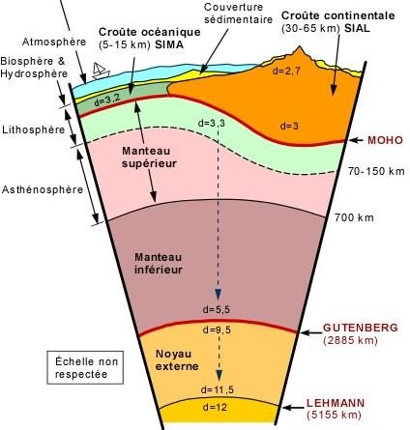
Figure 19: The Earth's various discontinuities (univ.laval.can ).

Slide 32
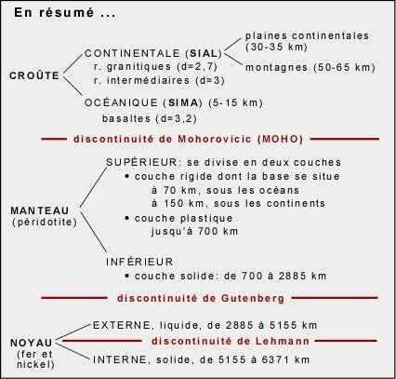
Table 2: Summary of the earth's internal structure

Slide 33
2.1.8. Secondary structures :
2.1.8.1. Subduction zone :
A subduction zone (3) shows a plate sinking into the mantle, sometimes up to several hundred kilometers.

Slide 34
2.1.8.2. Lithosphere and asthenosphere :
The lithosphere (11) consists of the crust (tectonic plates) and part of the upper mantle. The lower limit of the lithosphere lies at a depth of between 100 and 200 kilometers, where the peridotites approach their melting point. It includes the Mohorovicic discontinuity (14).

Slide 35
Sometimes found at the base of the lithosphere (some geologists include it here, but most place it in the asthenosphere) is a zone known as the LVZ (for "Low Velocity Zone"), where there is a marked decrease in the velocity and attenuation of P and S seismic waves. This phenomenon is due to the partial melting of peridotites, which results in greater fluidity. The LVZ is generally not present beneath the roots of mountain massifs in the continental crust.
The asthenosphere (12) is the zone beneath the lithosphere.

Slide 36
2.1.8.3. Volcanism :
Two types of active volcanism are represented here, the deeper of the two (5) is said to be "hot-spot". These are volcanoes whose magma originates deep in the mantle, close to the boundary with the liquid core. These volcanoes are therefore not linked to tectonic plates and, as they do not follow the movements of the Earth's crust, they are virtually immobile on the surface of the globe, forming island archipelagos such as Tahiti. Hot-spot volcanism is produced by a plume of hotter material (7) which, starting at the boundary with the core, partially melts as it approaches the Earth's surface.

Slide 37
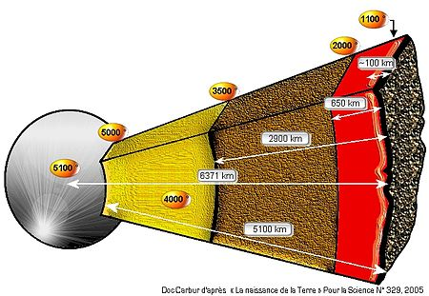
2.1.8.4. Characteristics :
Figure 20: Dimensions of the various layers and approximate temperatures https://commons.wikimedia.org/wiki/File:Dimensionsglobe.jpg?uselang=fr

Slide 38
2.1.8.4.1. Dimensions of the different layers and approximate temperatures :
Recent calculations have revised core temperatures upwards, to between 3800°C and 5500°C depending on depth.

Slide 39
2.1.8.4.2. Internal heat :
In the figure opposite, temperatures are given in degrees Celsius for guidance only. As they cannot be measured directly but can only be deduced, they are approximate (the deeper you go, the greater the margin of error). The Earth's internal heat is produced by
by the natural radioactivity of rocks through the decay of uranium, thorium and potassium.

Slide 40
2.1.9. Geoid concept :
2.1.9.1. Definition:
The shape of the earth appears very irregular in detail. The orographic features of the earth's surface are of minimal importance compared to the size of the earth.

Slide 41
2.1.9.2 Variable radius :
The globe is not perfectly spherical, and the actual equatorial radius is some twenty kilometers greater than the polar radius.
This has the astonishing effect of causing the Mississippi, whose source is near the Great Lakes, to flow into the Gulf of Mexico at a higher level (distance from the center of the globe) than its source. If altitude were measured in relation to the center of the Earth, water would flow from the lowest point to the highest. In reality, sea level is always taken as the reference for altitude, so the reasoning in terms of mechanical energy is valid.

Slide 42
The equatorial radius of this ellipsoid is a = 6378 km
The polar radius b = 6357 km the difference is 21 km
The average radius of the Earth is 6400 km.
The degree of flattening of the Earth is (a - b) / a = 1/ 297.
The Earth's mass is estimated at 5.977 × 1024 kg and its average density is 5.517.
The Earth can be considered as a solid surrounded by a discontinuous liquid envelope, the hydrosphere, and a gaseous envelope, the atmosphere.

Slide 43
The Earth is not spherical; its equatorial radius is 21 km greater than its polar radius. The globe is like a fluid that is subject to two forces: the force of gravity, which tends to transform it into a sphere, and the centrifugal force, which tends to flatten it.
Variations in the value of gravity are linked to; the heterogeneous distribution of masses in the earth's crust, topographical irregularities of the surface, as well as the presence of other masses such as the moon and sun in the earth's vicinity.

Slide 44
A geoid is defined by an equipotential surface of the Earth's gravity field, i.e. a surface where gravity is constant. This surface corresponds to the mean level of the oceans and seas (assumed to be at rest, in the absence of tides and currents) and extends beneath the continents. This surface is called the geoid, and represents the actual shape of the globe.

Slide 45
However, the surface of the geoid is irregular, with peaks and valleys due to heterogeneities in the density of the Earth's crust. It is believed, however, that the geoid remains close to a surface called the ellipsoid of revolution, flattened at the poles.
Note: If the Earth were stationary and mass distribution perfectly homogeneous, this geoid would be a sphere.

