Slide 1
Chap. 2.3.
Earth's magnetic field :

Slide 2
INTRODUCTION:
The Earth's magnetic field, also known as the Earth's shield, is an immense magnetic field that surrounds the Earth in a non-uniform manner.

Slide 3
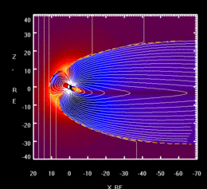
Model variation of the Earth's magnetic field in the face of a "solar wind" storm

Slide 4
The magnetic field is shaped like a "pseudo" sphere enveloping the Earth, known as the "magnetosphere".
It is spherical in shape, but squashed at the poles and thicker at the equator.

Slide 5
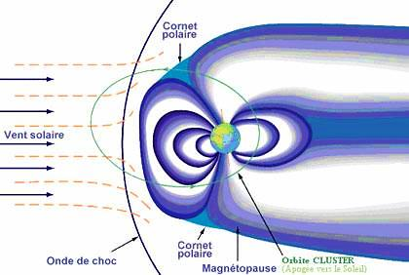

Slide 6
II. Origin :
The Earth's magnetic field is generated by the movements of the liquid metal core, in the Earth's deepest layers.

Slide 7
According to studies by John Tarduno (USA), the Earth already had a magnetic field 3.45 billion years ago.

Slide 8
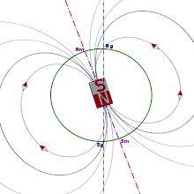

Slide 9
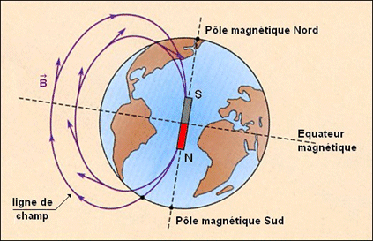
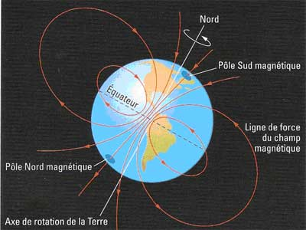

Slide 10
III. Description :
To a first approximation, the Earth's magnetic field can be compared to that of a straight magnet (or a magnetic dipole, or a flat coil through which current flows).

Slide 11
The center point of this magnet is not exactly at the center of the Earth, but a few hundred kilometers away.

Slide 12
Other planets in the solar system have magnetic fields: Mercury, Saturn, Uranus, Neptune and especially Jupiter. The Sun itself has one.

Slide 13
Although magnets have been known since ancient times, it was the Chinese who, around 1000-1100 A.D., used them to orient themselves with the aid of the compass. The relationship between magnets and the Earth's magnetic field was discovered in 1600 by William Gilbert, an English physicist and doctor to Queen Elizabeth I, who published Magno Magnete Tellure (On the Great Magnet of the Earth). This theory was the first to describe the Earth's global characteristics, before Isaac Newton's theory of gravity. He demonstrated how a compass placed on the surface of a magnetized ball always indicates the same point, as it does on Earth.

Slide 14
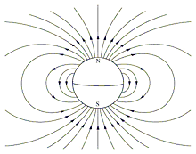
1. Pole concept :

Slide 15
Thus, the Earth's magnetic North Pole is in fact a misnomer, since it corresponds to the magnetic "South" of the right-hand magnet that is the Earth.

Slide 16
Thus, the Earth's North Magnetic Pole (which is actually a misnomer, since it corresponds to the magnetic "south" of the straight magnet that is the Earth) is located some 1000 km from the North Geographic Pole towards Canada, at 81°N 110°W; while the Earth's South Magnetic Pole (and thus the magnetic north of the magnet) is at 65°S 138°E. It should be noted, however, that these positions are not fixed, as they vary over the course of the day, and that the North Magnetic Pole, for example, moves closer to the North Geographic Pole by around 40km/year.

Slide 17
2. The terrestrial dipole :
The Earth's magnetic North Pole is actually a pole of "south" magnetism.

Slide 18
This is purely a convention, due to the choice of calling "north" the point of the compass needle that points approximately to the geographic North Pole.

Slide 19
The magnetic South Pole lies off the coast of Terre Adélie, in the Urville Sea, at 65°S and 138°E.

Slide 20
IV. Applications :
The compass :
The compass points in the direction of the Magnetic North Pole (not the Geographic North Pole).

Slide 21
The relative angular difference is called the magnetic declination, and its value depends on the location.

Slide 22
2. Mining exploration :
Mining exploration is one of the major fields of application for the study of geomagnetism.

Slide 23
As different rocks have different magnetizations, the value of the Earth's magnetic field intensity changes.

Slide 24
This makes it possible to map structures at depth, according to variations in rock magnetization.

Slide 25
3. A protective shield for life :
The Earth's magnetic field plays an essential role in the development of life on Earth,

Slide 26
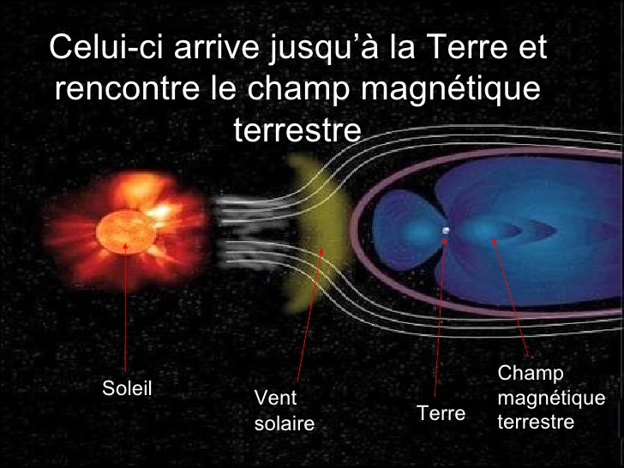

Slide 27
by deflecting the deadly solar wind particles that form the aurora borealis and aurora australis.

Slide 28
The electrically-charged particles thrown up by the sun during frequent eruptions on its surface crash violently into the Earth's magnetic field, so violently that some of them manage to penetrate this natural "shield" and enter the Earth's atmosphere, where they give rise to the splendid aurora borealis we all know.

Slide 29
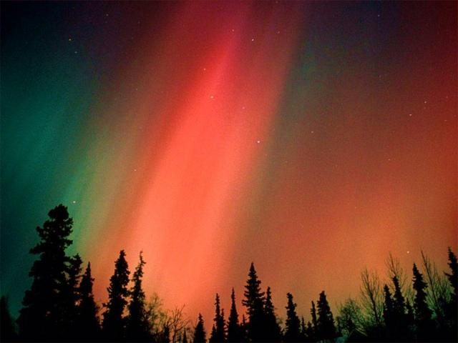

Slide 30
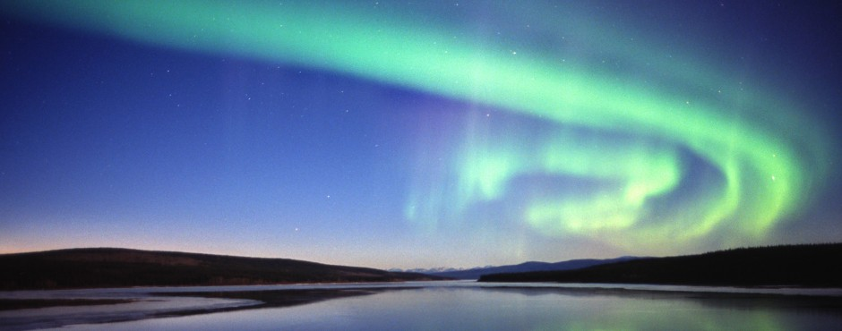

Slide 32
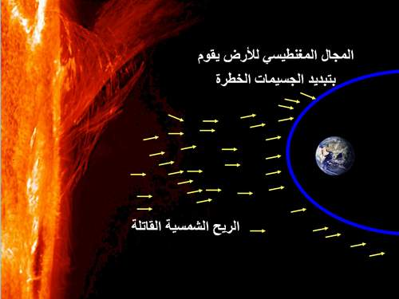

Slide 33
However, scientists have observed a decrease in the Earth's magnetic field.

Slide 34
Future evolution:
Once the core has cooled and solidified (in a few billion years) and the magnetic field has disappeared, it is likely that existing life forms will no longer be able to survive.

Slide 35
These are the conditions that prevail today on the Moon and Mars.

