Slide 1
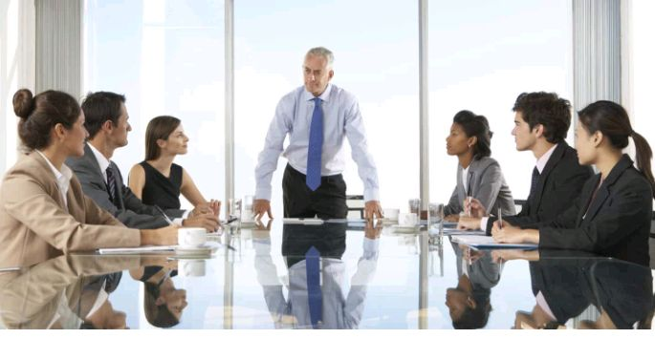
lesson 2
Meetings
Level:master 1
Teacher: Mrs Haddad.H

Slide 2
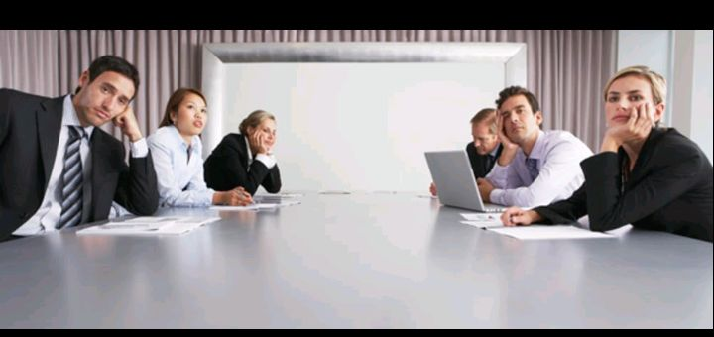
What is a meeting?
A gathering of two or more people for a specific purpose .

Slide 3
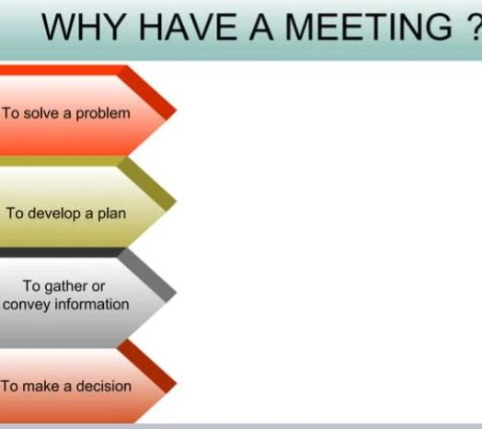

Slide 4
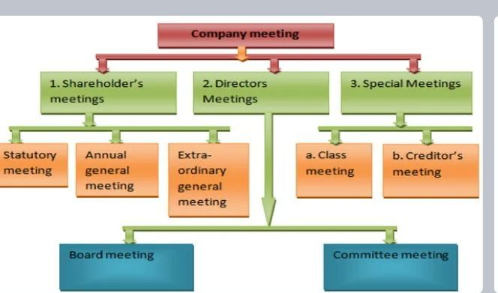

Slide 5
Company meetings
The case when the members of a company gather at a specific time and place in order to discuss business affairs.

Slide 6
Types of company’s meetings
✓ Shareholders Meetings:
1- Statutory Meetings
2-Annual General Meetings
. 3- Extraordinary Meetings

Slide 7
1- Statutory Meetings
Statutory means legal , so this meeting is based on law.
It is held once in the life of a public company.

Slide 8
Objectives of statutory meetings:
To discuss future plans.
To discuss Statutory Reports; total number of shares issued ……

Slide 9
2- Annual general meetings
A meeting of company’s members which is held once a year (every year).

Slide 10
Objectives of annual general meetings (AGM)
To check annual accounts.
To declare dividends.
To elect of directors.
appoint auditors.

Slide 11
3- Extraordinary general meetings
It is held on special occasions or emergency situations. For example: At the plan of Merger, the removal of a key manager, etc.

Slide 12
✓ Board meetings
A formal meeting of the board of a company

Slide 13
The objective of Board meetings
✓ frame the general policy of the company.
. ✓appoint the company ‘s officers and insure that they carry out their duties regarding the distribution of dividends.

Slide 14
✓ Special meetings:
1- Class Meetings
2- Creditors Meetings

Slide 15
1_ Class meetings
The case when the meeting is arranged by any shareholder of the company.

Slide 16
Objective of Class Meetings:
_to discuss the matters that affect the rights and duties of particular class of shareholders .

Slide 17
2_Creditors meetings
It is held by the company to consider a scheme in full settlement of debts .

Slide 18
Equivalent terms in Arabic
Meeting=إجتماع او لقاء
Company ‘meetings=اجتماعات الشركة
Shareholders meetings اجتماعات حاملي الاسهم
Statutory meetings=الإجتماعات الدستورية او القانونية
Annual general meetings=الاجتماعات العامة السنوية
Extraordinary meetings=الإجتماعات الاستثنائية

Slide 19
Statutory reports=التقارير القانونية
Dividends =أرباح الاسهم
Agenda =جدول الأعمال
Merger=الإندماج
Board meetings=إجتماعات مجلس الإدارة
General policy=السياسة عامة
Class meetings=إجتماعات الصف
Creditors meetings=إجتماعات الدائنين
Item =بند

Slide 20
Minutes=محاضر
Consensus=توافق
Venue=موقع اجتماع
Minute-taker=مدون محاضر الاجتماع

Slide 21
Task 1: match these words to their definitions below: chairperson, Agenda, Item, Minutes, AOB, Consensus, venue, minutes-taker
A place where the meeting is held.
One of the subjects or issues discussed in the meeting written on the agenda.
A person who writes down the things said and decided at the meeting.

Slide 22
A list of subjects to be discussed in a meeting.
An official record of what is said and decided at the meeting.
Agreement between all the people at the meeting

Slide 23
The last item on the agenda, an abbreviation for “any other business”; the time during a meeting when people can discuss things that were not on the agenda.
A person who is in charge of the meeting.

Slide 24


