Slide 1

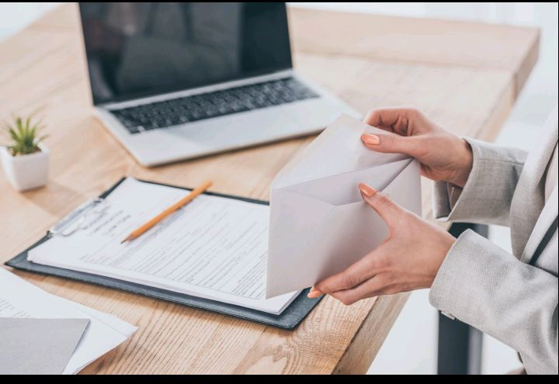
Lesson 4:
Business correspondence
المراسلات التجارية /مراسلات الاعمال
Level :master 1
Teacher :Mrs. HadDad.H

Slide 2
What is Business correspondence?
                The exchange of information in written format for the process of business activities. It can be between organizations, within organizations or between the customers and organizations.

Slide 3
Business correspondence can be written :
A- through emails
. B- through letters

Slide 4
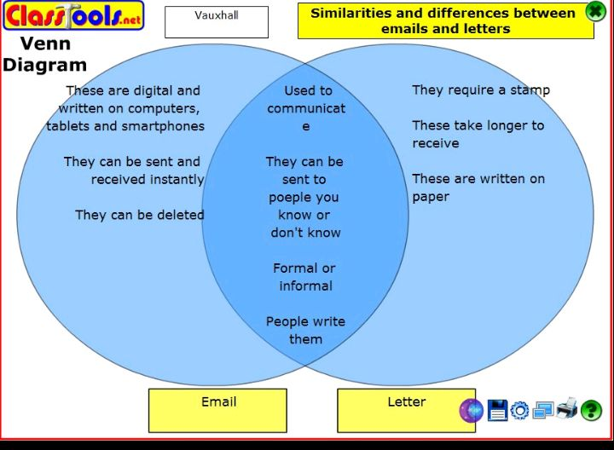
The difference between an email and a letter

Slide 5
Email etiquette
1- Clearly summarize the content of your message in the subject line Example “May 23 project Management Team Meeting Agenda” rather than just “Meeting”

Slide 6
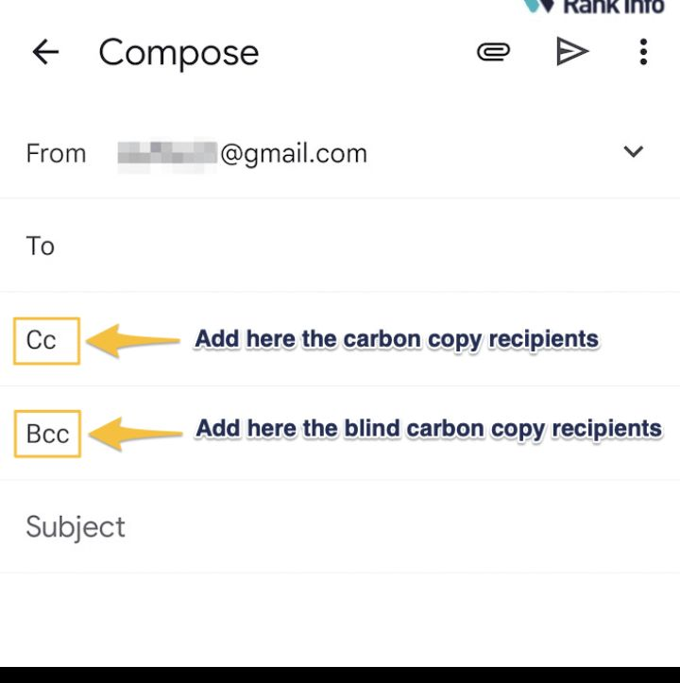
2- Don’t use the Cc (carbon copy) function to copy your message Unless you really need it.

Slide 7
Use Bccs (blind carbon copies) when sending a message to a large group of people who don’t know each other.

Slide 8
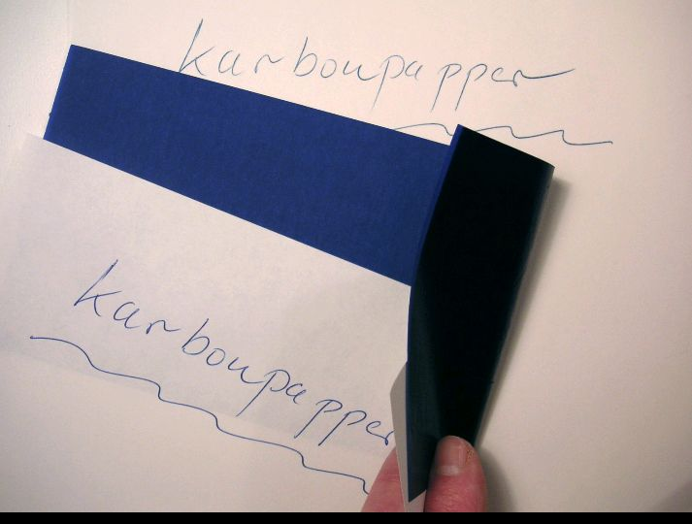


Slide 9
3- Address people as Mrs, Mr ,Ms Miss at the beginning of the email.

Slide 10
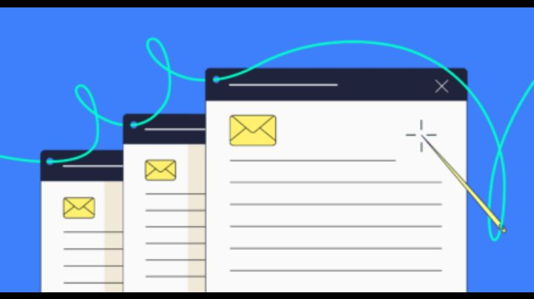
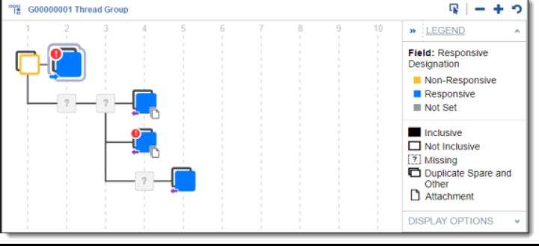
4- Reply to a message, don’t start a new email. Keep the “thread”by leaving the original messages attached

Slide 11
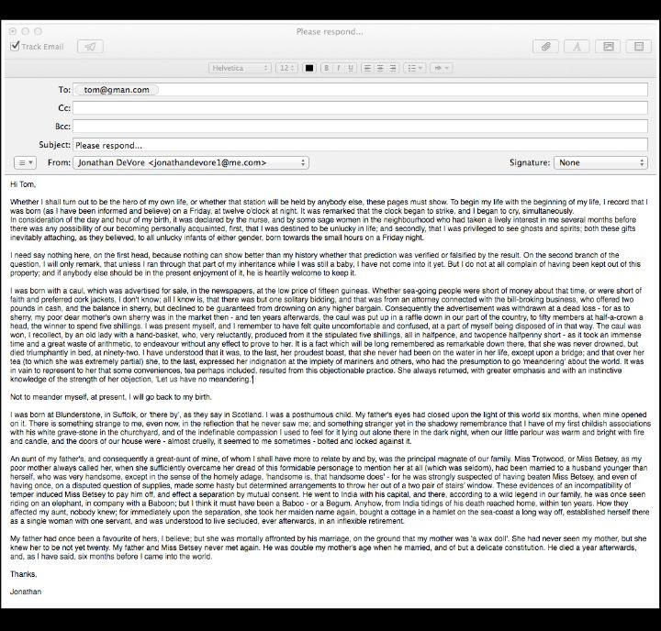


5-Keep your message shorter than a page. People reading messages using mobile devices often ignore long messages.

Slide 12

6-If you need someone to give you information or to do something for you, be very specific.

Slide 13
If you communicate very complex information use the telephone or face -to –face conversation rather than email

Slide 14
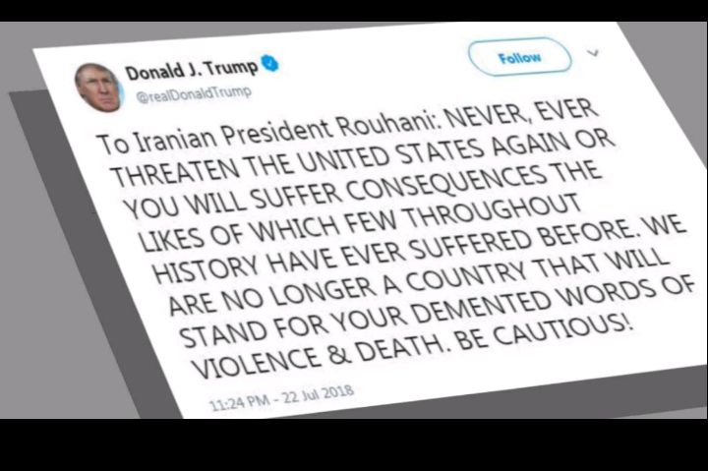



7-Avoid the capital letters_they are equivalent of shooting in someone’s eyes and they are more difficult to read

Slide 15

8-Use capitalization only in specific cases _ at the beginning of sentences, titles , Names
..)and punctuation . Don’t over-use exclamation marks!!!!

Slide 16

9- Smiles 😊are used in personal emails and are not appropriate for business.

Slide 17
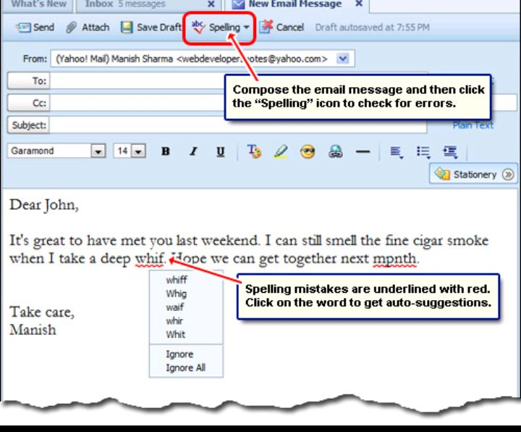
10- Use the spell check and re-read your message one last time before you send it.

Slide 18
Formal and informal style
A first email to someone in another company is usually formal, but later emails become more informal

Slide 19
People also use acronyms( the first letters of words), such as:
✓ TIA( thanks in advance)
✓ASAP( as soon as possible)
✓BTW( by the way)

Slide 20
In informal emails ,people writing quickly often use short forms of common words:
Yr(your)
Pls( please)
Rgds ( regards)
Thnx(thanks)

Slide 21
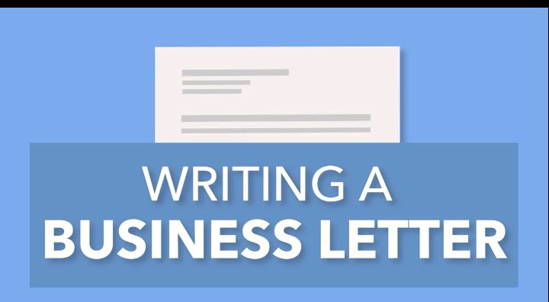
Business letters

Slide 22
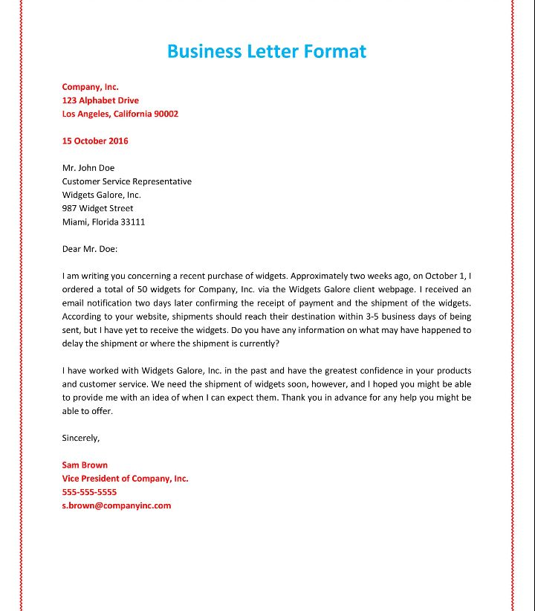

Slide 23
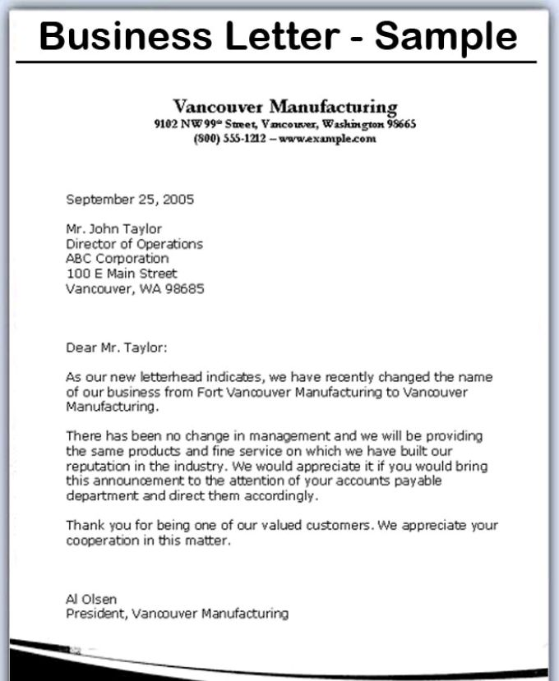

Slide 24
What is a Business letter?
A letter which is used by companies to communicate in professional way with customers, other companies, shareholders, investors, etc.

Slide 25
Note:
Subsequent correspondence between people who know and like each other often becomes less formal such type of correspondence is done by emails rather than letters.

Slide 26
The six main parts of a Business Letter
-heading( your address and the date)
Inside address(receiver’s name & address)
Salutation or greeting ( Dear,Mr..Mrs..Ms
Body ( the main parts of your letter)
closing ( sincerely or respectfully yours )
Signature

Slide 27
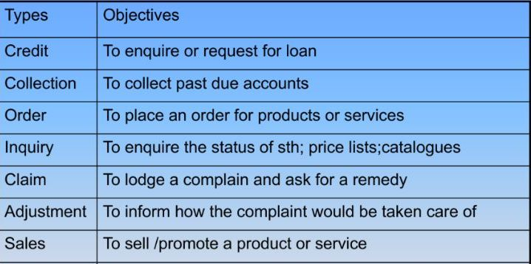
Types of Business Letters & their objectives

Slide 28
Examples of standard phrases in Business Letters
A- Starting a letter:
✓further to our meeting last Friday….
✓referring to previous meeting or correspondence…

Slide 29
B- explaining the reason for writing
✓I am just writing to inform ….
✓we are writing to give you further information about…

Slide 30
C- giving good news ☺☺
✓We are pleased to announce….

Slide 31
D-Giving bad news
☹☹
✓I regret to inform you that….

Slide 32
E- giving information
I wanted to tell you about the information about….

Slide 33
F-apologizing
✓ we deeply regret any inconvenience caused by ..
✓despite of all our security procedures…
✓ this was an error on our part…
✓ please accept our apologies.

Slide 34
F- ending a letter
✓ do not hesitate to contact us if you need assistance….
.✓if you have any further questions contact us …
✓we look forward to hearing from you..

Slide 35
Task Use these less formal phrases and short forms 1-10 to replace the underlined phrases a-j in the emails below:
1-Can I 7- Can you..
2-don’t forget to. 8-Re
3-feel free to 9-see you tomorrow
4-I can’t make. 10-Rgds
5-I have to 6-I am sorry 😔 to tell you

Slide 36
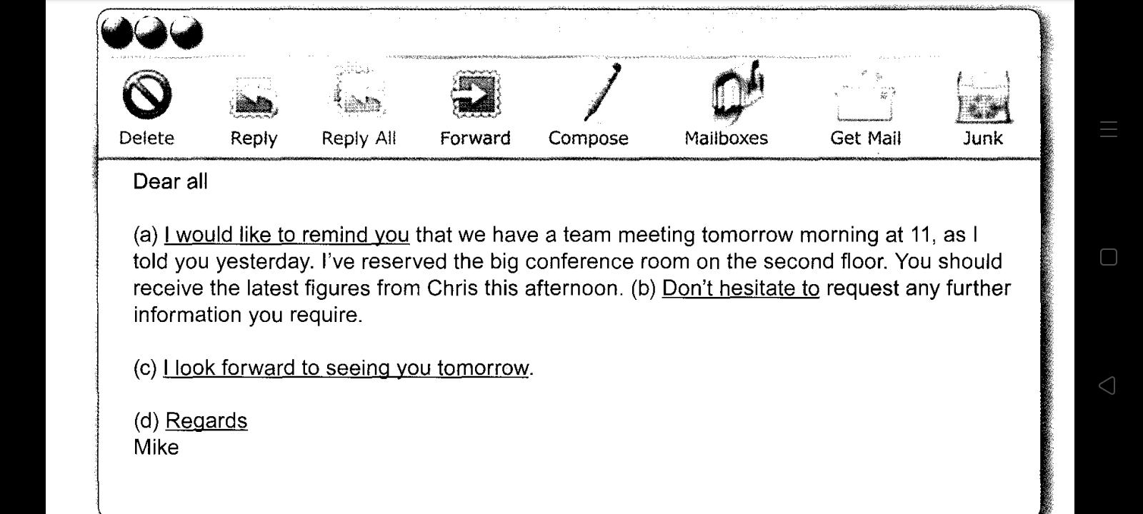

Slide 37
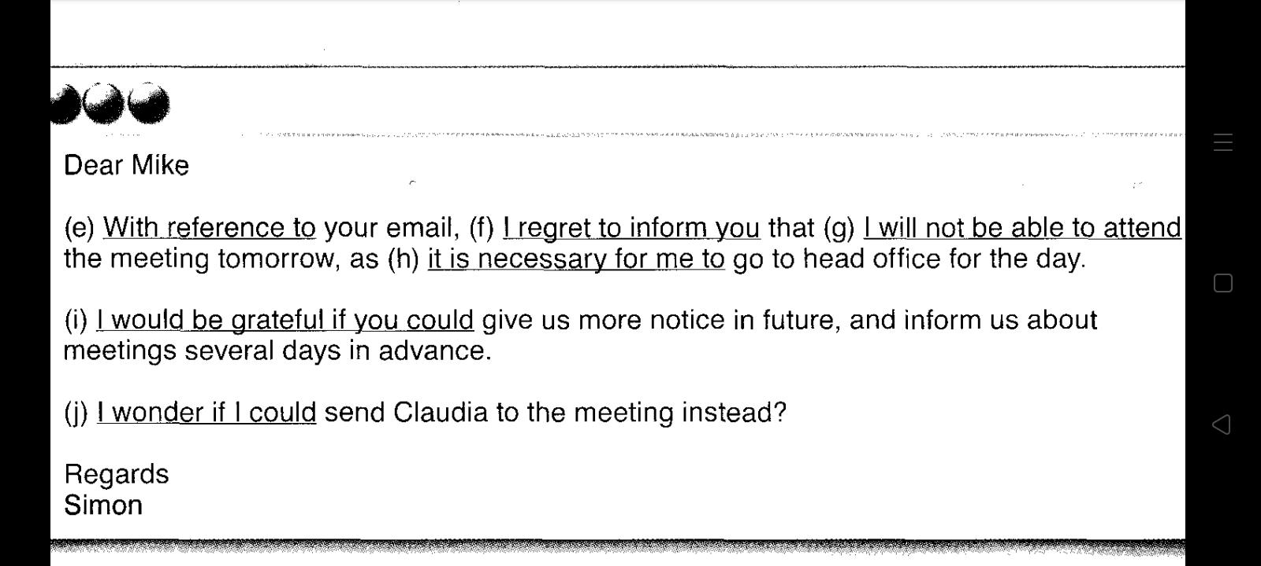

Slide 38
The answers:
1-Can I = I wonder if I could..
2-don’t forget to= I would like to remind you…
3-feel free to =Don’t hesitate to ..
4-I can’t make= I will not be able to ..
5-I have to go = it is necessary for me to go..

Slide 39
7- Can you..=I would be grateful if you could..
8-Re=with reference to ..
9-see you tomorrow =I look forward to seeing you.
10-Rgds=Regards
6-I am sorry 😔 to tell you= I regret to inform you…

Slide 40


