Slide 1
Dimensions of Culture
Prepared by: Dr. Hamida Bouzekria

Slide 2


Agenda
A
Introduction
Hofestede’s Dimensions of Culture
Summary

Slide 3
Introduction
Hofstede's Cultural Dimensions Theory, developed by Geert Hofstede, is a framework used to understand cultural differences between nations and how these differences can influence behaviors and values in the workplace. The theory is based on a study conducted in the late 1960s and early 1970s involving IBM employees from different countries. Hofstede identified six main dimensions along which cultures can be compared

Slide 4
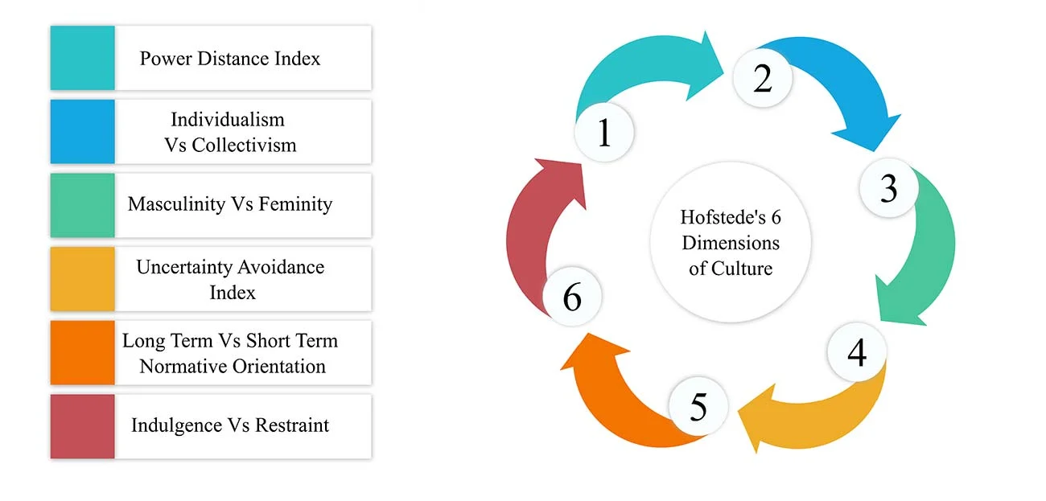
Hofstede’s Dimensions Of Culture

Slide 5
Power Distance Index (PDI)

Slide 6
This dimension measures the extent to which less powerful members of a society accept and expect unequal distribution of power. Cultures with high power distance have a greater acceptance of hierarchical order, while low power distance cultures tend to have more egalitarian and democratic structures
A high-power distance index indicates that a culture accepts inequity and power differences, encourages bureaucracy, and shows high respect for rank and authority.
A low power distance index indicates that a culture encourages flat organizational structures that feature decentralized decision-making responsibility, a participative management style, and emphasis on power distribution.

Slide 7
Individualism vs. Collectivism (IDV):

Slide 8
Individualism
Collectivism
Individualism refers to societies where individuals are expected to take care of themselves and their immediate families, prioritizing personal goals over group goals.
Collectivism emphasizes the importance of the group, with individuals being integrated into strong, cohesive groups that protect them in exchange for loyalty.

Slide 9
Femininity vs. Masculinity (MAS):
F
This dimension reflects the degree to which societies emphasize traditional masculine values vs traditional feminine values. Masculine cultures tend to value assertiveness, competitiveness, and achievement, while feminine cultures prioritize cooperation, modesty, caring for others, and quality of life.
Masculinity includes the following characteristics: distinct gender roles, an appreciation of assertiveness, courage, strength, and competition.
Femininity includes characteristics such as fluid gender roles, modest, nurturing, and concerned with the quality of life.

Slide 10
Uncertainty Avoidance Index (UAI):

Slide 11
Uncertainty avoidance measures the tolerance for uncertainty and ambiguity within a society. This dimension considers how unknown situations, uncertainty, and unexpected events are dealt with.
A high uncertainty avoidance index indicates a low tolerance for uncertainty, ambiguity, and risk-taking. The unknown is minimized through strict rules, regulations, etc. Both the institutions and the individuals in these societies strive to reduce uncertainty by employing vigorous rules, regulations, and similar measures.
A low uncertainty avoidance index indicates a high tolerance for uncertainty and ambiguity. The unknown is more openly accepted, and there are lax rules, regulations, etc. Individuals and cultures with low uncertainty avoidance embrace and feel at ease in situations lacking structure or in fluctuating environments.

Slide 12
Long-Term Orientation vs. Short-Term Normative Orientation (LTO):
The long-term orientation vs. short-term orientation dimension was later added to Hofstede's original four dimensions. It refers to the extent to which a society values long-term traditions, perseverance, and thrift (long-term orientation) versus short-term results, respect for tradition, and fulfilling social obligations (short-term orientation).
Societies that emphasize long-term orientation prioritize future outcomes, postponing immediate success for achievements over the long term. In these cultures, values like persistence, endurance, frugality, savings, sustained growth and adaptability take centre stage.
Short-term orientation shows focus on the near future, involve delivering short-term success or gratification, and place a stronger emphasis on the present than the future. Short-term orientation emphasizes quick results and respect for tradition.

Slide 13
Indulgence vs. Restraint

Slide 14
Indulgence
Cultures high in indulgence tend to allow and encourage gratification of natural human desires related to enjoying life and having fun.
People in these cultures may exhibit behaviors such as emphasizing leisure time, spending money on entertainment, and expressing emotions openly.
Examples of countries scoring high in indulgence include countries like the United States, Australia, and many Western European nations.

Slide 15
Restraint
Cultures high in restraint place a stronger emphasis on the regulation of gratification of needs and desires.
These societies often have stricter social norms and regulations, with a focus on controlling impulses, regulating behaviors, and adhering to social obligations.
Examples of countries scoring high in restraint include many Asian countries like South Korea and Singapore, as well as some Middle Eastern and African nations.

Slide 16
Summary
These dimensions provide a framework for comparing and contrasting cultural differences between countries. It's important to note that cultures are complex and diverse, and individuals within a culture may not perfectly align with these dimensions. Hofstede's theory has been influential in cross-cultural management and understanding how cultural values impact various aspects of society, including business practices, communication styles, leadership approaches, and organizational behavior.

Slide 17
Question
How might understanding cultural dimensions like individualism vs. collectivism or masculinity vs. feminity help us work better in a multicultural team?

Slide 18
Thank you
Hamida Bouzekria
hamida.bouzekria@yahoo.fr

