Slide 1
Globalization
A Transformative Force in the Modern World

Slide 2
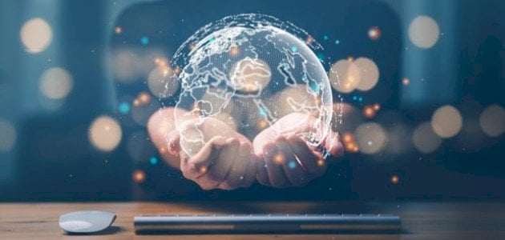
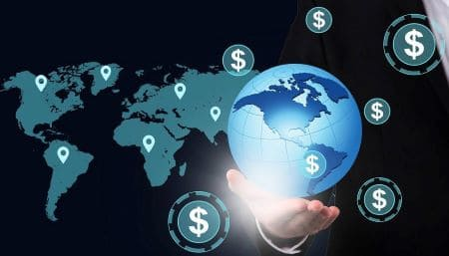
Globalization

Slide 3
Introduction
Globalization is a phenomenon characterized by the increased interconnectedness and interdependence of nations, cultures, economies, and individuals worldwide. This transformative process has shaped the 21st century, influencing nearly every aspect of our lives, from the way we communicate and trade to the foods we consume and the ideas we share. As university students studying globalization, it's essential to understand both its benefits and challenges, as well as its profound impact on societies

Slide 4
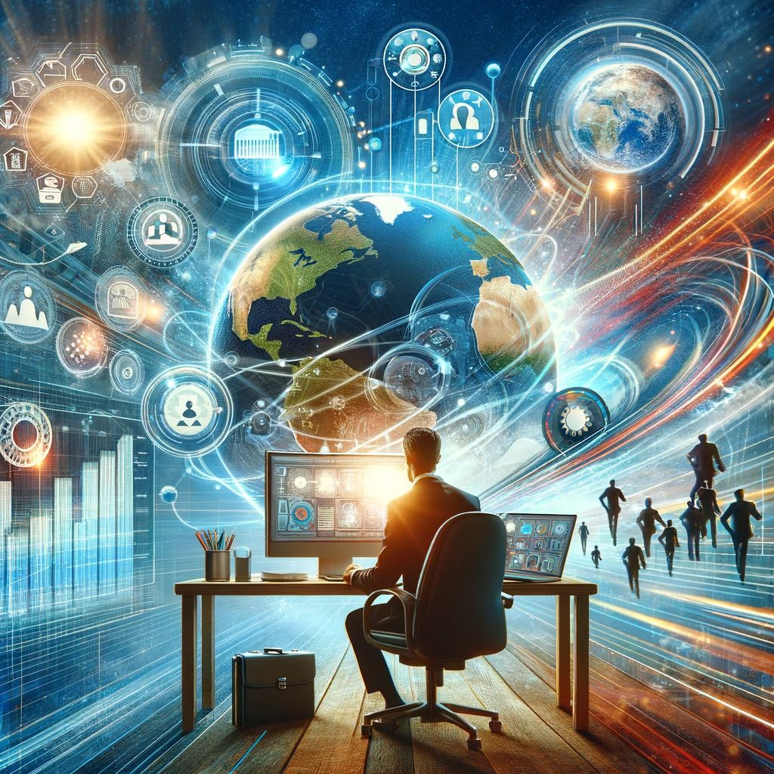
Economic Impacts of Globalization

Slide 5

One of the most visible effects of globalization is economic. The liberalization of trade and capital markets has enabled companies to operate across borders, creating a global marketplace. This trend has led to increased production efficiencies, reduced prices for consumers, and expanded access to goods and services. Major corporations, from technology giants to retail chains, benefit from sourcing materials and labor from diverse regions, often reducing costs and improving profits.

Slide 6
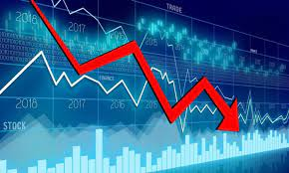
However, this economic integration also raises concerns. Critics argue that it has led to the exploitation of labor in some developing countries, where low wages and poor working conditions persist. Furthermore, small businesses often struggle to compete with multinational corporations, leading to significant socioeconomic disparities

Slide 7

Cultural Exchange and Identity

Slide 8
Cultural Exchange and Identity
Culturally, globalization has facilitated an unprecedented exchange of ideas, beliefs, and practices. Through technology, such as the internet and social media, people worldwide can share their cultures instantly. This cultural diffusion has promoted a broader appreciation for diversity and encouraged cross-cultural understanding. Many individuals find it easier than ever to experience music, films, literature, and food from distant countries, fostering a sense of global community.
Yet, this blending of cultures also presents challenges. Some argue that globalization leads to cultural homogenization, where dominant cultures overshadow traditional practices and languages. For example, the global spread of Western brands, media, and lifestyles often influences younger generations in non-Western societies, creating a tension between cultural preservation and the appeal of modern, global trends.

Slide 9

Technological Advancements and Communication

Slide 10
Technological Advancements and Communication
The role of technology in globalization cannot be overstated. Advances in communication and transportation have made it possible to connect with people on the other side of the world in real time. This ease of communication has driven innovation, enabling businesses to expand, governments to cooperate, and individuals to collaborate on a global scale. However, technological inequality remains a critical issue, as many regions lack the infrastructure necessary to benefit fully from these advancements. Bridging this digital divide is essential for ensuring that the benefits of globalization are more equitably distributed.

Slide 11
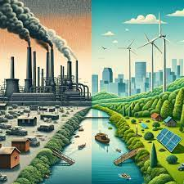
Environmental Challenges
Globalization’s impact on the environment is complex. Increased industrialization and the demand for raw materials have led to environmental degradation, deforestation, and a rise in greenhouse gas emissions. The global economy’s emphasis on consumerism exacerbates these issues, with large amounts of waste generated from disposable goods and packaging. On the positive side, globalization has also facilitated international cooperation on environmental issues, as countries collaborate to tackle climate change, biodiversity loss, and pollution.

Slide 12
Conclusion
In summary, globalization is a double-edged sword. It has brought economic growth, cultural exchange, and technological advancements that have improved the quality of life for many. Yet, it also poses challenges, including economic inequality, cultural erosion, and environmental degradation. Understanding these dimensions is crucial for today’s university students, who are preparing to become future leaders in an interconnected world. As such, the question for the coming generations is not whether to embrace globalization, but how to manage and balance its impacts responsibly and sustainably

