Slide 1

University of Mohammed Essedik Benyehia Jijel
Faculty of technology
1st year master architecture
Data analysis using SPSS
M. Soltani & M. Bouzenita

Slide 2
Data analysis using SPSS
M. Soltani & M. Bouzenita
1st year master architecture - University of Jijel
Introduction
Lecture 1

Slide 3
Data analysis
Data analysis is The process of transforming data into information useful for decision.
It starts by careful planning followed by data collection, data description (numerical and graphical description), data analysis and finished by interpretation of the obtained results.

Slide 4
Data analysis process
Planning
Data collection
Data description
Data analysis
Interpretation of the results

Slide 5
Data analysis process
1. Planning : This phase determines the main outlines and the objectives of the analysis.
3. Data description : This phase aims to summarize the collected data and provide a clear overview of its key characteristics such as data type and the distribution patterns.
2. Data collection: This phase aims to collect the necessary information and observations required to conduct the analysis and achieve the defined objectives.
5. Interpretation of the results : based on the outcomes of the previous step (data analysis phase), this phase allows drawing conclusions and making decisions.
4. Data analysis : During this phase various statistical methods are employed to transform the data into valuable information.

Slide 6
Statistics
Statistics is the branch of mathematics, which provide methods that organizing, analyzing and interpreting data.
It focus on:
Gathering and describing data (Descriptive statistics)
Interpreting the results (Inferential statistics).

Slide 7
Descriptive statistics
Descriptive statistics is the branch of statistics that use numerical (Mean, Median..) and graphical (Bar, Histogram) methods to :
Organize and summarize data and
Present the information revealed in the data in convenient form.

Slide 8
Inferential statistics
Inferential statistics is a branch of statistics that Use data sample to involve generalization to the population and :
make decisions, estimations or predictions and assessing the reliability of the obtained generalization.

Slide 9
Elements of statistics
The main elements of statistics are defined in what follows.
Population : A Population is the entire set of individuals or objects called units of interest in which we are interested.
Sample : Sample is a subset of the population selected for the entire study.
Experimental unit : Experimental unit is the individual or the object in which we collect data.
Variable : A variable is any characteristic or property of individual or object (experimental unit) which may change from one unit to another.

Slide 10
Types of data
There are two types of data
Quantitative data
Discrete
Continuous
Qualitative data
Ordinal
Nominal

Slide 11
Quantitative data
A data set is considered quantitative or numerical if the observation are naturally occurring numerical scale
Age, Temperature, Salary …
Quantitative data can be:
Discrete : if the value is correspond to isolated and fixed number
number of rooms: 3, number of children: 6 ...
Continuous : if the data is measured over a particular interval
Area: 523.25, Price: 245.75 ...
There are two types of data
Quantitative data
Discrete
Continuous
Qualitative data
Ordinal
Nominal

Slide 12
Qualitative data
Qualitative or categorical data are measurement collected in categories and cannot be recorded in natural numerical scale
Gender, scholarly year ...
Qualitative data can be:
Ordinal : if they can be put in an order
Grade(Weak, Middle, Good) ,
Nominal : if the order have no real meaning
Gender (Male, Female),
Quantitative data
Discrete
Continuous
Qualitative data
Ordinal
Nominal

Slide 13
Statistical parameters
Statistical parameters are numerical characteristics of a population or a sample introduced to describe and summarize its properties.
In general, the statistical parameters are categorized into:
Measures of central tendency
Measures of dispersion

Slide 14
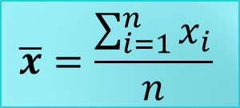
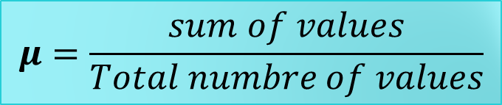

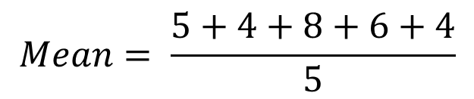
Measure of central tendency
Mean (Average)
The mean is a statistic parameter that used to measure the central tendency and set out the average of numerical data set.
Data : 5 4 8 6 4
$$μ=\frac{sum of values}{Total numbre of values}$$
$$Mean= \frac{5+4+8+6+4}{5}$$
$$=5.4$$
$$\overline{x}=\frac{\sum_{i=1}^{n}{x_{i}}}{n}$$

Slide 15
Measure of central tendency
Median
The Median is another statistic parameter to measure the central tendency of a dataset.
The Median presents the middle value in an ordered data set.
Median
Ordered data : x x x x x

Slide 16
Measure of central tendency
Median
Determining the median is based on the number of observations :
For an Odd number of observations
Step1: arrange the values in ascending order.
Step2 : determine the median as the middle value.
7 3 8 1 5
1 3 5 7 8
1 3 5 7 8
Median

Slide 17
Measure of central tendency
Median
Determining the median is based on the number of observations :
For an Even number of observations
Step1: arrange the values in ascending order.
Step2 : determine the median as the mean of the two middle observations .
7 3 8 1 5 4
1 3 4 5 7 8
1 3 4 5 7 8
Median
(4+5)/2 = 4.5

Slide 18
Measure of central tendency
Mode
Presents the most frequently value in a dataset.
In a data set can be found:
No mode : if the observations have same frequency
Unimodal: in this case, the dataset have one value that appears more frequently
Bimodal : we found two highest frequency values.
Multimodal : If there are more than two values that share the highest frequency.
 | Dataset | Mode
No mode | 5 3 4 3 5 4 | /
Uni-modal | 3 1 3 5 3 5 | 3
Bi-modal | 5 1 3 4 2 3 5 9 | 3 , 5
Multi-modal | 5 1 3 4 2 3 5 9 4 6 7 0 | 3 , 5 , 4

Slide 19
Measures of dispersion
The measures of dispersion also called the measures of variability, offer information about the dispersion of observations in dataset.
Measures of dispersion includes various parameters among them:
Range
Variance
Standard deviation
Quartiles

Slide 20

Measures of dispersion
Range
The Range presents the difference between the highest and lowest values in a dataset according to the following formula:
Min
Max
3 1 7 4 9 8 5 2
$$Range=Max−Min$$
Range
9 – 1 = 8

Slide 21
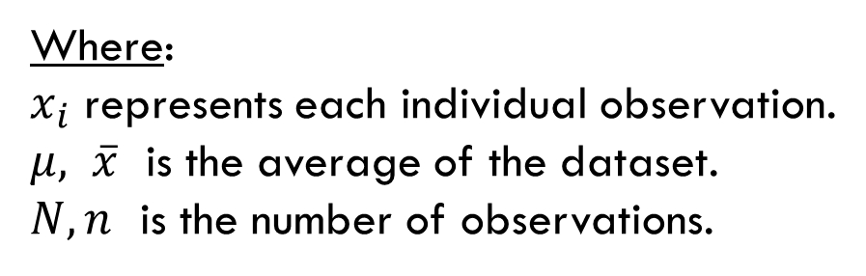
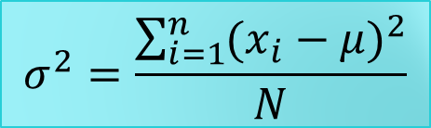
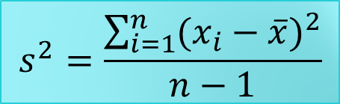
Measures of dispersion
Variance
Variance is a statistical measure that quantifies the degree of dispersion in a set of data points.
It offers a measure of how far individual data points are from the mean of the dataset.
$$σ^{2}=\frac{\sum_{i=1}^{n}{{(x_{i}−μ)}^{2}}}{N}$$
Population
Where:
$x_{i}$ represents each individual observation.
$μ, \overline{x}$ is the average of the dataset.
$N, n$ is the number of observations.
$$s^{2}=\frac{\sum_{i=1}^{n}{{(x_{i}−\overline{x})}^{2}}}{n−1}$$
Sample

Slide 22
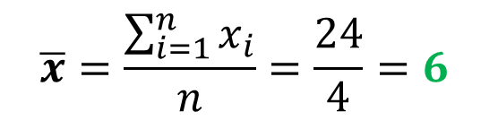
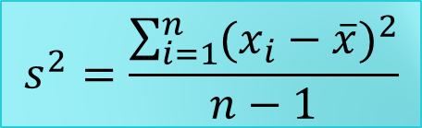
Measures of dispersion
$$s^{2}=\frac{\sum_{i=1}^{n}{{(x_{i}−\overline{x})}^{2}}}{n−1}$$
Variance
3 9 7 5
$$\overline{x}=\frac{\sum_{i=1}^{n}{x_{i}}}{n}=\frac{24}{4}=6$$
$$Variance=\frac{\sum_{i=1}^{n}{{(x_{i}−\overline{x})}^{2}}}{n−1}=\frac{{\left(3−6\right)}^{2}+{\left(9−6\right)}^{2}+{\left(7−6\right)}^{2}+{(5−6)}^{2}}{4−1}=6.667$$

Slide 23
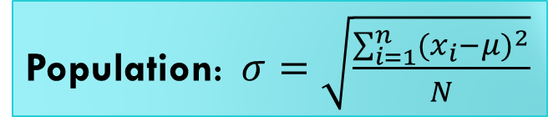
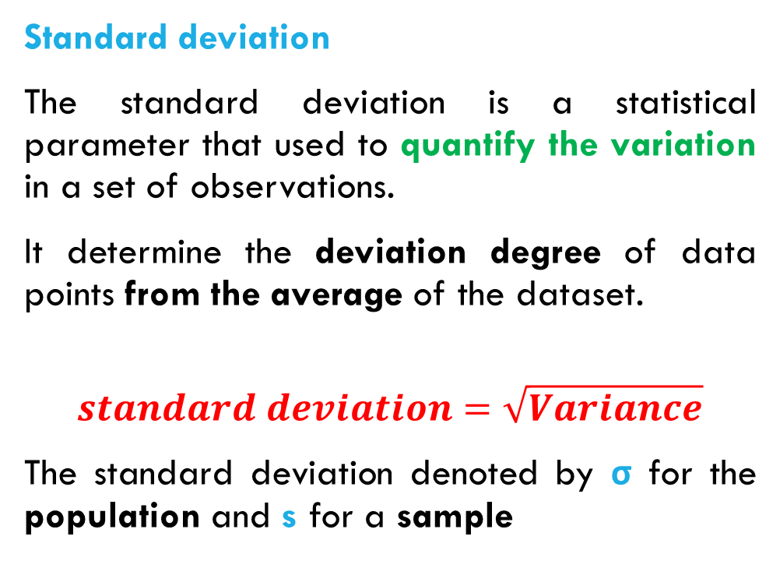
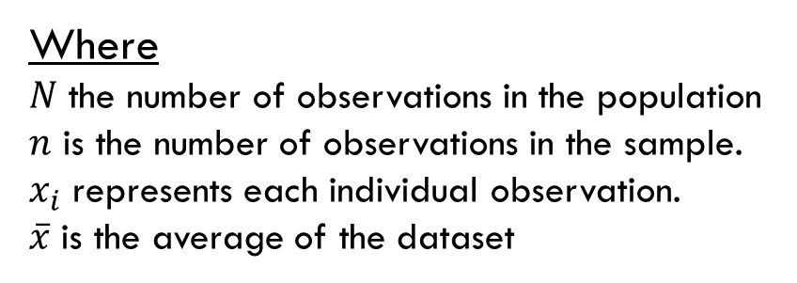
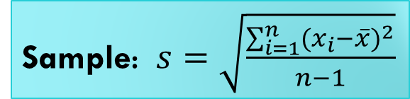
Measures of dispersion
Standard deviation
The standard deviation is a statistical parameter that used to quantify the variation in a set of observations.
It determine the deviation degree of data points from the average of the dataset.
$$standard deviation=\sqrt{Variance}$$
The standard deviation denoted by σ for the population and s for a sample
Population: $σ=\sqrt{\frac{\sum_{i=1}^{n}{{(x_{i}−μ)}^{2}}}{N}}$
Sample: $s=\sqrt{\frac{\sum_{i=1}^{n}{{(x_{i}−\overline{x})}^{2}}}{n−1}}$
Where
$N$ the number of observations in the population
$n$ is the number of observations in the sample.
$x_{i}$ represents each individual observation.
$\overline{x}$ is the average of the dataset

Slide 24

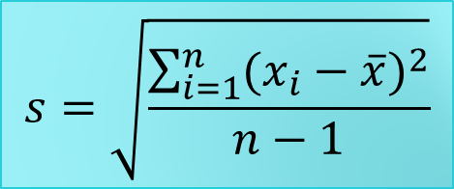
Measures of dispersion
$$s=\sqrt{\frac{\sum_{i=1}^{n}{{(x_{i}−\overline{x})}^{2}}}{n−1}}$$
Standard deviation
3 9 7 5
$$\overline{x}=\frac{\sum_{i=1}^{n}{x_{i}}}{n}=\frac{24}{4}=6$$
$$s^{2}=\frac{\sum_{i=1}^{n}{{(x_{i}−\overline{x})}^{2}}}{n−1}=\frac{{\left(3−6\right)}^{2}+{\left(9−6\right)}^{2}+{\left(7−6\right)}^{2}+{(5−6)}^{2}}{4−1}=6.667$$
$$standard deviation \left(s\right)=\sqrt{s^{2}}= \sqrt{6.667}=2.5821$$

Slide 25

Measures of dispersion
Quartiles
is a statistical parameters that divide a data set into four equal parts, there are three quartiles (Q1, Q2, Q3) where:
The first quartile (Q1): termed as the first 25th percentile, this mean the median of the lower half of the dataset.
The second quartile (Q2): also called the 50th percentile, which is the median or the middle value of the dataset.
The third quartile (Q3): also termed the 75th percentile, in other term the median of the upper half of the dataset
The interquartile (IQ) is a measure of statistical dispersion which calculated as the difference between the third quartile (Q3) and the first quartile (Q1), as follows:
Q1
Q2
Q3
25%
25%
25%
25%
dataset
$$IQ=Q3−Q1$$

Slide 26
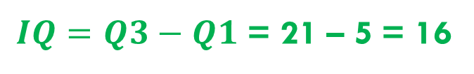
Measures of dispersion
Quartiles
Dataset
30 20 15 8 3 1 5 12 16 21 38
Median
Q1
Q2
Q3
Ordered dataset
1 3 5 8 12 15 16 20 21 30 38
$IQ=Q3−Q1$ = 21 – 5 = 16

Slide 27
Example
The following table presents data collected from six urban districts, focusing on two key socio-economic variables: population size and unemployment rate.
Perform the descriptive statistic of the two variables
 | Population | Unemployment Rate (%)
A | 10.000 | 8
B | 15000 | 12
C | 8000 | 15
D | 20000 | 6
E | 12000 | 18
F | 18000 | 10

