Slide 1

University of Mohammed Essedik Benyehia Jijel
Faculty of technology
1st year master architecture
Data analysis using SPSS
M. Soltani & M.Bouzenita

Slide 2
Data analysis using SPSS
M. Soltani
1st year master architecture - University of Jijel
Lecture 2
Introduction (2/2)

Slide 3
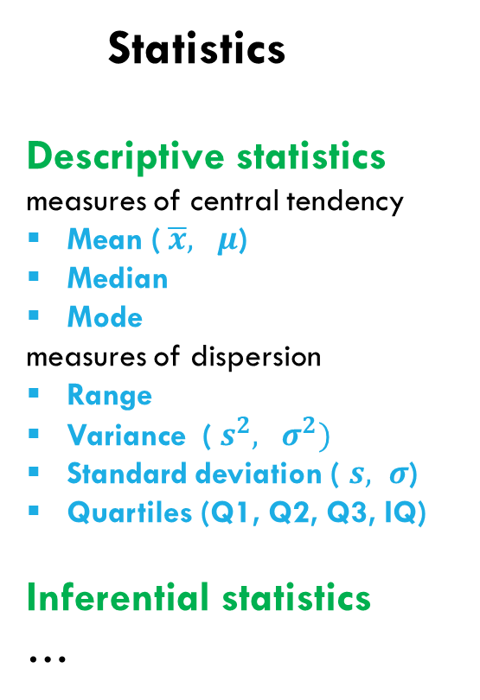
Review of Lecture 1
Elements of statistics
Types of data
Statistics
Descriptive statistics
measures of central tendency
Mean ($\overline{x}, μ$)
Median
Mode
measures of dispersion
Range
Variance ($s^{2}, σ^{2})$
Standard deviation ( $s, σ$)
Quartiles (Q1, Q2, Q3, IQ)
Inferential statistics
…
Quantitative data
Discrete
Continuous
Qualitative data
Ordinal
Nominal
Population
Sample
E. Unit

Slide 4
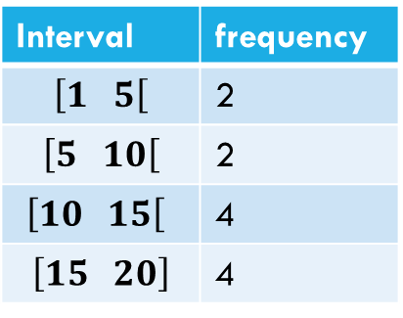
Interval notation (Grouped data)
The data ca be grouped into groups or classes which we call intervals.
[ ][ ][ ][ ]
3 4.5 6 8.25 10 11 13.5 14 15.25 16 18.5 20
$\left[1 5\right[$$\left[5 10\right[$$\left[10 15\right[$$\left[15 20\right]$
Interval | frequency
$$\left[1 5\right[$$ | 2
$$\left[5 10\right[$$ | 2
$\left[10 15\right[$ | 4
$$\left[15 20\right]$$ | 4

Slide 5
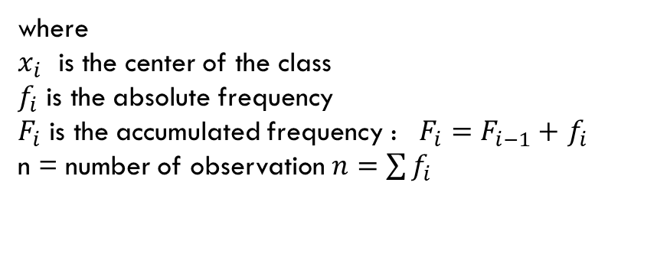
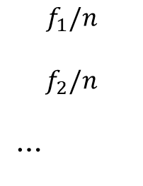
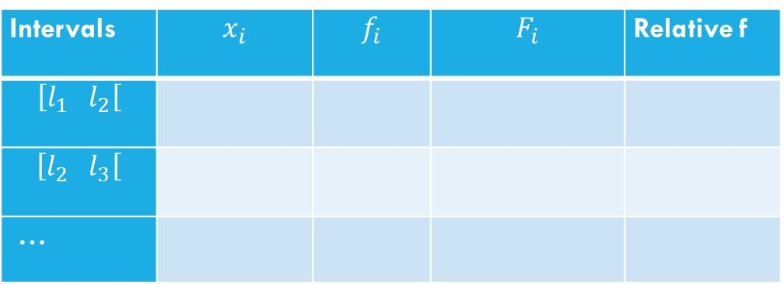
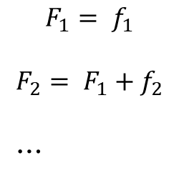
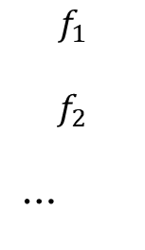
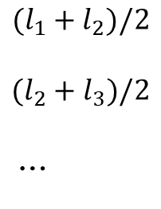
Mean, Mode, Median and quartiles of grouped data
Frequency Table
First we construct the frequency table
Intervals | $$x_{i}$$ | $$f_{i}$$ | $$F_{i}$$ | Relative f
$$\left[l_{1} l_{2}\right[$$
$$\left[l_{2} l_{3}\right[$$
…
$$(l_{1}+l_{2})/2$$
$$(l_{2}+l_{3})/2$$
…
$$f_{1}$$
$$f_{2}$$
…
$$F_{1}= f_{1}$$
$$F_{2}= F_{1}+f_{2}$$
…
$$f_{1}/n$$
$$f_{2}/n$$
…
where
$x_{i}$ is the center of the class
$f_{i}$ is the absolute frequency
$F_{i}$ is the accumulated frequency : $F_{i}=F_{i−1}+$$f_{i}$
n = number of observation $n=\sum{f_{i}}$

Slide 6
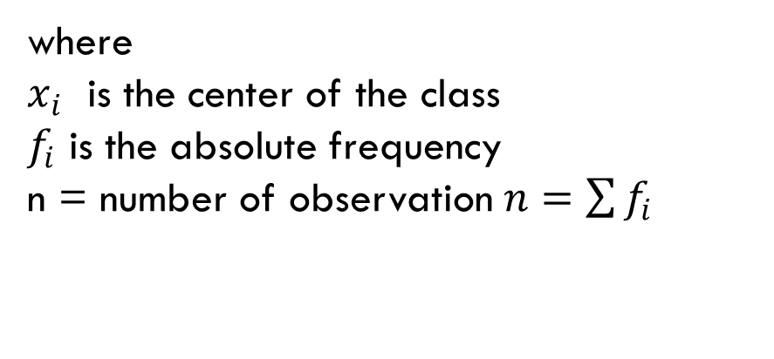
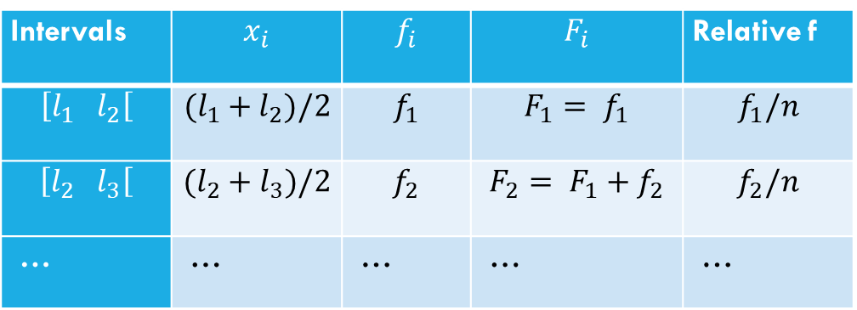
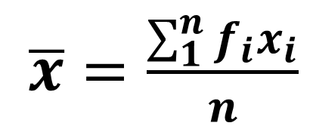
Mean, Mode, Median and quartiles of grouped data
Estimated mean
Intervals | $$x_{i}$$ | $$f_{i}$$ | $$F_{i}$$ | Relative f
$$\left[l_{1} l_{2}\right[$$ | $$(l_{1}+l_{2})/2$$ | $$f_{1}$$ | $$F_{1}= f_{1}$$ | $$f_{1}/n$$
$$\left[l_{2} l_{3}\right[$$ | $$(l_{2}+l_{3})/2$$ | $$f_{2}$$ | $$F_{2}= F_{1}+f_{2}$$ | $$f_{2}/n$$
… | … | … | … | …
$\overline{x}=\frac{\sum_{1}^{n}{f_{i}x_{i}}}{n}$
where
$x_{i}$ is the center of the class
$f_{i}$ is the absolute frequency
n = number of observation $n=\sum{f_{i}}$

Slide 7
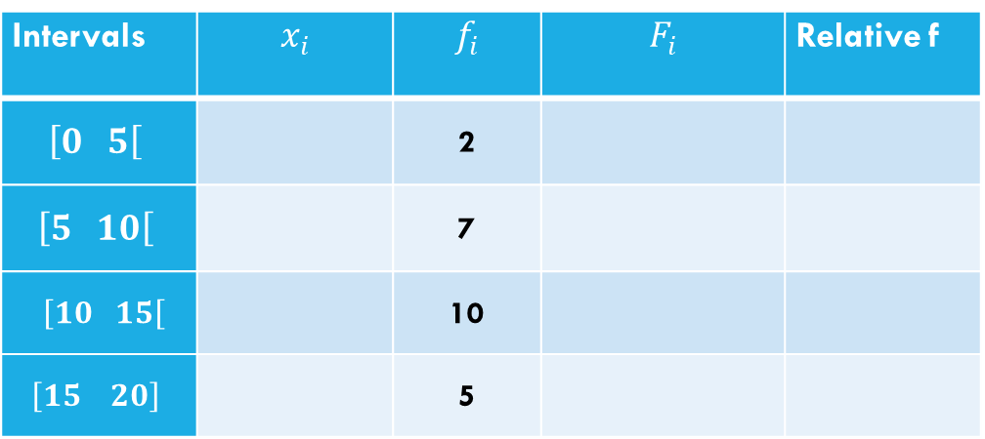
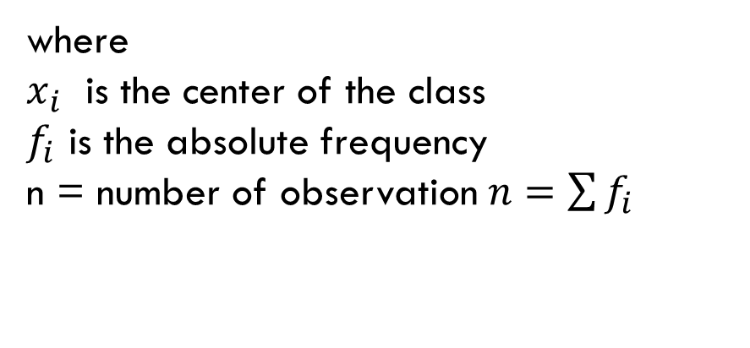
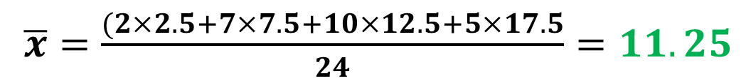
Mean, Mode, Median and quartiles of grouped data
Estimated mean (Example)
Intervals | $$x_{i}$$ | $$f_{i}$$ | $$F_{i}$$ | Relative f
$$\left[0 5\right[$$ |  | 2
$$\left[5 10\right[$$ |  | 7
$\left[10 15\right[$ |  | 10
$$\left[15 20\right]$$ |  | 5
2.5
7.5
12.5
17.5
2 | 0.083
9 | 0.2916
19 | 0.416
24 | 0.208
$\overline{x}=\frac{\sum_{1}^{n}{f_{i}x_{i}}}{n}$
where
$x_{i}$ is the center of the class
$f_{i}$ is the absolute frequency
n = number of observation $n=\sum{f_{i}}$
$\overline{x}=\frac{(2×2.5+7×7.5+10×12.5+5×17.5}{24}=11.25$

Slide 8



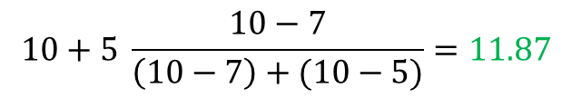
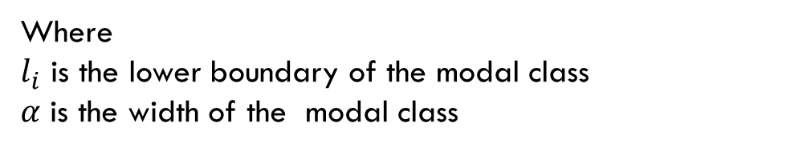
Mean, Mode, Median and quartiles of grouped data
Estimated mode
Intervals | $$x_{i}$$ | $$f_{i}$$ | $$F_{i}$$ | Relative f
$$\left[0 5\right[$$ |  | 2
$$\left[5 10\right[$$ |  | 7
$\left[10 15\right[$ |  | 10
$$\left[15 20\right]$$ |  | 5
1. Determine the modal class
Class with highest frequency
2.5
7.5
12.5
17.5
2 | 0.083
9 | 0.2916
19 | 0.416
24 | 0.208
2. Estimated mode
$$Estimated mode =l_{i}+ α \frac{∆_{1}}{∆_{1}+∆_{2}}$$
Where
$l_{i}$ is the lower boundary of the modal class
$α$ is the width of the modal class
$$10+5 \frac{10−7}{\left(10−7\right)+(10−5)}=11.87$$
$$Estimated mode =$$
$$∆_{1}=f_{i}−f_{i−1}$$
$$∆_{2}=f_{i}−f_{i+1}$$

Slide 9
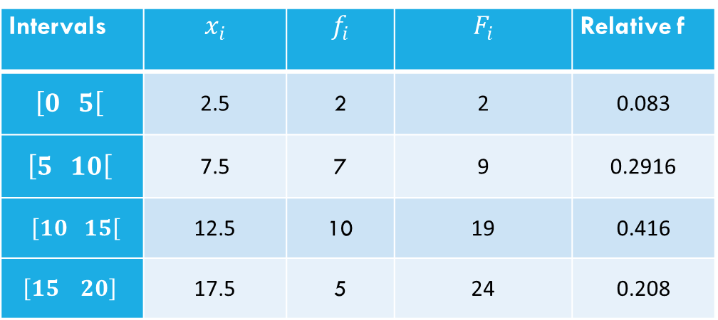
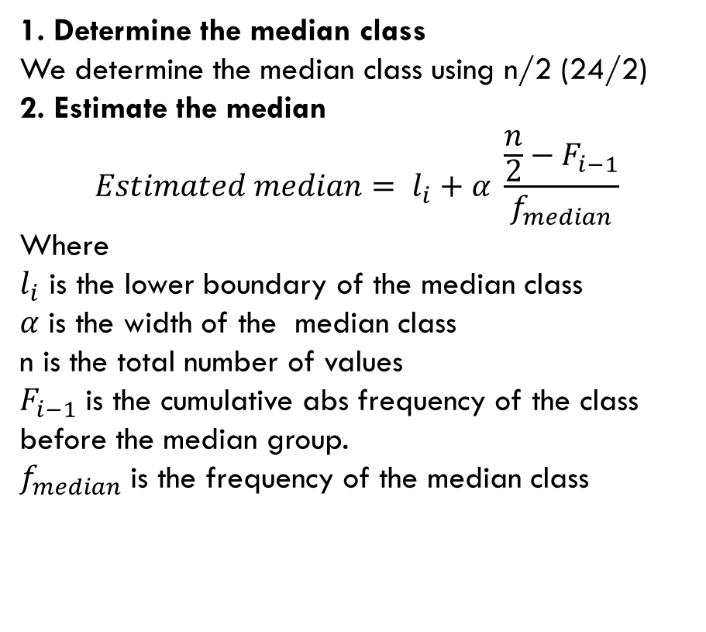

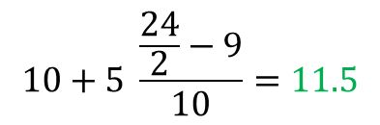
Mean, Mode, Median and quartiles of grouped data
Estimated median
Intervals | $$x_{i}$$ | $$f_{i}$$ | $$F_{i}$$ | Relative f
$$\left[0 5\right[$$ | 2.5 | 2 | 2 | 0.083
$$\left[5 10\right[$$ | 7.5 | 7 | 9 | 0.2916
$\left[10 15\right[$ | 12.5 | 10 | 19 | 0.416
$$\left[15 20\right]$$ | 17.5 | 5 | 24 | 0.208
1. Determine the median class
We determine the median class using n/2 (24/2)
2. Estimate the median
$$Estimated median= l_{i}+α \frac{\frac{n}{2}−F_{i−1}}{f_{median}}$$
Where
$l_{i}$ is the lower boundary of the median class
$α$ is the width of the median class
n is the total number of values
$F_{i−1}$ is the cumulative abs frequency of the class before the median group.
$f_{median}$ is the frequency of the median class
$$10+5 \frac{\frac{24}{2}−9}{10}=11.5$$
$$Estimated median=$$

Slide 10
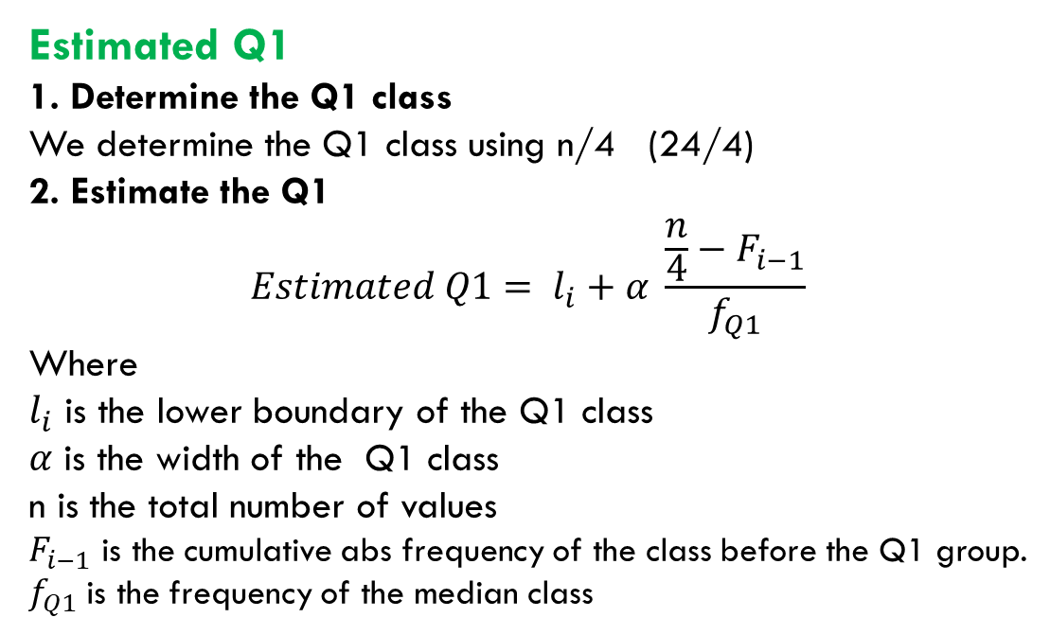

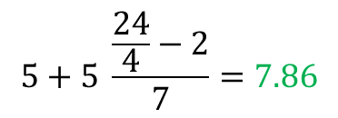
Mean, Mode, Median and quartiles of grouped data
Estimated quartiles
Intervals | $$x_{i}$$ | $$f_{i}$$ | $$F_{i}$$ | Relative f
$$\left[0 5\right[$$ | 2.5 | 2 | 2 | 0.083
$$\left[5 10\right[$$ | 7.5 | 7 | 9 | 0.2916
$\left[10 15\right[$ | 12.5 | 10 | 19 | 0.416
$$\left[15 20\right]$$ | 17.5 | 5 | 24 | 0.208
Estimated Q1
1. Determine the Q1 class
We determine the Q1 class using n/4 (24/4)
2. Estimate the Q1
$$Estimated Q1= l_{i}+α \frac{\frac{n}{4}−F_{i−1}}{f_{Q1}}$$
Where
$l_{i}$ is the lower boundary of the Q1 class
$α$ is the width of the Q1 class
n is the total number of values
$F_{i−1}$ is the cumulative abs frequency of the class before the Q1 group.
$f_{Q1}$ is the frequency of the median class
$$5+5 \frac{\frac{24}{4}−2}{7}=7.86$$
$$Estimated Q1=$$

Slide 11
Mean, Mode, Median and quartiles of grouped data
Estimated quartiles
Estimated Q2
Q2 is the median of the data.

Slide 12



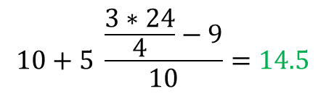
Mean, Mode, Median and quartiles of grouped data
Estimated quartiles
Intervals | $$x_{i}$$ | $$f_{i}$$ | $$F_{i}$$ | Relative f
$$\left[0 5\right[$$ | 2.5 | 2 | 2 | 0.083
$$\left[5 10\right[$$ | 7.5 | 7 | 9 | 0.2916
$\left[10 15\right[$ | 12.5 | 10 | 19 | 0.416
$$\left[15 20\right]$$ | 17.5 | 5 | 24 | 0.208
Estimated Q3
1. Determine the Q3 class
We determine the Q3 class using 3n/4
2. Estimate the Q3
$$Estimated Q3= l_{i}+α \frac{\frac{3n}{4}−F_{i−1}}{f_{Q1}}$$
Where
$l_{i}$ is the lower boundary of the Q3 class
$α$ is the width of the Q3 class
n is the total number of values
$F_{i−1}$ is the cumulative abs frequency of the class before the Q3 group.
$f_{Q3}$ is the frequency of the median class
$$10+5 \frac{\frac{3∗24}{4}−9}{10}=14.5$$
$$Estimated Q3=$$

Slide 13
Example
A city’s police department records the number of reported incidents in various cites. They categorize the data by the number of incidents per year, and we want to analyze this information and assess public safety.
Perform the descriptive statistical analysis
Interpret the results
Income Range | Frequency
0 - 50 | 10
50 - 100 | 8
100-150 | 5
150 - 200 | 3
200 - 250 | 2
250 - 300 | 1

