Slide 1

University of Mohammed Essedik Benyehia Jijel
Faculty of technology
1st year master architecture
Numerical Data Analysis
M. Soltani & M.Bouzenita

Slide 2
Numerical Data Analysis
M. Soltani
1st year master architecture - University of Jijel
Lecture 2
Introduction (3/3)

Slide 3
Graphical analysis
Graphical models serve at presenting numerical data in a manner that enhances understanding and simplifies comprehension
most commonly employed graphical tools for data analysis:
Bar chart
Pie chart
Histogram
Scatter plot
Box plot
Pareto chart

Slide 4
Bar chart
A bar chart is a graph represents the frequency distribution (or relative frequency ) of categorical data, in which we draw each category frequency by a bar or rectangle.
The area of each bar is proportional to the corresponding frequency or relative frequency.

Slide 5
Bar chart
Frequency table
Example1
 | C1
Male | 20
female | 25

Slide 6
Bar chart
Frequency table
Example2
 | C1 | C2
Male | 20 | 22
female | 25 | 10

Slide 7
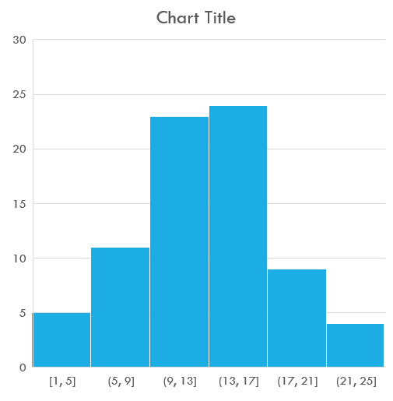
Histogram
A histogram is a graphical representation that composed of bars that presents a specifics range of values.
Generally, a histogram is used to describe the frequency distribution of a continuous variable

Slide 8
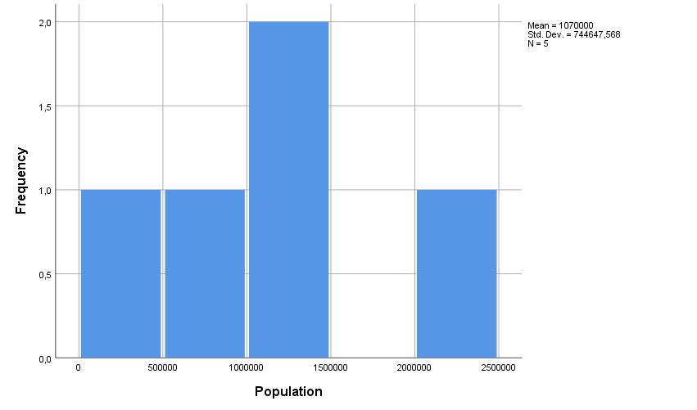
Histogram
City Name | Population
City A | 1500000
City B | 800000
City C | 2200000
City D | 1000000
City E | 1200000

Slide 9
Pie chart
A pie chart is a graph represents the frequency distribution (or relative frequency ) of categorical data, in which we draw each category frequency by a slice of a pie.

Slide 10
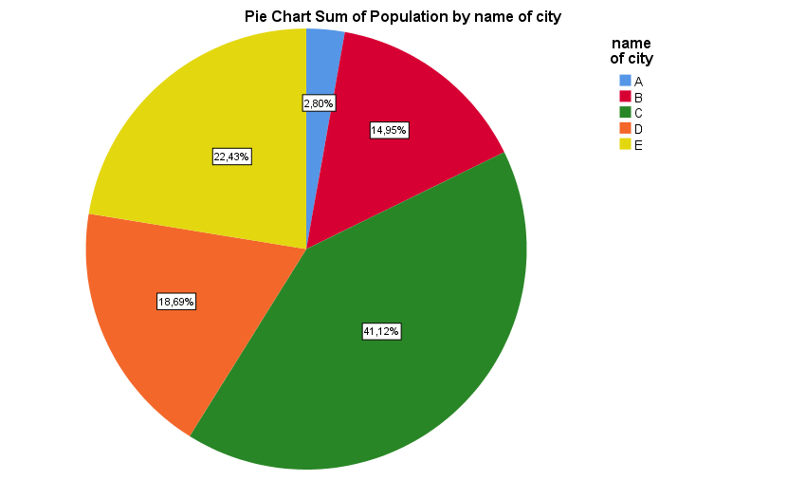
Pie chart
City Name | Population
City A | 1500000
City B | 800000
City C | 2200000
City D | 1000000
City E | 1200000

Slide 11
Scatter plot
A scatter plot is a kind of graphical representation utilized to visualize the association between two quantitative variables,
it display data points on a two dimensional plane with two axis (x and y).

Slide 12
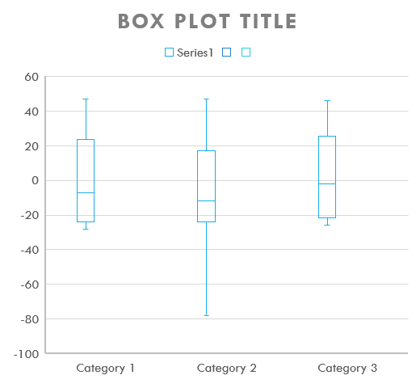
Box Plot
A Box Plot is a graphical analysis tool to summarize dataset
The Box Plot displays minimum, first quartile (Q1), median (Q2), third quartile (Q3) and maximum of dataset.

Slide 13
Box Plot
How to construct a box plot
Min
Q1
Median
Q3
Max
Ordered Dataset
25%
25%
50%

Slide 14
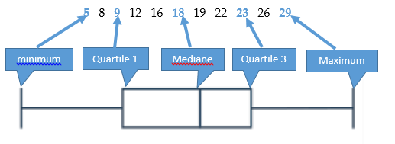
Box Plot

Slide 15
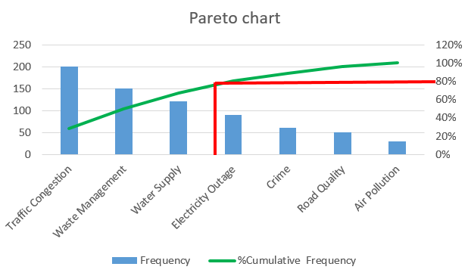
Pareto chart
A Pareto chart is a bar chart that is used in data analysis to display the frequency of categories.
The Pareto chart is based on the 20/80 principle, which means that 80% of effects come from 20% of the causes.
.

Slide 16
Pareto chart
We have a dataset that records the types of issues reported in a city. Our objective is to create a Pareto chart to identify the 20% of issues that account for 80% of the complaints

Slide 17
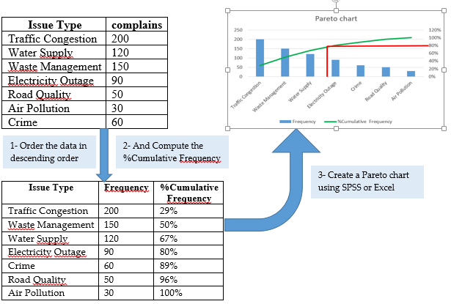
Pareto chart

