Slide 1

University of Mohammed Essedik Benyehia Jijel
Faculty of technology
1st year master architecture
Data analysis using SPSS
M. Soltani
M. Bouzenita

Slide 2
Data analysis using SPSS
M. Soltani
1st year master architecture - University of Jijel
Lecture 3
Analysis using SPSS

Slide 3
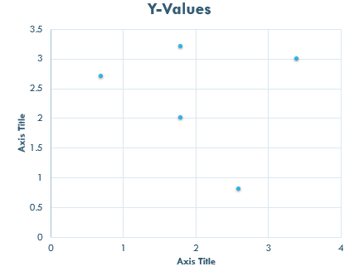
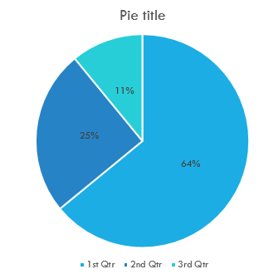
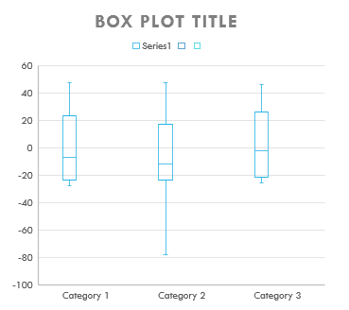
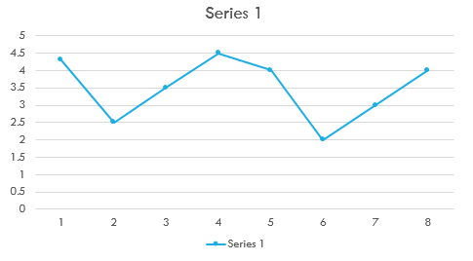
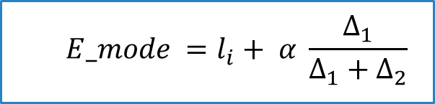
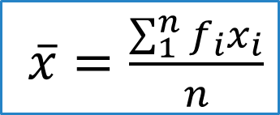
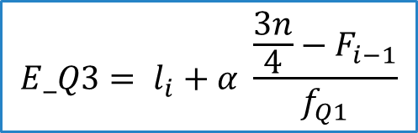
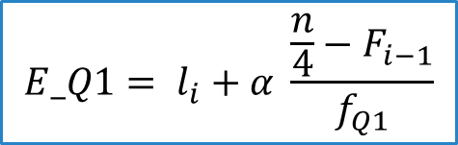
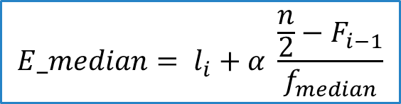
Review of Lecture 3
Mean, Mode, Median and quartiles of grouped data
Graphical analysis
Bar chart
Histogram
Scatter plot
$\overline{x}=\frac{\sum_{1}^{n}{f_{i}x_{i}}}{n}$
$$E_mode =l_{i}+ α \frac{∆_{1}}{∆_{1}+∆_{2}}$$
$$E_median= l_{i}+α \frac{\frac{n}{2}−F_{i−1}}{f_{median}}$$
Pie chart
Run chart
Box plot
$$E_Q1= l_{i}+α \frac{\frac{n}{4}−F_{i−1}}{f_{Q1}}$$
$$E_Q3= l_{i}+α \frac{\frac{3n}{4}−F_{i−1}}{f_{Q1}}$$

Slide 4
SPSS:Statistical package for the social sciences
SPSS : Statistical Package for the Social Sciences, is an IBM software package used for statistical data analysis.
Some SPSS alternatives
Paid: Minitab, Number Analytics, OriginPro
Free: Jamovi, Posit, jmp, PSPP, R, Rstudio, JASP

Slide 5
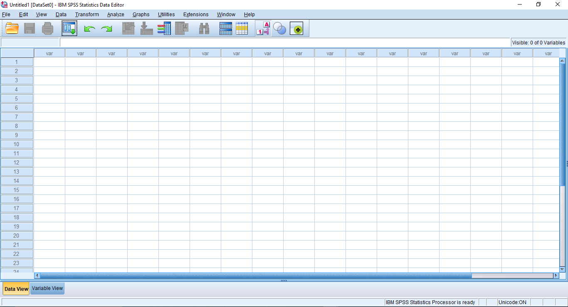
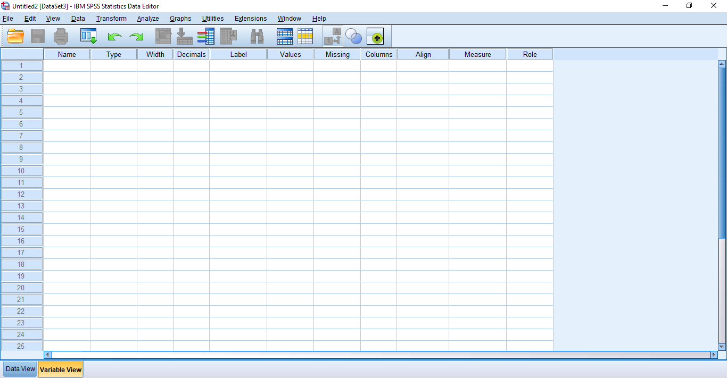
SPSS - General environment
Main parts of SPSS environment
Command bar
Tool bar
Data editor windows
Data view
Variable view
1
2

Slide 6
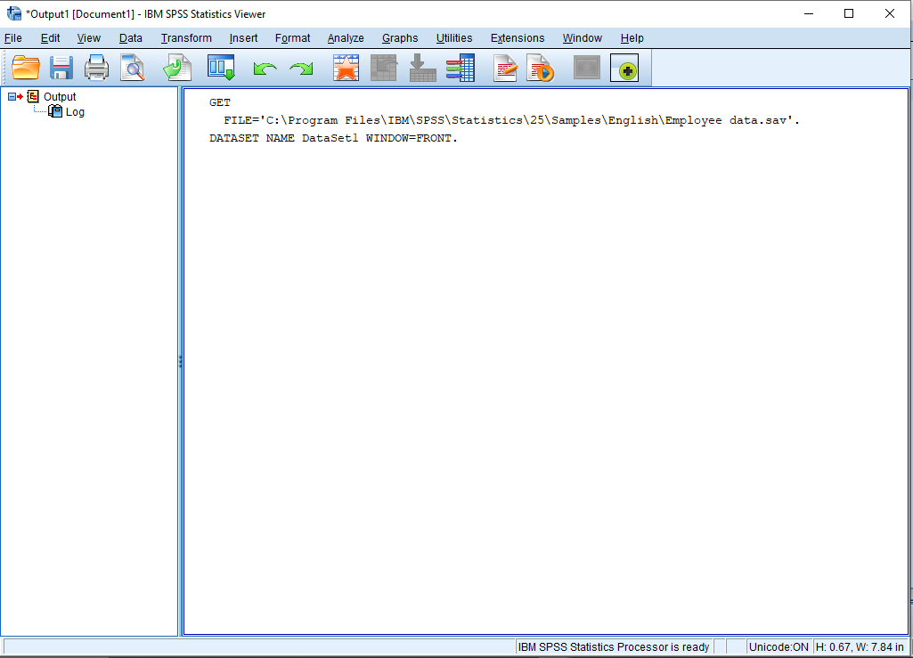
SPSS - General environment
Main parts of SPSS environment
Output viewer window
This window displays the user output

Slide 7
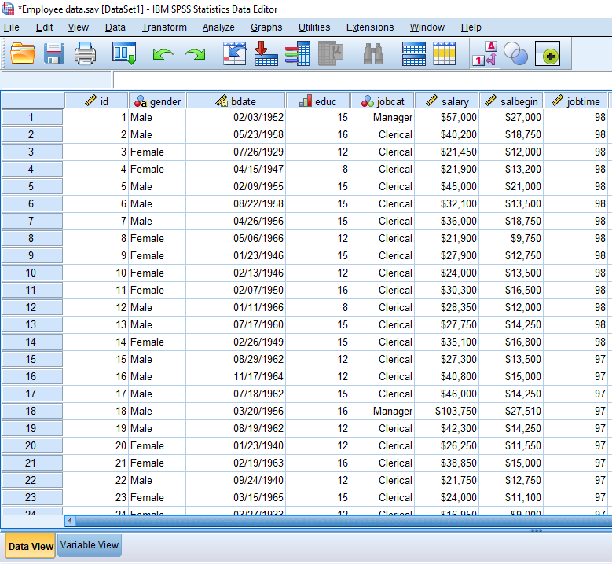
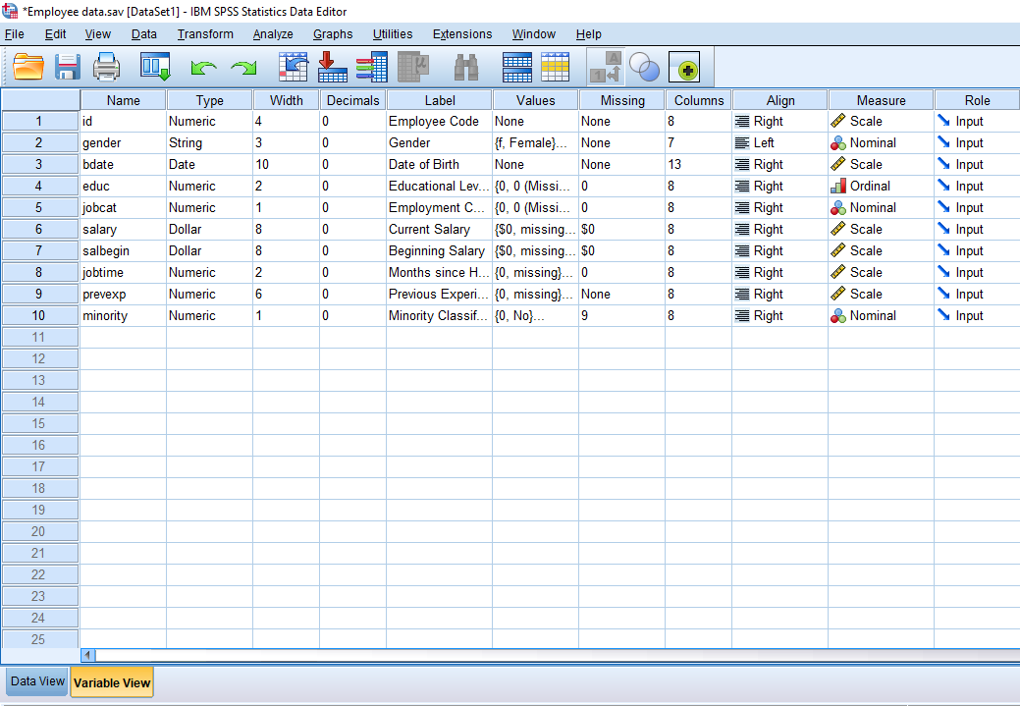
SPSS - General environment
Data view and variable view
Variables
Data view
Variable view

Slide 8
SPSS - General environment
Data view and variable view
Data view:
Variables names
Data values

Slide 9
SPSS - General environment
Data view and variable view
Variable view:
Variables names
Variable parameters

Slide 10
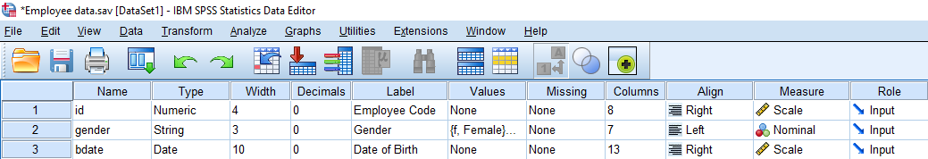
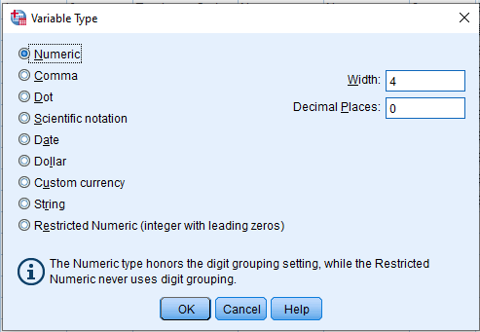
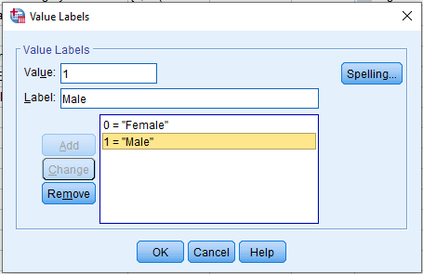

SPSS - General environment
Variable view
Name: Name of the variable
Width: length of the variable
Decimals: Number of decimals
Measure:
Scale: for quantitative data
Ordinal: for ordered qualitative data
Nominal: No ordered qualitative data
Label: Description of the variable
Type: Define the type of the variable
Values: Define the possible values of the data

Slide 11
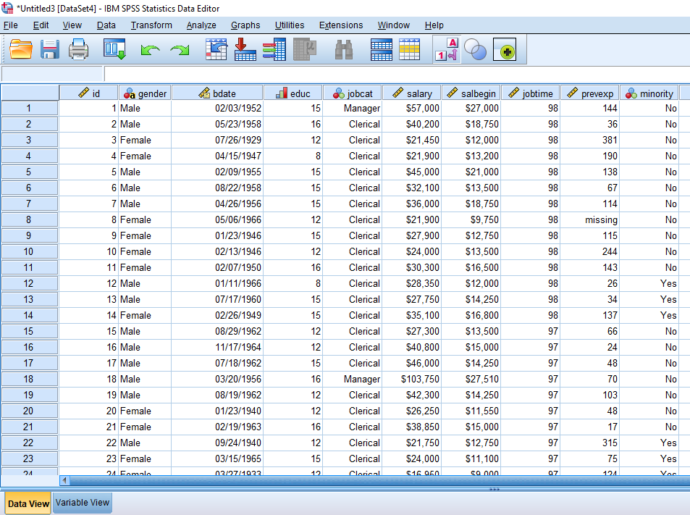
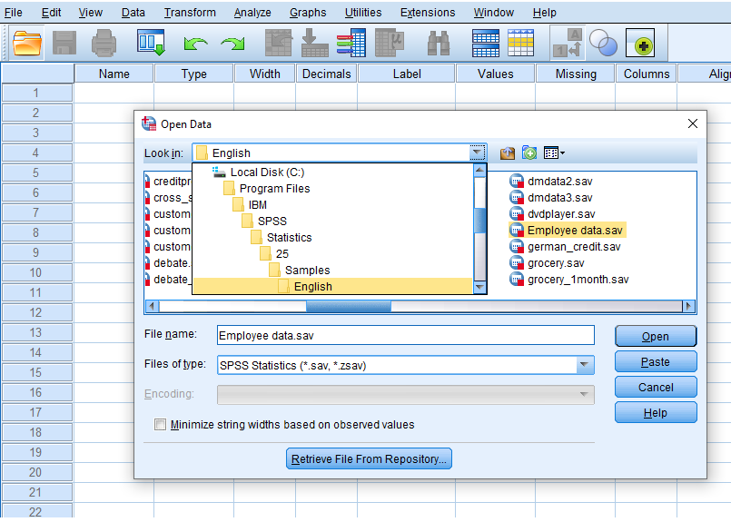
Descriptive analysis
In this presentation we use the ‘Employee data.sav’ data base as an example for explanation
English version
C:\Program Files\IBM\SPSS\Statistics\25\Samples\English
1
2
3

Slide 12
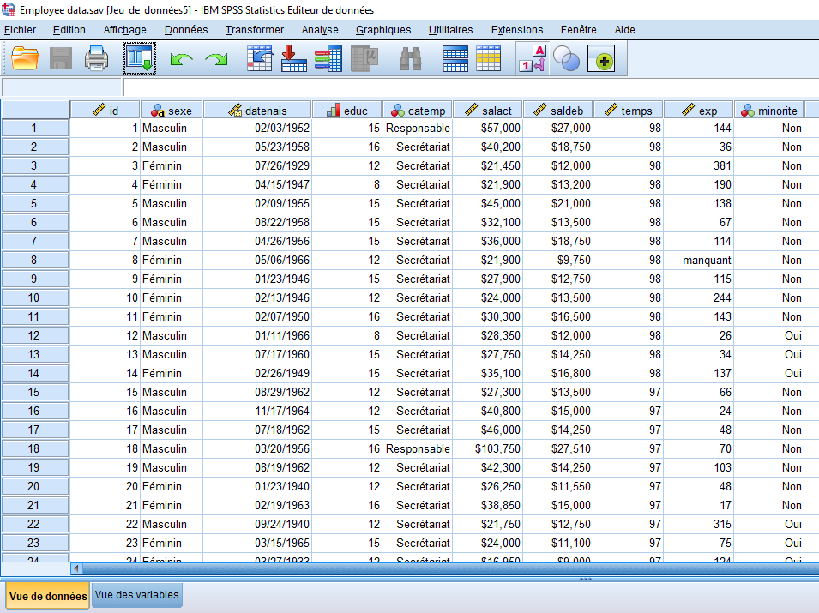
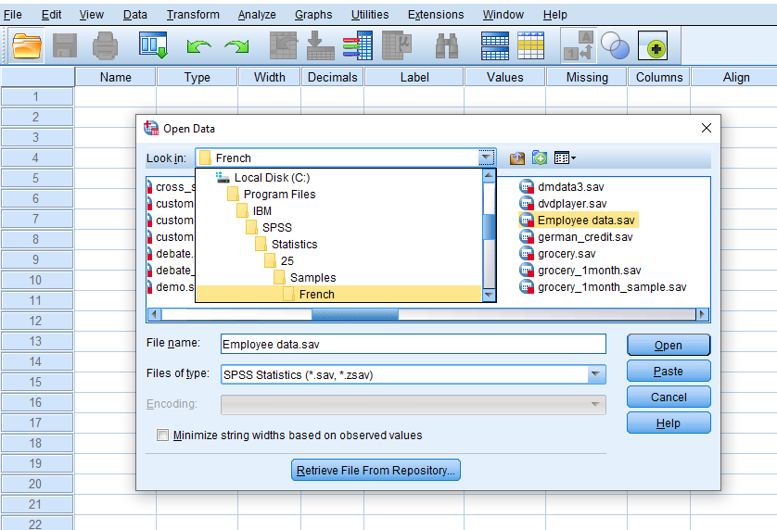
Descriptive analysis
In this presentation we use the ‘Employee data.sav’ data base as an example for explanation
French version
C:\Program Files\IBM\SPSS\Statistics\25\Samples\French

Slide 13
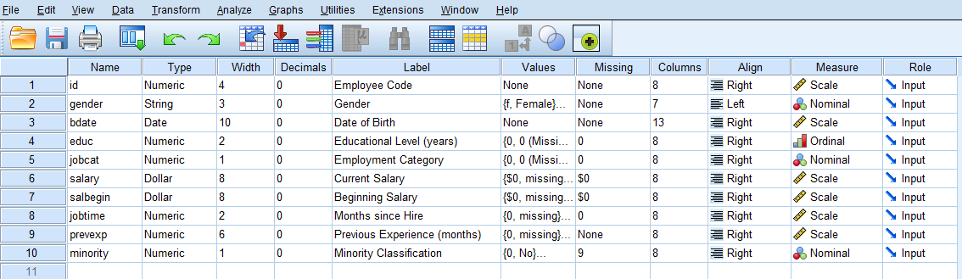
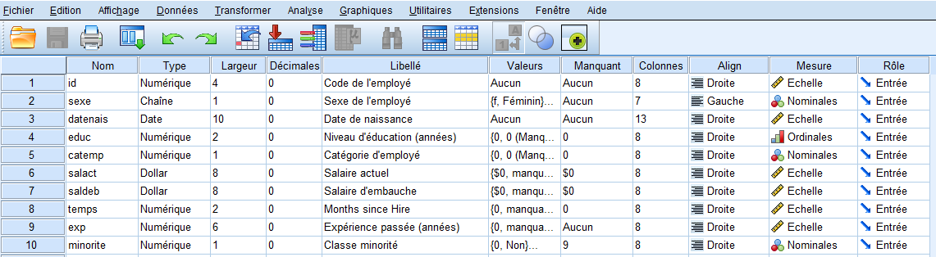
Descriptive analysis
English version
C:\Program Files\IBM\SPSS\Statistics\25\Samples\English
French version
C:\Program Files\IBM\SPSS\Statistics\25\Samples\French

Slide 14
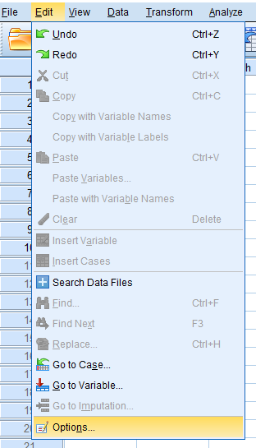
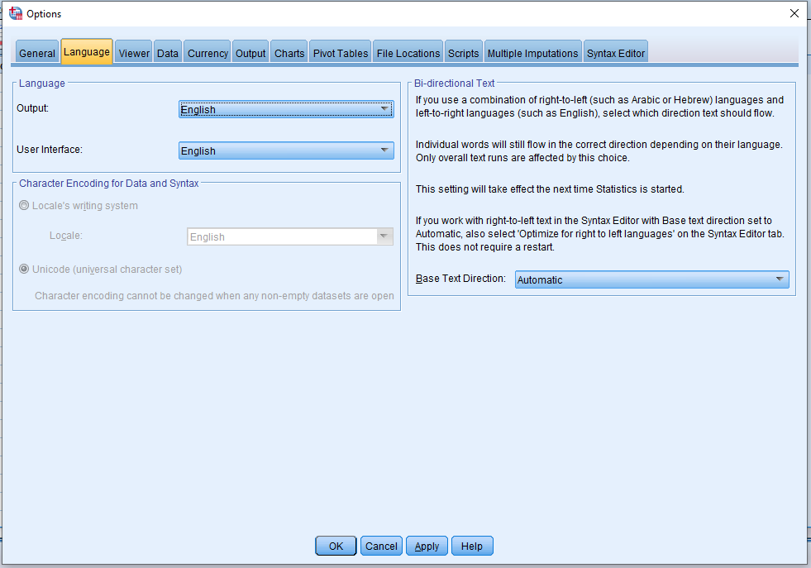
Descriptive analysis
English version
C:\Program Files\IBM\SPSS\Statistics\25\Samples\English
To change language: Edit > Options
and select Language
French version
C:\Program Files\IBM\SPSS\Statistics\25\Samples\French

Slide 15
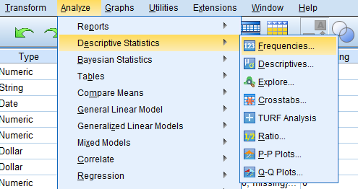
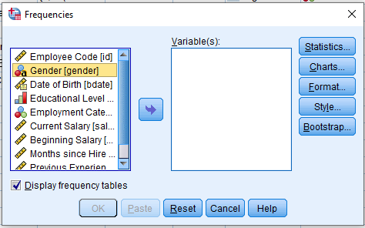
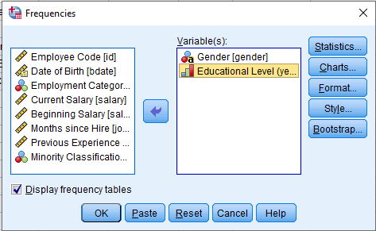
Descriptive analysis - Tables
1. Frequency table
Analyze > Descriptive Statistics > Frequencies
NB : In general frequency table is useful for qualitative data
3. Click OK
Analyze >
Descriptive Statistics > Frequencies
2. Select the variables we need to construct the frequency tables

Slide 16
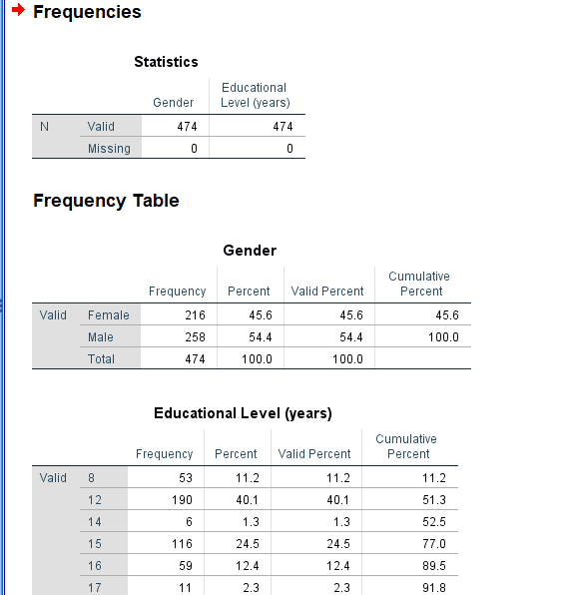
Descriptive analysis - Tables
1. Frequency table
Output
Frequency table for Gender
Frequency table for Educational level

Slide 17
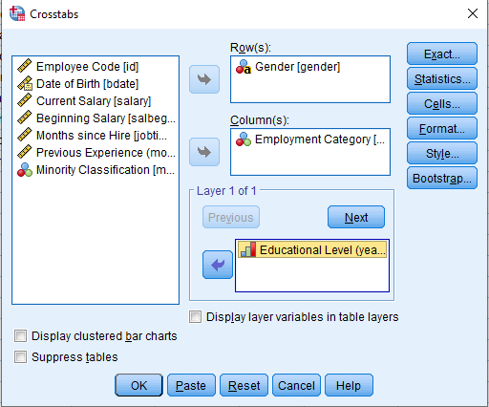
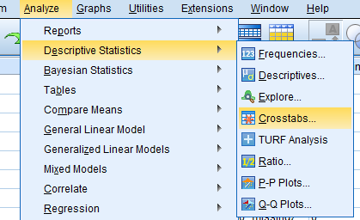
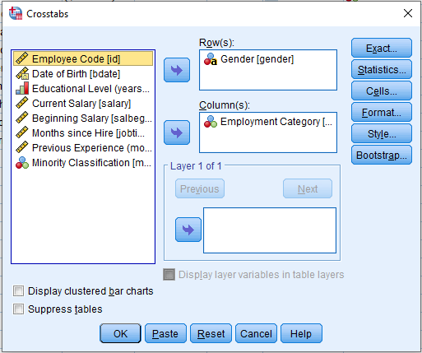
Descriptive analysis - Tables
2. Cross table :
Cross table with layers
Analyze > Descriptive Statistics > Crosstabs
Simple cross table
1. Analyze >
Descriptive Statistics > Crosstabs
4. Adding layers if needed
2. Select the row of the cross tab
3. Select the column of the cross tab

Slide 18
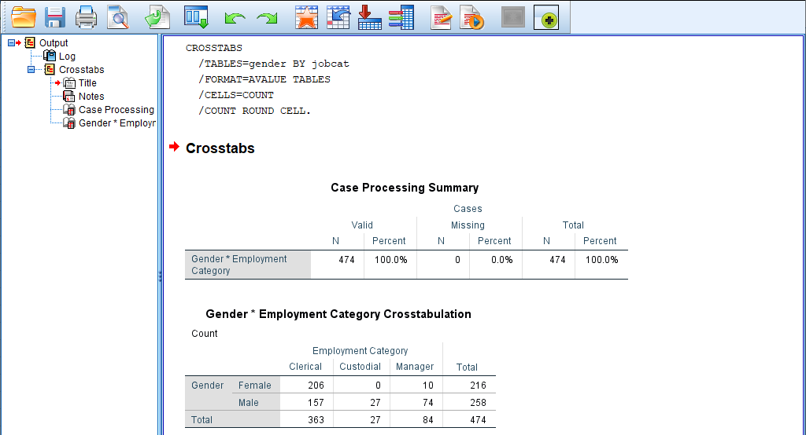
Descriptive analysis - Tables
2. Cross table :
Simple cross table : output
206 of females are clericals

Slide 19
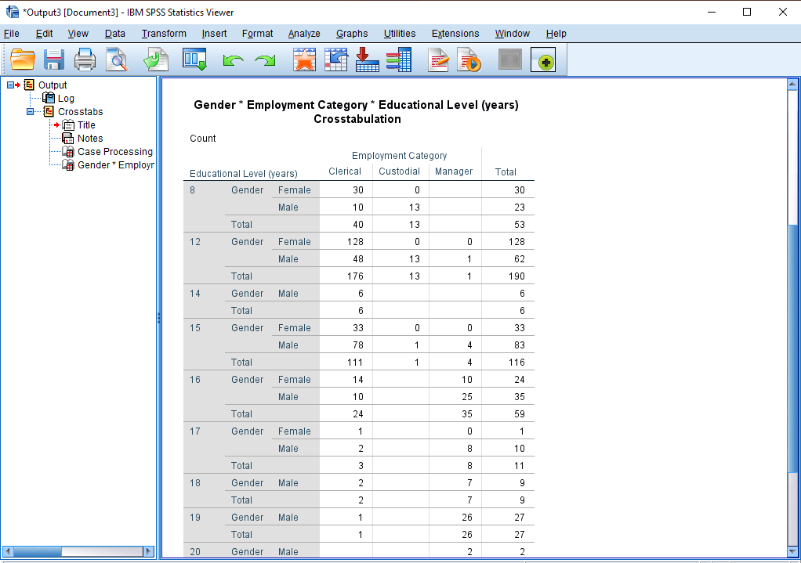
Descriptive analysis - Tables
2. Cross table :
Cross table with layers : output
14 of females having 16 years of education are Clerical

Slide 20
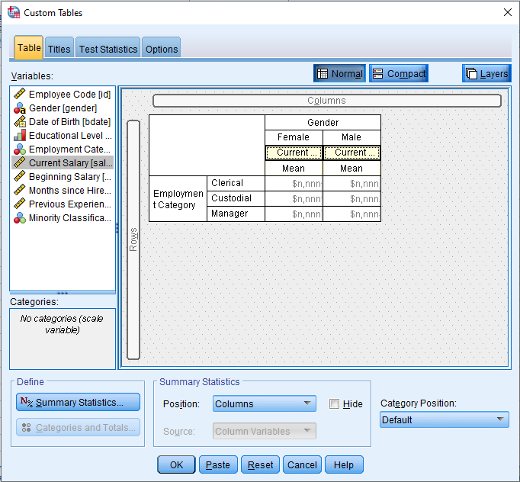
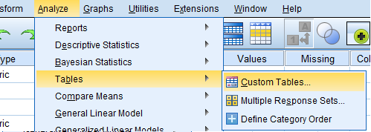
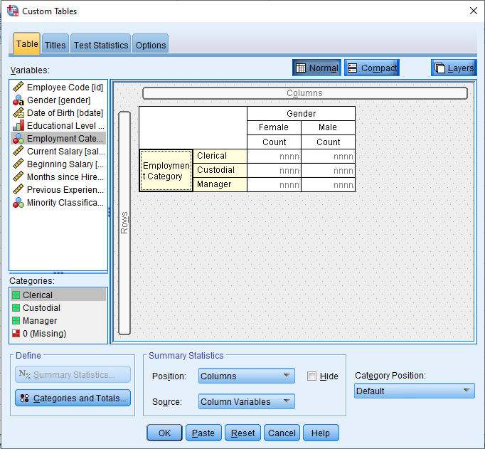
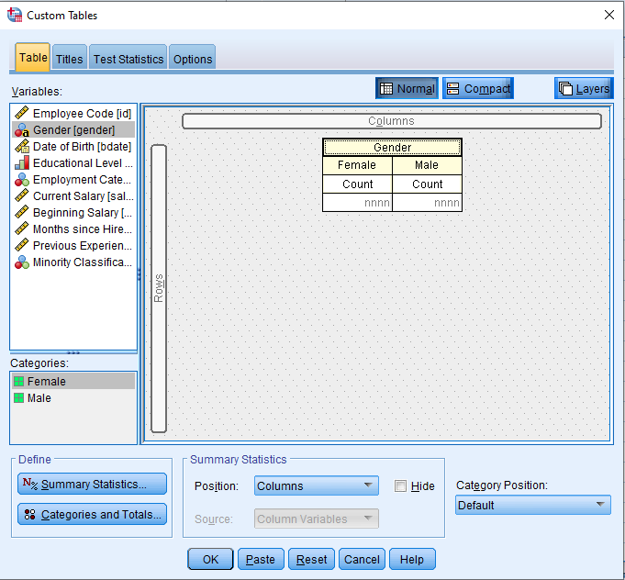
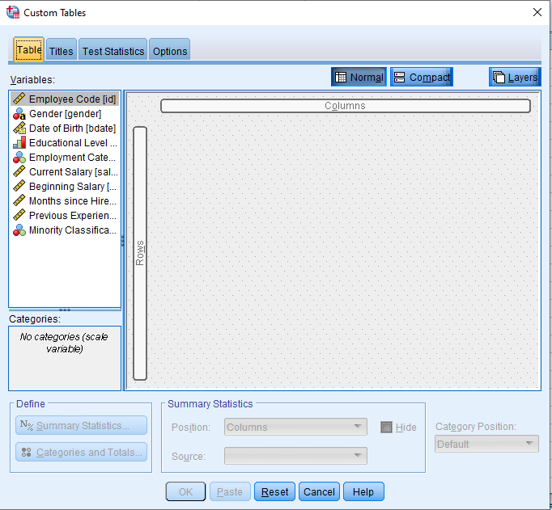
Descriptive analysis - Tables
3. Custom table :
Analyze > Tables > Custom Tables
4. Drag to add layers if needed
3. Drag to define the row variable
2. Drag to define the column variable
Empty custom table

Slide 21
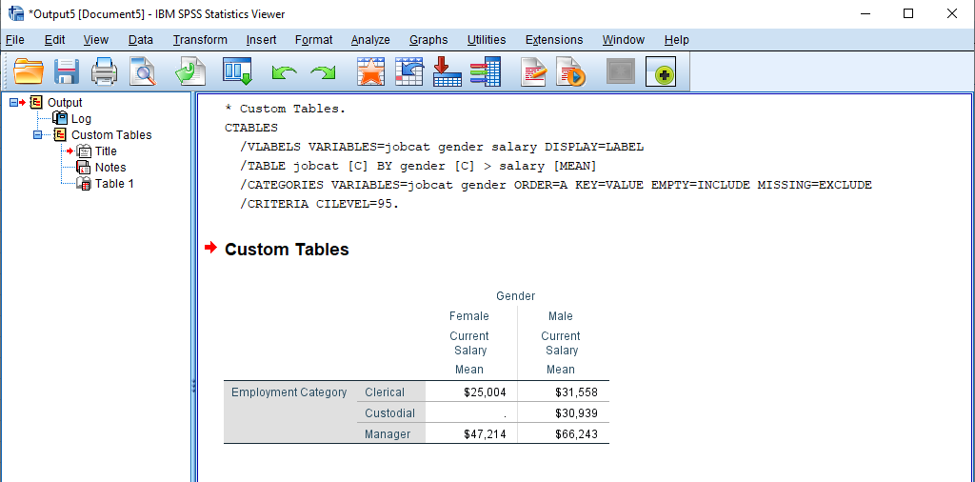
Descriptive analysis - Tables
Mean current salary of clerical male
3. Custom table : output

Slide 22
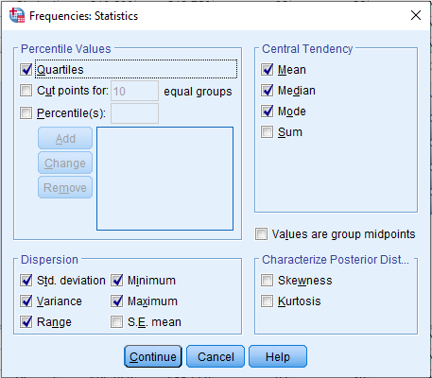
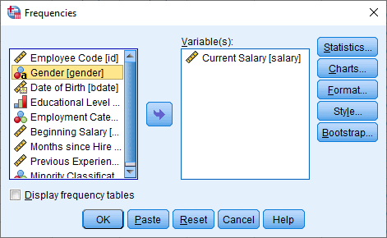
Descriptive analysis - Numerical
Frequencies: Mean, Mode, Median …
Analyze >
Descriptive Statistics > Frequencies
3. Select the desired statistics
2. Select variables

Slide 23
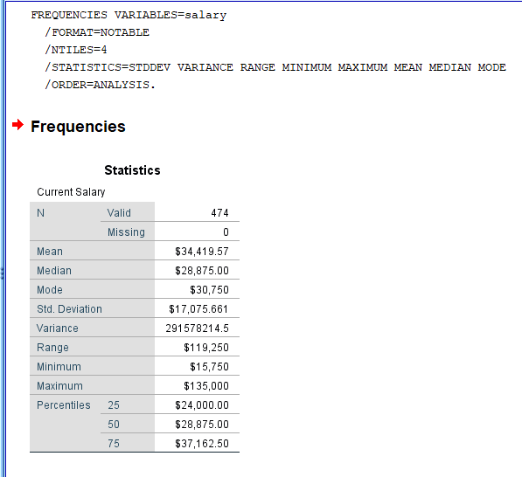
Descriptive analysis - Numerical
Frequencies: Mean, Mode, Median …
Output:

Slide 24
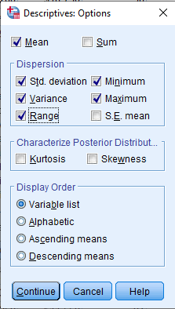
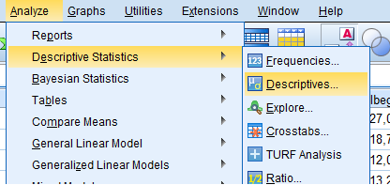
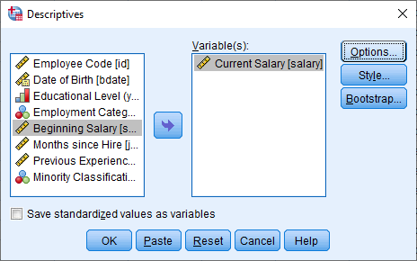
Descriptive analysis - Numerical
Frequencies: Mean, Mode, Median …
Other alternative
Analyze > Descriptive statistics > Descriptives
2. Select variables
1. Analyze >
Descriptive statistics > Descriptives
3. Select desired statistics

Slide 25
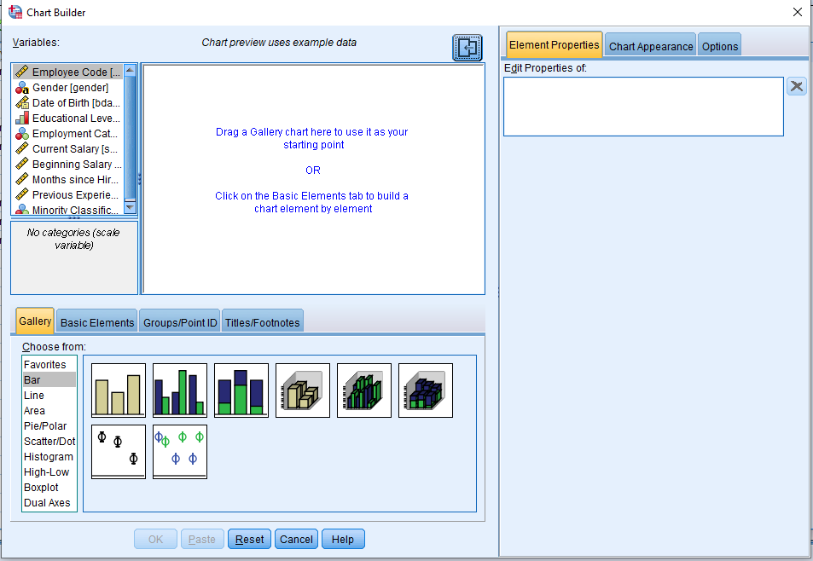
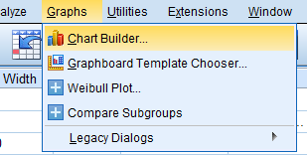
Descriptive analysis - Graphics
Chart builder
Interactive facility to compose graphs
Variables
Graphs > Chart Builder
Gallery of graphs
Type of the selected graph

Slide 26
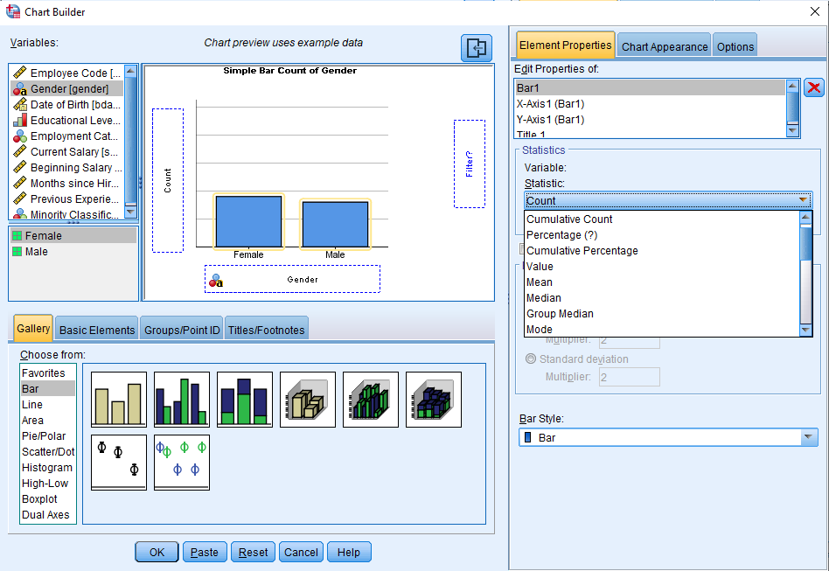
Descriptive analysis - Graphics
1. Bar chart :
4
1. Graphs > Chart Builder
2. Select ‘Bar’ in Gallery
5
*
3. Drag the selected model
4. Drag the selected variable to x axis
3
2
5. Select the statistic parameter needed for y axis
*. We can choose a variable for y axis
6. Click OK
6

Slide 27
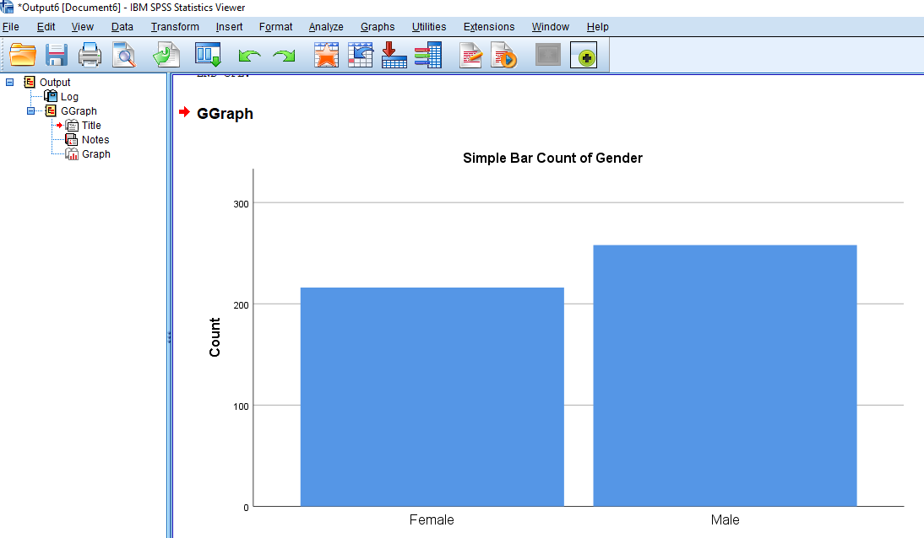
Descriptive analysis - Graphics
1. Bar chart :
Output : Bar chart for Count of Gender

Slide 28

Descriptive analysis - Graphics
2. Pie chart :
4
1. Graphs > Chart Builder
*
5
2. Select ‘Pie’ in Gallery
3. Drag the selected model
4. Drag the selected variable to x axis
3
5. Select the statistic parameter needed for y axis
2
*. We can choose a variable for y axis
6. Click OK
6

Slide 29

Descriptive analysis - Graphics
2. Pie chart :
Output : Pie chart for Count of Gender

Slide 30

Descriptive analysis - Graphics
3. Histogram:
4
1. Graphs > Chart Builder
5
2. Select ‘Histogram’ in Gallery
3. Drag the selected model
4. Drag the selected variable to x axis
3
5. Select the statistic parameter needed for y axis
2
6. Click OK
6

Slide 31

Descriptive analysis - Graphics
3. Histogram:
Output : Histogram of Count of Current salary

Slide 32

Descriptive analysis - Graphics
4. Box plot
1.D Boxplot
1. Graphs > Chart Builder
4
2. Select ‘Boxplot’ in Gallery
3. Drag the selected model
4. Drag the selected variable to y axis
3
5. Click OK
2
5

Slide 33

Descriptive analysis - Graphics
4. Box plot
1.D Boxplot
Output : Boxplot of Current salary

Slide 34

Descriptive analysis - Graphics
4. Box plot
4. Box plot
Simple Boxplot
5
1. Graphs > Chart Builder
4
2. Select ‘Boxplot’ in Gallery
3. Drag the selected model
4. Drag the selected variable to y axis
3
5. Drag a categorical variable into x axis
6. Click OK
2
6

Slide 35

Descriptive analysis - Graphics
4. Box plot
Simple Boxplot
Output : Boxplot of Current salary by Gender

Slide 36
Practice
…

