Slide 1

University of Mohammed Essedik Benyehia Jijel
Faculty of technology
1st year master architecture
Data analysis using SPSS
M. Soltani
M. Bouzenita

Slide 2
Data analysis using SPSS
M. Soltani
1st year master architecture - University of Jijel
Lecture 4
Inferential analysis using SPSS

Slide 3
Review of Lecture 3
Descriptive analysis - Tables
Descriptive analysis - Graphics
1. Frequency table
Chart builder
2. Cross table
1. Bar chart :
3. Custom table
2. Pie chart :
3. Histogram:
Descriptive analysis - Numerical
4. Box plot
Frequencies: Mean, Mode, Median …

Slide 4
1. Correlation
Correlation
is a statistical measure for describing and quantifying the relationship or association between two quantitative variables.
Negative correlation where an increase in the value of one variable is associated with a decrease in the value of the other variable
No correlation changes in the value of one variable do not predict changes in the other.
Positive correlation where an increase in the value of one variable is associated with an increase in the value of the other variable.
Typically, this relationship can manifest in one of three main cases:

Slide 5

1. Correlation
Correlation
It is a statistical method used to quantify the association between two quantitative variables. Typically, this relationship can manifest in one of three main cases:
Negative correlation,
Positive correlation ;
No correlation;
The mentioned cases can be stated based on a statistical measure called correlation coefficient which is generally denoted by the symbol r and varied between 1 and -1:

Slide 6
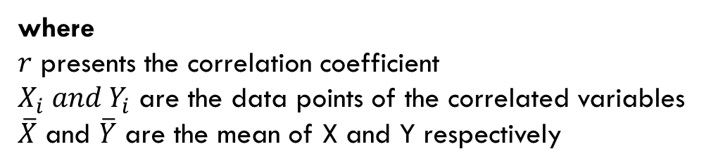
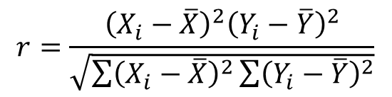
1. Correlation
Pearson's Correlation Coefficient
It is a parametric statistical measure used quantify the relationship degree between two quantitative variables. This type of correlation is employed the following assumptions:
The variables are assumed to be independent,
The variables have been randomly selected from the populations;
The two variables follow the normal distribution;
The Pearson’s correlation coefficient is computed using the following equation
$$r=\frac{{\left(X_{i}−\overline{X}\right)}^{2}{\left(Y_{i}−\overline{Y}\right)}^{2}}{\sqrt{\sum{{\left(X_{i}−\overline{X}\right)}^{2}\sum{{\left(Y_{i}−\overline{Y}\right)}^{2}}}}}$$
where
$r$ presents the correlation coefficient
$X_{i}{ and Y}_{i}$ are the data points of the correlated variables
$\overline{X}$ and $\overline{Y}$ are the mean of X and Y respectively

Slide 7
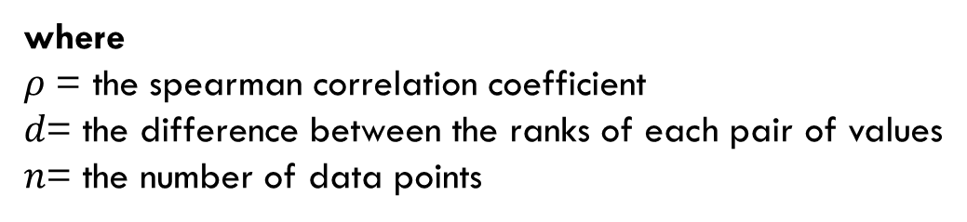
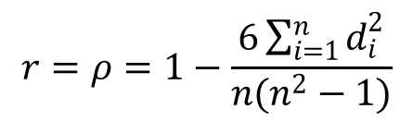
1. Correlation
Spearman correlation coefficient
It is non-parametric correlation test used to investigate the association between two variables. This kind of correlation is used when the following assumption are satisfied:
The investigated Variables are non-Normally distributed.
The investigated variables are discrete or ranked in some manner
The Spearman correlation coefficient is computed by using the following equation
$$r=ρ=1−\frac{6\sum_{i=1}^{n}{d_{i}^{2}}}{n(n^{2}−1)}$$
where
$ρ$ = the spearman correlation coefficient
$d$= the difference between the ranks of each pair of values
$n$= the number of data points

Slide 8
1. Correlation
Graphical analysis of correlation
Positive correlation
A scatter plot is an excellent way to visualize the correlation between two variables.
These figures illustrate various scenarios of correlation between variables
Negative correlation
No correlation

Slide 9
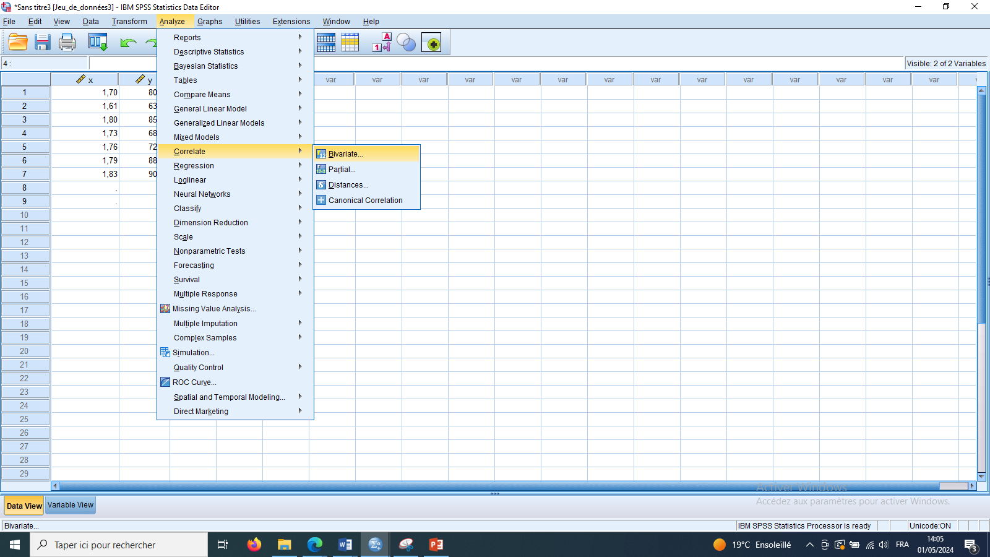
1. Correlation
Correlation analysis in SPSS
The validation of correlation in SPSS software is based on the following steps
Analyze > Correlate > Bivariate…

Slide 10
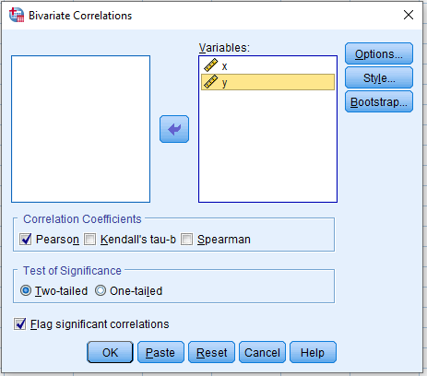
1. Correlation
Correlation analysis in SPSS
The following window is appear then:
1
1- Move the variables from the left side to the right side
2- Select the kind of correlation coefficient
3- Click Ok
2
3

Slide 11
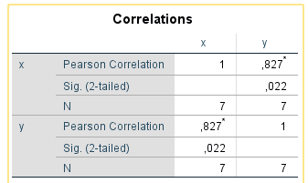
1. Correlation
Correlation analysis in SPSS
The correlation coefficient is equal to 0,827 which means that there is high positive correlation between the two variable X and Y
The correlation is significant because p-value (Sig) = 0.022 < 0.05

Slide 12

2. Regression analysis
The regression is mathematical technique that is used to underline the relationship between one dependent variable (Y) and one or various independent variables (X1, X2, …,Xn)
$$Y=f(X1, X2, …, Xn)$$

Slide 13
2. Regression analysis
Regression
Simple
Y = f(X)
Linear
$$Y= a + bX$$
Linear
𝑌= 𝑎 + 𝑏𝑋
Non linear
Exp: $Y = aX + bX^{2}$
Non linear
Exp: 𝑌 = 𝑎𝑋 + 𝑏𝑋^2
Multiple
Y = f(X1,X2, …, Xn)
Linear
Y = a + bX1+ cX2 + …
Non linear
Types of regression analysis

Slide 14
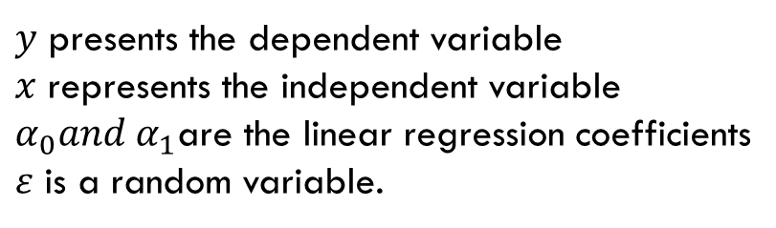

2. Regression analysis
Simple linear regression
The mathematical model of the Simple linear regression is given as follows
This kind of regression aims to investigate the relationship between one dependent (the response variable) variable and one independent variable (the predictor variable).
$$Y=α_{0}+α_{1}x+ε$$
$y$ presents the dependent variable
$x$ represents the independent variable
$α_{0}and α_{1}$are the linear regression coefficients
$ε$ is a random variable.

Slide 15






2. Regression analysis
Simple linear regression
The mathematical model of the Simple linear regression is given as follows
$$Y=α_{0}+α_{1}x$$
$$ε_{3}$$
$$ε_{4}$$
$$Y=α_{0}+α_{1}x+ε$$
$$ε_{2}$$
$y$ presents the dependent variable
$x$ represents the independent variable
$α_{0}and α_{1}$are the linear regression coefficients
$ε$ is a random variable.
$$ε_{1}$$
$$α_{0}$$

Slide 16
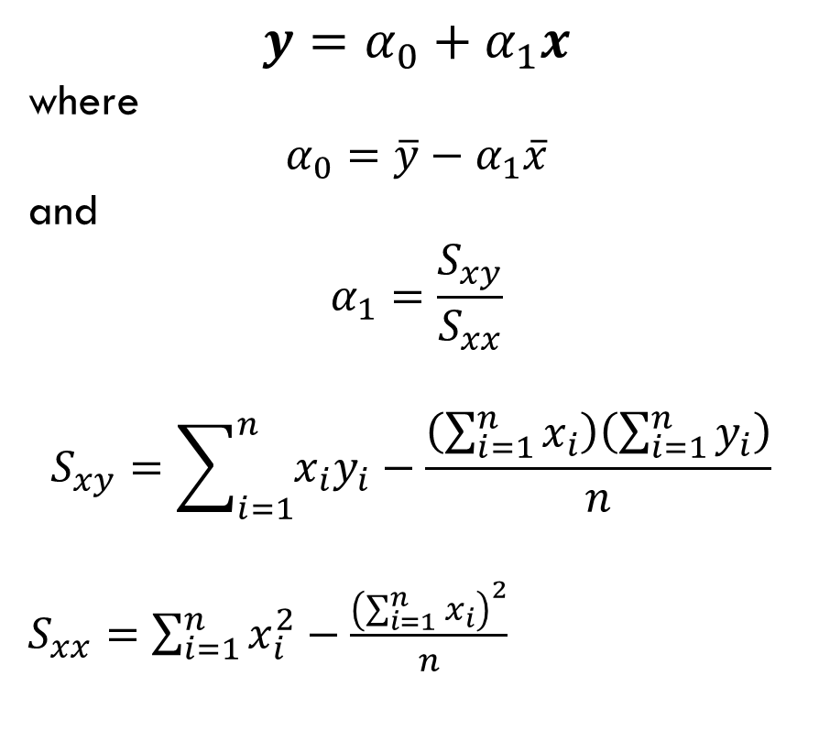
2. Regression analysis
least square method
Simple linear regression
$$y=α_{0}+α_{1}x$$
where
$$α_{0}=\overline{y}−α_{1}\overline{x}$$
and
$$α_{1}=\frac{S_{xy}}{S_{xx}}$$
$$S_{xy}=\sum_{i=1}^{n}{x_{i}y_{i}}−\frac{\left(\sum_{i=1}^{n}{x_{i}}\right)\left(\sum_{i=1}^{n}{y_{i}}\right)}{n}$$
$S_{xx}=$ $\sum_{i=1}^{n}{x_{i}^{2}}−\frac{{\left(\sum_{i=1}^{n}{x_{i}}\right)}^{2}}{n}$
The regression coefficient are computed using the least square method in order to adjust the straight line that represents the relationship between two variables. This is done based on the following procedures:

Slide 17

2. Regression analysis
least square method
Simple linear regression
$$y=α_{0}+α_{1}x$$
where
$$α_{0}=\overline{y}−α_{1}\overline{x}$$
and
$$α_{1}=\frac{S_{xy}}{S_{xx}}$$
$$S_{xy}=\sum_{i=1}^{n}{x_{i}y_{i}}−\frac{\left(\sum_{i=1}^{n}{x_{i}}\right)\left(\sum_{i=1}^{n}{y_{i}}\right)}{n}$$
$S_{xx}=$ $\sum_{i=1}^{n}{x_{i}^{2}}−\frac{{\left(\sum_{i=1}^{n}{x_{i}}\right)}^{2}}{n}$
Example
Given the underline variables
=-0.78
x | Y
1 | 2.5
2 | 3.3
3 | 5.2
4 | 8.7
5 | 12.2
6 | 14.5
7 | 15
=2.39
$$y=−0.78+2.39x$$
=66.9
=28

Slide 18
2. Regression analysis
least square method
Simple linear regression
Example
Given the underline variables
x | Y
1 | 2.5
2 | 3.3
3 | 5.2
4 | 8.7
5 | 12.2
6 | 14.5
7 | 15
$$y=−0.78+2.39x$$
-0.78

Slide 19
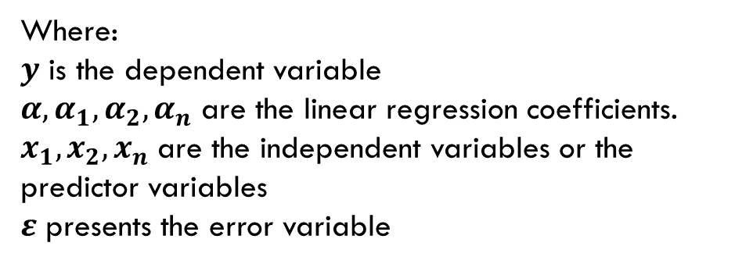
2. Regression analysis
Multiple linear regression
The mathematical model of The multiple linear regression is take the following form :
The multiple linear regression is an extension of the simple linear regression. The main difference between them is that the multiple linear regression deals with one dependent variable and various independent variable.
$$y=α_{0}+α_{1}x_{1}+α_{2}x_{2}+…+α_{n}x_{n}+ε$$
Where:
$y$ is the dependent variable
$α, α_{1}, α_{2}, α_{n}$ are the linear regression coefficients.
$x_{1}, x_{2}, x_{n}$ are the independent variables or the predictor variables
$ε$ presents the error variable
In multiple regression analysis, the computing procedures of regression coefficients is difficult due to the complexity of the implicated calculations. In this case, it is necessary to utilize statistical software such as Minitab, Excel, and SPSS

Slide 20
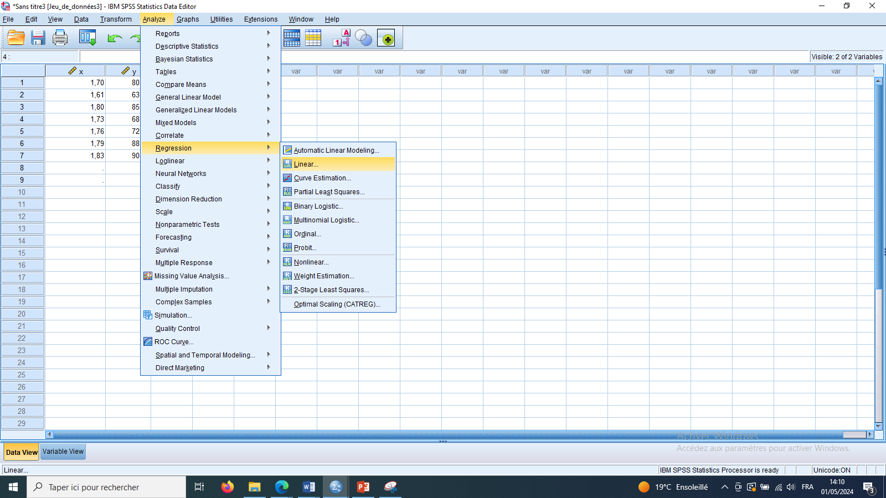
2. Regression analysis
Regression analysis in SPSS
The validation of regression in SPSS software is based on the following steps
Analyze > Regression > Linear…

Slide 21
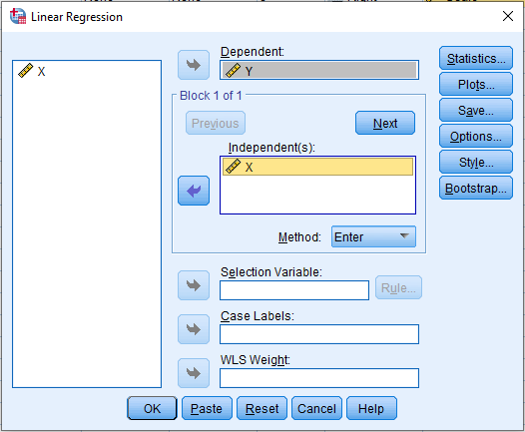
2. Regression analysis
Regression analysis in SPSS
1
The following window is appear then:
1- Move the dependent and the independent variables in the right place
2- Click Ok
1
2

Slide 22
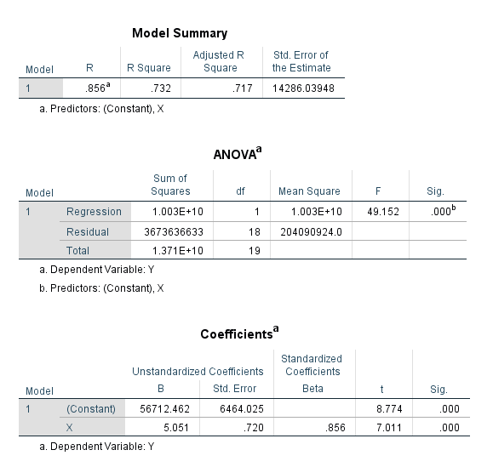
2. Regression analysis
Regression analysis in SPSS
1
The obtained results are interpreted as follows
1- Model summary
- R indicate the correlation between the real value and the predicted value that obtained by the regression model
- R-square Indicate the coefficient of variation in the dependent variable based on the variations of the independent variable
2- ANOVA table
Sig shows the significance of the model
3- Coefficients table
Sig shows the significance of each regression coefficient in the model
2
3
The regression model is as follow Y=56712.462 + 5.051X

Slide 23
Practice
…

