Slide 1

University of Mohammed Essedik Benyehia Jijel
Faculty of technology
1st year master architecture
Data analysis using SPSS
M. Soltani
M. Bouzenita

Slide 2
Data analysis using SPSS
M. Soltani
1st year master architecture - University of Jijel
Normal distribution and hypothesis test
Lecture 4

Slide 3



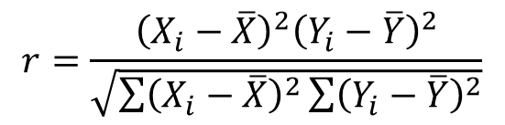




Review of Lecture 3
Correlation
Regression
Pearson's Correlation Coefficient
$$Y=f(X1, X2, …, Xn)$$
$$r=\frac{{\left(X_{i}−\overline{X}\right)}^{2}{\left(Y_{i}−\overline{Y}\right)}^{2}}{\sqrt{\sum{{\left(X_{i}−\overline{X}\right)}^{2}\sum{{\left(Y_{i}−\overline{Y}\right)}^{2}}}}}$$
$$ε_{3}$$
$$ε_{4}$$
-1
0
+1
$$ε_{2}$$
Negative correlation
No correlation
Positive correlation
$$Y=α_{0}+α_{1}x$$
$$ε_{1}$$
$$α_{0}$$

Slide 4
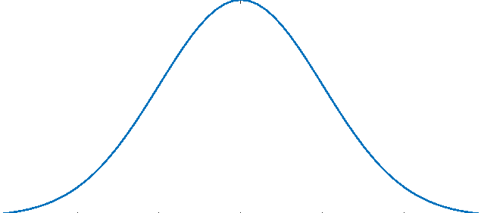


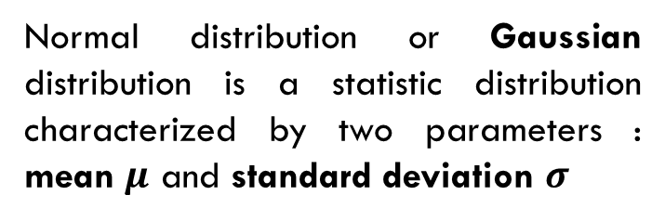



Normal distribution
Normal distribution
Normal distribution or Gaussian distribution is a statistic distribution characterized by two parameters : mean $μ$ and standard deviation $σ$
The form of normal distributions represented by a continuous probability distributions that are bell shaped and symmetric, as shown in this figure
$$σ=5$$
$$σ=5$$
$$7$$
$$μ=12$$
1$7$
Mode
Median
In normal distribution: Mean ≈ Mode ≈ Median

Slide 5
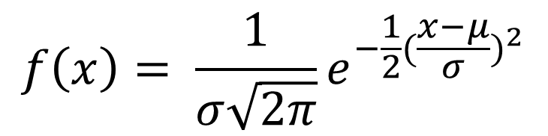
Normal distribution
Normal distribution
Normal distribution or Gaussian distribution is a statistic distribution characterized by two parameters : mean $μ$ and standard deviation $σ$
$$f\left(x\right)= \frac{1}{σ\sqrt{2π}}e^{−\frac{1}{2}{(\frac{x−μ}{σ})}^{2}}$$
The density function of the normal distribution is given by

Slide 6
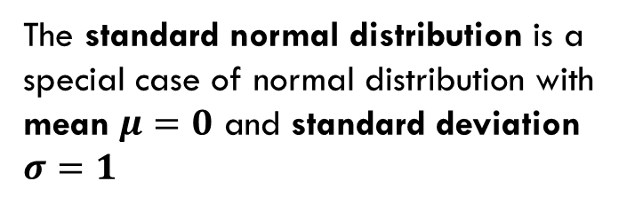




Normal distribution
Standard normal distribution
The standard normal distribution is a special case of normal distribution with mean $μ=0$ and standard deviation $σ=1$
The form of the standard normal distributions represented by
$$σ=1$$
$$σ=1$$
$$−1$$
$$μ=0$$
1

Slide 7






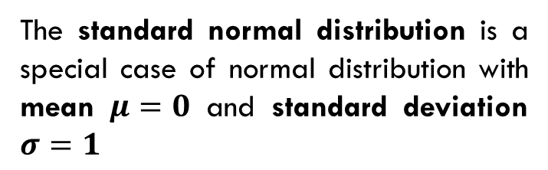
Normal distribution
Standard normal distribution
The standard normal distribution is a special case of normal distribution with mean $μ=0$ and standard deviation $σ=1$
it is also used in probability calculations for other normal distributions by translating the problem into an equivalent problem under the standard normal distribution using z score.
$$1$$
$$1$$
$$z= \frac{x−μ}{σ}$$
$$−1$$
$$0$$
1
$$\frac{μ−μ}{σ}$$

Slide 8
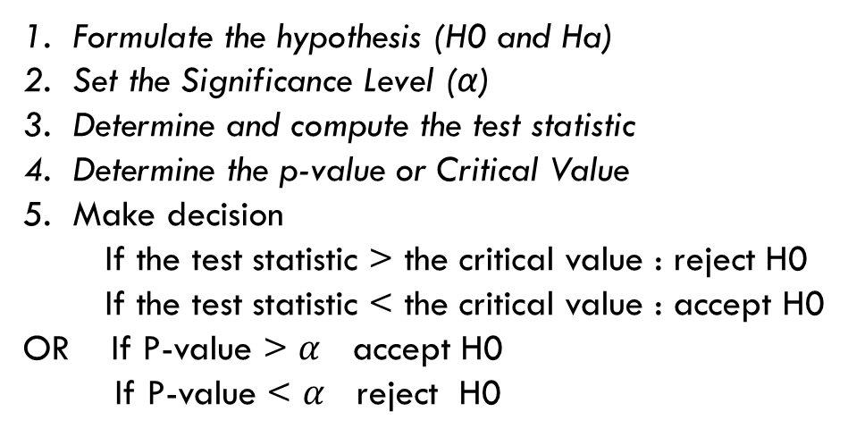
Hypothesis test
Statistic tests
Hypothesis testing is a statistical procedure used to draw conclusion or decision about a population parameter
Hypothesis test steps
Formulate the hypothesis (H0 and Ha)
Set the Significance Level (α)
Determine and compute the test statistic
Determine the p-value or Critical Value
Make decision
If the test statistic > the critical value : reject H0
If the test statistic < the critical value : accept H0
OR If P-value > $α$ accept H0
If P-value < $α$ reject H0

Slide 9
Hypothesis test
Normality test
Normality test is used to test if the variable or the data is issued from a normal distribution
Normal distribution is mandatory if we need to
Quantify the correlation
Study the regression
Apply some statistics tests : T-test, ANOVA test ….

Slide 10
Hypothesis test
Normality test
- Numerical method
1. Hypothesis formulation
H0 : The data issued from the normal distribution
H1 : The data is not issued from the normal distribution
Some frequented tests :
2. Set the Significance Level (α)
Jarque-Bera test
Anderson-Draling test
K-Squared test
Cramér-von Mises creterion,
Kolmogorov- Smirnov test
Shapiro-Wilk test
3. Calculate the test criteria
3. Determine the P-value
3. Make the decision
If P-value > 0.05 accept H0
If P-value < 0.05 reject H0

Slide 11
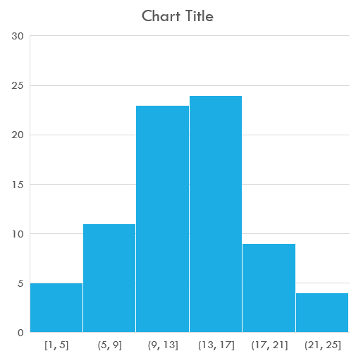
Hypothesis test
Normality test
- Graphical methods
Histogram
If the histogram of the data resemble to the normal distribution shape then the data is normal distributed

Slide 12
Hypothesis test
Normality test
- Graphical methods
2. Quantile - quantile plot (Q-Q plot)
Is a probability plot to assess the normality of the data.
If the theoretical distribution good fit the data then the data is issued from the normal distribution

Slide 13
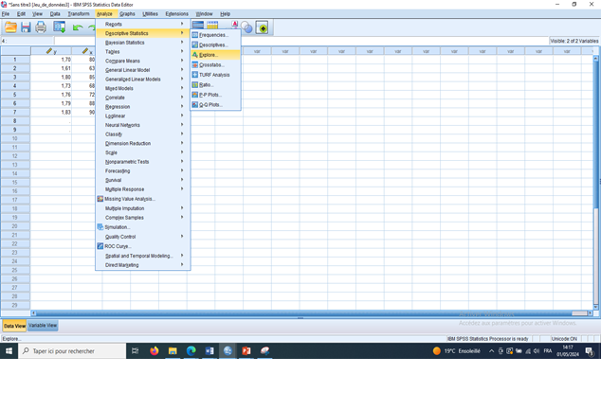
Hypothesis test
Normality test using SPSS
To test the normality of variable on SPSS software we follow the next steps
Analyze > Descriptive Statistics > Explore…

Slide 14
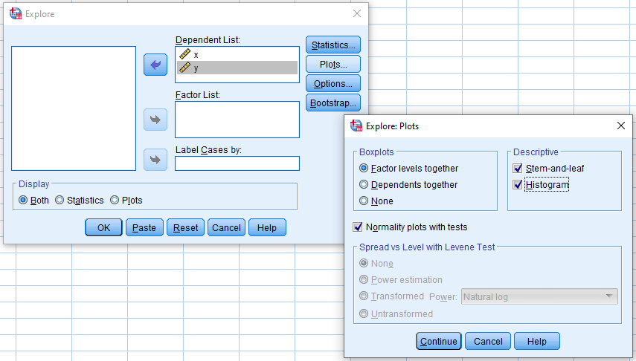
Hypothesis test
Normality test using SPSS
To test the normality of variable on SPSS software we follow the next steps
1
2
Analyze > Descriptive Statistics > Explore…
1- Move the variable needed to test its normality in the right place
2- Click on plot
3- In the appeared window, Check the normality plot with test and Histogram
4- Click continue
5- Clock Ok
3
5
3
4

Slide 15
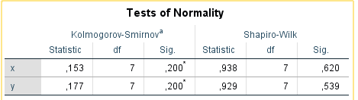
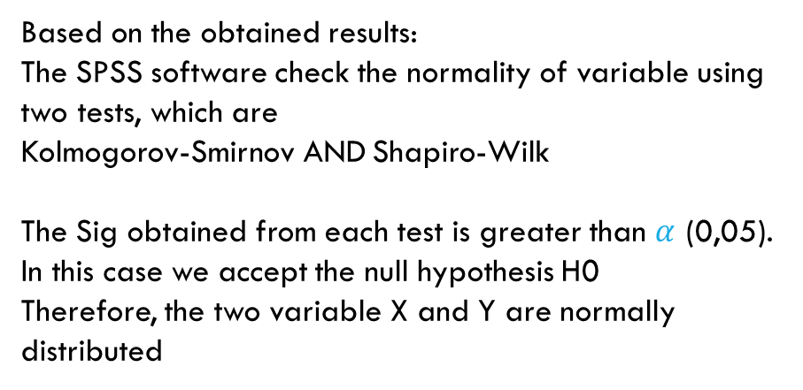
Hypothesis test
Normality test using SPSS
Based on the obtained results:
The SPSS software check the normality of variable using two tests, which are
Kolmogorov-Smirnov AND Shapiro-Wilk
The Sig obtained from each test is greater than $α$ (0,05). In this case we accept the null hypothesis H0
Therefore, the two variable X and Y are normally distributed
Notice
The Sig or the P-value is set by default with the value of 0,05

Slide 16
Hypothesis test
ANOVA test
It is a hypothesis test used to investigate if there is a statistically significant differences between the means of three or more independent groups.
The AVOVA test is used when the following conditions are satisfied:
The population where the samples are drawn, must be normally distributed.
The samples must be independently drawn.

Slide 17
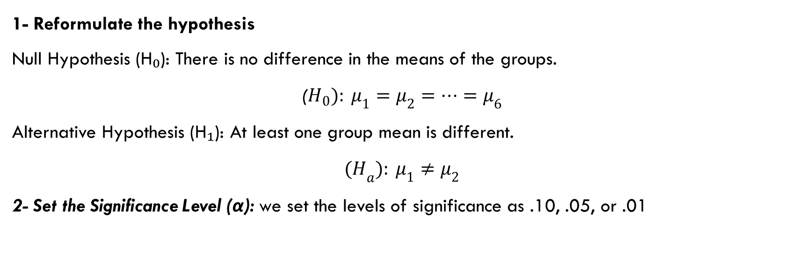
Hypothesis test
Application of ANOVA test
1- Reformulate the hypothesis
Null Hypothesis (H₀): There is no difference in the means of the groups.
($H_{0}): μ_{1}=μ_{2}=…=μ_{6}$
Alternative Hypothesis (H₁): At least one group mean is different.
$${(H}_{a}): μ_{1}≠μ_{2}$$
2- Set the Significance Level (α): we set the levels of significance as .10, .05, or .01

Slide 18
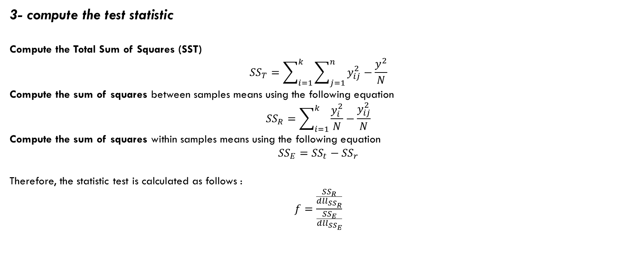
Hypothesis test
Application of ANOVA test
3- compute the test statistic
Compute the Total Sum of Squares (SST)
$${SS}_{T}=\sum_{i=1}^{k}{\sum_{j=1}^{n}{y_{ij}^{2}}}−\frac{y^{2}}{N}$$
Compute the sum of squares between samples means using the following equation
$${SS}_{R}=\sum_{i=1}^{k}{\frac{y_{i}^{2}}{N}}−\frac{y_{ij}^{2}}{N}$$
Compute the sum of squares within samples means using the following equation
$${SS}_{E}={SS}_{t}−{SS}_{r}$$
Therefore, the statistic test is calculated as follows :
$$f=\frac{\frac{{SS}_{R}}{{dll}_{{SS}_{R}}}}{\frac{{SS}_{E}}{{dll}_{{SS}_{E}}}}$$

Slide 19
Hypothesis test
Application of ANOVA test
Make a decision
Based on the critical F-value
we compare the calculated F-value with the critical F-value determined by the degrees of freedom (df₁, df₂) and the chosen significance level (α). If the calculated F-value is less than the critical F-value, we fail to reject the null hypothesis. Otherwise, we reject the null hypothesis.
Based on p-value
If p-value ≤ significance level (α) : reject the null hypothesis
If p-value > significance level (α) fail to reject the null hypothesis

Slide 20
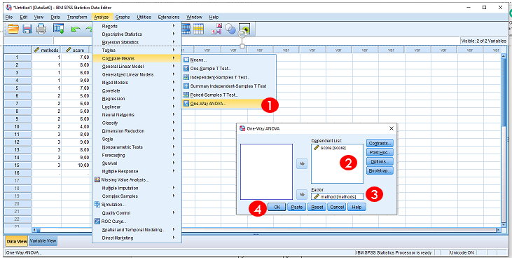
Hypothesis test
Application of ANOVA test in SPSS
To perform the ANOVA test we perform the next steps:
Analyze > Compare means > One-Way ANOVA
Move the dependent variable (e.g., score) into the Dependent Lis
Move your grouping variable (e.g., method) into the Factor box
Clock Ok

Slide 21
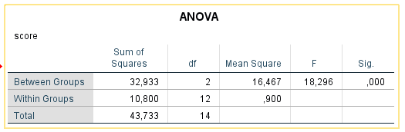
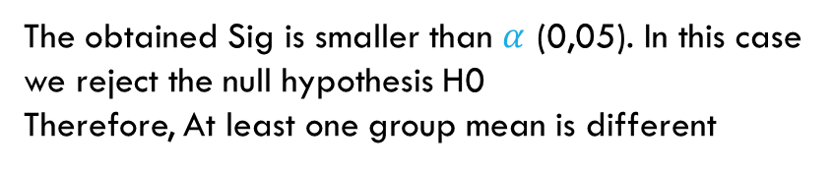
Hypothesis test
Application of ANOVA test in SPSS
The SPSS software generate the following results
The obtained Sig is smaller than $α$ (0,05). In this case we reject the null hypothesis H0
Therefore, At least one group mean is different
Notice
The Sig or the P-value is set by default with the value of 0,05

Slide 22
Practice
…

Slide 23
practice
Exercise 1
You collected exam scores from 10 students:
Scores: 72, 75, 78, 74, 77, 76, 73, 79, 74, 75
Check the normality of scores
Exercise 2
Suppose you collected the amount of water consumed per day (in litres) by 10 people.
Water Consumption (litres): 3.2, 3.5, 3.3, 7.8, 8.1, 7.9, 3.4, 3.3, 7.5, 8.0
Check the normality of the water consumption variable.

Slide 24
Exercise 3
Perform a one-way ANOVA on this dataset comparing three waste collection methods (1=Door-to-door, 2=Drop-off, 3=Private firm) based on satisfaction scores.
Method (Group) | Score
1 | 7
1 | 8
1 | 6
1 | 9
1 | 7
2 | 5
2 | 6
2 | 5
2 | 6
2 | 4
3 | 8
3 | 9
3 | 8
3 | 9
3 | 10

Slide 25
Exercise 4
Is there a significant difference in citizen satisfaction with public parks across three urban districts
ID | District | Satisfaction
1 | District A | 7.2
2 | District A | 6.8
3 | District A | 7.5
4 | District B | 6.1
5 | District B | 5.8
6 | District B | 6.3
7 | District C | 5.2
8 | District C | 5.5
9 | District C | 5.0

