Slide 1
SIMPLE TISSUES
EPIDERMAL TISSUES

Slide 2
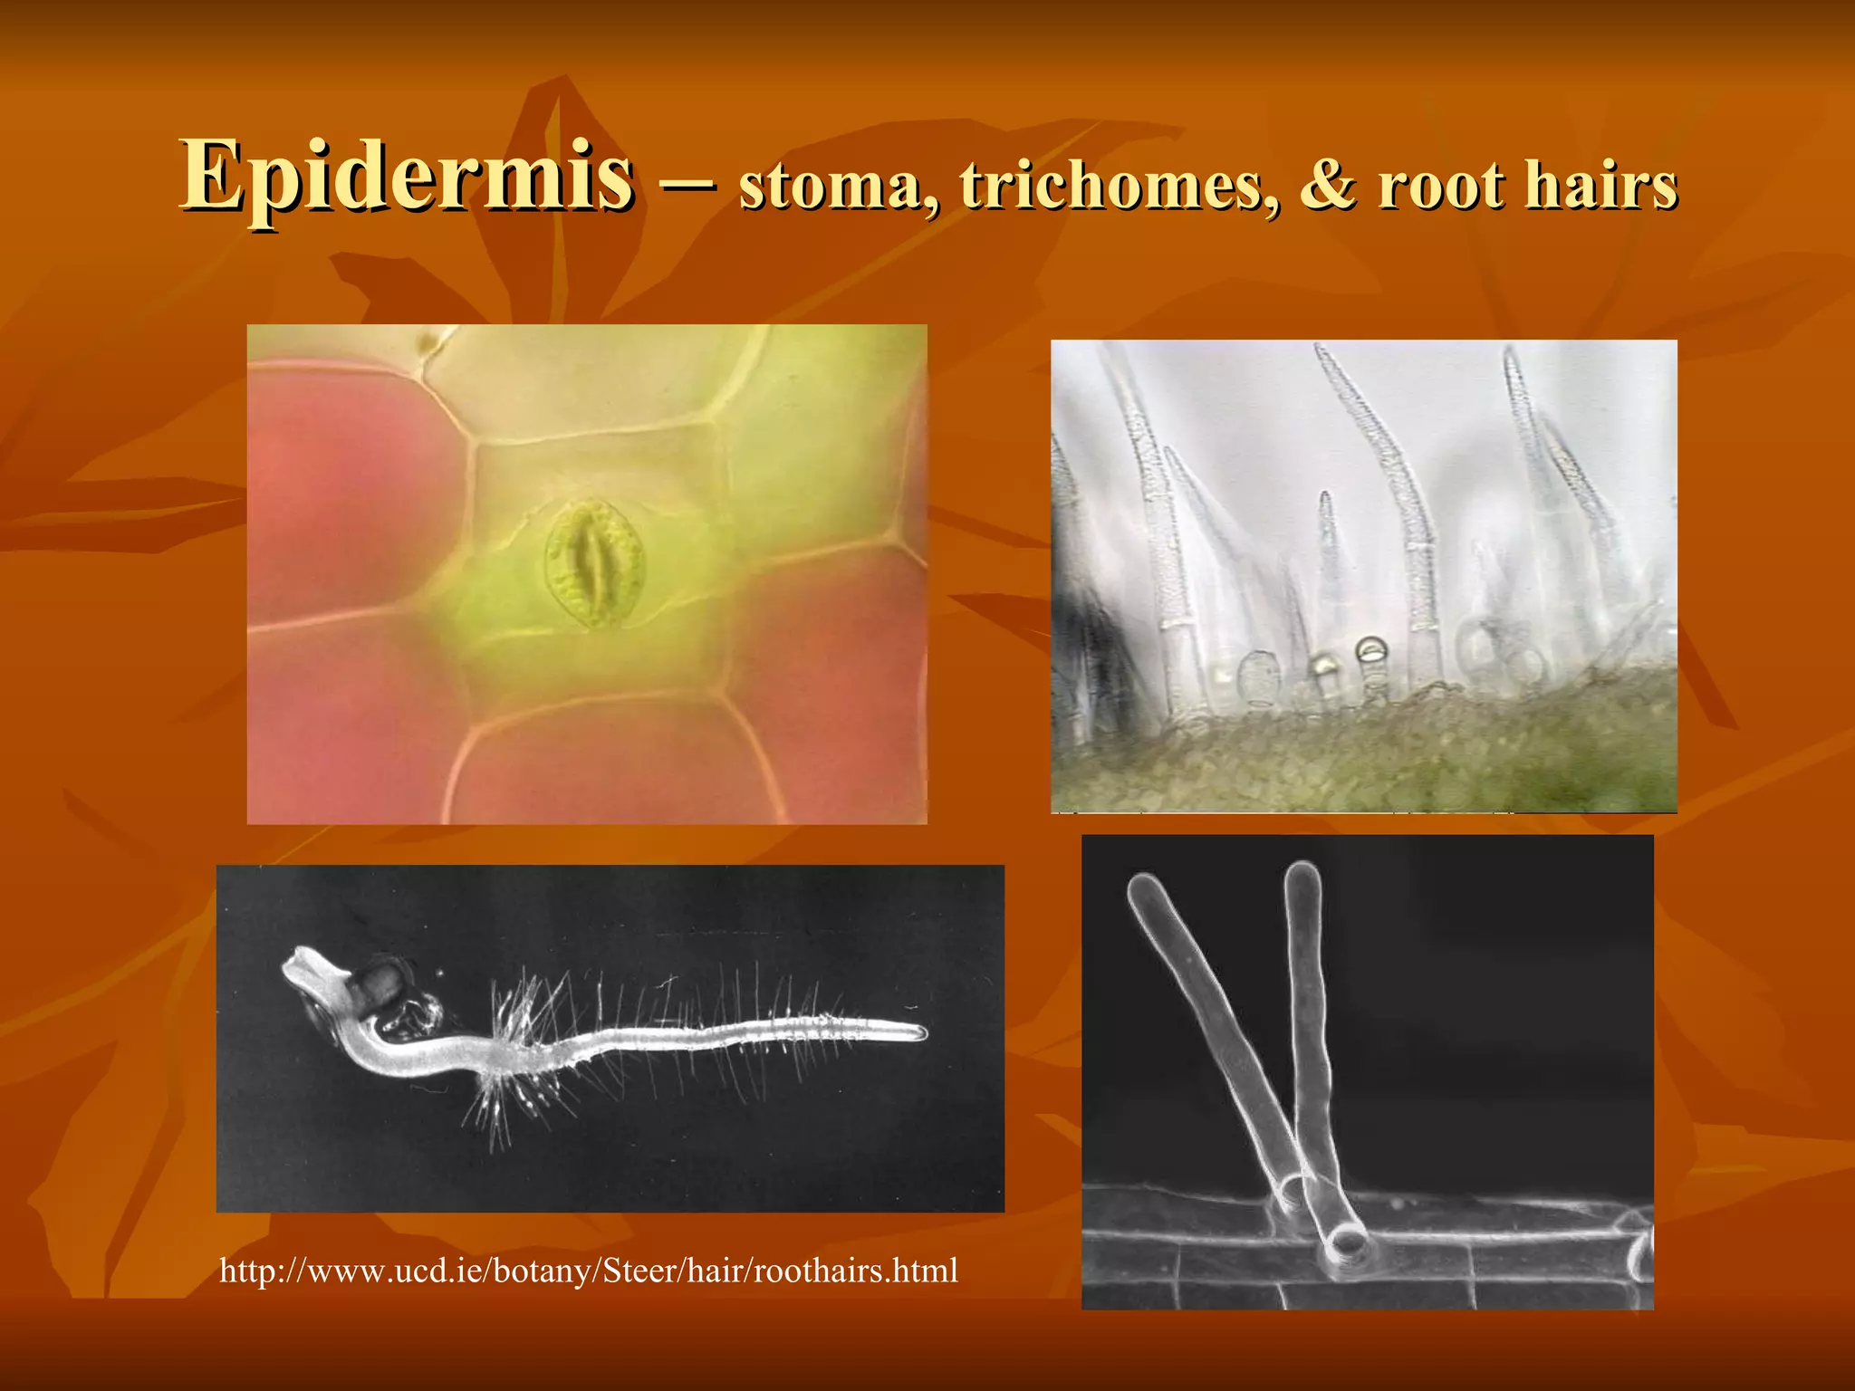

Slide 3
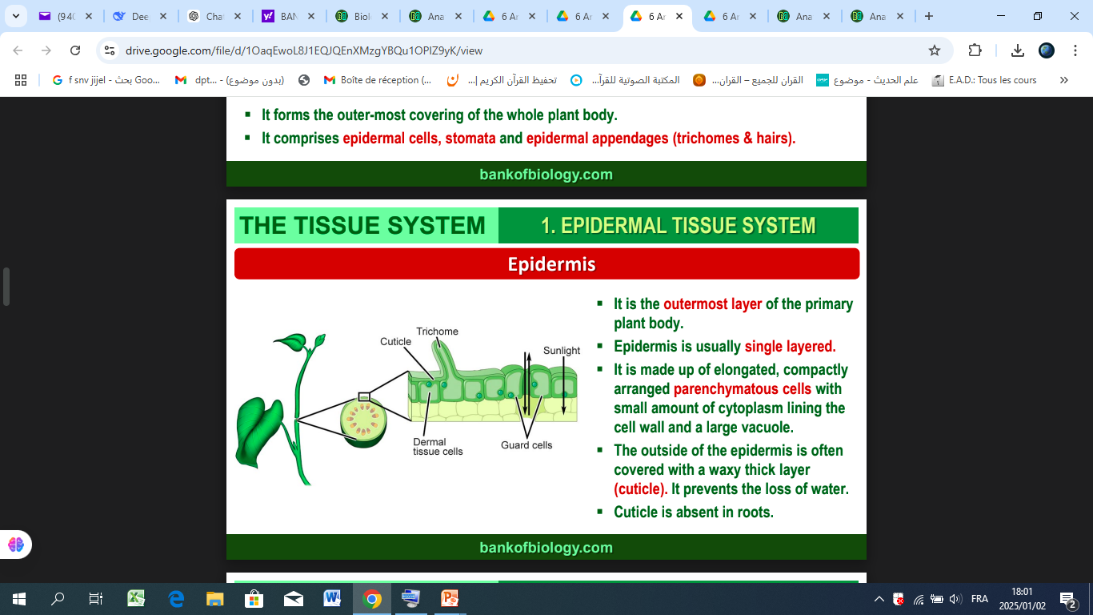
الادمة
الادمة

Slide 4
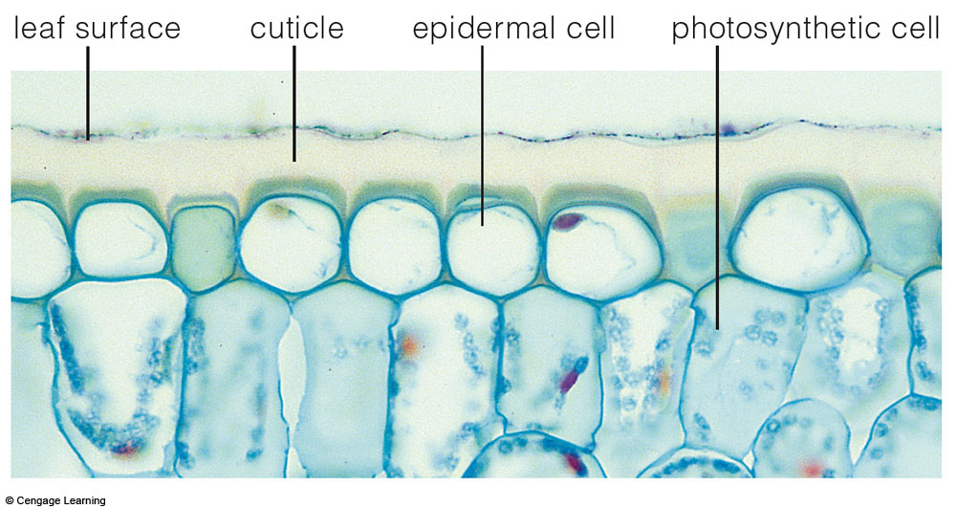
Epidermis
سطح الورقة
الادمة
خلايا البشرة
خلايا يخضورية

Slide 5
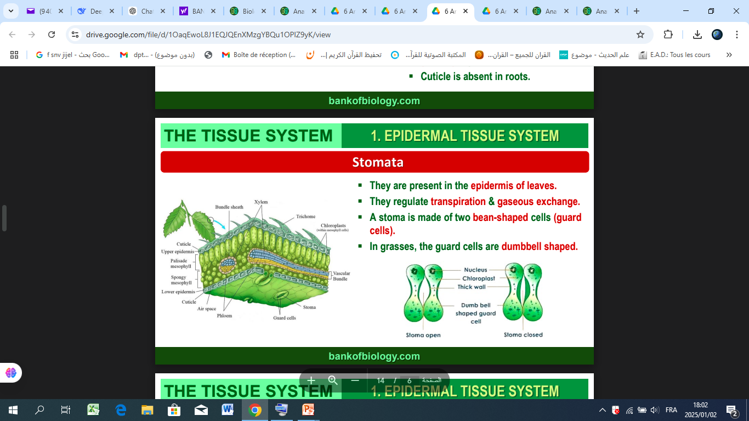

Slide 6
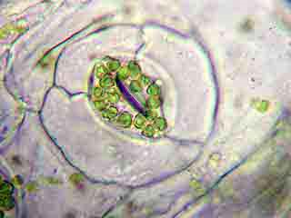
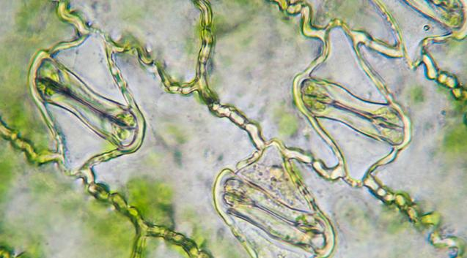
The stomata of dicotyledons (dicots) are described as bean-shaped OR reniform كلوي
hypostomatic distribution, with most stomata located on the lower surface of leaves,
خلايا البشرة
Guard Cells
الخلايا الحارسة بداخلها صانعات
الخلايا الثانوية (Subsidiary Cells
الخلايا المساعدة
amphistomatic, meaning they are found on both the upper and lower epidermis of leaves.
dumbbell-shaped guard cellsالصولجاني

Slide 7
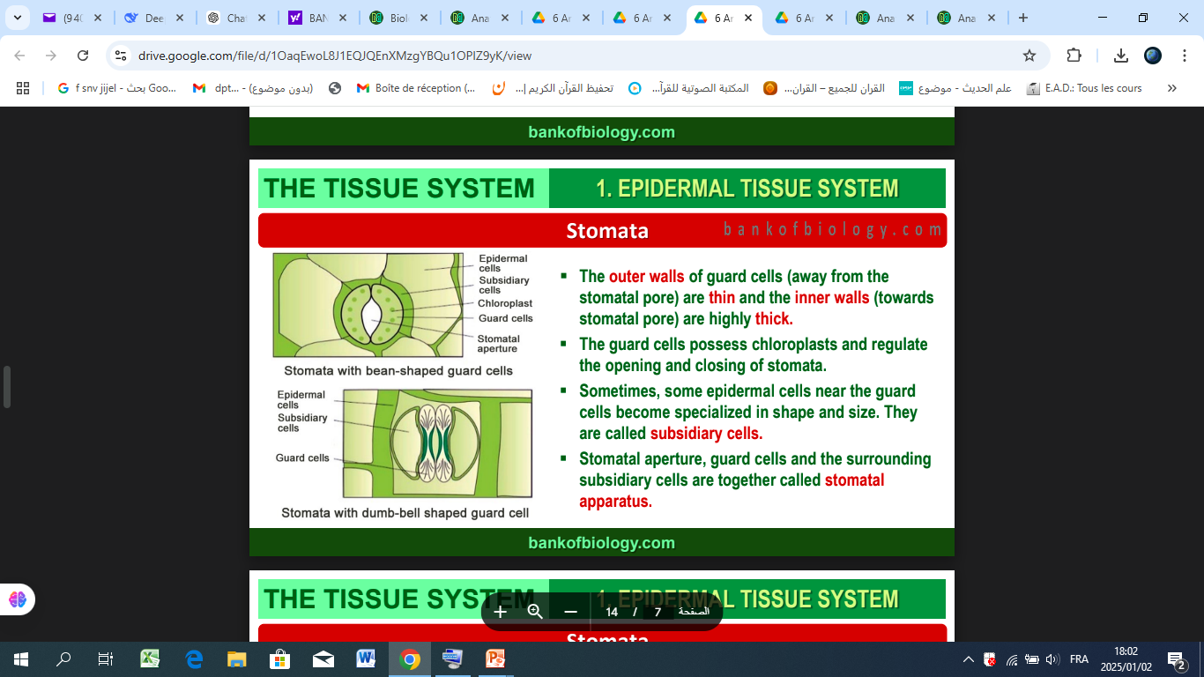
الخلايا المساعدة
الجهاز الثغري

Slide 8
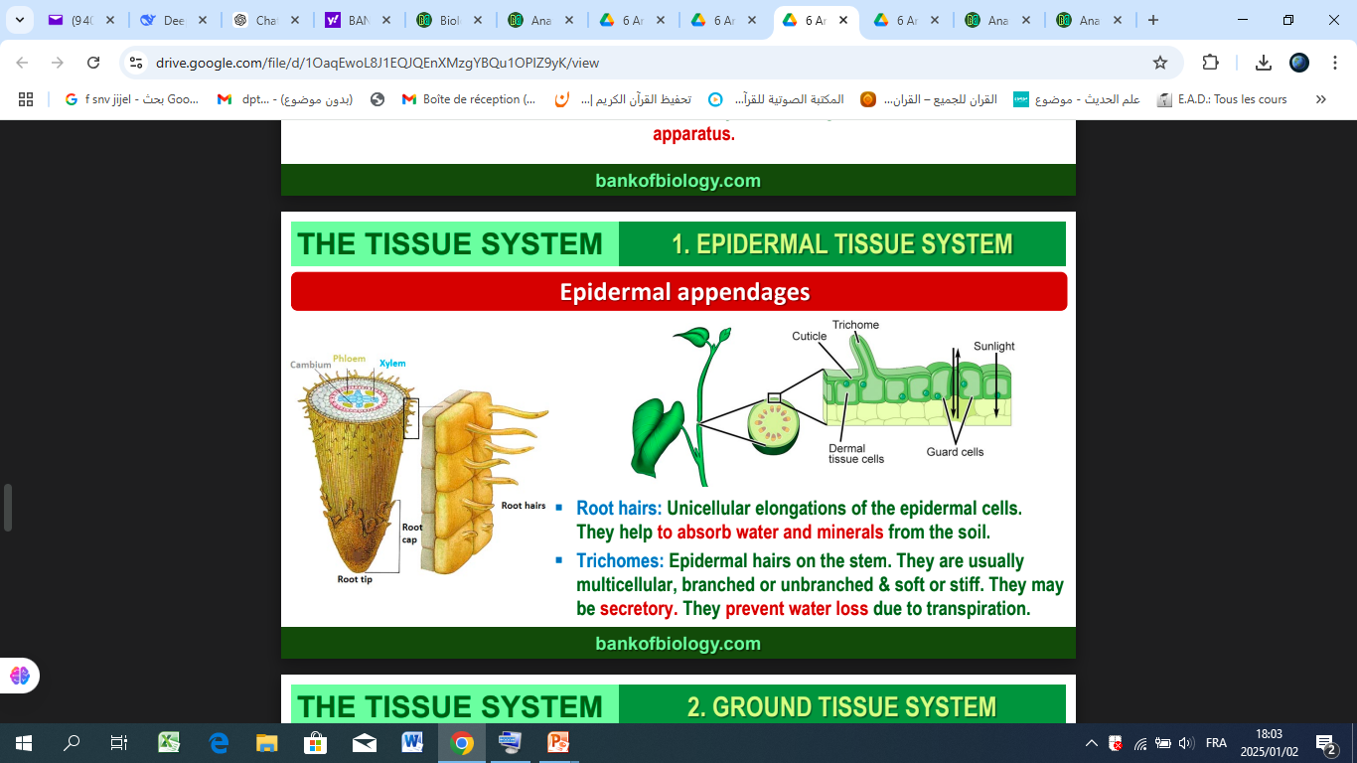

Slide 9
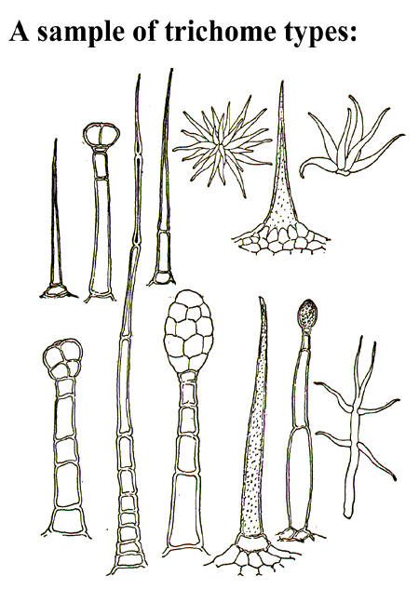
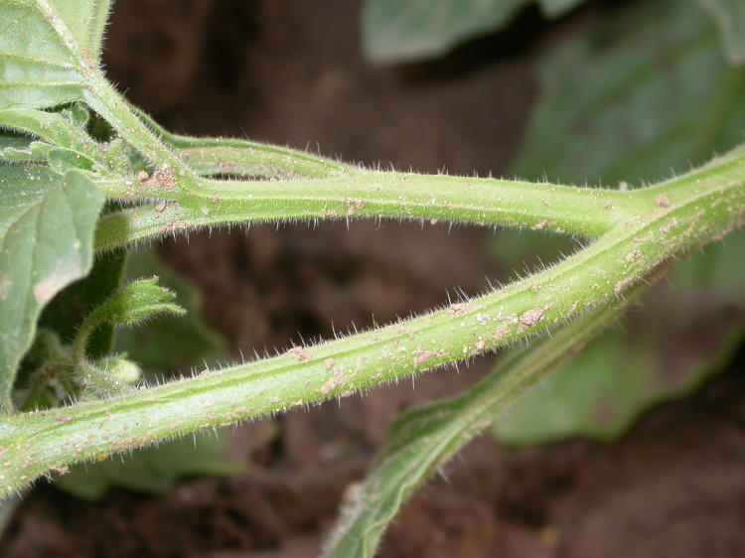
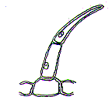
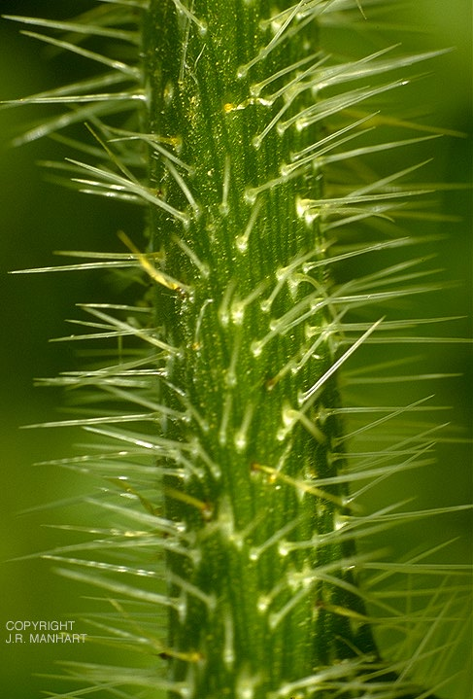
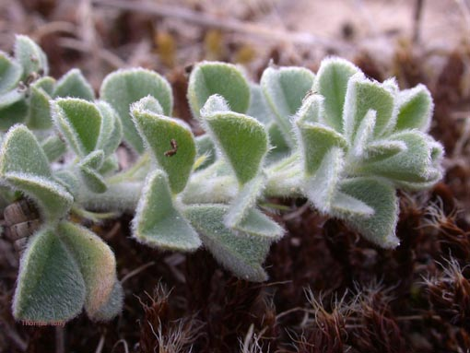
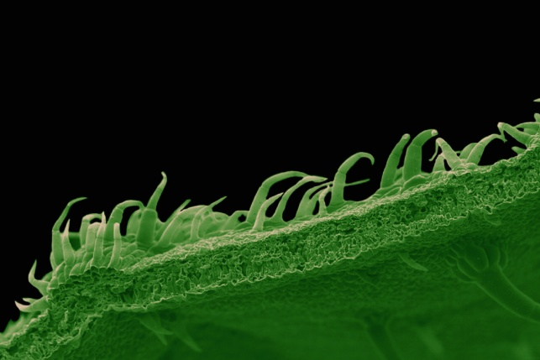
Trichomes are small outgrowths that emerge from the epidermis of plants, formed by modified epidermal cells. They can be either unicellular or multicellular and vary in their shapes and functions.

Slide 10
Complex tissues

Slide 11
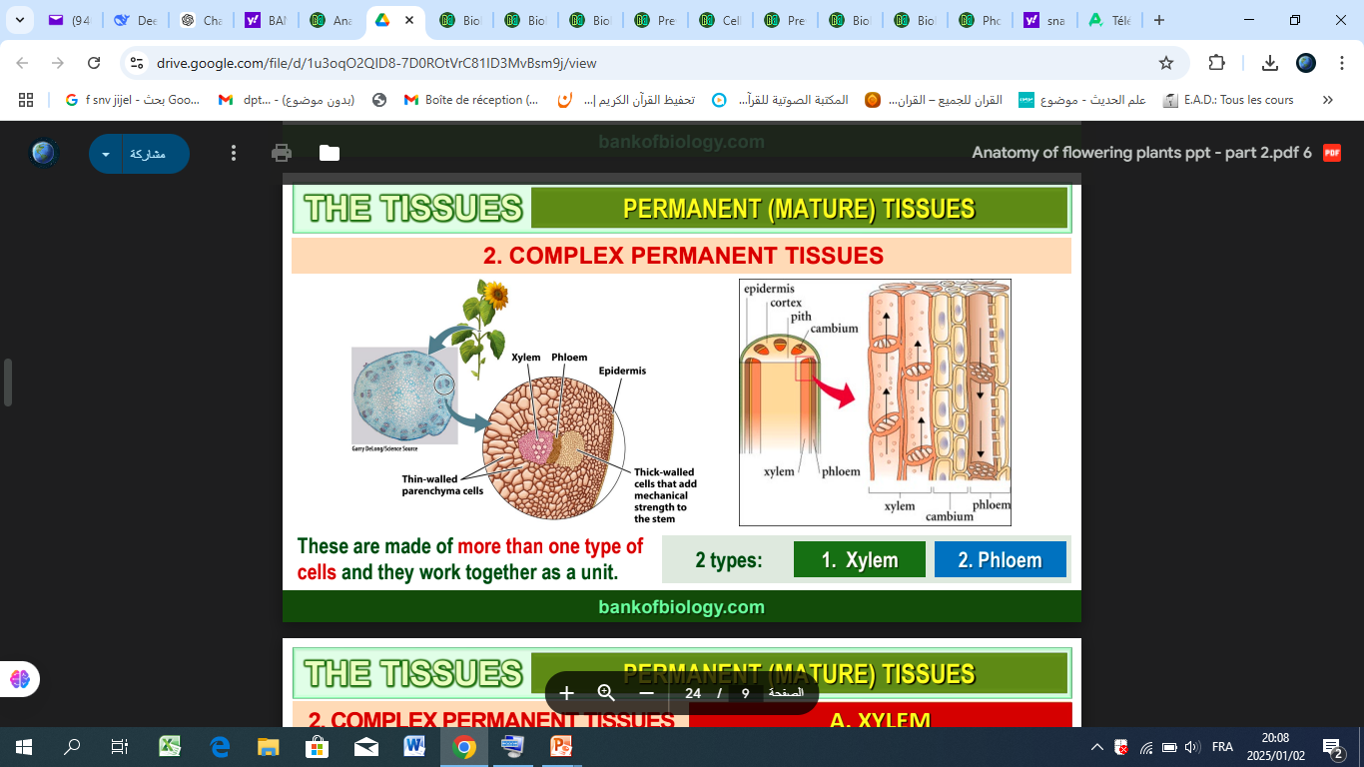

Slide 12
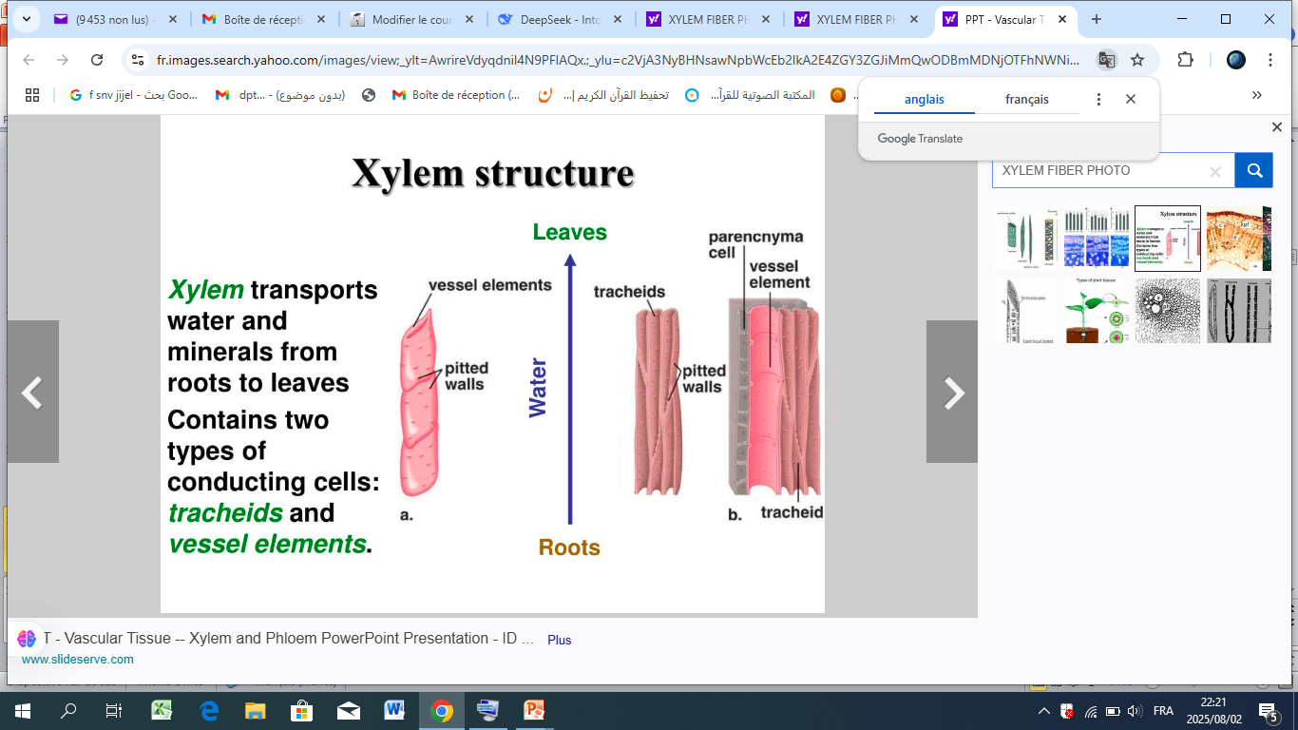

Slide 13
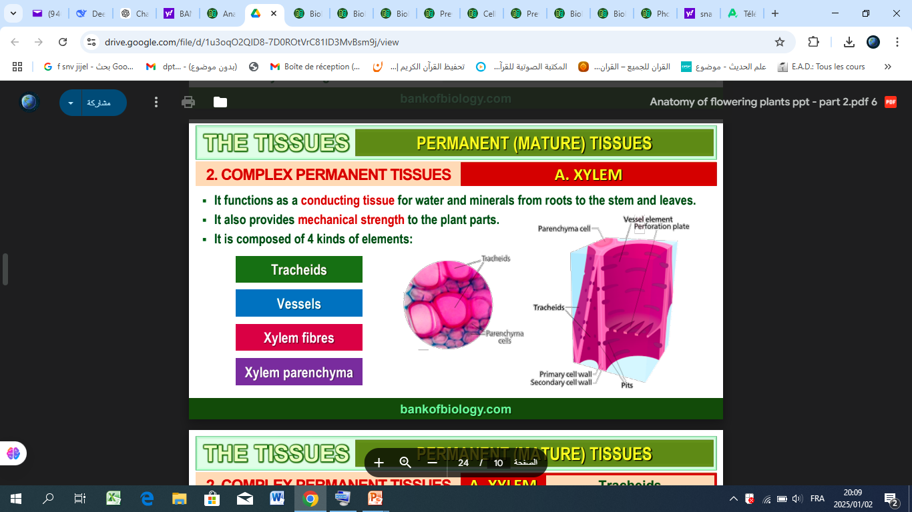
القصيبات
الاوعية
الياف الخشب
برانشيم خشبي

Slide 14
VESSELS AND TRACHEIDS
الاوعية و القصيبات

Slide 15
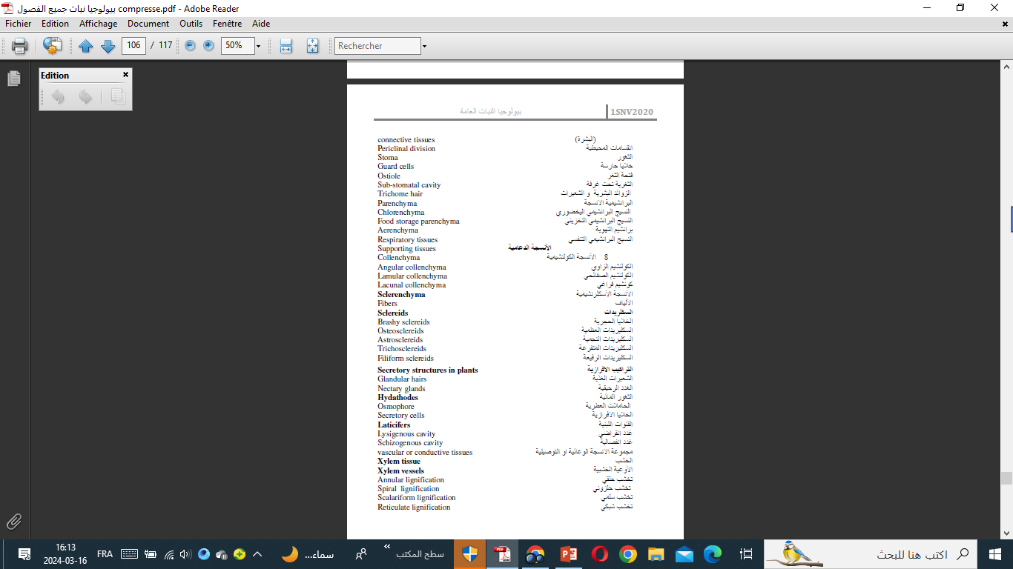

Slide 16
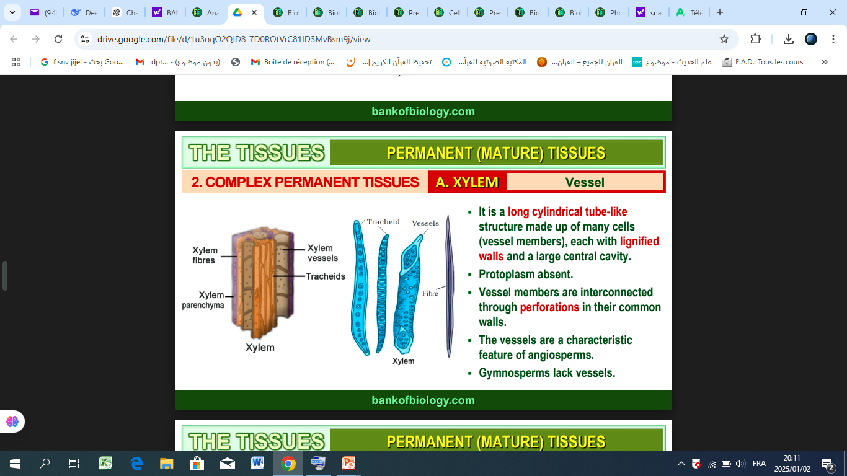
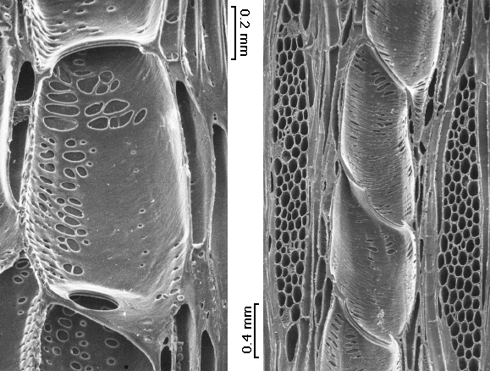
Vessels وعاء الخشبى
PITSنقر
صفيحة مثقبة
Perforated Plate

Slide 17
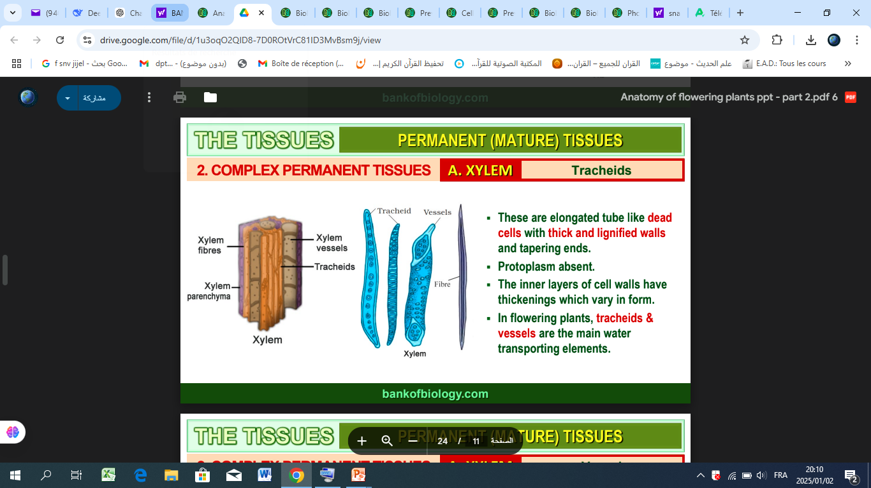
قصيباتtracheids
PARENCHYMA

Slide 18
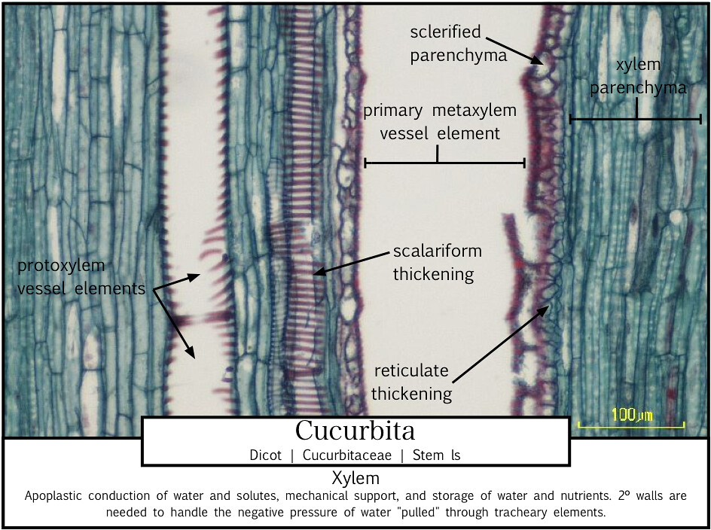

Slide 19
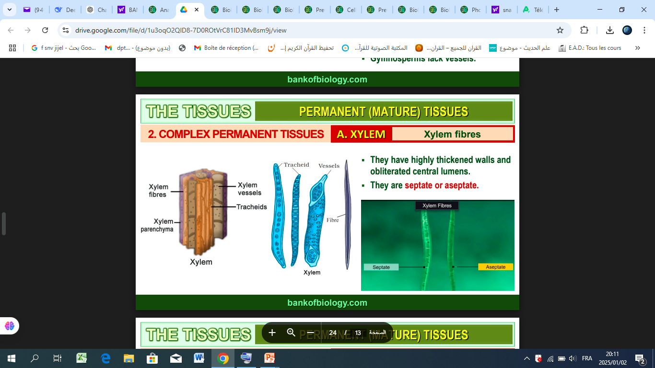

Slide 20
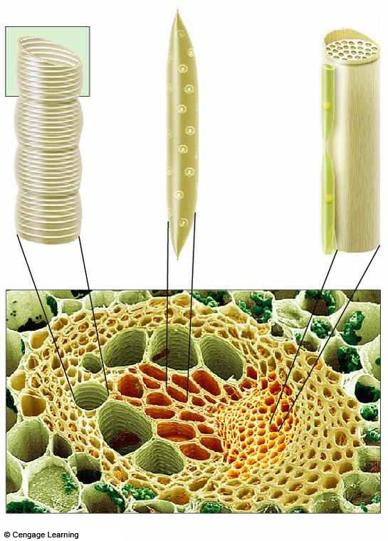
one
cell’s
wall
sieve plate
of sieve
tube cell
pit in
wall
companion
cell
parenchyma
fibers of
sclerenchyma
vessel
of xylem
phloem
Fig. 26.8, p.429

Slide 21
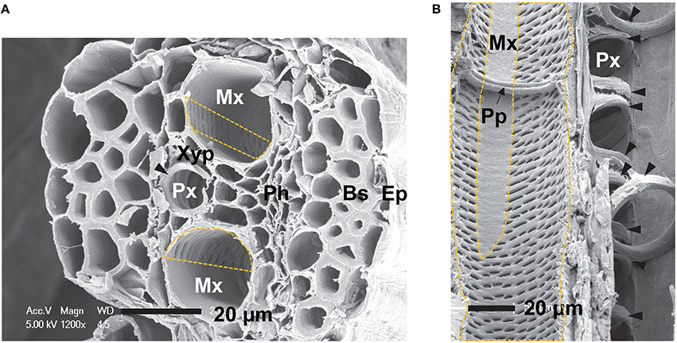
maize (Zea mays L.). (A) Transverse section of a maize sheath, showing a protoxylem (Px) vessel with secondary wall thickenings (filled arrowheads) and two metaxylem (Mx) vessels with pits distributed in a nonuniform manner (dashed box). (B) Longitudinal section of a maize leaf, showing protoxylem and metaxylem vessels with a single perforation plate (Pp). Ep, epidermis; Bsf, bundle sheath fiber; Ph, phloem; Mx, metaxylem vessel; Px, protoxylem vessel; Xyp, xylem parenchyma cell; Pp, perforation plate. Scale bar = 20 μm

Slide 22
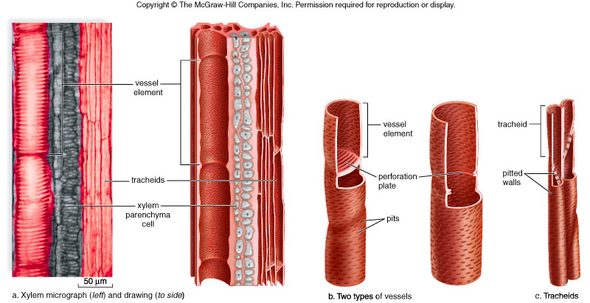
Xylem structure
longitudinal cut
الاوعية
الاوعية
القصيبات
القصيبات
النقر
البرانشيم

Slide 23
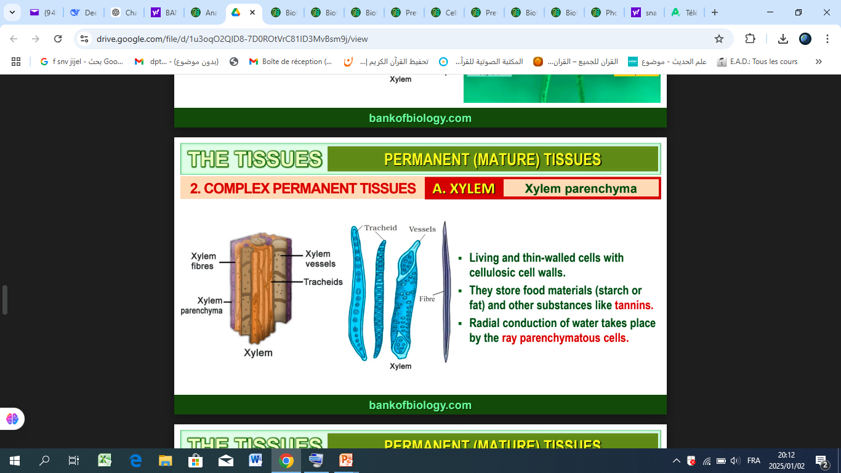

Slide 24
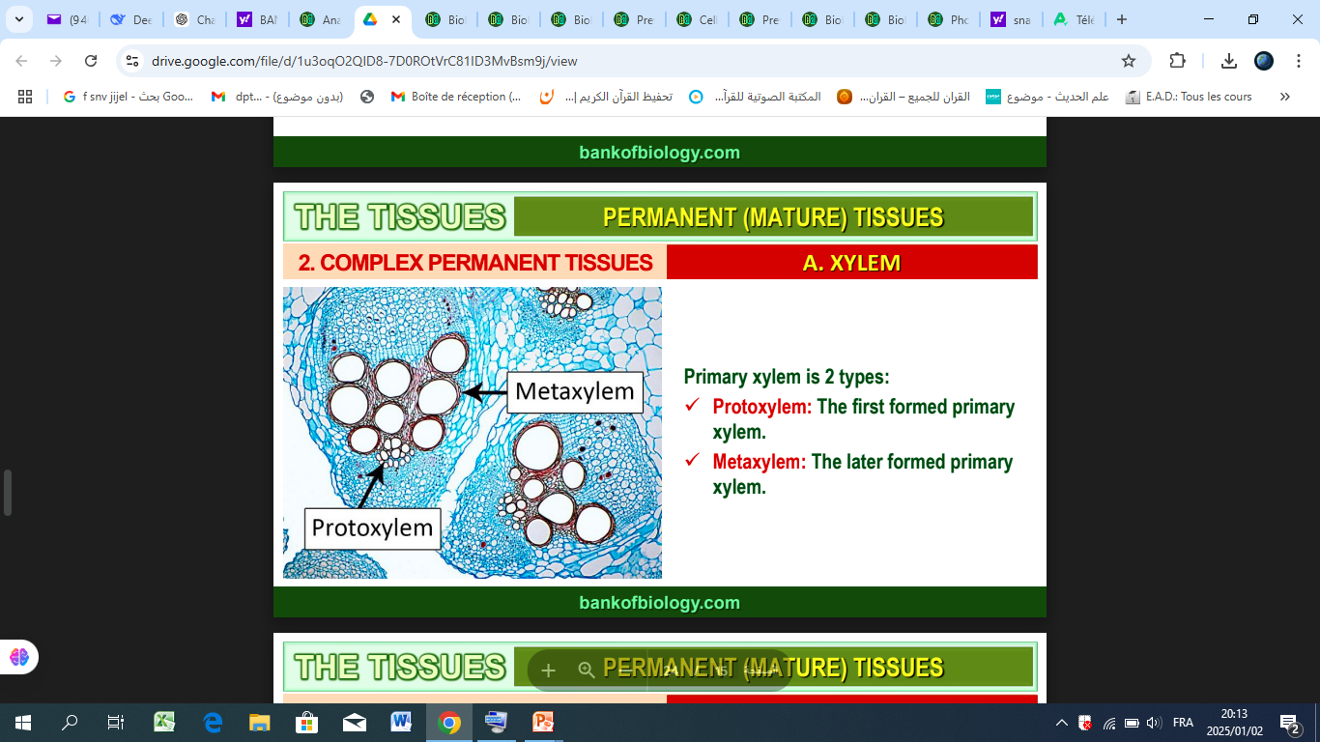

Slide 25
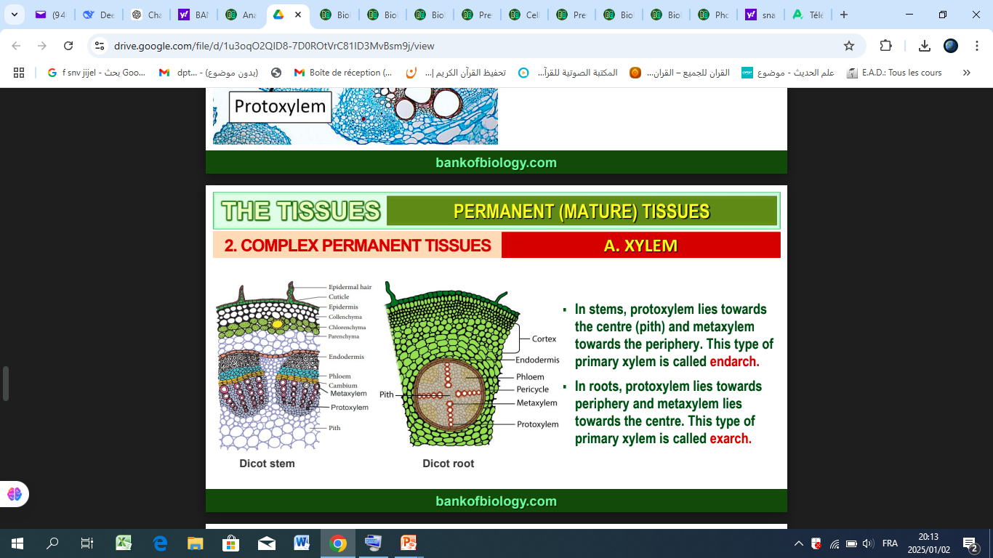

Slide 26
Vascular bundles kinds
انواع الحزم الوعائية

Slide 27
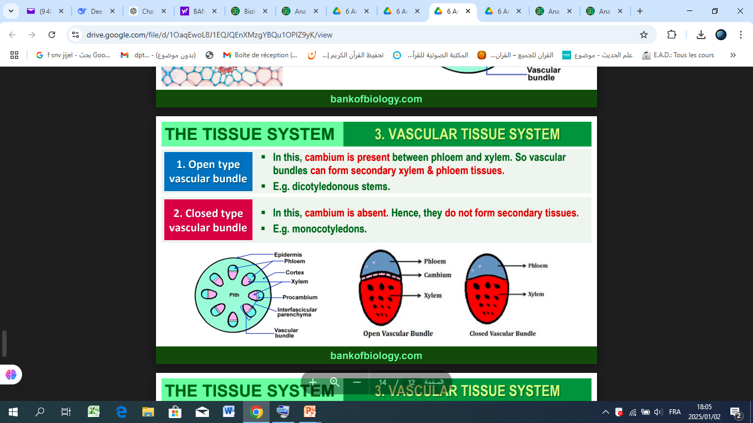

Slide 28
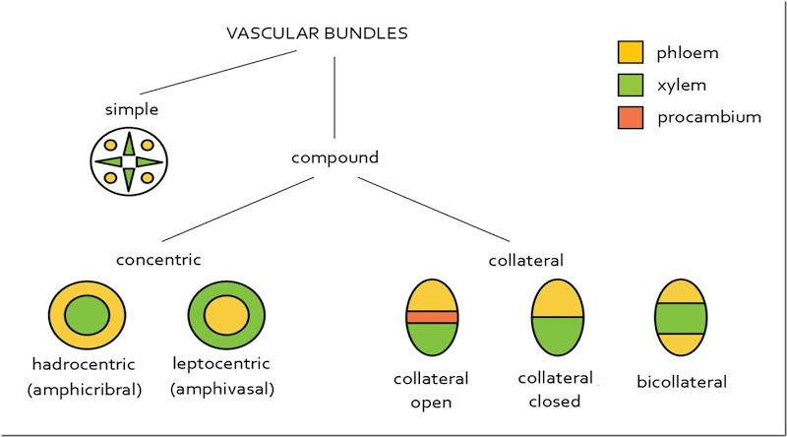
Types of vascular bundles in plants

Slide 29
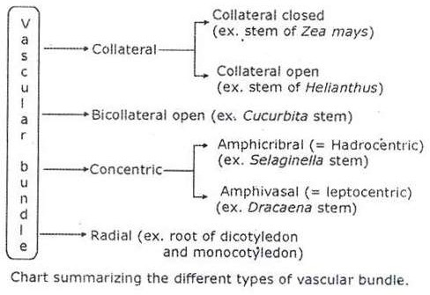
جانبية مغلقة
جانبية
جانبية مفتوحة
ثنائية الجانب
مركزية
القطرية

Slide 30
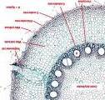
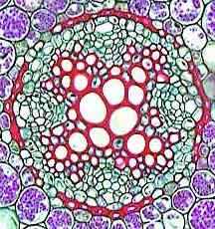
الحزم الوعائية Vascular bundles
The vascular bundle consists of a phloem mass and a xylem arm. There are three main types of vascular bundles that differ in the arrangement of xylem and phloem within the bundle. These types are :
1- الحزم القطرية Radial bundles: n this type of vascular bundle, the phloem masses and xylem arms are arranged on alternating radii, similar to the vascular bundles in the roots of most flowering plants. The vascular bundle consists of a phloem mass on one radius and a xylem arm on the adjacent radius.
جزء من الأسطوانة الوعائية فى جذر من ذوات
الفلقة الواحدة
الأسطوانة الوعائية فى جذر من ذوات الفلقتين

Slide 31
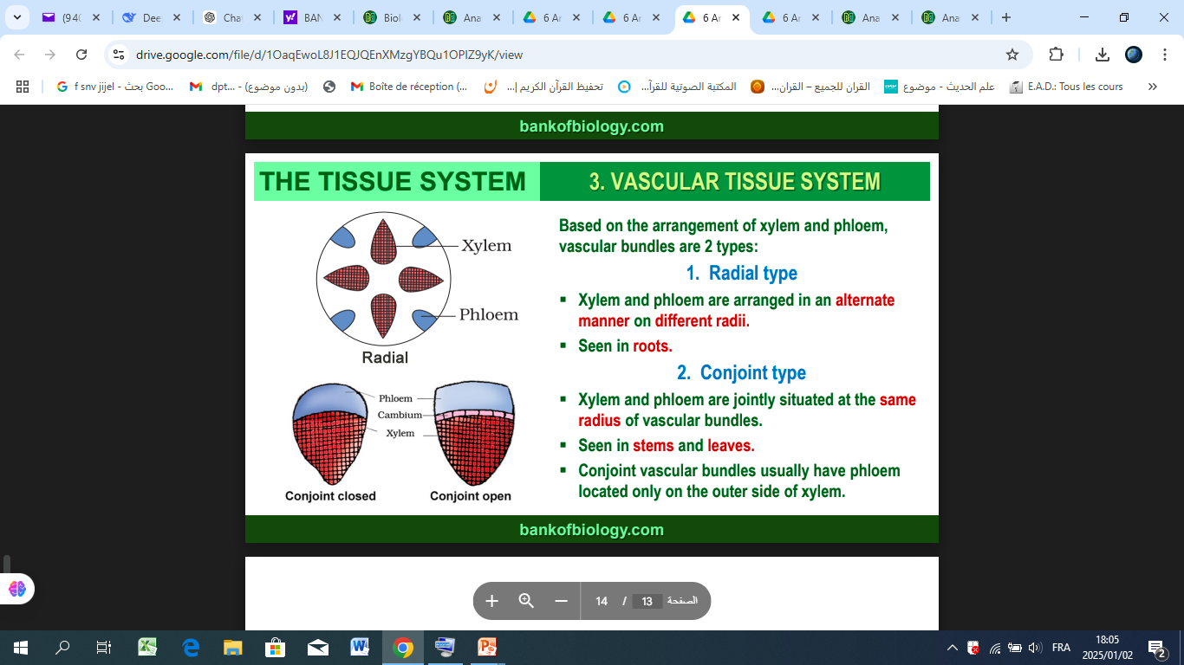

Slide 32

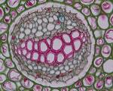
  2- الحزم المركزية Concentric bundles : "In this type, one of the vascular tissues is located at the center of the bundle, while the other tissue completely surrounds it. There are two types
أ- حزم مركزية اللحاء Amphivasal: In this type, the phloem is at the center of the bundle, surrounded by the xylem from the outside, as seen in the stem of Dracaena."
ب- حزم مركزية الخشب Amphicribal: In this type, the xylem is at the center of the bundle, surrounded by the phloem from the outside, as seen in the rhizomatous stems of Adiantum (Maidenhair fern).".
حزم مركزية اللحاء Amphivasal
حزم مركزية الخشب Amphicribal

Slide 33
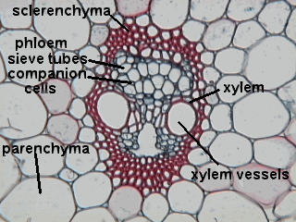


3- الحزم الجانبية Collateral bundles: "In this type, both the phloem and xylem are located on the same radius, as in stem bundles. There are three types :-
  أ- حزم جانبية مفتوحة Opened collateral bundles : In this type, a fascicular cambium tissue is present between the xylem and phloem, as seen in the stems of dicotyledonous plants
ب- حزم جانبية مقفولة Closed collateral bundles: In this type, there is no fascicular cambium tissue separating the xylem and phloem, as seen in the stems of monocotyledonous plants..
ج- حزم وعائية ذات جانبين (ذات لحائين) Bicollateral bundles: In this type, the xylem is located between two phloem tissues—one external, which may be separated from the xylem by fascicular cambium, and one internal, which is not separated from the xylem by cambium. These bundles are found in the stems of pumpkin, loofah, and some plants from the Cucurbitaceae and Solanaceae families
حزم وعائية ذات جانبين
حزم جانبية مقفولة
حزم جانبية مفتوحة

Slide 34
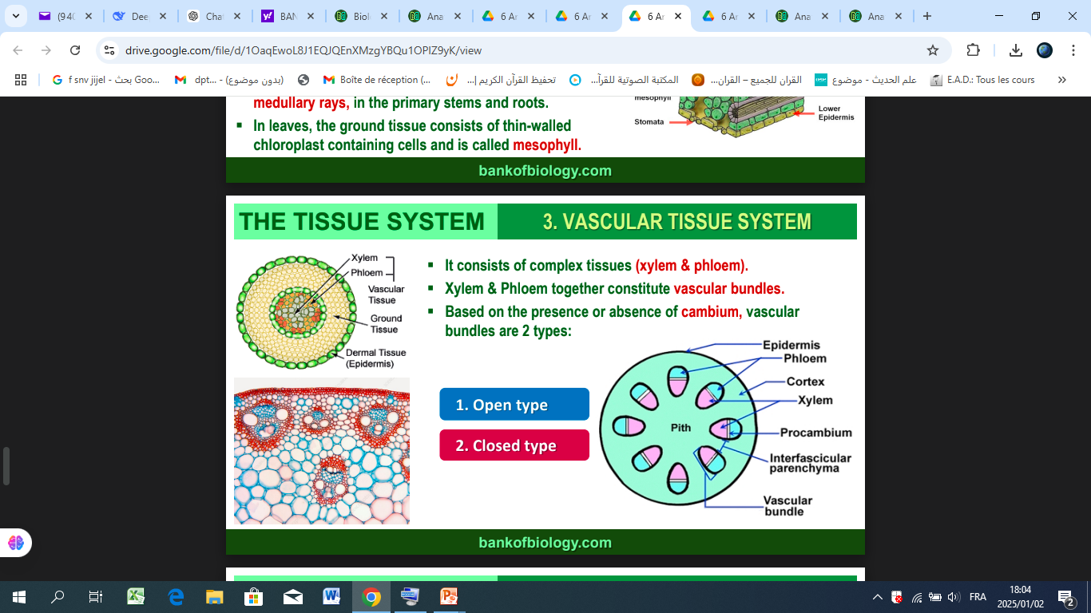

Slide 35
Vessels differenciation from cambium

Slide 36
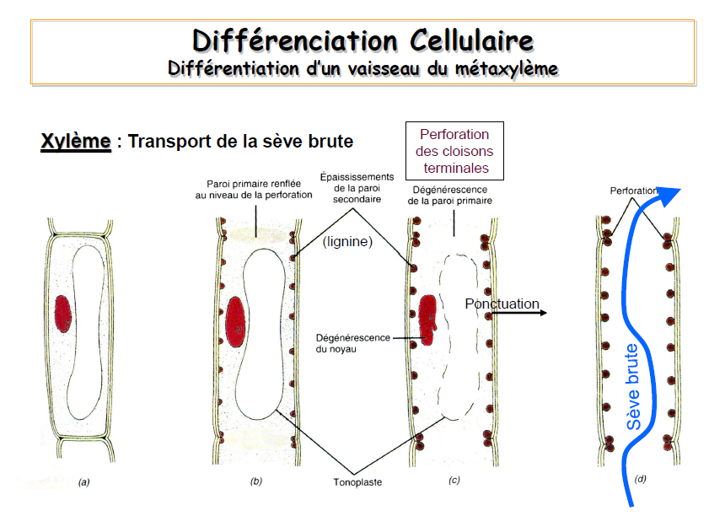
تمايز الكامبيوم
wall thickening
wall perforation
Deposition of lignine
تغلظ الجدر الثانوية
ظهورثقوب في الجدر العرضية
الخشب
ترسب الخشبين
زوال الفجوة و النواة
Disappearance of vacuole

Slide 37
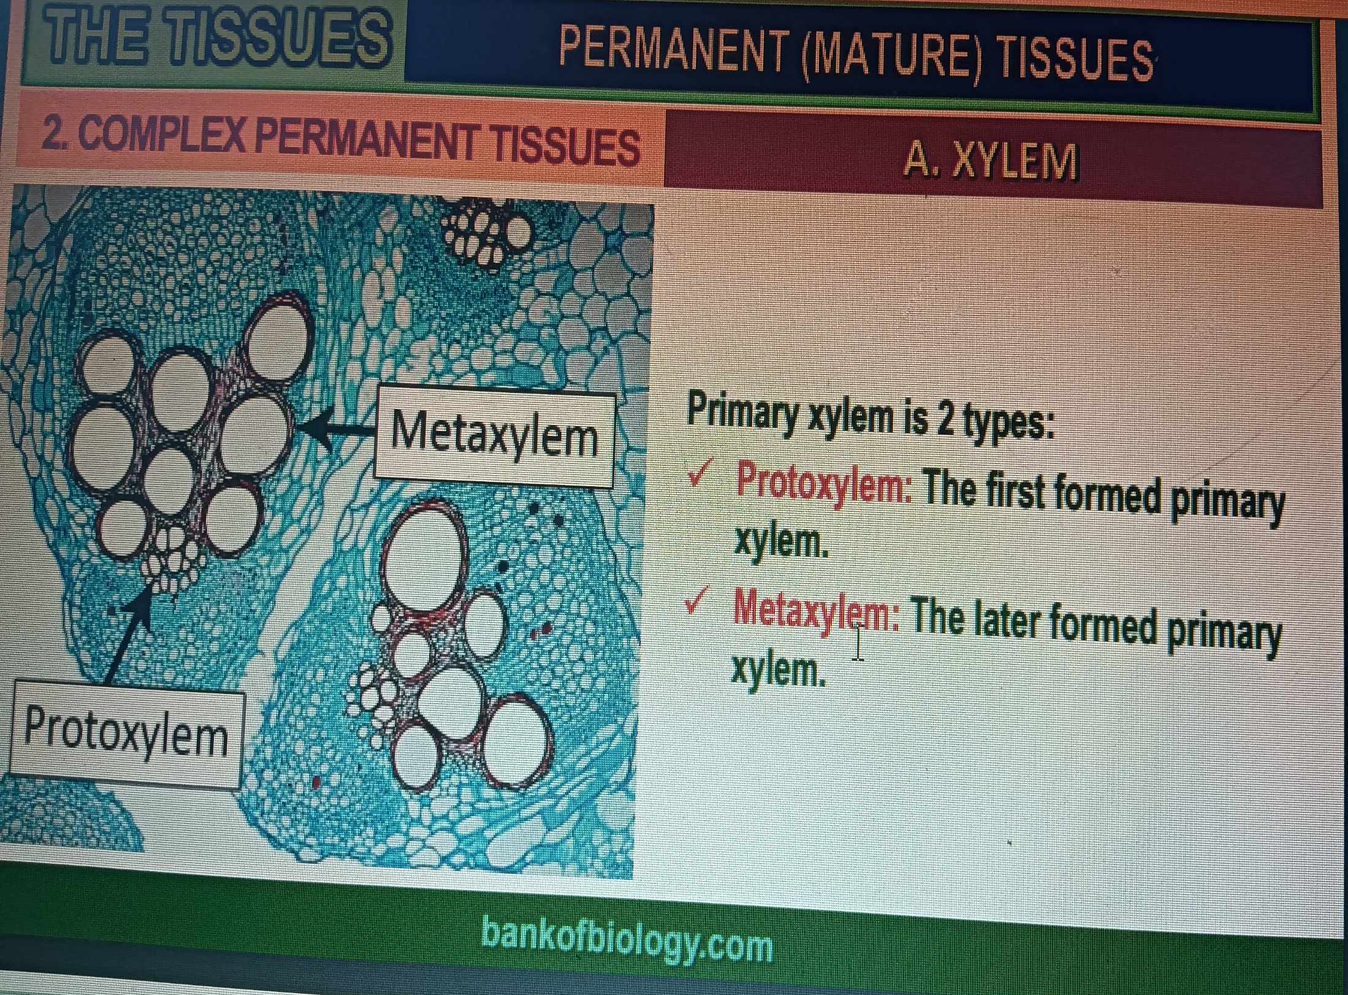

Slide 38
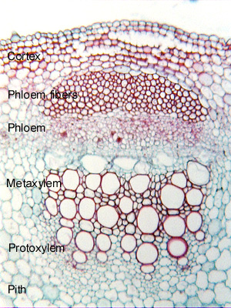

Slide 39
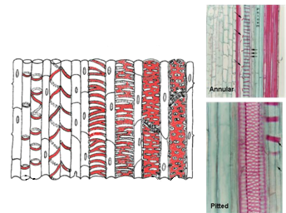
تركيب الجدار الثانوى ونظم ترسيبه فى اوعية الخشب
.
composition of the secondary wall and its deposition systems in wood vessels in longitudinal section
الحلزوني
السلمي
الحلقي
السلمي
الشبكي
المنقر
الشبكي
المنقر
Annular
Spiral
Scalariform
Reticulate
Pitted
الخشب الاول
الخشب التالي
Protoxylem vessels
Metaxylem vessels

Slide 40
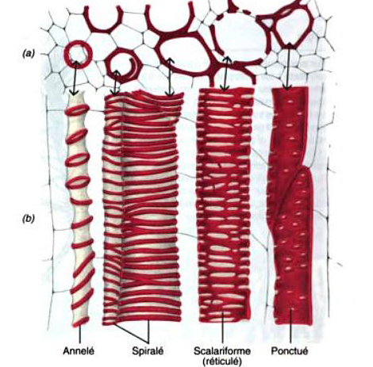

Slide 41
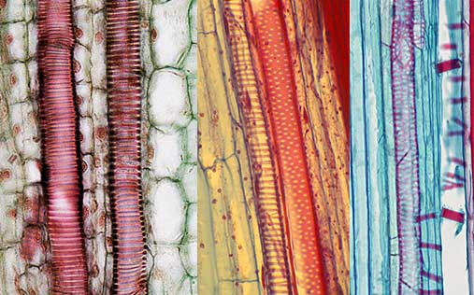

Slide 42
2-Phloem

Slide 43
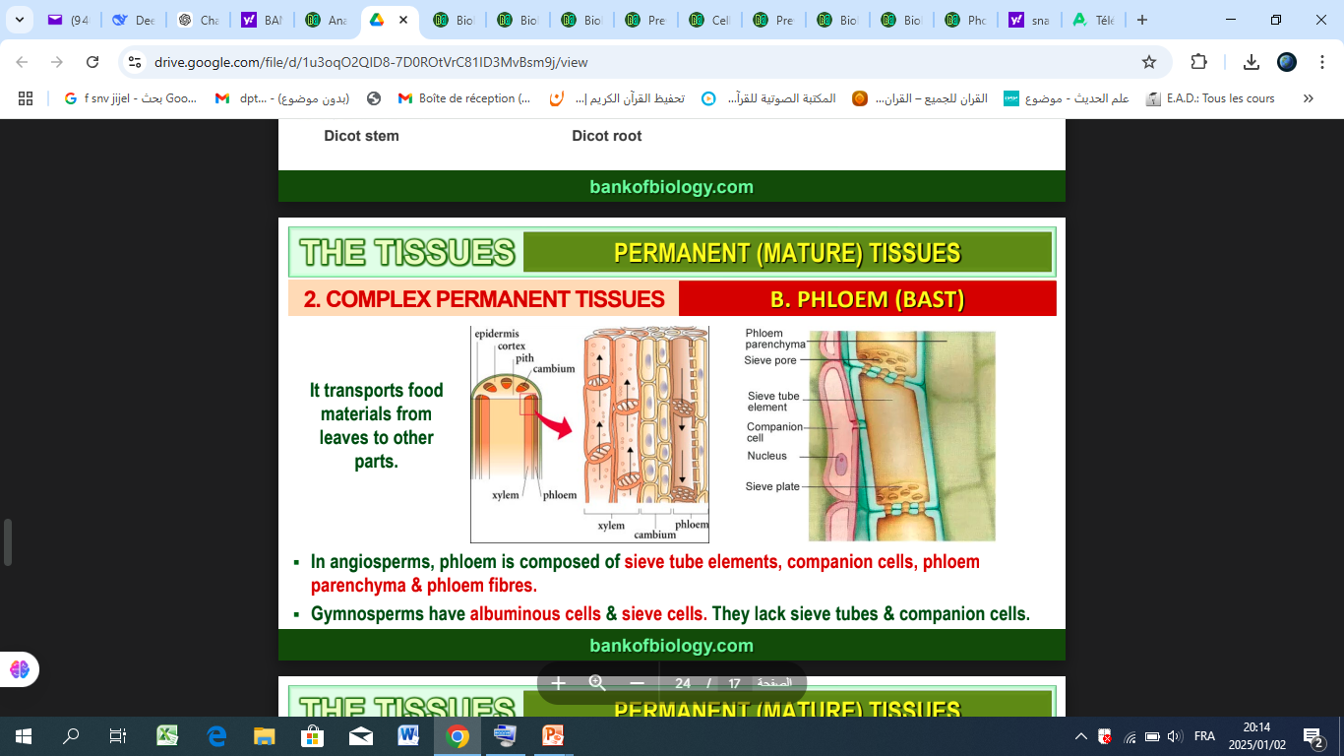

Slide 44
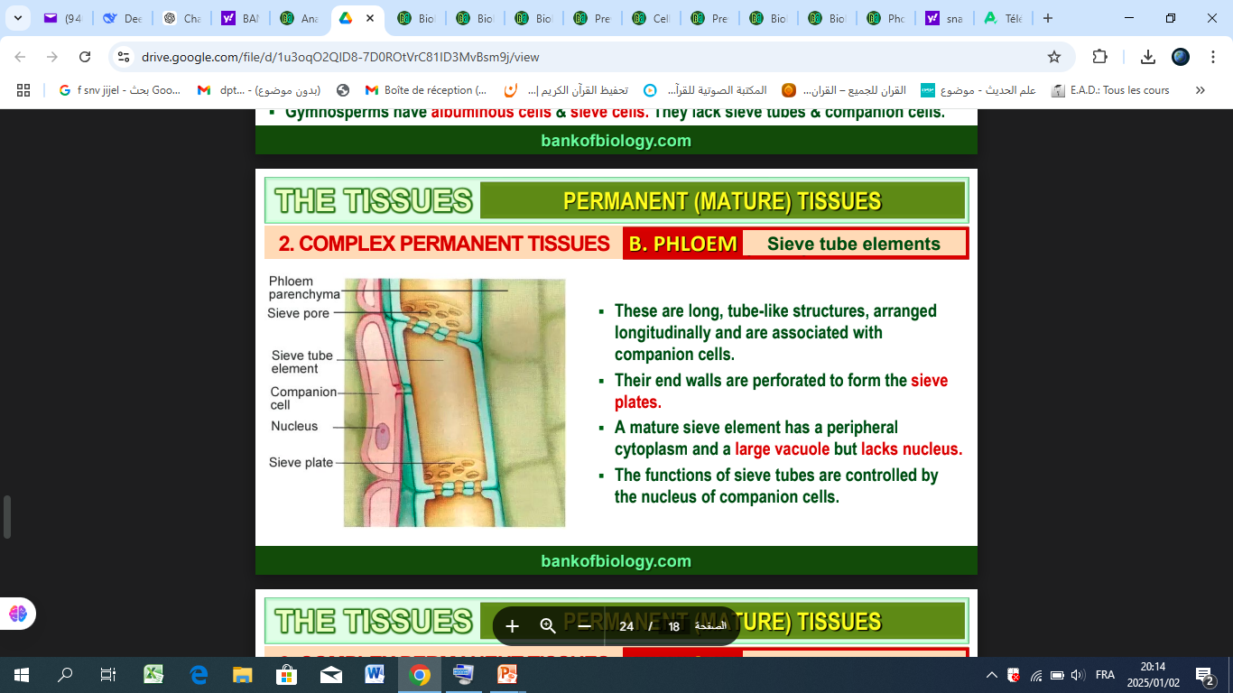

Slide 45
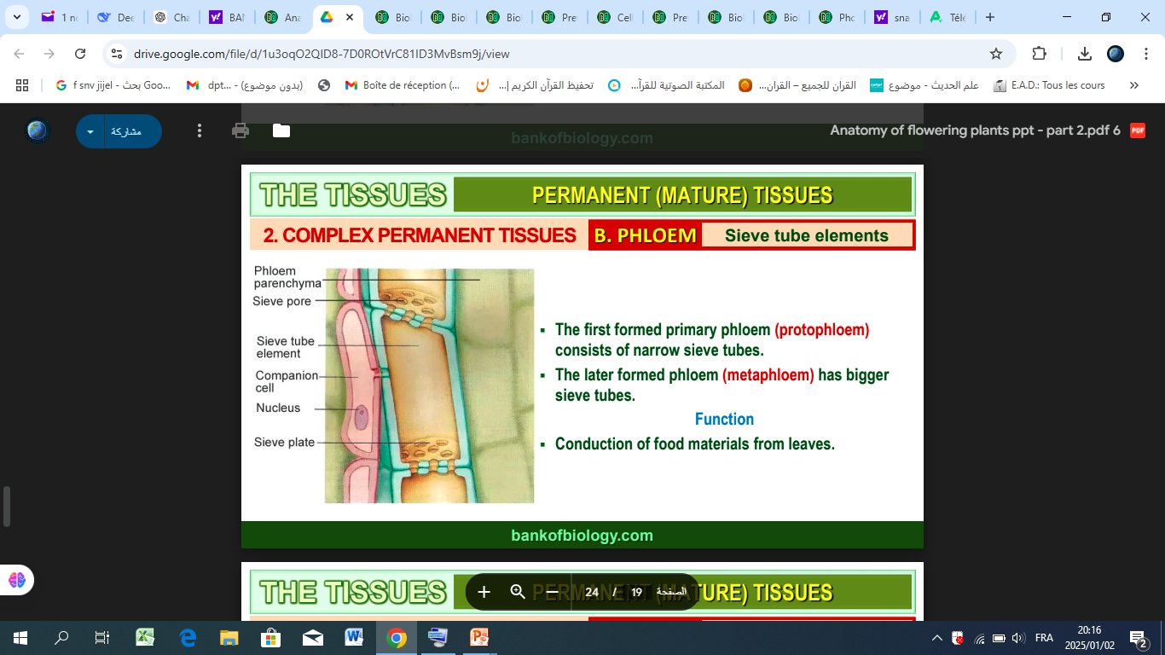

Slide 46
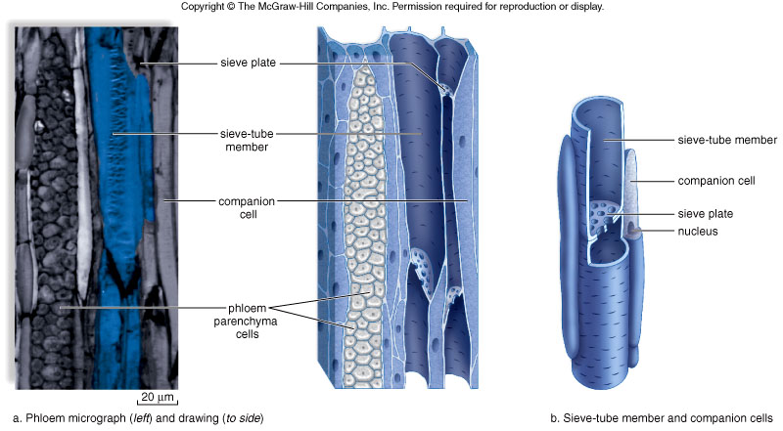
Phloem structure
الحواجز الغربالية
الانبوب الغربالي
الانبوب الغربالي
الخلايا المرافقة
الخلايا المرافقة
نواة الخلية المرافقة
برونشيم لحائي

Slide 47
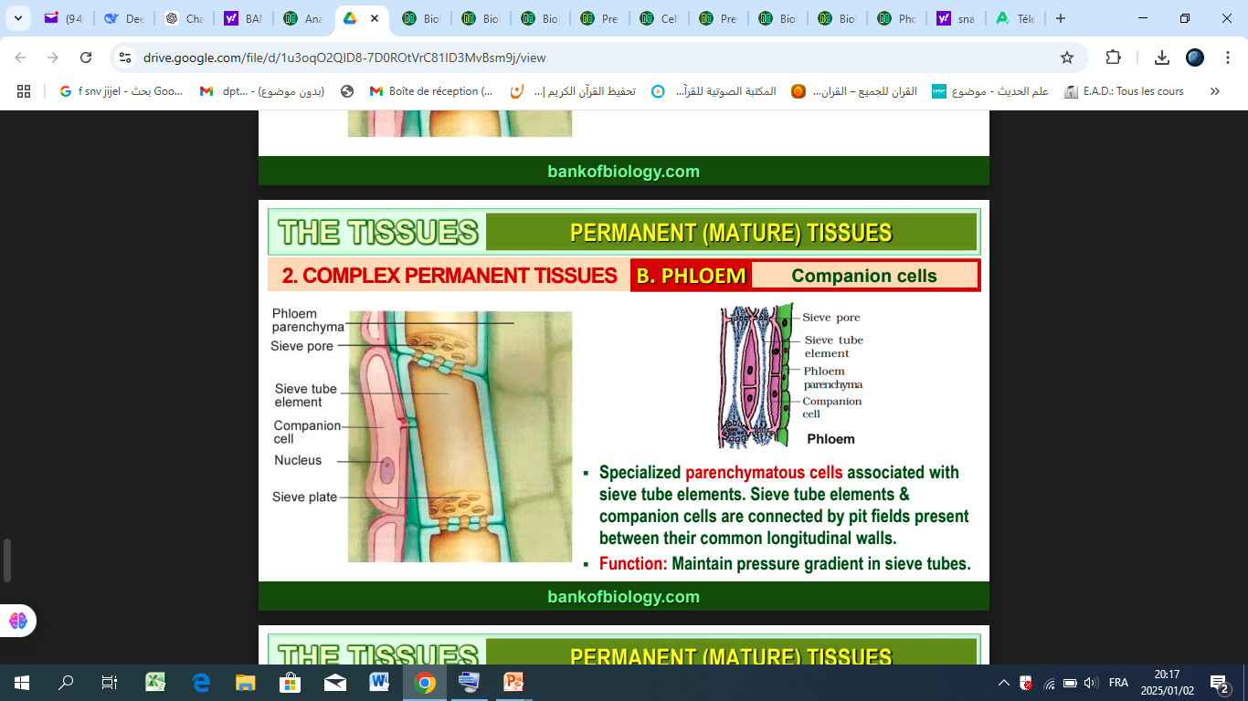

Slide 48
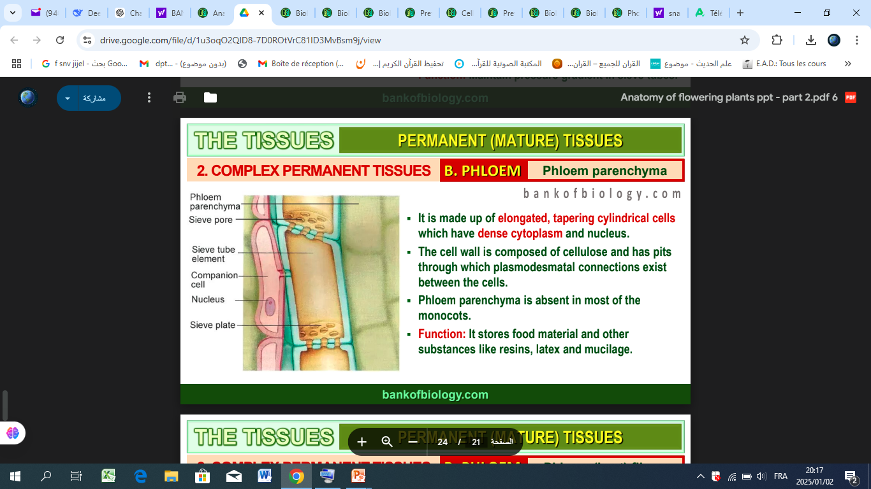

Slide 49


Slide 50

تمايز العناصر الغربالية
تمايز خلايا الكامبيوم
wall perforation
الخلية الغربالية
الوصلات السيتوبلازمية
زوال البروتينات
الخلية المرافقة
انقسام النواة
زوال النواة و الفجوات
Disappearance of vacuole

Slide 51



CAMBIUM ACTIVITY

Slide 52

The cambium is a layer of meristematic tissue (actively dividing cells) located between the xylem and phloem in the stem or root of a plant.
It divides periclinally (parallel to the surface) to produce new cells.

Slide 53
Cell Division and Differentiation
Inward Cell Production: Cells produced toward the inside of the cambium differentiate into secondary xylem (wood).
Outward Cell Production: Cells produced toward the outside of the cambium differentiate into secondary phloem (bast).

Slide 54


Slide 55

مسؤولة عن تكوين الأشعة النخاعية (Medullary Ray
الأصول الشعاعية
الاصول المغزلية
تعطي خلايا أوعية الخشب، القصيبات، ألياف اللحاء، والخلايا الغربالية

Slide 56

wood formation
The cells of the cambium (in yellow) divide and produce cells that differentiate inwardly into secondary xylem (or wood) and outwardly into secondary phloem (or bast). The primary xylem is located toward the center of the stem, and its position remains fixed. As a result of its activity, the cambium is gradually pushed outward. In general, the production of wood (X2) is greater than the production of bast (P2).

Slide 57


Slide 58


