Slide 1
Module :
Littératies numériques

Slide 2
Lesson 9
Data Centers

Slide 3
What is a Data Center?
At its simplest, a data center is a specialized physical facility designed to house an organization's critical IT infrastructure. However, this simple definition belies its true complexity and importance. Think of it not as a single computer, but as a "computer building"—a highly engineered environment where hundreds or thousands of servers, storage systems, and network devices work in concert.

Slide 4
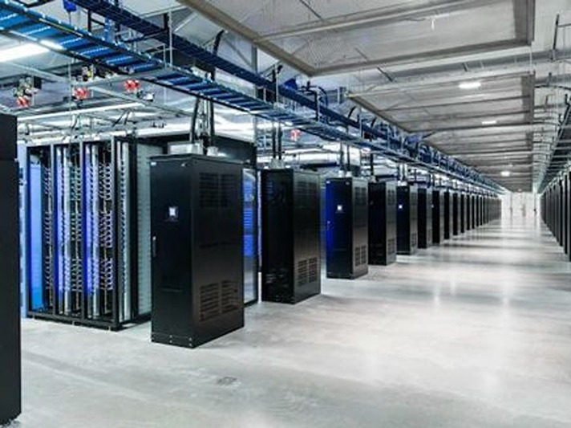
A Data Centre

Slide 5
The purpose of a Data center

Slide 6
Every time you stream a movie, send an email, use a cloud application, or interact with an AI, you are relying on a data center somewhere in the world. So, the core purpose of a data center is threefold:
To Centralize IT Operations: It consolidates all of an organization's essential computing resources in a single, secure, and manageable location.

Slide 7
To Store, Process, and Disseminate Data: It is the physical location where data lives, is analyzed, and from which it is served to users around the world.
To Ensure Business Continuity: By providing redundant and reliable power, cooling, and security, a data center is designed to keep applications and data accessible even during major disruptions, such as power outages or natural disasters.

Slide 8
Data centers in Algeria
Data centers in Algeria are rapidly expanding to support national digitalization, with key facilities including the Mohammadia National Data Center, Algeria Telecom's Constantine facility, and Icosnet’s data centers in Algiers and Oran.
Major providers like YOTTA, Hodi, and Ayrade offer secure, Tier-certified hosting and cloud services. The industry focuses on data sovereignty, high availability, and localized, efficient infrastructure.

Slide 9
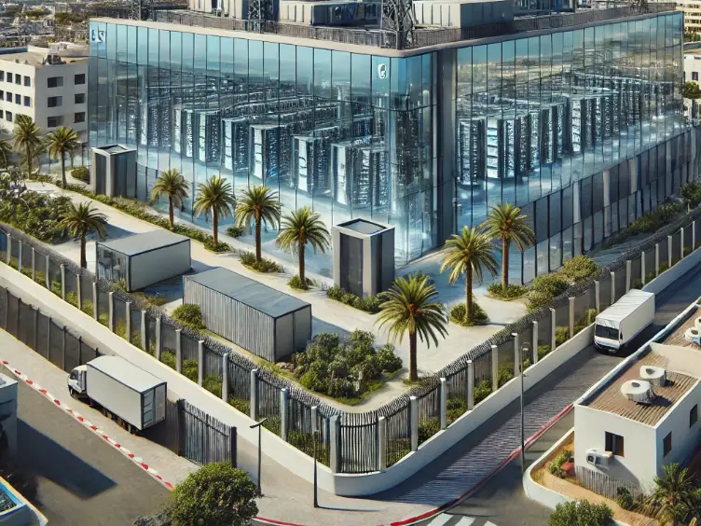
Algeria’s Data Center located in El-Mohammadia (Algiers)

Slide 10
The Main Components: An Ecosystem of Systems
A functioning data center is more than just a room full of computers. It is an intricate ecosystem composed of three main pillars: the Facilities, the IT Equipment, and the Operations.

Slide 11
1. Facilities (The Infrastructure Layer)
This is the physical plant that supports the IT equipment.
Power Systems: This is the single most critical component. Data centers require an absolutely reliable and continuous supply of electricity. This is achieved through a multi-layered system:
Utility Feed: The primary power source from the local electrical grid.

Slide 12
Uninterruptible Power Supply (UPS): Provides instantaneous backup power from large battery banks. The UPS bridges the critical gap between a power failure and the start of the backup generators.
Backup Generators: Large, on-site generators, typically running on diesel or natural gas, that can power the facility for days or even weeks during an extended outage.

Slide 13
Cooling Systems: The dense concentration of servers generates enormous amounts of heat, which can cause hardware failure. Cooling systems maintain a strict temperature and humidity range. Common methods include:
Air Conditioning: Large, industrial-grade CRAC (Computer Room Air Conditioner) or CRAH (Computer Room Air Handler) units that cool the air.
Liquid Cooling: Increasingly used for high-density computing (like AI servers), where coolant is pumped directly to the hottest components.

Slide 14
Networking Infrastructure: The physical cabling (fiber optic and copper), switches, and routers that provide the "plumbing" to connect everything internally and to the outside world.

Slide 15
2. IT Equipment (The Compute Layer)
This is the actual hardware that performs the computational work.
Servers: These are the workhorses—powerful computers that process data and run applications. For efficiency, they are typically stacked vertically in standardized frames called racks.
Storage Systems: Dedicated hardware for persisting data. This can range from traditional spinning hard disk drives (HDDs) for capacity to high-speed solid-state drives (SSDs) and all-flash arrays for performance.
Network Equipment: The switches and routers that interconnect all the servers and storage within the data center and connect the facility to the internet backbone.

Slide 16
3. Operations (The Security and Management Layer)
This layer ensures the facility runs smoothly and securely.
Physical Security: A multi-layered defense including perimeter fencing, security guards, biometric scanners (fingerprint/retina), video surveillance, and mantraps (interlocking doors) to prevent unauthorized access.

Slide 17
Cybersecurity: Firewalls, intrusion detection systems, and other virtual defenses protect the data and applications from cyber threats.
Management Software: DCIM (Data Center Infrastructure Management) software monitors everything in real-time, from power usage and temperature to server health and network traffic.

Slide 18
Types of Data Centers
Data centers are not monolithic; they are built and operated to serve different needs and range dramatically in size and purpose.

Slide 19
Enterprise Data Centers: Built, owned, and operated by a single organization (e.g., a bank, a university, a government agency) exclusively for its own internal workloads.

Slide 20
Colocation Facilities (Colos): A "data center hotel" or "apartment building for servers." The colo provider supplies the building, power, cooling, and physical security, while customers rent the space to house their own servers and networking equipment.

Slide 21
Hyperscale Data Centers: The giants of the industry. These are massive, purpose-built facilities owned and operated by tech titans such as Amazon Web Services (AWS), Google, Microsoft Azure, and Meta. They are engineered for maximum efficiency and economies of scale to power public cloud services and massive global platforms.

Slide 22
Edge Data Centers: Smaller facilities strategically located closer to population centers or data sources (e.g., a cell tower or a city outskirts). Their primary purpose is to reduce latency (delay) for real-time applications like autonomous vehicles, IoT devices, and game streaming by processing data near the user instead of sending it to a far-away hyperscale data center.

Slide 23
Why Data centers Matter?

Slide 24
Data centers are the physical foundation of the digital world. They are not just technical infrastructure; they are critical national assets that underpin modern communication, commerce, entertainment, and scientific research.

Slide 25
Three major trends are shaping the future of data centers:
1. Sustainability and "Green" Data Centers:
The Challenge: Data centers are massive consumers of electricity, leaving a significant carbon footprint.
The Response: The industry is aggressively pursuing sustainability through Power Purchase Agreements (PPAs) for renewable energy (wind and solar), improving energy efficiency (measured by Power Usage Effectiveness or PUE), and innovating in water conservation.

Slide 26
2. The Rise of AI and High-Performance Computing:
The Impact: Artificial Intelligence and machine learning workloads require immense computational power, especially from specialized processors like Graphics Processing Units (GPUs).
The Response: This is driving a new wave of data center design focused on high-density computing and the widespread adoption of advanced liquid cooling to manage the extreme heat generated by these powerful chips.

Slide 27
3. The Growth of Edge Computing:
The Impact: The explosive growth of connected devices and the demand for instant, real-time experiences are pushing computing to the edge.
The Response: We are witnessing the proliferation of edge data centers, which act as a distributed layer of computing that complements the centralized power of hyperscale facilities, ensuring low-latency processing for the next generation of applications.

Slide 28
What is Data Sovereignty?
In simple terms, data sovereignty is the concept that digital data is subject to the laws and governance structures of the nation where it is physically located . It’s not just about where your data sits, but which government's laws apply to it and who has the legal authority to access it.
This creates a powerful link between a physical building (the data center) and national jurisdiction.
A data center in Berlin is not just a German building; it's a piece of territory subject to German and EU law (like the GDPR). A server in that building, even if owned by a US company, falls under that jurisdiction.

Slide 29
Why Data Centers are Strategic Projects with Sovereignty at the Core
The key dimensions that make data centers strategic assets, driven by sovereignty concerns are outlined below:

Slide 30
National Security & Defense
Military operations, intelligence, and command-and-control systems now run on data centers and cloud infrastructure. If this infrastructure is foreign-owned or controlled, it creates a critical vulnerability and Governments are moving sensitive workloads to "sovereign cloud enclaves" —data centers that are legally and operationally insulated from foreign interference.

Slide 31
Legal & Regulatory Control
,
Data stored in a data center falls under the jurisdiction of its host country. A foreign-owned data center could be compelled by its home government to hand over data under laws, potentially breaching local privacy laws, so Nations are creating certification frameworks, like Australia's "Certified Strategic" data centre status. This requires everything from the land ownership to the supply chain to be nationally controlled, ensuring data is protected from foreign claims.

Slide 32
Economic & Industrial Strategy
,
Data is the raw material of the 21st-century economy, powering AI, finance, and innovation. Losing control of this data means losing economic value and competitive advantage, so some Countries are using investment screening to protect this "cognitive sovereignty." Deals involving foreign state-owned entities or sovereign wealth funds are subject to intense scrutiny to ensure they don't lead to foreign control over national digital assets.

Slide 33
Geopolitical Leverage
,
In an interconnected world, control over digital infrastructure is a source of power. A nation's reliance on foreign data infrastructure can be used as leverage in a geopolitical crisis, so some projects aim to create a federated, sovereign data infrastructure to reduce reliance on US-based hyperscalers, ensuring that national data is governed by national rules.
In essence, data centers, and where the ground is located determines whose laws rule. This fusion of the digital and the physical is what transforms a data center from a commercial building into a strategic national project.

Slide 34
Conclusion
A data center is a marvel of modern engineering, a highly orchestrated convergence of power, cooling, networking, and security. It is far more than a "room full of servers"; it is the robust, resilient, and secure engine room that powers the 21st century, enabling the digital experiences we now take for granted.

Slide 35
Thank you!

