Slide 1
Secondary growth
النمو الثانوي

Slide 2
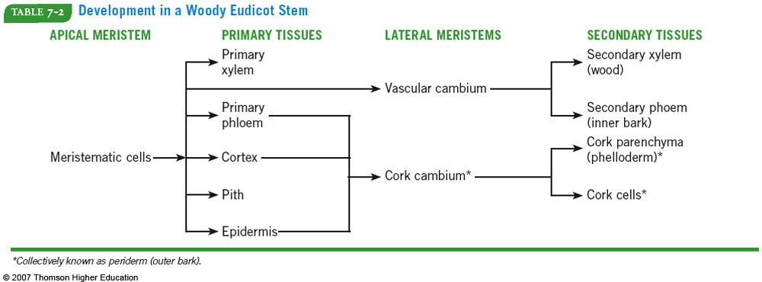
Undergo secondary growth – increase in girth of stems/roots from vascular and cork cambium (lateral meristem or secondary meristem)
الانسجة الثانوية
المرستيم الثانوي
المرستيم الاولي
الخشب الثانوي
اللحا الثانوي
القشرة الثانوية
الفلين

Slide 3
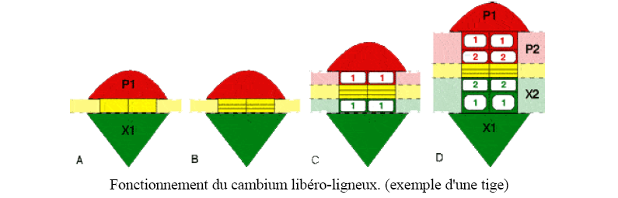
Wood formation
Cells in the cambium (yellow) divide and produce:
- cells inward that differentiate into cells secondary xylem (or wood)
- and outward cells that differentiate into secondary phloem cells (or liber).
The primary xylem being on the center side of the stem, its position is fixed. As a result of its activity, the cambium is therefore pushed outwards. Generally speaking,
- the production of wood (X2) is greater than the production of bast (P2)
اللحا الثانوي
الخشب الاولي
الخشب الثانوي
اللحا الاولي

Slide 4
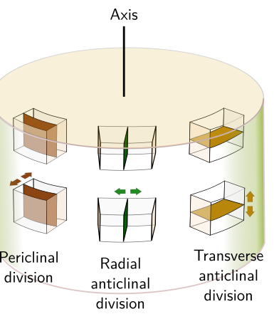
انقسام
محيطي
انقسام
مماسي
انقسام
عرضي

Slide 5
secondary growth in dicot roots

Slide 6
The process of secondary growth in dicot roots is accomplished in two steps,
a) Formation and activity of the vascular cambium
b)Formation and activity of the cork cambium.
-The parenchyme below the primary phloem, become meristematic cells and forms small cambial strips.
- at the same time, a portion of pericycle become meristematic cells, and forms small cambial strips.
These two cambial strips join together and form a wavy band of cambium
- Hence the wavy cambium gradually becomes a circular cambium.
Then it forms secondary xylem and phloem tissues toward the primary phloem

Slide 7
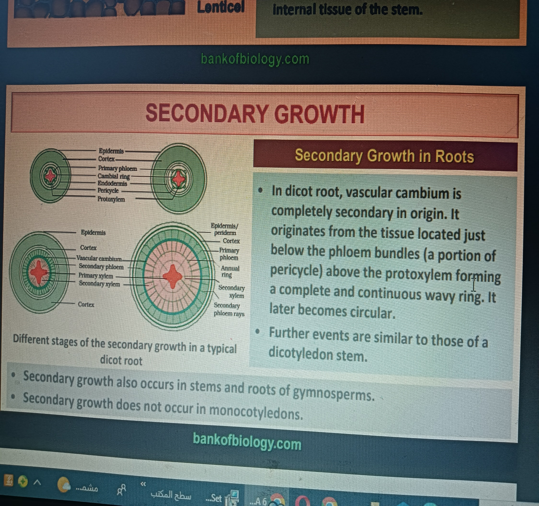
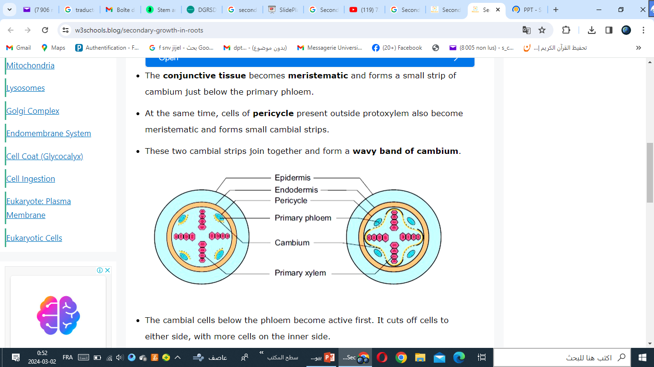

Slide 8
Periderm formation
The cells of pericycle become meristematic and forms secondary meristems called cork cambium or phellogen.
These cells cut off phellem towards the outer region and phelloderm towards the inner region.
These three tissues together form the outer protective layer of a root known as the periderm.

Slide 9
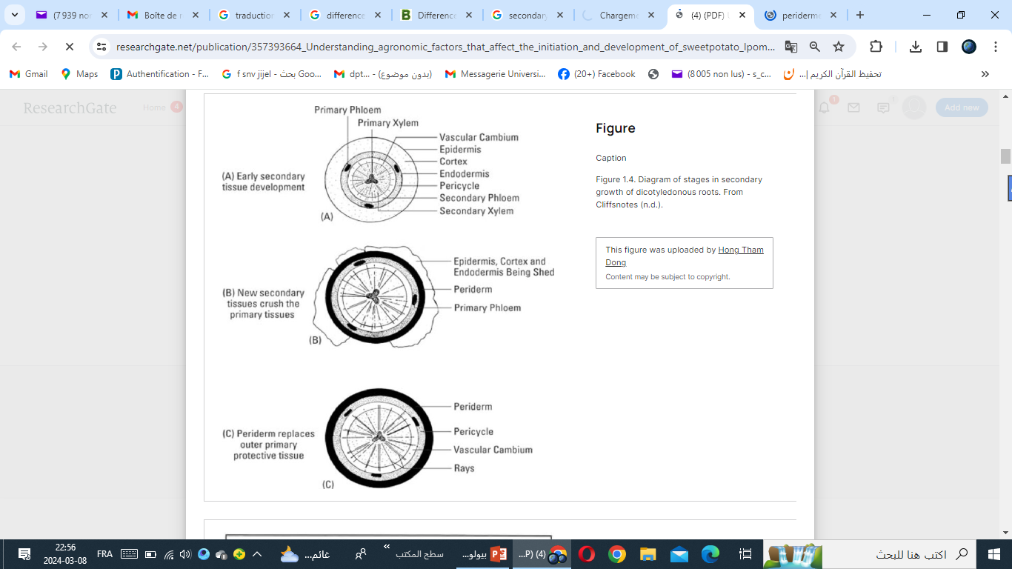
الانسجة الثانوية
الخشب و اللحا الثانويين
البشرة المحيطية
تعويض البشرة الممزقة

Slide 10
Stem secondary growth

Slide 11
Primary growth

Slide 12
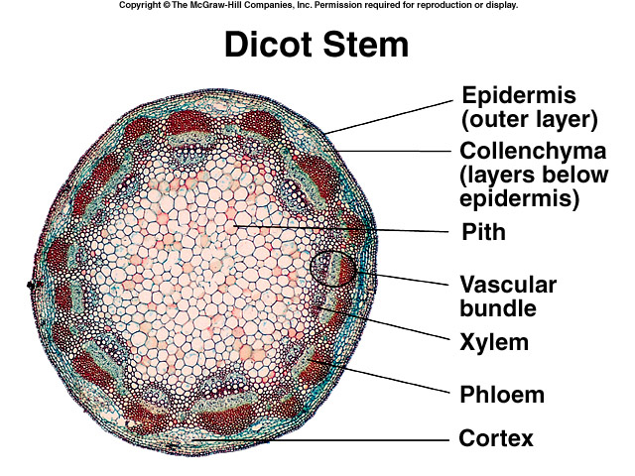

Slide 13
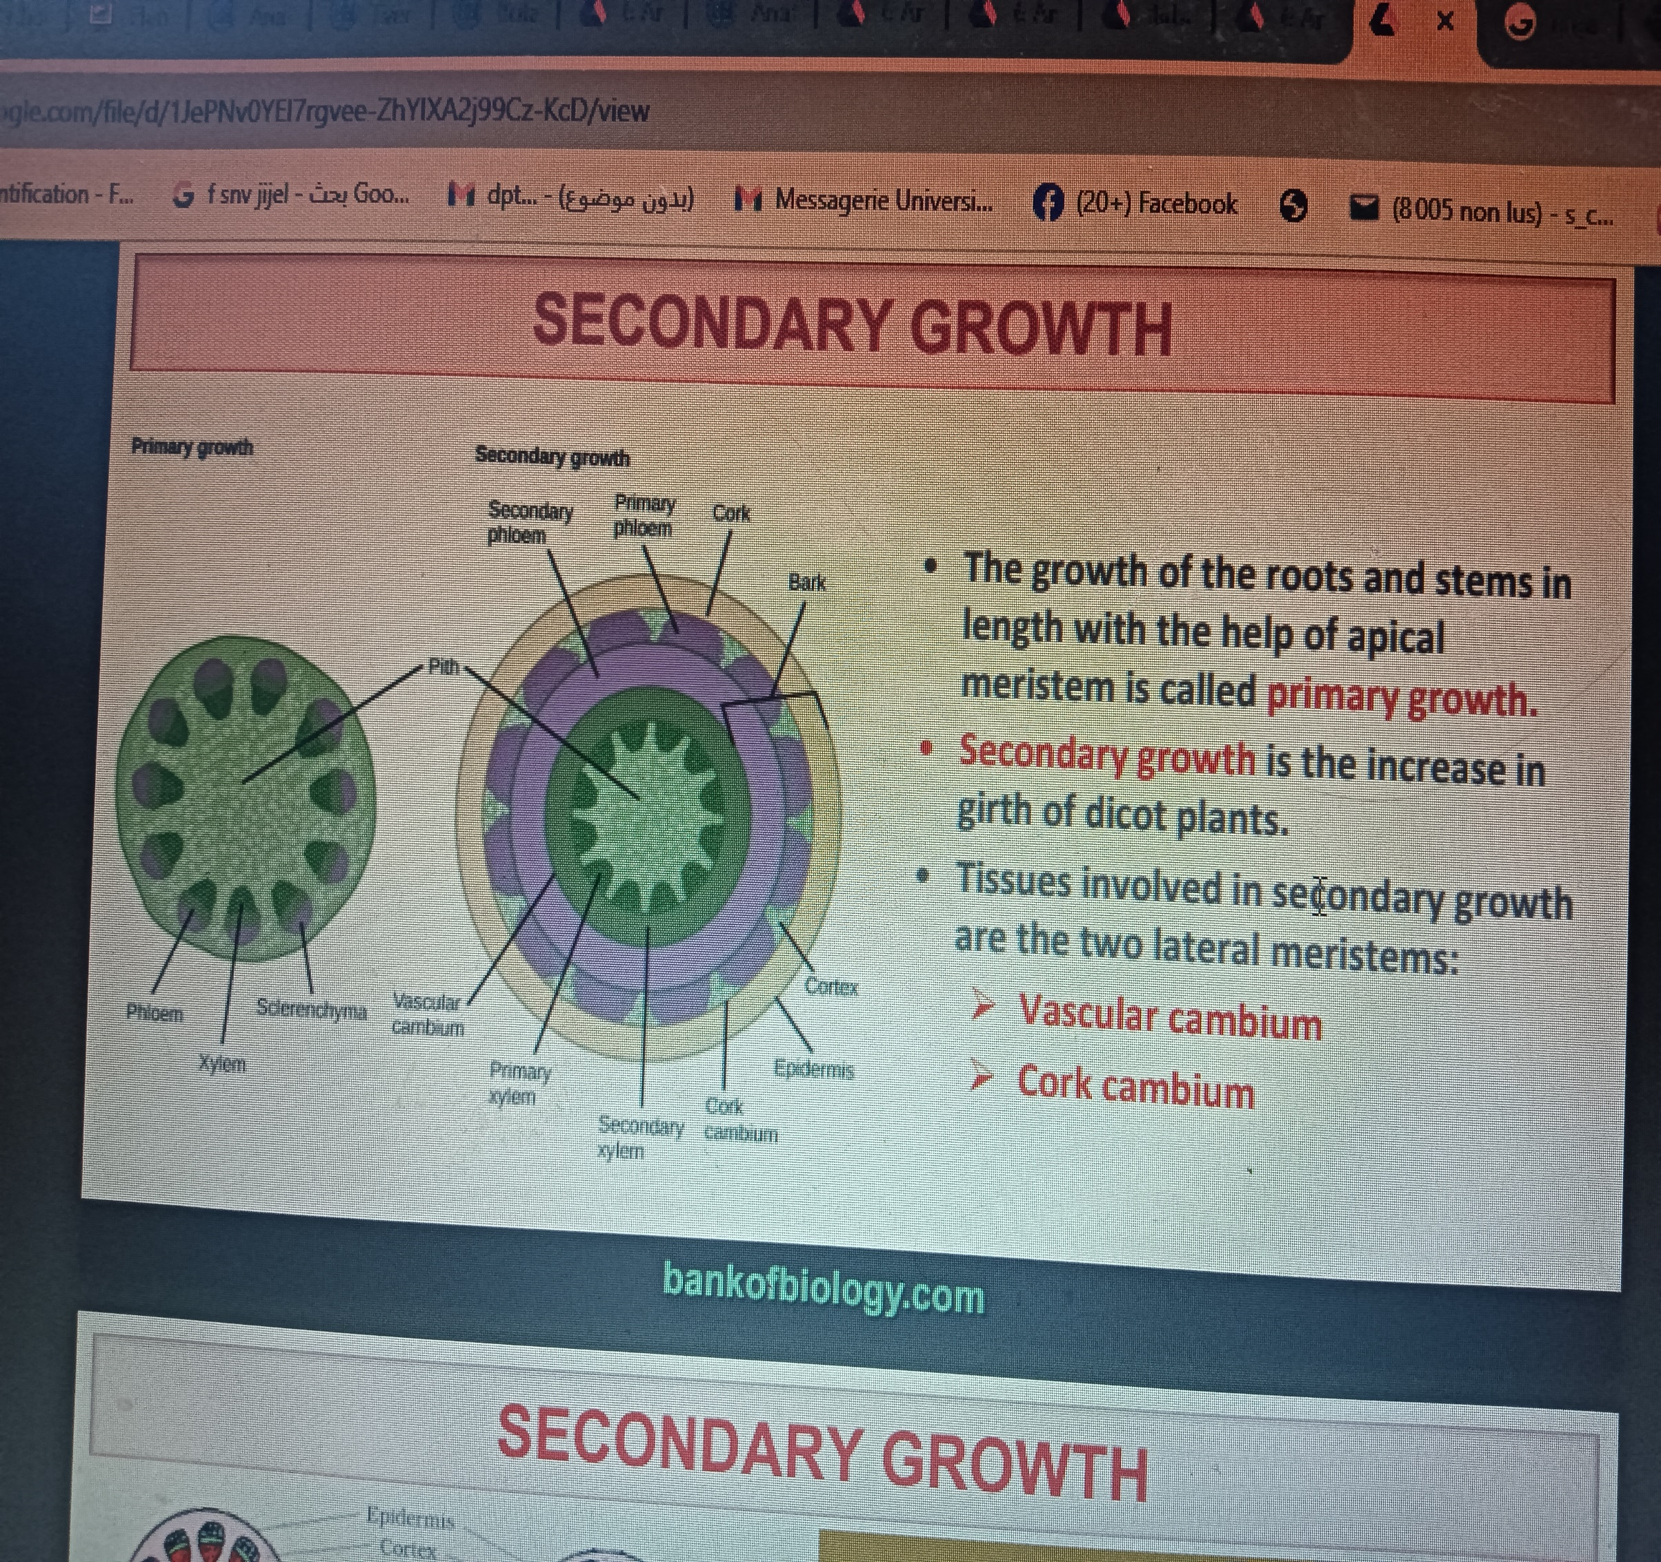
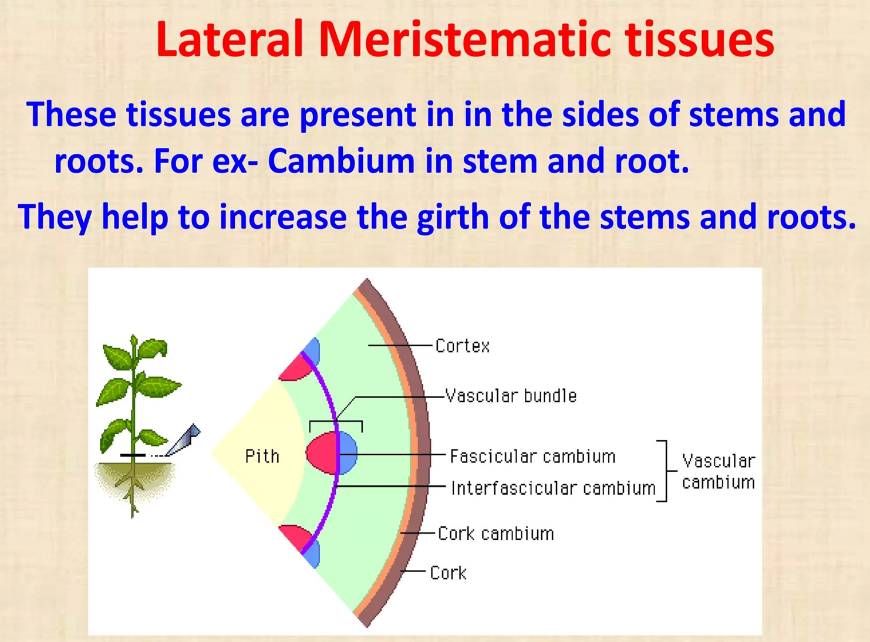

Slide 14
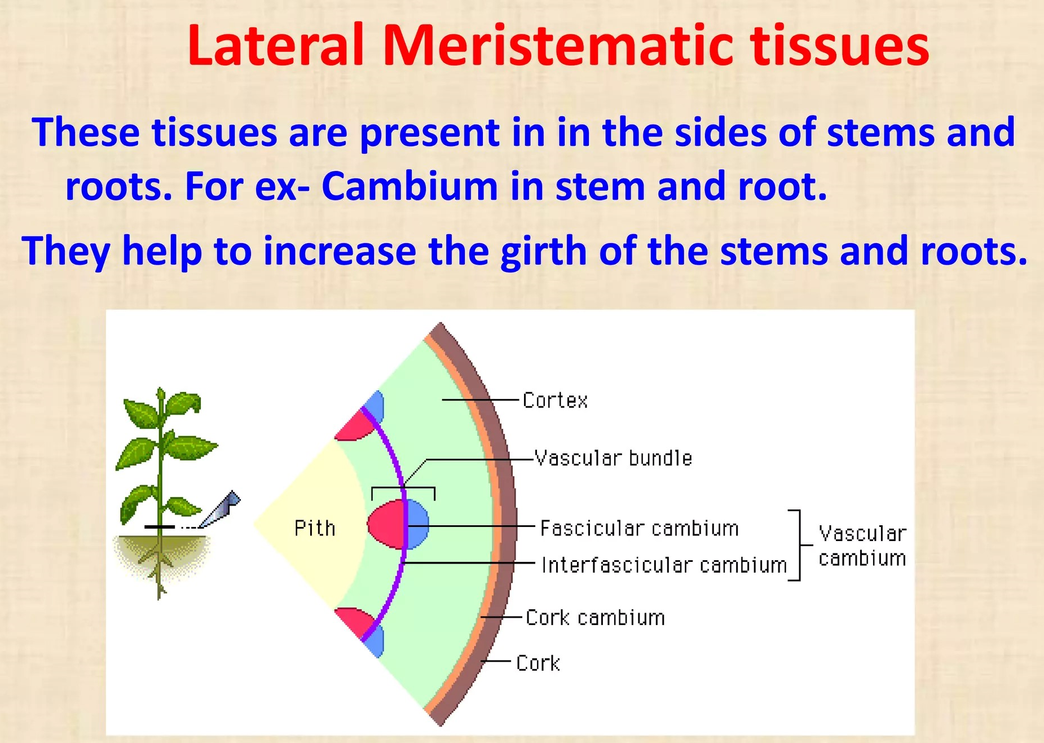

Slide 15
Secondary structure and cork cambium

Slide 16
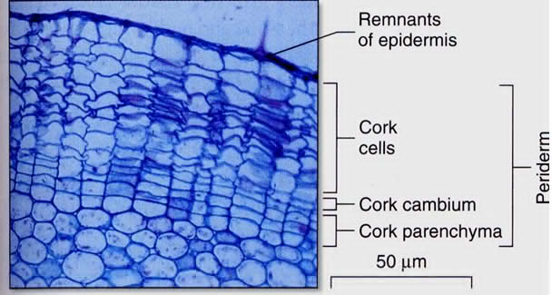

Slide 17
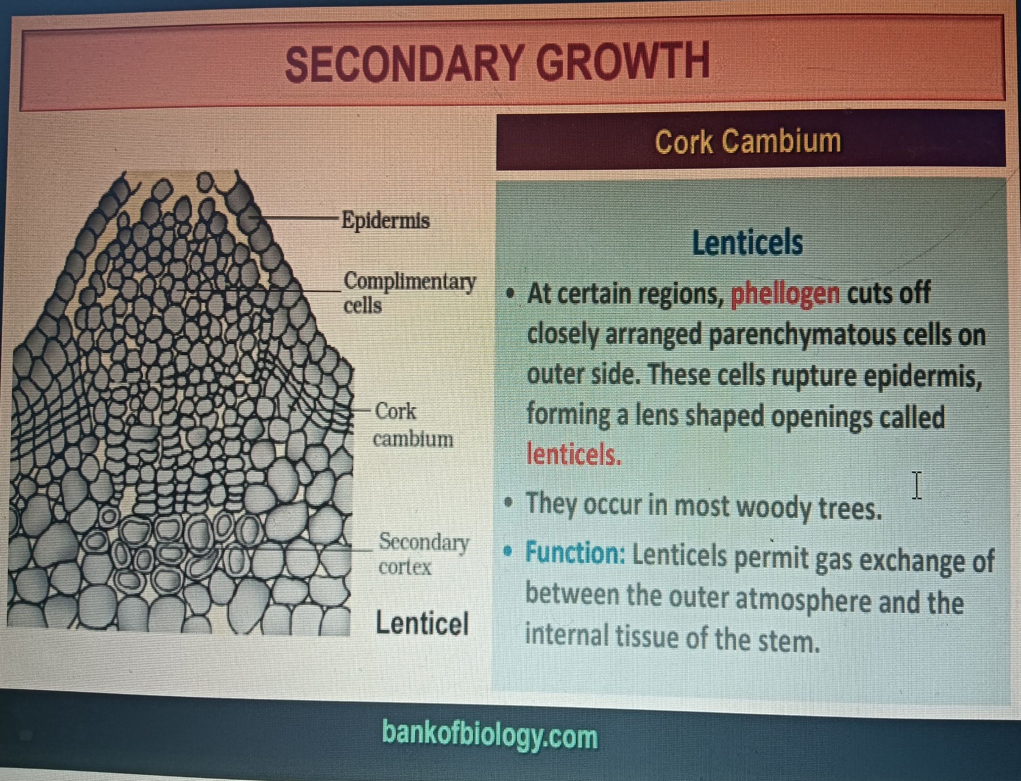

Slide 18
