Slide 1
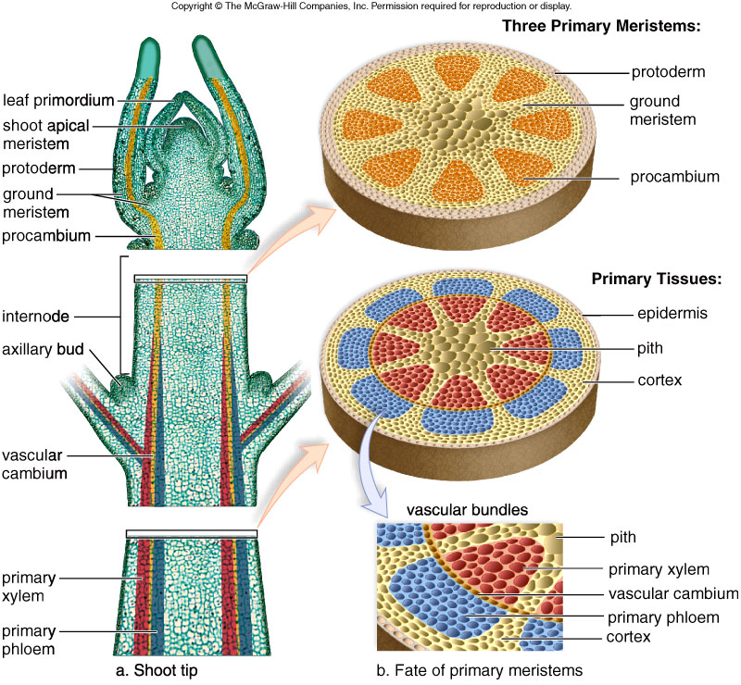
Shoot tip and primary meristems
المرستيم الاولي
1
2
الانسجة البالغة الاولية
3

Slide 2
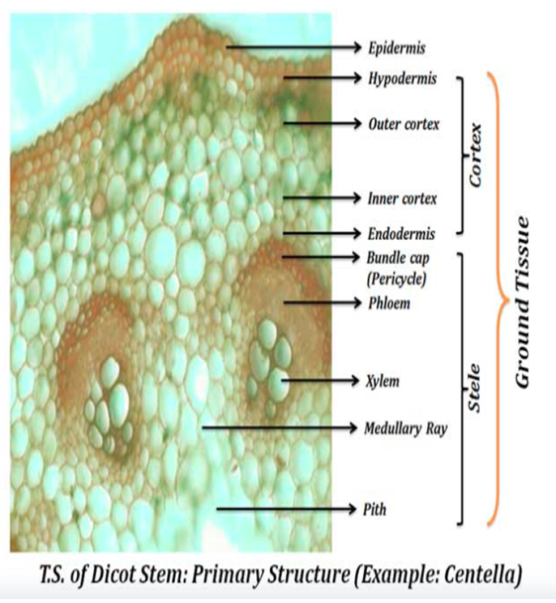
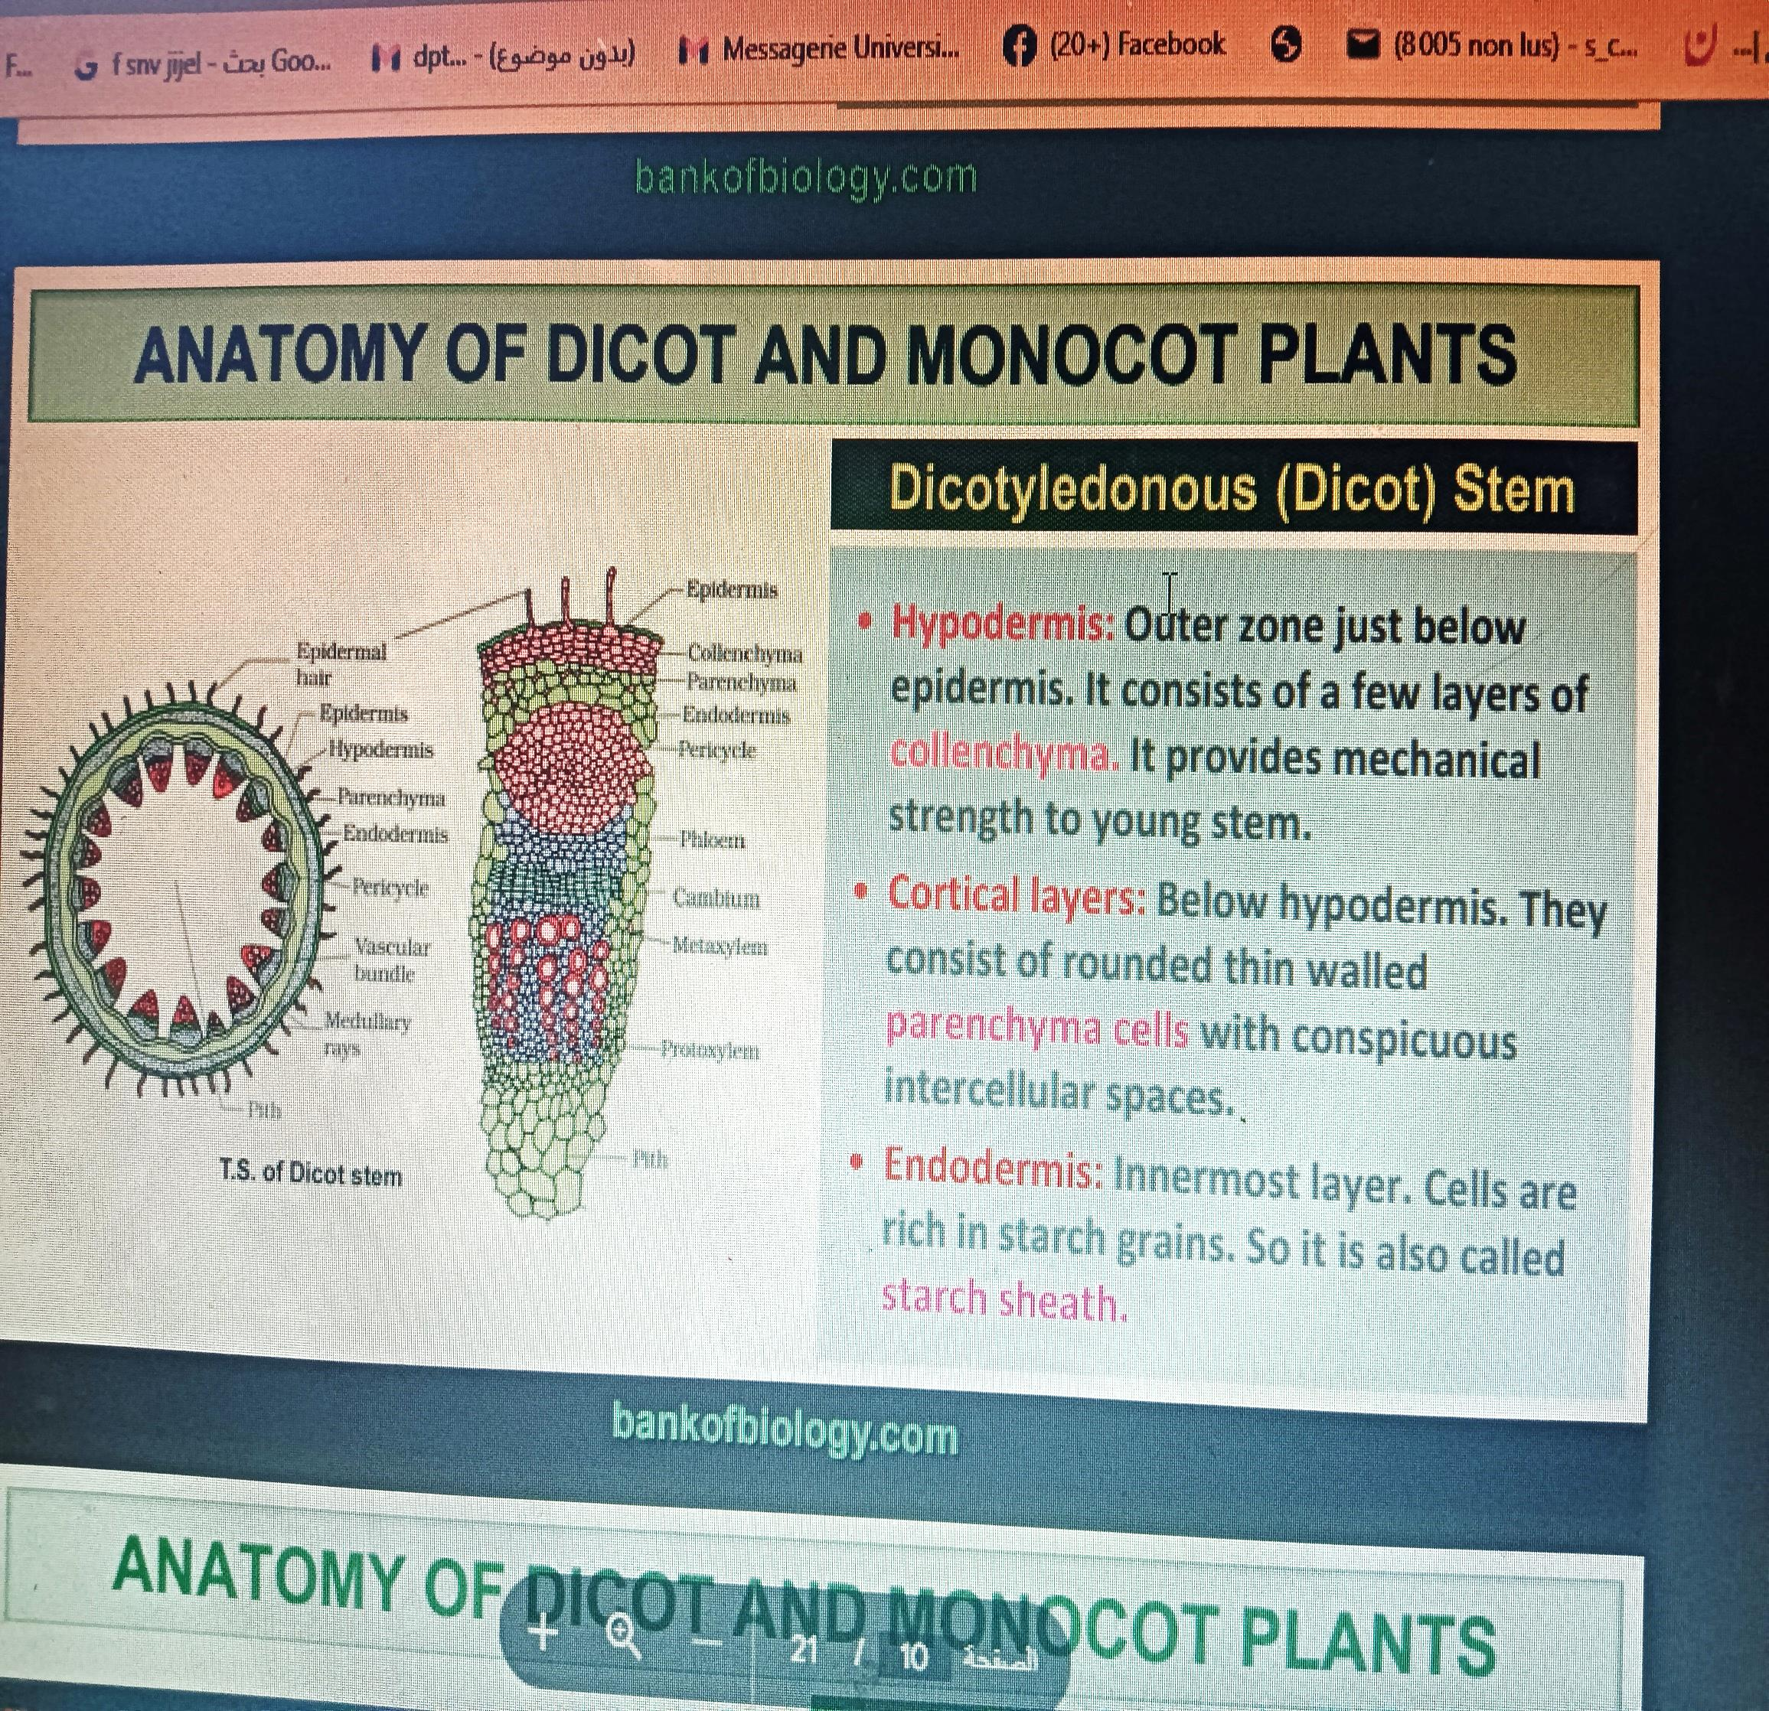

Slide 3
Cortex
Hypodermis: A few layers of collenchyma cells providing mechanical support.
General Cortex: Made up of parenchyma cells for storage.
Endodermis: A single layer of compact cells, also called the starch sheath due to starch grain storage.
Vascular Bundle Arrangement
Distinct, arranged in a ring (unlike scattered bundles in monocots).
Each bundle consists of:
  Xylem (inner part): Conducts water and minerals.
  Phloem (outer part): Transports food (sugars).
  Cambium (between xylem & phloem): Responsible for secondary growth (producing new xylem & phloem).
Pith (Medulla)
Central part of the stem, composed of parenchyma cells, responsible for storage and transport of nutrients.

Slide 4
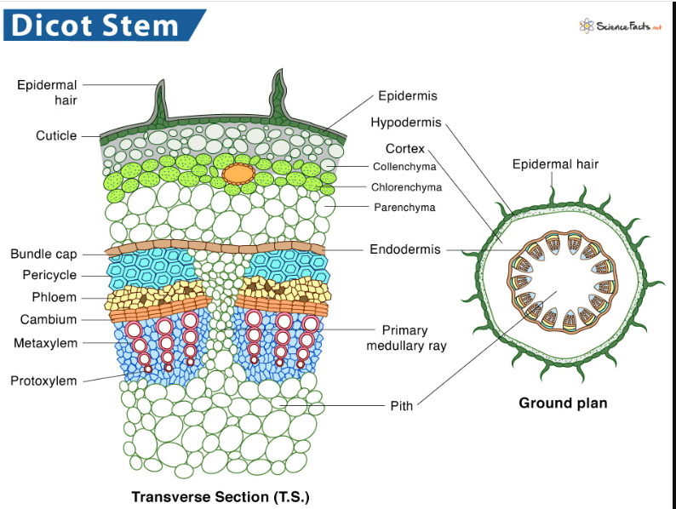
الادمة
القشرة
القشرة الداخلية
الخشب التالي
الاشعة اللبية
الخشب الاول
مقطع عرضي

Slide 5
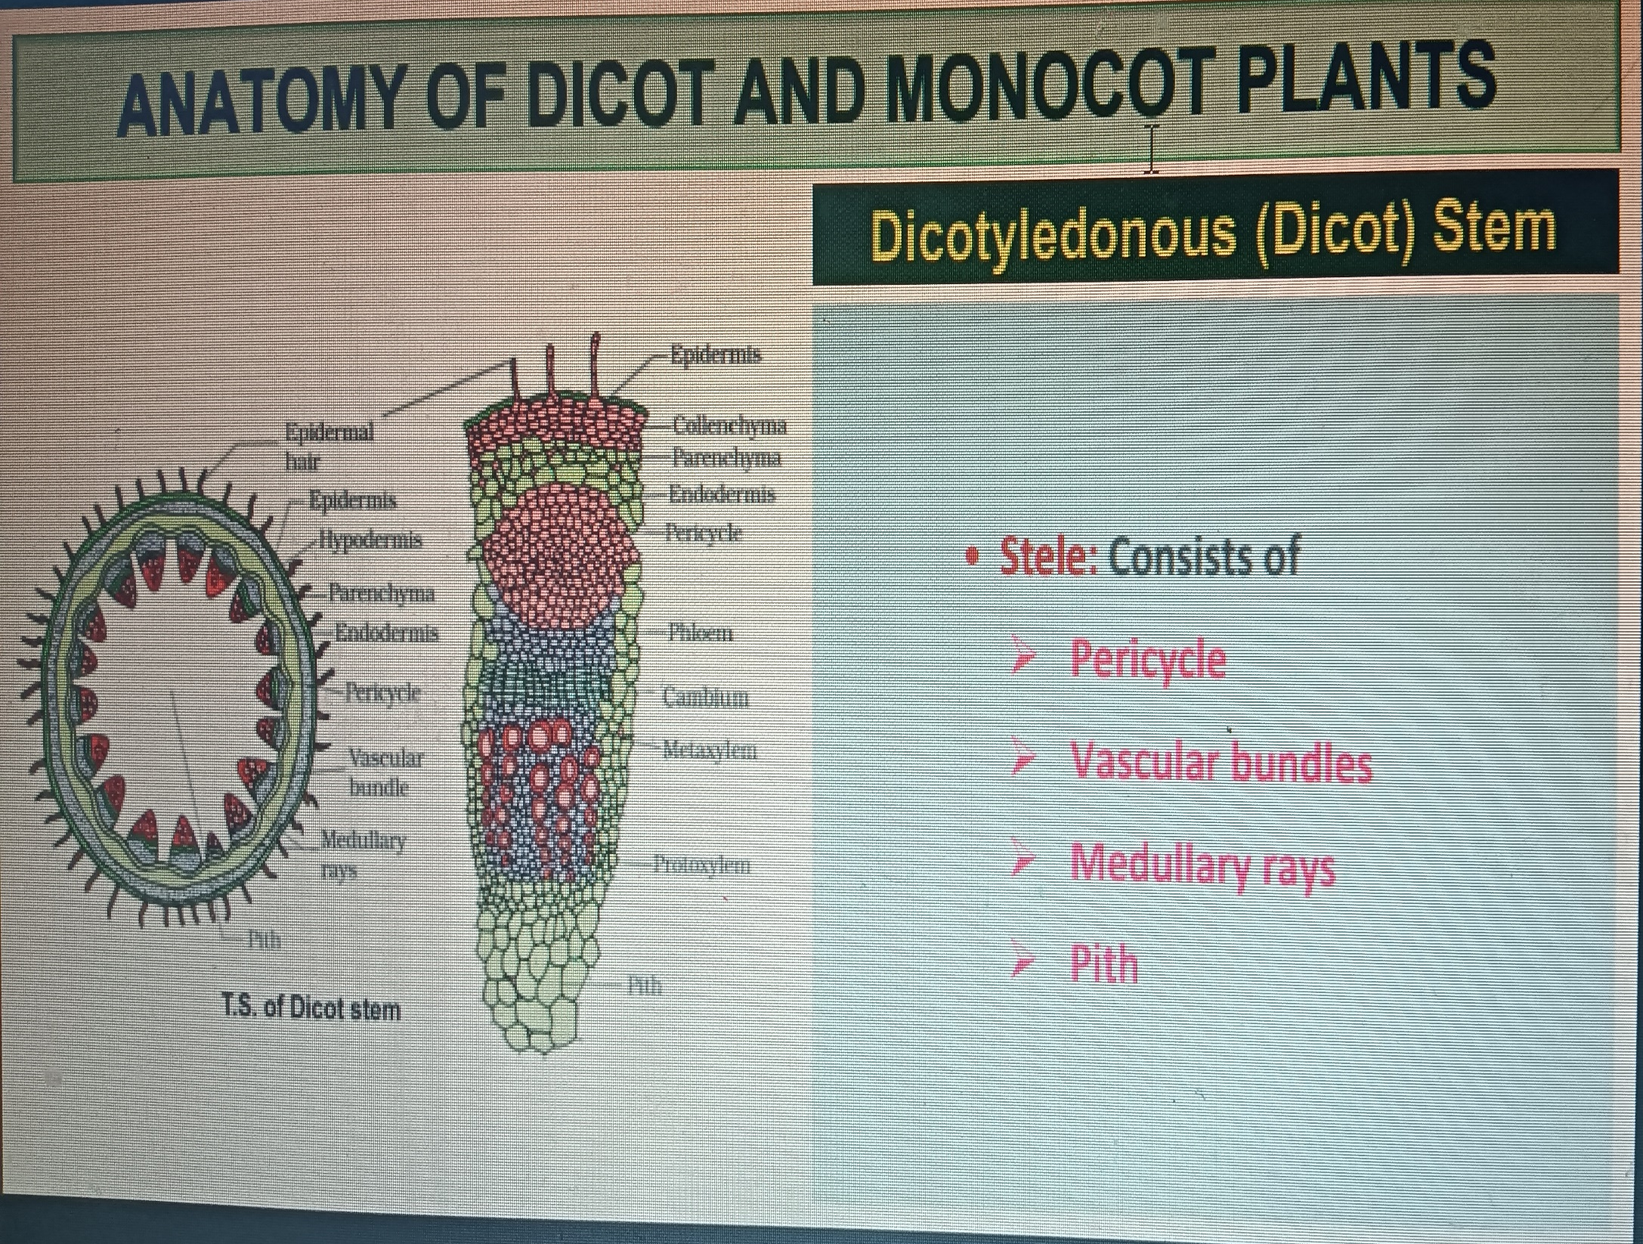
الاسطوانة المركزية

Slide 6
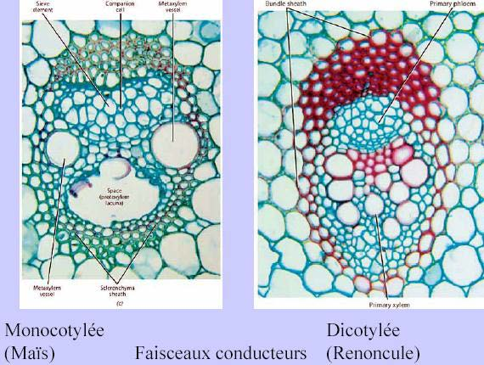

Slide 7
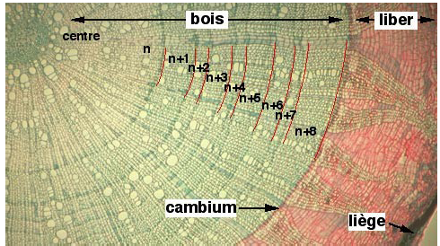

Slide 8
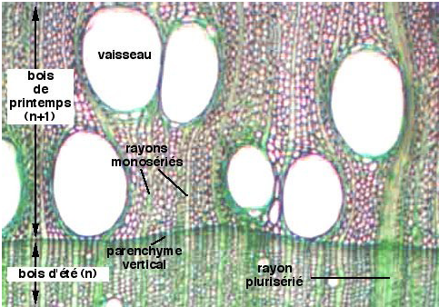

Slide 9
Anatomy of monocotyledonous stem

Slide 10
The internal structure of a monocot stem mainly comprises:
- a well-developed epidermis,
- hypodermis, ground tissue,
- and numerous dispersed vascular bundles.
Tulips, onions, lilies and garlic are examples of monocot stems.

Slide 11
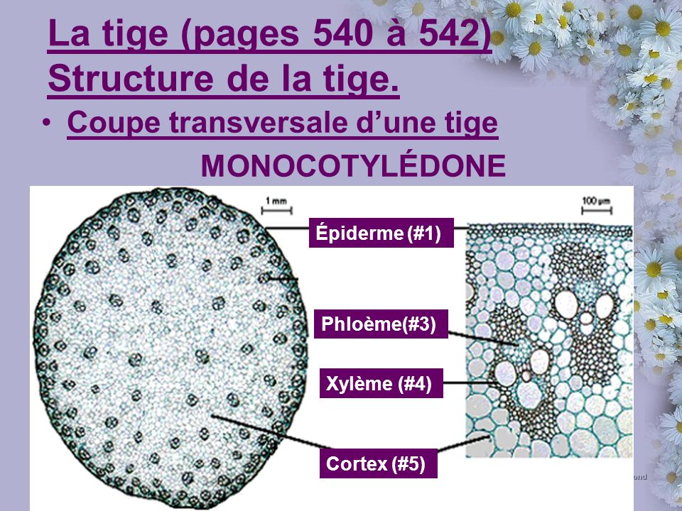
البشرة
اللحا
الخشب
القشرة

Slide 12
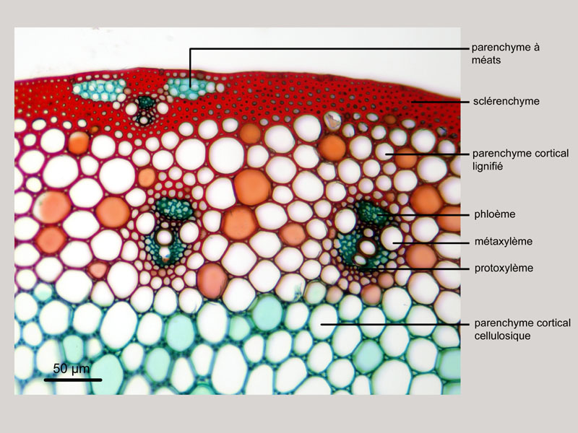
البرانشيم
السكليرونشيم
البرانشيم المتخشب
الخشب الاولي
البرانشيم السللوزي

Slide 13
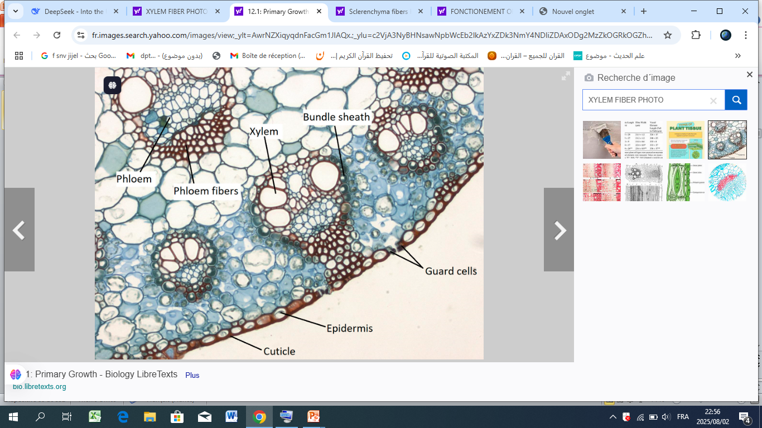

Slide 15
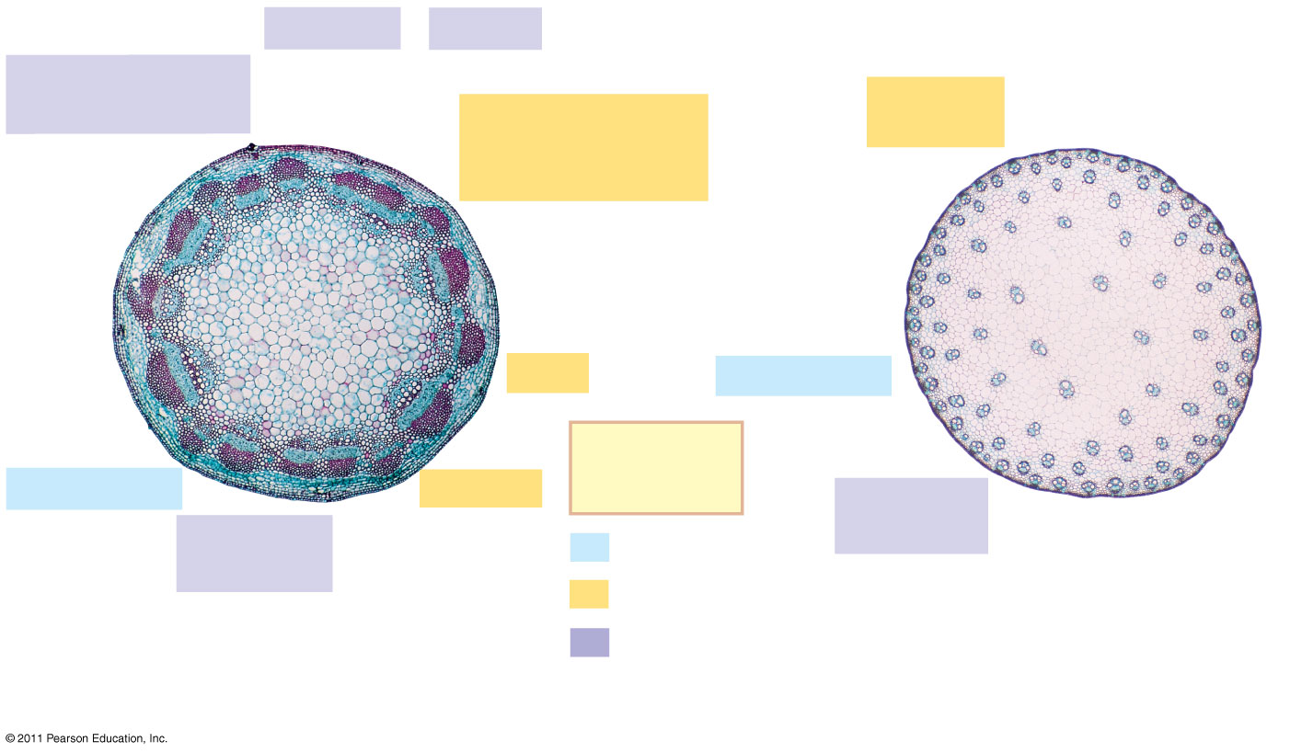
Differences between stem anatomy of monocots and dicots
In gymnosperms and most eudicots (a)
  The vascular tissue consists of vascular bundles arranged in a ring
In most monocot stems (b)
The vascular bundles are scattered throughout the ground tissue, rather than forming a ring
Phloem
Xylem
Sclerenchyma
(fiber cells)
Ground tissue
connecting
pith to cortex
Ground
tissue
Pith
Epidermis
Key
to labels
Epidermis
Cortex
Vascular
bundles
Vascular
bundle
Dermal
1 mm
1 mm
Ground
(b)
(a)
Vascular
Notes:
Figure 35.17 Organization of primary tissues in young stems.

Slide 16
