Slide 1
Chapter III
Anatomy of monocot and dicot roots

Slide 2
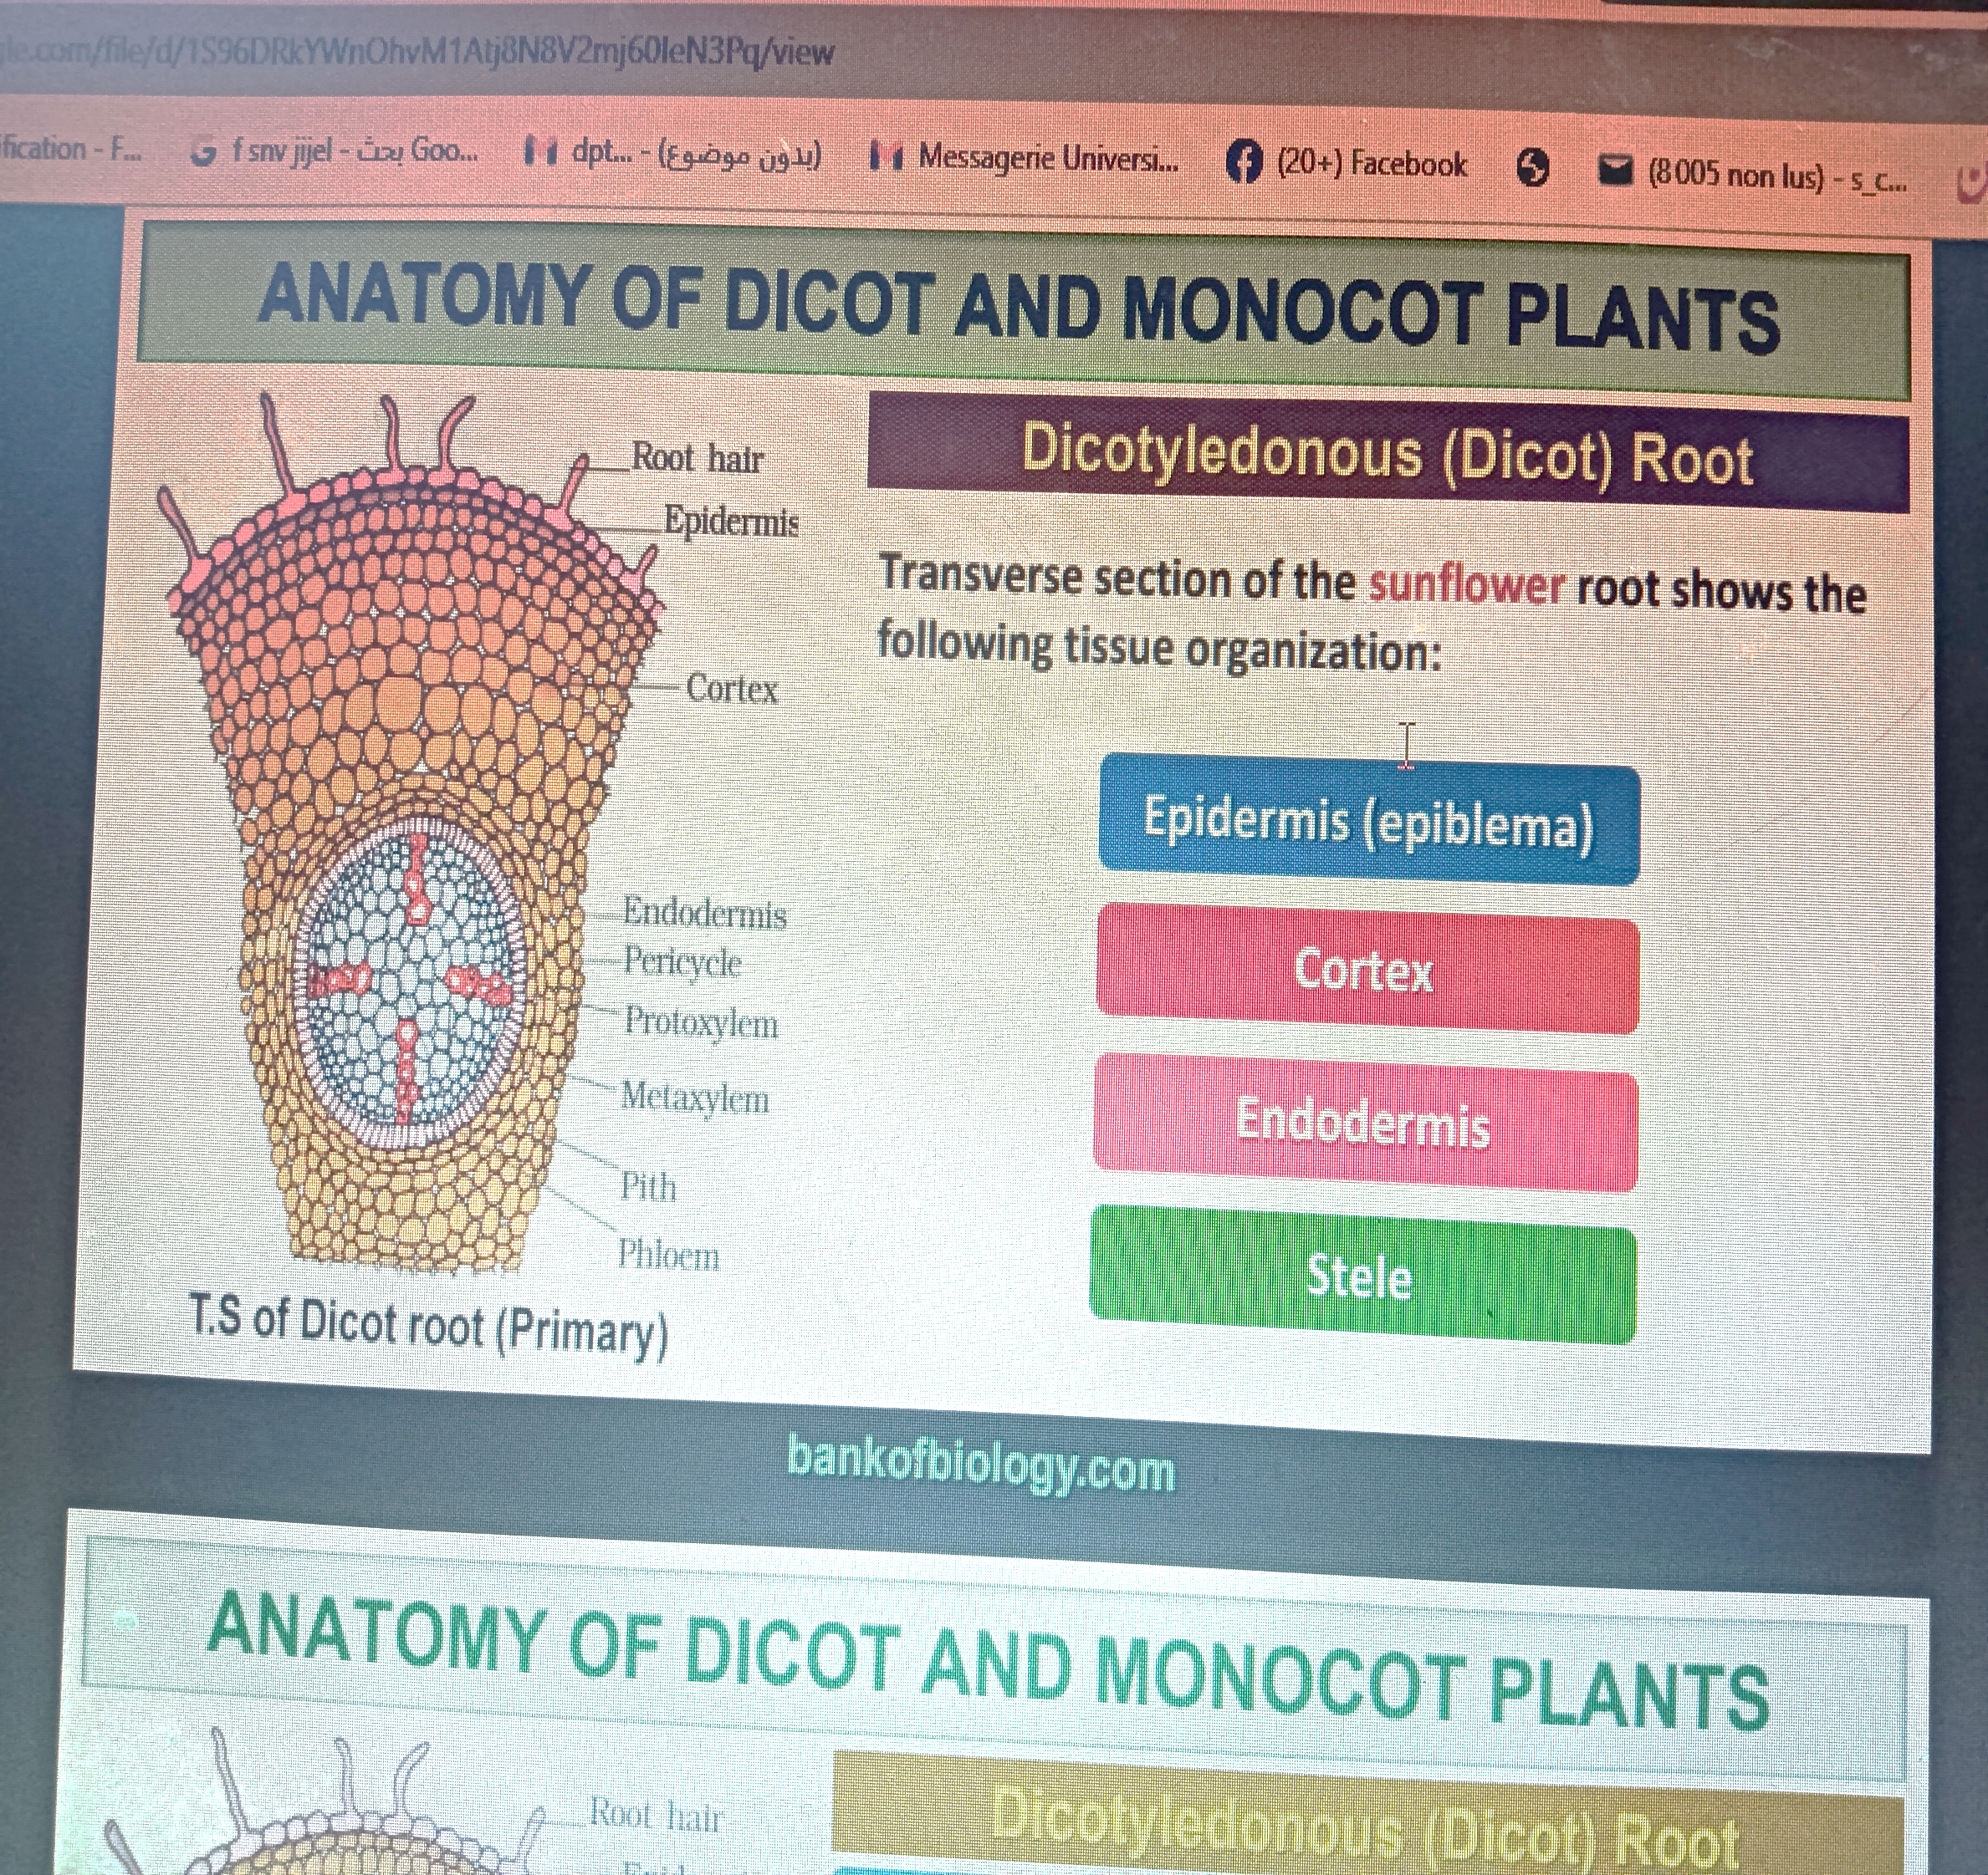

Slide 3
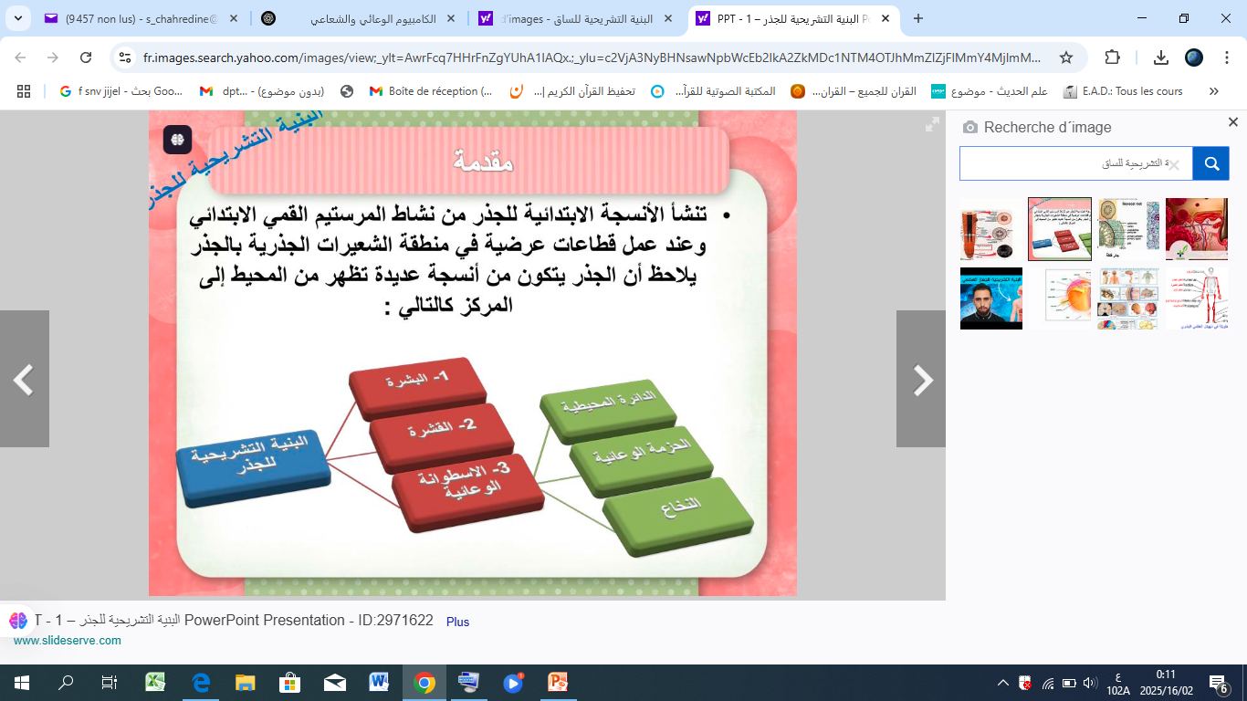

Slide 4
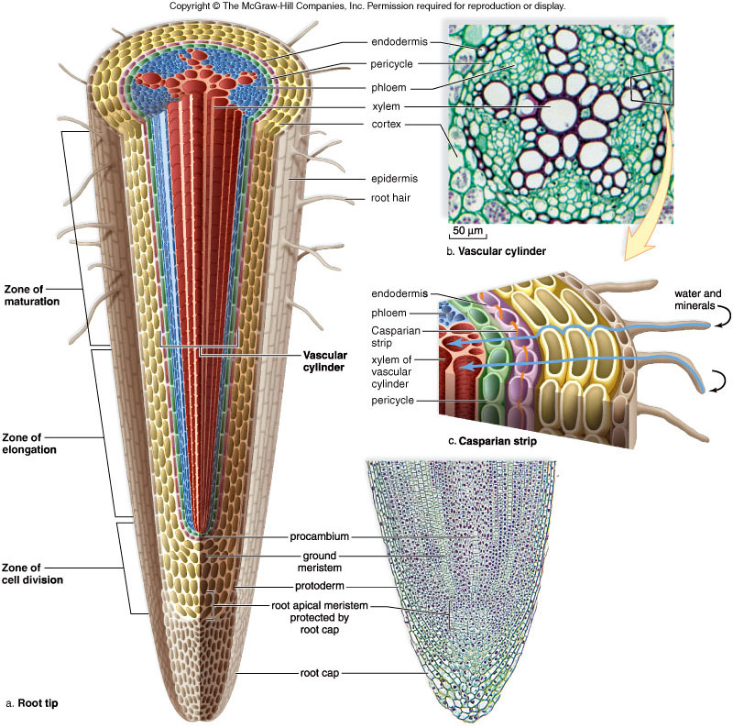
حزمة وعائية
القشرة الداخلية
phloem
xylem
الدائرة المحيطية

Slide 5
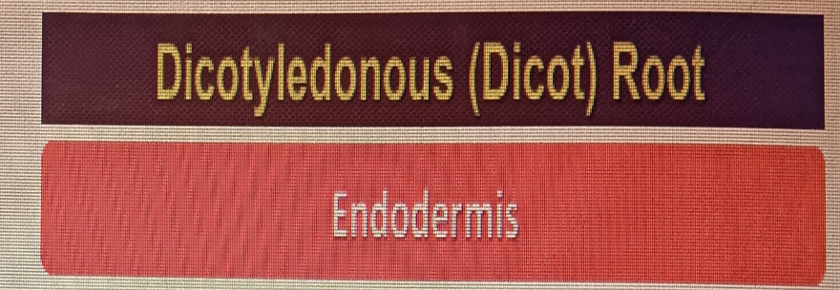
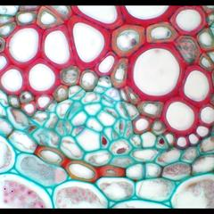
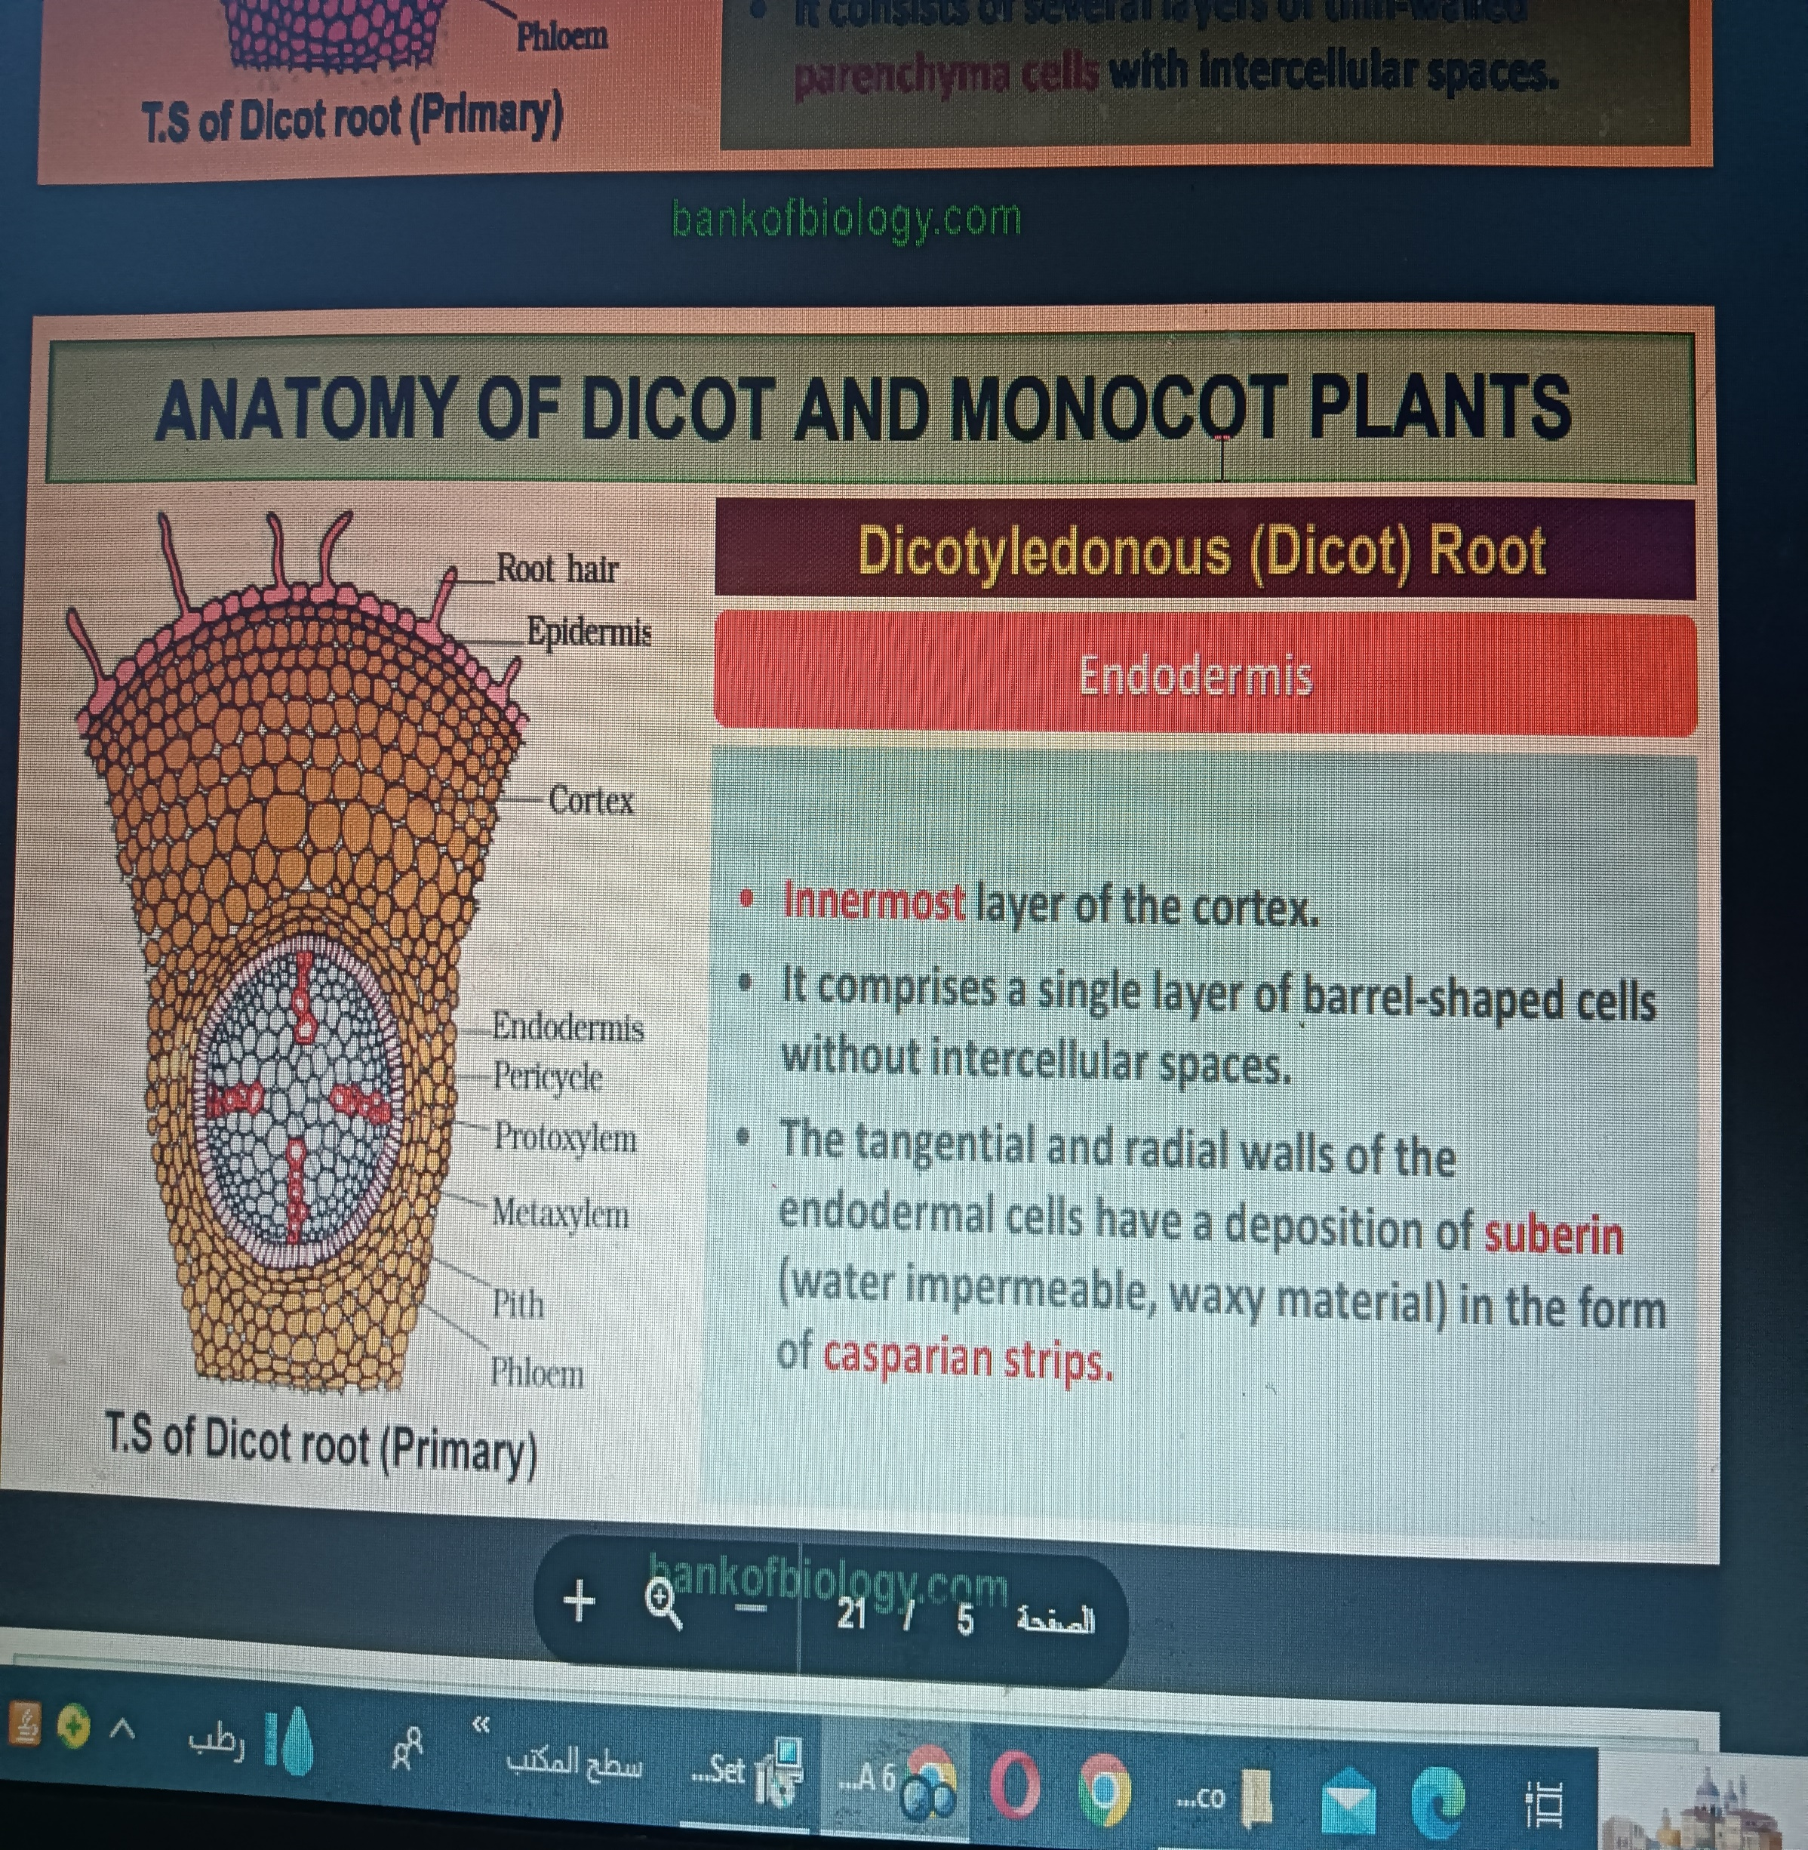
خشب تالي
أسطواني ممتلئ
لحا
خشب اول
الفلين
القشرة الداخلية
اشرظة كاسبار
خلايا المرور

Slide 6
It is the innermost layer of cortex.
It is made up of single layer of barrel shaped cells.خلايا بشكل برميل
Radial and transverse walls of endodermal cells show thickenings due to deposition of lignin and suberin. These are called casparian thickenings. It is characteristic feature of endodermis.
Endodermal cells present opposite to protoxylem are thin walled without casparian strips. These cells are called passage cells.
Passage cells help in the entry of water and salts from cortex into stele.

Slide 7
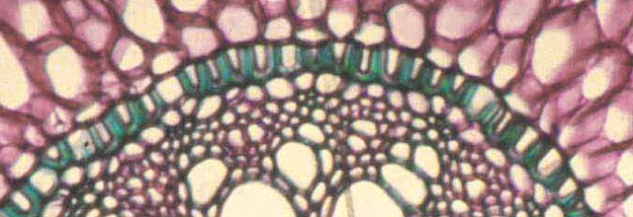
épaississement subérolignifié" → تعني تغلظًا يحتوي على السوبرين واللجنين، مما يجعله حاجزًا لحماية الأنسجة الداخلية.
لى شكل حدوة حصان.
The endoderm with suberolignified thickening in the shape of a horseshoe, characteristic of the roots of monocots

Slide 8
خشب تالي
لحا
خشب اول
القشرة الداخلية
خلايا المرور

Slide 9
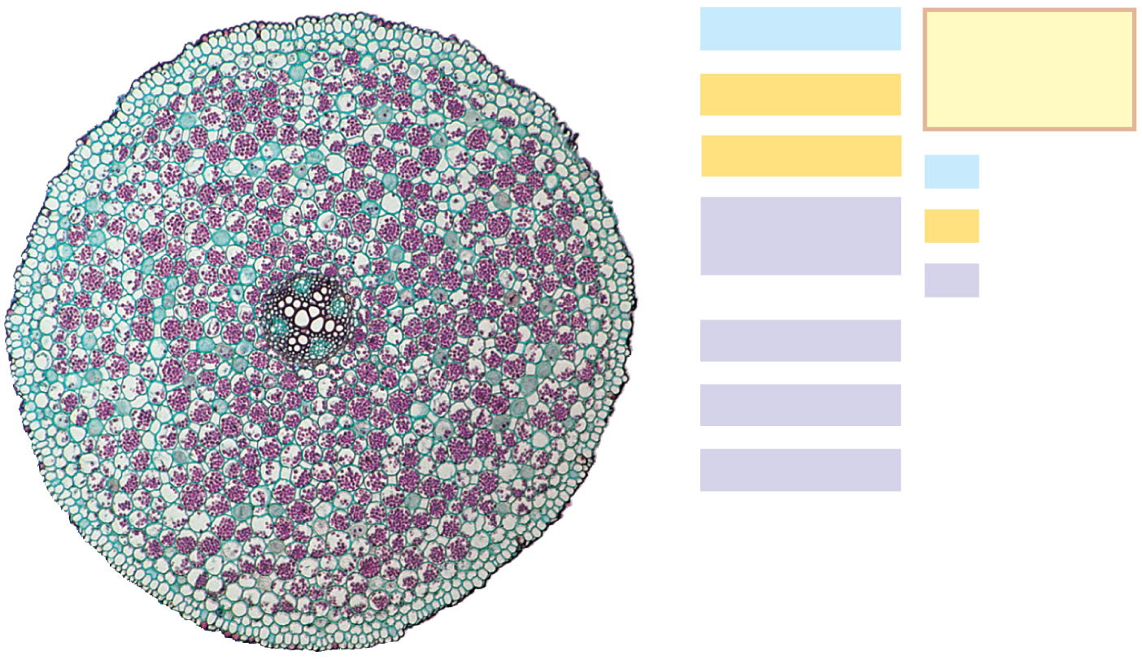
Root with xylem and phloem in the center
(typical of eudicots)
Epidermis
Key
to labels
Cortex
Endodermis
Dermal
Vascular
cylinder
Ground
Vascular
Pericycle
Xylem
Phloem
100 μm
Notes:
Figure 35.14 Organization of primary tissues in young roots.

Slide 10
الأسطوانة المركزية
Stele

Slide 11
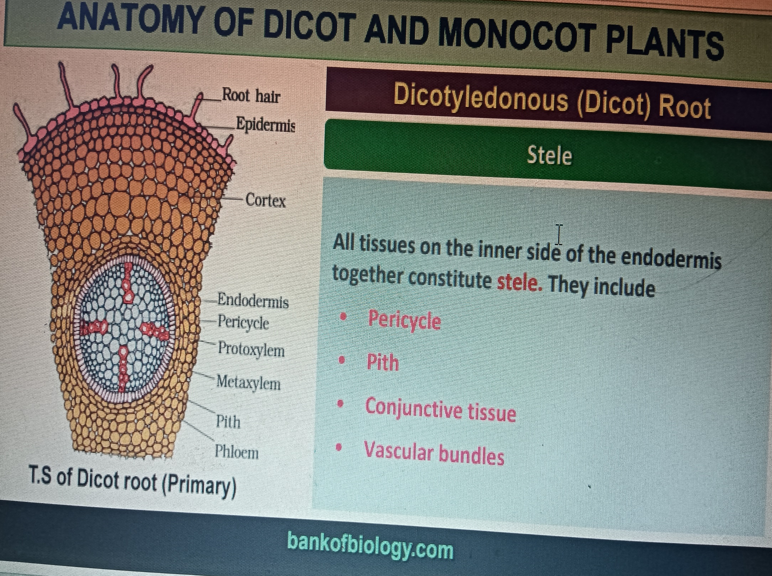

Slide 12
Anatomy of monocotyledonous Root
جذر احاديات الفلقة

Slide 13
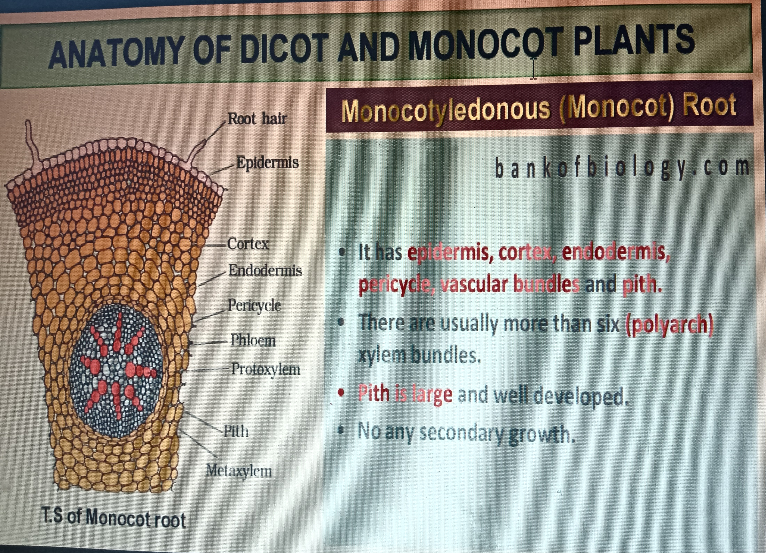

Slide 14
Monocots are usually Polyarch(12-20). Bundles of Phloem alternate with the Xylem arms.

Slide 15
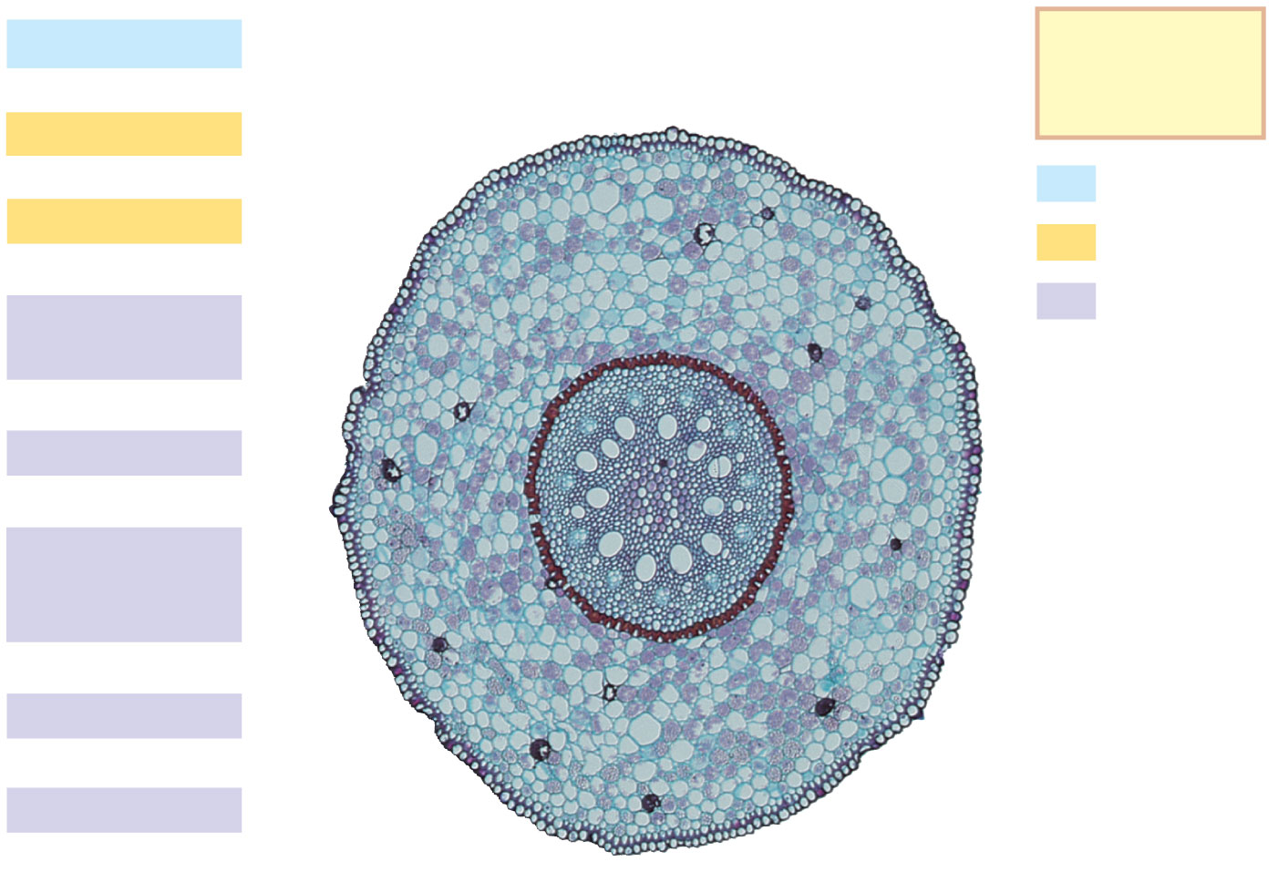
Root with parenchyma in the center
(typical of monocots)
Epidermis
Key
to labels
Cortex
Dermal
Endodermis
Ground
Vascular
cylinder
Vascular
Pericycle
Core of
parenchyma
cells
Xylem
Phloem
100 μm
Notes:
Figure 35.14 Organization of primary tissues in young roots.

Slide 16
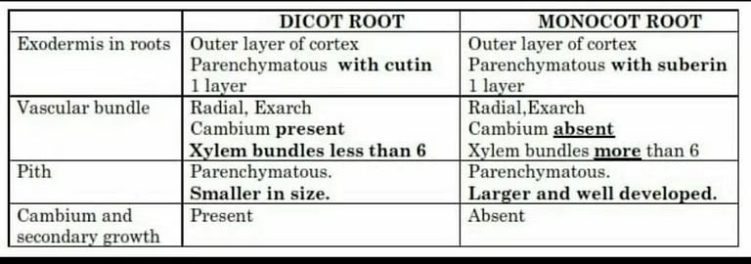

Slide 17
Lateral roots

Slide 18
تشكل الجذور الثانوية
Lateral roots formation

Slide 19
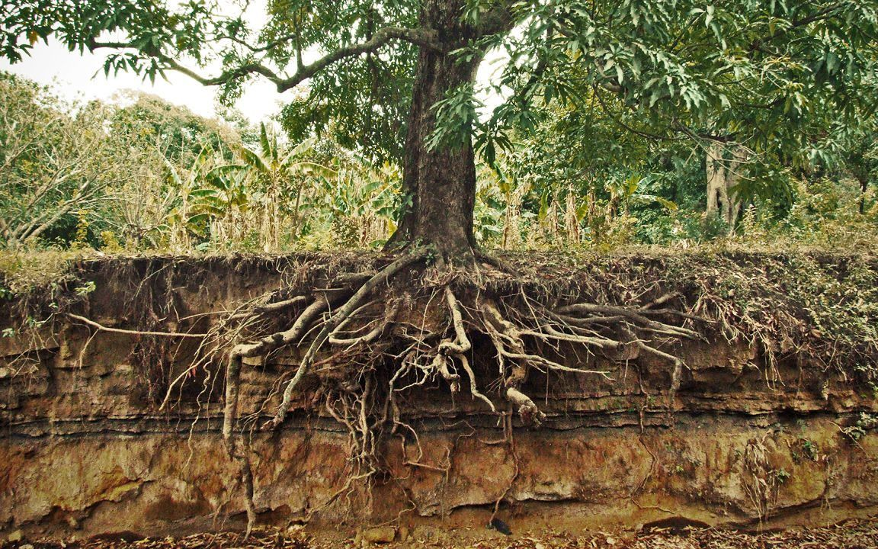

Slide 20
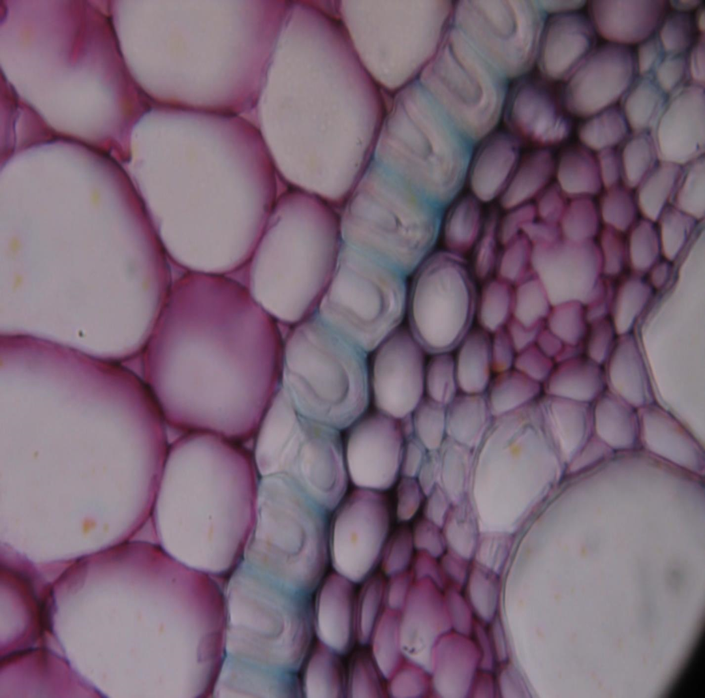
Lateral roots arise from the pericycle, the outermost cell layer in the vascular cylinder
Pericycle الدائرة المحيطية

Slide 21
teps of Lateral Root Emergence
1️⃣ Initiation in the Pericycle
The pericycle cells near a xylem pole become meristematic (capable of division).
These cells divide to form a lateral root primordium (a small root structure).
2️⃣ Growth Through the Cortex
The developing lateral root elongates, pushing outward.
It secretes enzymes that break down cortex cells, creating a pathway.
3️⃣ Breaking Through the Epidermis
The lateral root reaches the epidermis and emerges into the soil.
Root hairs develop for absorption, and vascular connections form with the main root.

Slide 22
