Slide 1
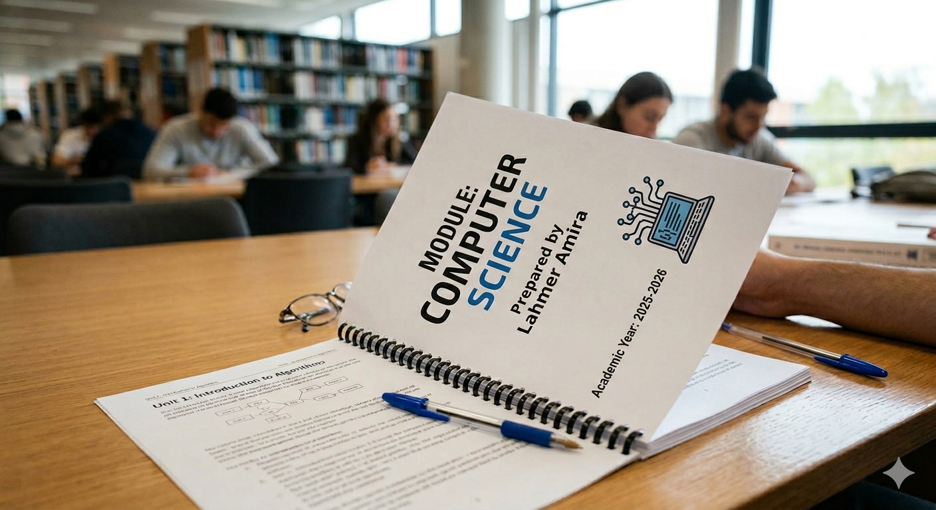

Slide 2

Computational Thinking
Computational Thinking, Algorithms & Programming
lesson 1

Slide 3
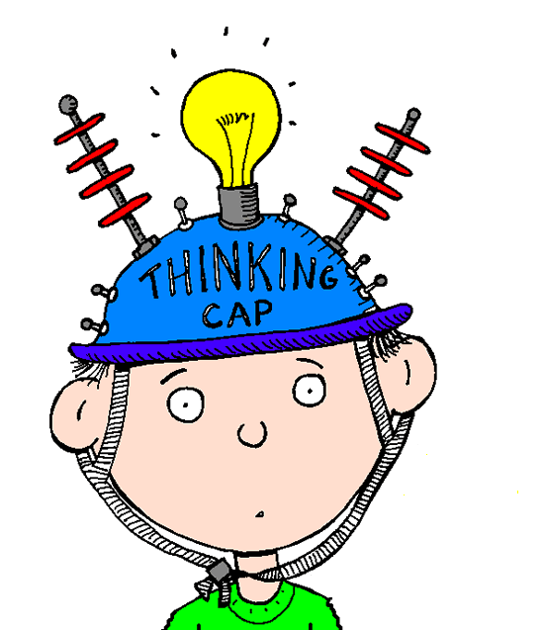
Computational Thinking
Computational Thinking, Algorithms & Programming
Learning Objective: To be able to demonstrate an understanding of the thought processes involved in understanding problems and formulating solutions that computers can process.
Success Criteria:
I can define the terms Decomposition, Abstraction and Algorithmic Thinking.
I can explain how each of these are used to help understand and process computing problems.

Slide 4
Decomposition
Computational Thinking, Algorithms & Programming
Decomposition reduces a problem into sub-problems or components. These smaller parts are easier to understand and solve.
Problem
Create a ‘snakes and ladders’ computer game
Definition: Breaking a complex problem down into smaller problems and solving each one individually.
Sub-problems
As you can see in this example, the main problem has been decomposed into smaller sub-problems making it easier to understand.
Design of playing area
Positions of snakes and ladders
Example:
Dice throw for each player
Movement of each player on the board
Just like how you used decomposition to break down your NEA task.
Movement up ladders and down snakes
How does a player finish?

Slide 5

Abstraction
Computational Thinking, Algorithms & Programming
Definition: the process of removing unnecessary details so that only the main, important points remain.
Abstraction identifies essential elements that must be included in the computer models of real-life situations and discards inessential ones.
For a computer model of ‘Snakes and Ladders’, the sub-problem ‘Dice throw for each player’ includes the essential element ‘Generate a random number between 1 and 6’.
Inessential elements would include whether you use a shaker, how long you shake it for and how far you throw the dice.
Example:
When driving a car, there are some essential elements that you need to know:
How to turn on the engine
How to use the brakes
How to use the gears
There are some inessential elements that you could afford to ignore:
The number of miles per gallon
The dimensions of the wheels
How each component under the bonnet works
These inessential things are useful to know, but not essential to actually driving the car = Abstraction.

Slide 6
Algorithmic Thinking
Computational Thinking, Algorithms & Programming
Algorithmic thinking is a subset of computational thinking that involves defining a clear set of instructions to solve a problem.
Once a successful solution to a problem has been found, it can be used repeatedly for the same problem.
For example, the process of calculating the mean of a set of numbers is always the same irrespective of how many numbers and what they are – add up all the numbers and divide the total by the number in the set.
Definition: a logical way of getting from the problem to the solution. A set of instructions for solving a problem.

Slide 7


