Slide 1
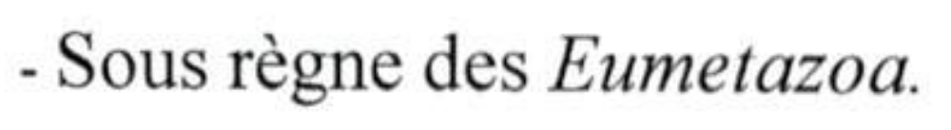
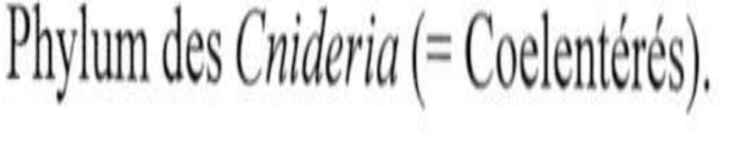

Slide 2
1- General Characteristics
They have true tissues
They are named after characteristic cells found on the surface of their body = stinging cells, the cnidocysts (cnidé = nettle), which are very abundant along their tentacles and in the ectoderm
Radial symmetry, with a secondary bilateral symmetry superimposed on it (in Anthozoa)
Sac-like body with an internal digestive cavity provided with a single opening serving as both anus and mouth, surrounded by hollow tentacles specialized in prey capture.
Unique life cycle with alternation of generations between the
polyp stage (sessile), generally the benthic asexual form
medusa stage (free-living), sexual and pelagic

Slide 3
Aquatic, almost all marine, solitary or colonial, pelagic or benthic
Sexual reproduction (polyp or medusa, with separate sexes or hermaphroditism), and/or asexual reproduction (polyp by budding, strobilation, etc.).
Predators using cnidoblasts to capture and immobilize their prey
Some sea anemones produce cellulases that enable them to digest plant material
They very often live in symbiotic associations
Example: sea anemone and clownfish

Slide 4
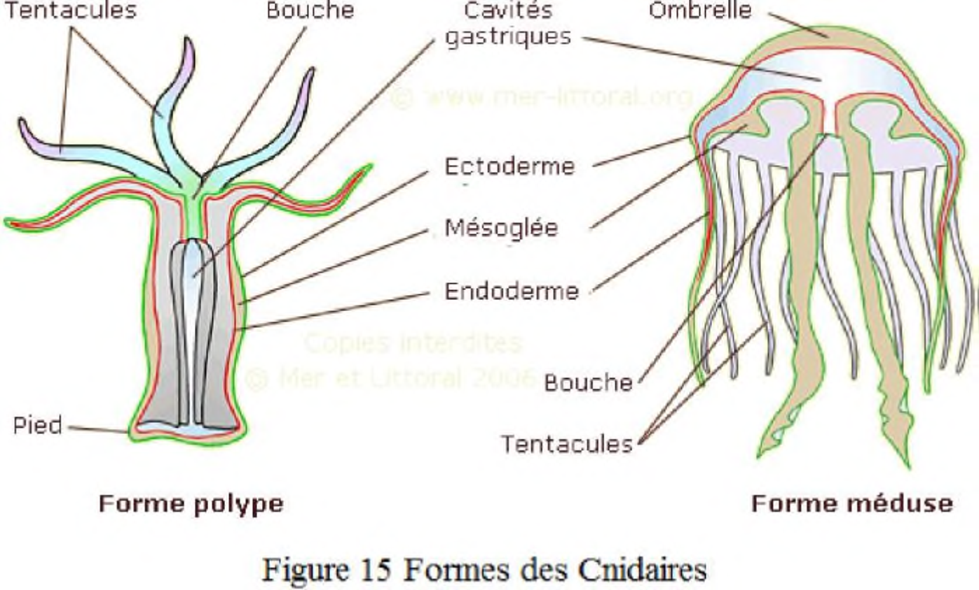

Slide 5
2- Wall Structure
Case of Hydra:
Ectoderm, consisting of 4 cell types:
Myoepithelial cells
Neurosensory cells
Interstitial cells
Stinging cells (cnidocytes or cnidoblasts)
Endoderm, composed of 4 cell types:
Myoepithelial cells
Gland cells
Sensory cells
Interstitial cells
Between the two layers there is an intermediate layer: mesoglea containing protoneurons

Slide 6
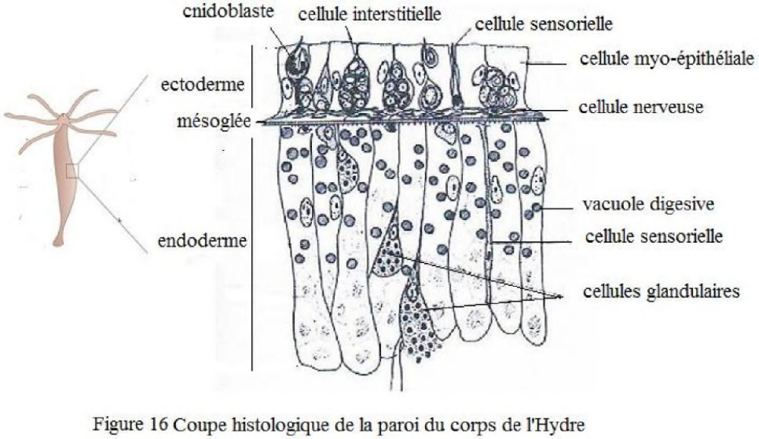

Slide 7
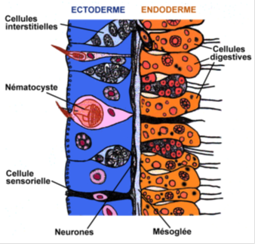
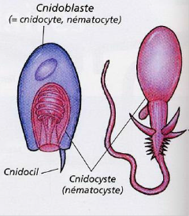

Slide 8
Medusa:
Swimming
Convex aboral surface: umbrella
Concave oral surface
The mouth opens at the end, faces downward, and is suspended by the manubrium
Branched gastrovascular cavity within the umbrella, which is bordered by tentacles
Cnidoblasts concentrated on the tentacles
Polyp:
Small sac whose opening (mouth) is directed upward and surrounded by a ring of tentacles into which the gastrovascular cavity extends; it attaches to the substrate by its pedal disc
Thin mesoglea
Digestive cells take up food by phagocytosis, while gland cells release digestive enzymes into the gastrovascular cavity
Cnidarians: carnivores that capture their prey using their tentacles and cnidocysts

Slide 9
Reproduction
Alternation between polyp and medusa forms
Both forms can release gametes
Result of fertilization: ciliated larva = planula
The larva attaches and transforms into a small polyp (scyphistoma), which may live for several years and reproduce by lateral budding
Transverse constrictions appear along the scyphistoma, forming the strobila
These detach successively to form small medusae (ephyrae)
All medusae produced by the same scyphistoma are of the same sex and lead a pelagic life
They can reproduce vegetatively to produce other medusae, or by gametes to begin a new cycle at the polyp stage

Slide 10
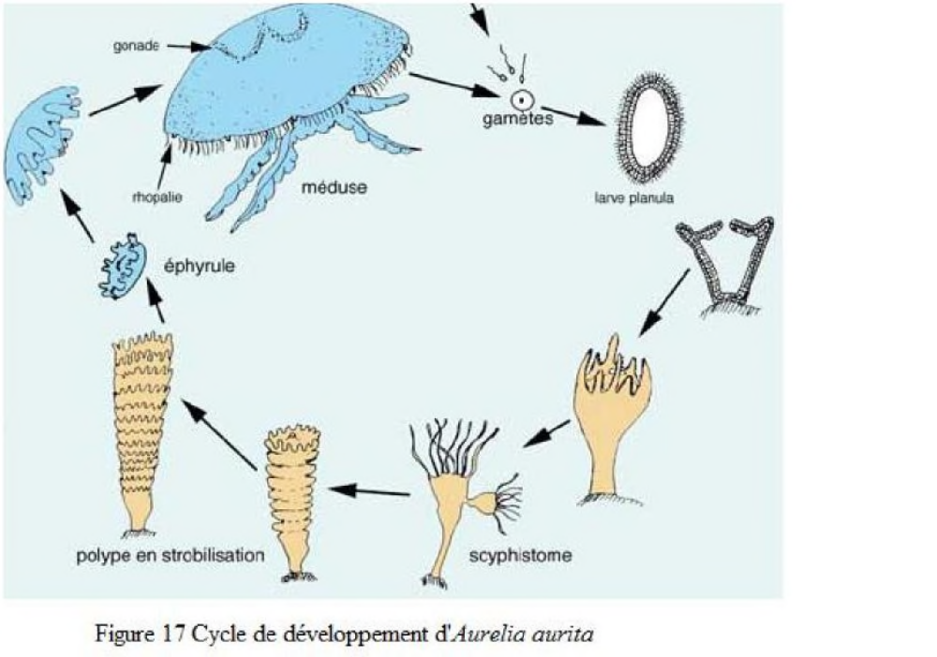

Slide 11
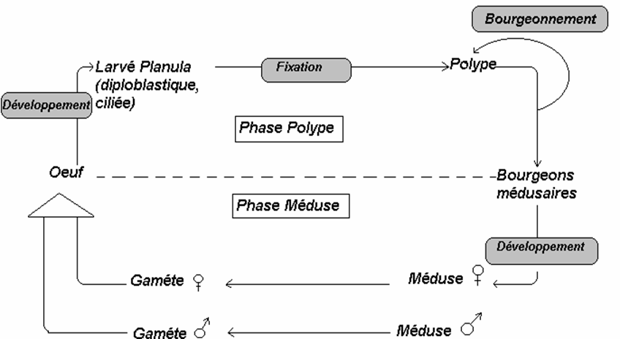
General life cycle of a cnidarian

Slide 12
Classification
Based on 2 criteria:
Structure of the gastric cavity: without partitions, incompletely partitioned, or completely partitioned
Development cycle: alternation or predominance of the polyp or medusa phases

Slide 13
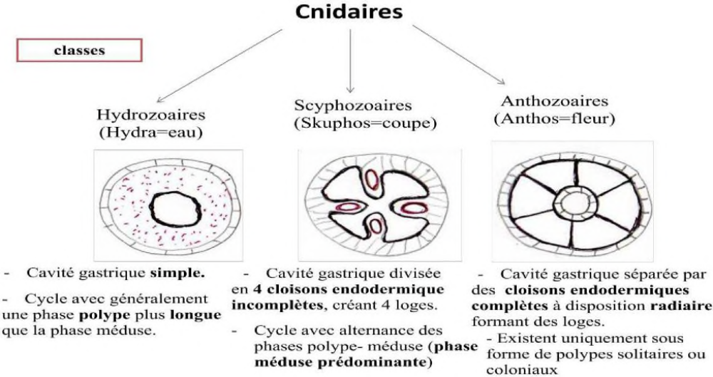

Slide 14
Class 1 – Hydrozoa
Freshwater species, e.g. Hydra, or marine species living in colonies: Obelia
Simple gastrovascular cavity, not divided by partitions
Solitary or colonial polyp
Planktonic, transparent, and small medusa
Alternation between polyp and medusa forms, or a cycle reduced to the polyp or medusa phase
Polyp generation more highly developed
Medusae with a velum (fold of the umbrella)

Slide 15
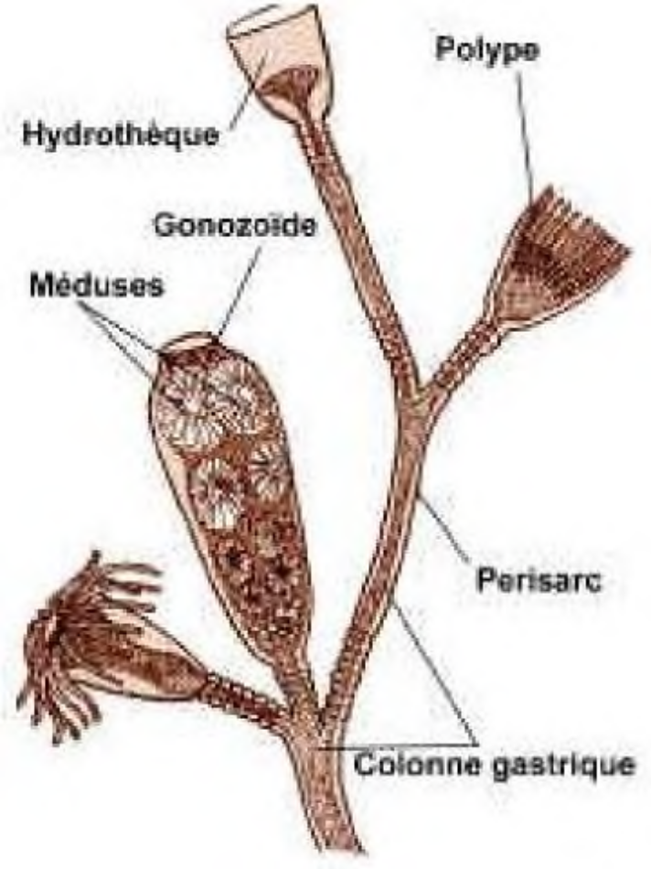
Fragment of an Obelia sp. colony

Slide 16
2 Subclasses: Hydroids and Siphonophores
Subclass 1: Hydroids
Hollow tentacles
Solitary or colonial
2 orders: Hydrida, Leptolida
Order 1: Hydrida:
Exclusively in the polyp form.
Example: Hydra viridis (freshwater hydra).
Order 2: Leptolida:
Example: Obelia geniculata
Subclass 2: Siphonophores:
Pelagic (floating) colonies, composed of similar units: cormidia
Permanent or detachable
Example: Physalia physalis

Slide 17
Class 2 – Scyphozoa
(Skyphos = cup)
Gastric cavity with 4 endodermal folds
Polyp phase greatly reduced when present; solitary, small, and attached to a substrate
Medusa formation by asexual reproduction = strobilation
Medusa phase dominant and without a velum
In winter, the body of the scyphistoma (small polyp derived from the planula) elongates and constricts into superimposed discs: the strobila
Each disc separates, detaches, turns over, and forms an ephyra
Example: Aurelia aurita

Slide 18
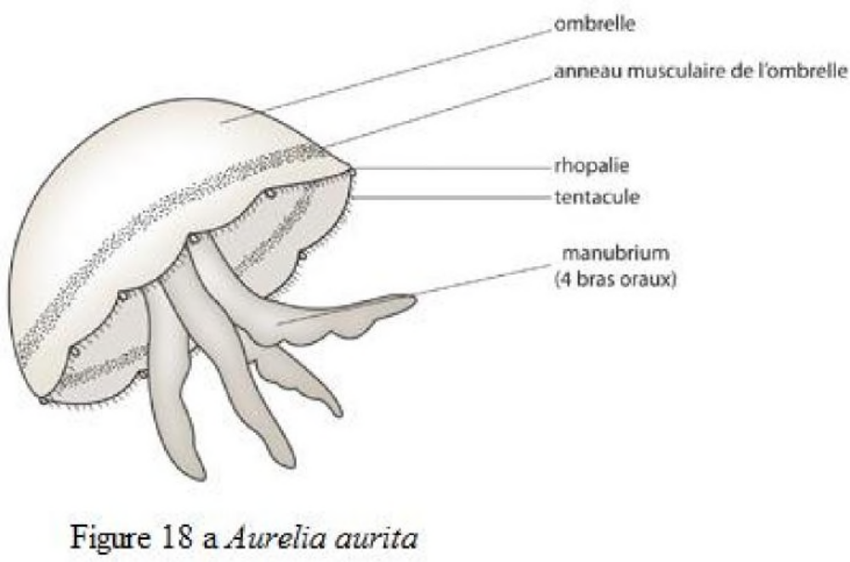

Slide 19
Class 3 – Anthozoa
Polyp form only
Gastric cavity partially divided into chambers by endodermal walls
At the center of the circle of tentacles, the ectoderm invaginates to form a pharynx
On the side of the pharynx there is a ciliated groove: siphonoglyph
This gives the animal dorsoventral (bilateral) symmetry, superimposed on the radial symmetry indicated by the tentacles
Sexes generally separate
Systematics based on the number of tentacles and gastric chambers.
2 subclasses: Octocorallia and Hexacorallia

Slide 20
Subclass 1: Octocorallia:
8 pinnate tentacles
8 gastric septa
1 ventral siphonoglyph
Example: Corallium rubrum, red coral
Subclass 2: Hexacorallia:
Smooth tentacles, in multiples of 6
Gastric septa, in multiples of 6
2 siphonoglyphs: 1 ventral and 1 dorsal
Example: sea anemone

Slide 21
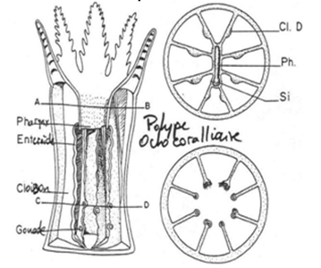
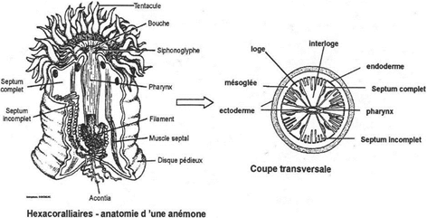

Slide 22
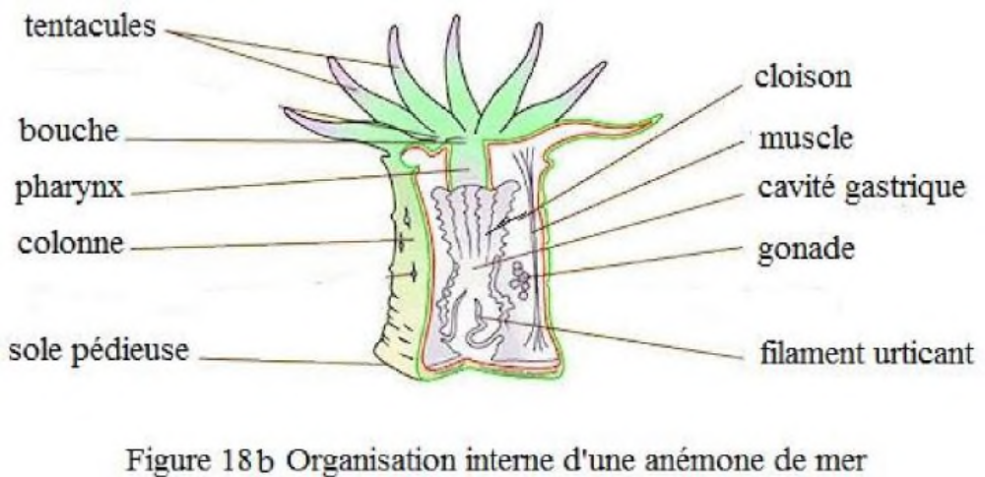

Slide 23
Defense and Ecology
Cnidoblasts = excellent means of defense
Released toxins are injected into the prey's tissues
For divers, the toxic substance can cause painful burns
The calcareous skeleton of corals provides protection against very voracious fish.
Polyps produce mucus to clean their surface of sedimenting particles, and many coral reef fish feed on this mucus
Several corals contain photosynthetic algae in vacuoles
The algae produce sugars that are assimilated by the corals and remove nitrogenous wastes from the corals
Coral — coral reef — very important marine ecosystem

