Slide 1
Metazoans
Diploblasts

Slide 2
Subkingdom Parazoa.
Phylum Porifera (= Sponges).

Slide 3
1- General characteristics
The most primitive multicellular animals
Simple diploblastic metazoans (ectoblast and endoblast separated by mesoglea)
Simple organisms without tissues or organs
Cells loosely attached to one another, not forming true tissues
They therefore form the subkingdom Parazoa
Aquatic animals, mainly marine, always sessile
Sac-like body wall perforated by numerous pores, hence the other name of the phylum: Porifera
Water enters through these inhalant pores and exits through the osculum = exhalant pore, functioning like an anus.

Slide 4
Sessile aquatic filter-feeders that filter suspended food particles (phytoplankton, bacteria, organic debris) from the water.
Asymmetrical animals
Skeleton made of calcareous, siliceous, or organic spicules.
Rudimentary and diffuse nervous system
Respiration by simple diffusion
Osmoregulation provided by contractile vacuoles present in each cell
Vital functions are performed by cells (rather than by tissues, organs, or systems)
Characterized by the presence of choanocytes.
Hermaphroditic or gonochoric animals
Generally inhabit coastal and sublittoral zones

Slide 5
2- Structure and morphology
Body wall formed by 2 cellular layers / double sac-shaped body
Outer layer = simple covering epithelium formed by epidermal cells: pinacocytes, forming the pinacoderm, perforated by openings allowing water to enter the animal: the spongocoel (atrium)
Inner layer: collar cells line the gastric cavity (atrium) and bear a flagellum: choanocytes ensure water circulation and food retention
The beating of the flagella causes water and food particles to enter through the pores of the pinacoderm and leave through the opening of the sac: the osculum
It also contains calcareous or siliceous spicules, or spongin fibers secreted by amoebocytes

Slide 6
Between the two layers is a gelatinous matrix called mesoglea, composed of:
Amoebocytes:
Derived from choanocytes
Able to move by amoeboid movement
Can give rise to different types of specialized cells
A flagellum is located at the center of the collar
Collencytes:
Derived from choanocytes
Secreting a gelatinous interstitial substance
Nerve cells forming a rudimentary nervous system
Porocytes of ectodermal origin: tubular cells containing an intracellular canal
Scleroblasts of ectodermal origin, producing calcareous or siliceous spicules, or spongin fibers secreted by amoebocytes

Slide 7
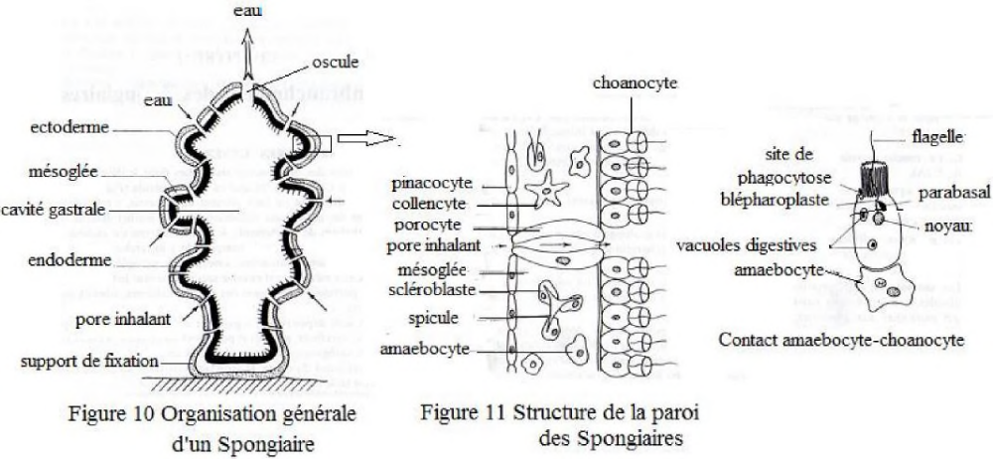

Slide 8
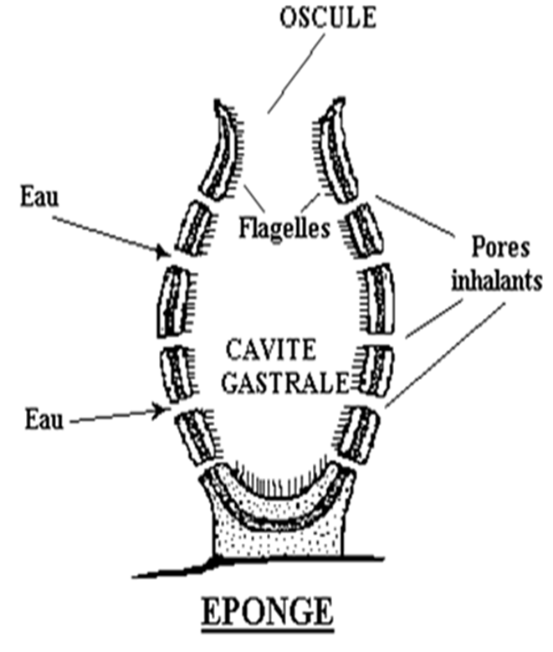
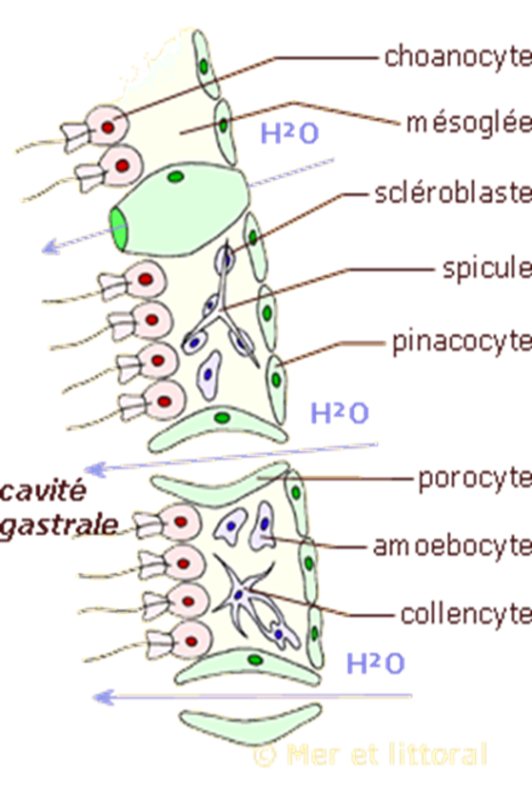

Slide 9
There are 3 forms or types of sponges:
Asconoid form (Ascon type)
The simplest
Found only in the smallest sponges
Characterized by ostia leading directly to the gastric cavity, which is lined with choanocytes
Syconoid form (Sycon type)
Represents an evolutionary development compared with the first form
Choanocytes no longer line the gastric cavity but a multitude of small canals: radial canals
They increase the contact surface between water and the animal's cells
They allow greater food absorption.
Leuconoid form (Leucon type)
The most complex
Ostia and canals leading to numerous chambers (flagellated chambers) lined with choanocytes
Found in large colonial sponges

Slide 10
3- Classification
3 classes: Class 1: Calcarea (calcareous sponges), Class 2: Demospongiae (demosponges), Class 3: Hexactinellida (glass sponges)

Slide 11
3-1- Calcareous sponges
Skeleton composed of calcareous spicules or a continuous calcareous structure
May be simple or compound
Les 3 types d'éponges: ascon, sycon et leucon y sont représentés
There are 2 forms:
Homocoel: choanocytes lining the entire atrium
Heterocoel: formation of flagellated chambers or tubular diverticula
Attached to a hard substrate

Slide 12
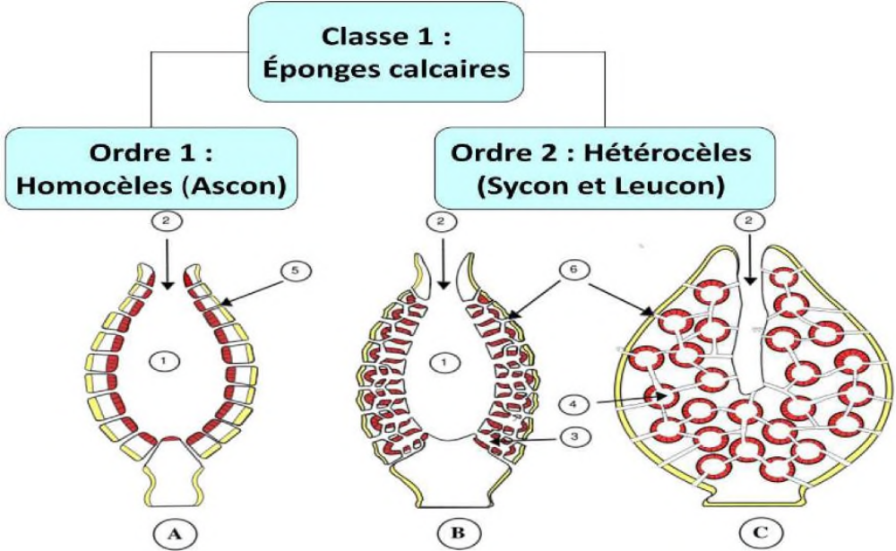

Slide 13
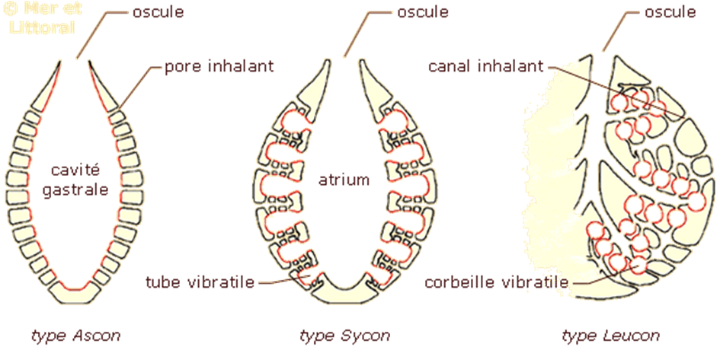

Slide 14
3-2- Hexactinellids
Also called triaxonids
Example: genus Euplectella
Glass sponges with a siliceous skeleton
Spicules composed of hydrated silica, of heterogeneous size, forming a coherent architecture
They have 3 axes and can reach 60 cm in length
Species living beyond the continental shelf (at about 200 m and deeper)
Spicules divided into megascleres and microscleres

Slide 15
3-3- Demosponges
Skeleton made of spongin, which may be associated with some siliceous spicules; Leucon type sponges
Siliceous spicules of heterogeneous size, differentiated into megascleres (large spicules) and microscleres (small spicules).
Example: Spongilla sp.

Slide 16
4- Reproduction
2 modes: asexual and sexual
Asexual reproduction by external and internal budding and by regeneration
External budding
Undifferentiated cells found in the mesoglea, called archaeocytes
They can give rise to a bud that develops into a new sponge
Internal budding
In freshwater sponges and some marine sponges
Gemmule production occurs
These gemmules are released at the end of autumn
The archaeocytes leave the gemmules and develop into a new sponge.

Slide 17
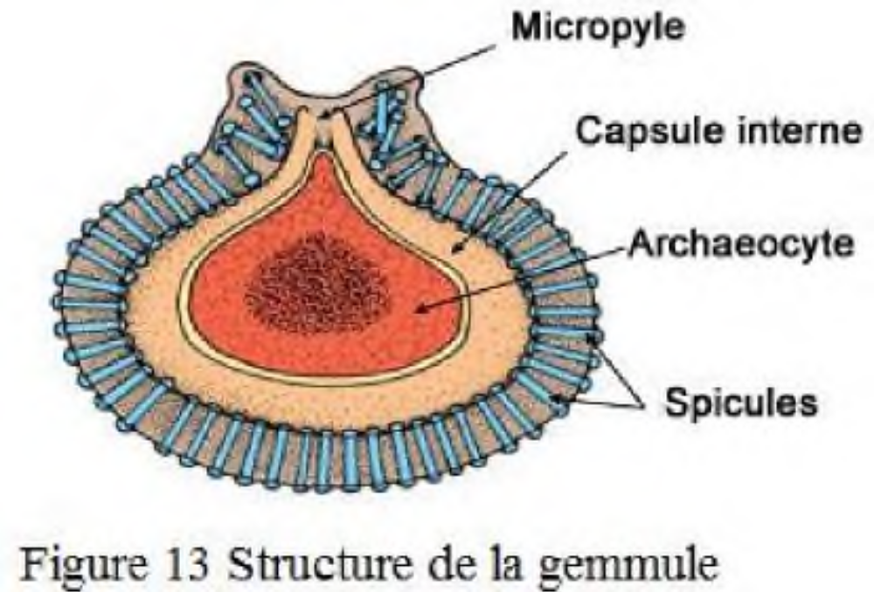

Slide 18
Regeneration
Detached fragments can regenerate into a complete sponge
This property is used to propagate bath sponges
Sexual reproduction
Mostly hermaphroditic (siliceous sponges), with some gonochoric species (calcareous sponges)
This group has no true gonads; gonocytes derive from amoebocytes and are then dispersed in the mesoglea
They divide and give rise to spermatogonia and oogonia
Sperm are released by one individual and enter another sponge

Slide 19
Choanocytes that have captured sperm become mobile and transport the sperm through the mesoglea where the ova are located
After fertilization, the egg develops in the mesoglea and becomes a flagellated larva (amphiblastula or parenchymula), which is released into the external environment
The small proportion of larvae that survive attaches to a substrate and metamorphoses into an adult sponge

Slide 20
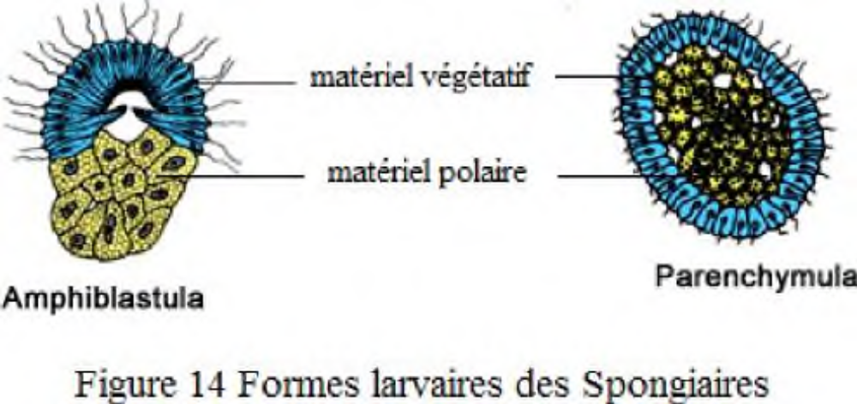

Slide 21
5- Feeding and digestion
Suspended particles entering the sponge are filtered by choanocytes
Digestion is intracellular, but does not occur in the choanocyte
The digestive vacuole containing the particles is transferred to an amoebocyte
Inside the amoebocyte, this vesicle fuses with a lysosome, where digestion takes place
Nutrients are redistributed by amoebocytes, which move either toward the
outer wall to nourish the pinacoderm cells
inner wall to nourish the choanocytes

