Slide 1
Phylum Mollusca
1- General characteristics

Slide 2
Metazoans, coelomates, protostomes, hyponeurians, unsegmented, bilaterians (modified in gastropods).
The coelom, initially formed by one pair of coelomic sacs, becomes three communicating cavities.
  Genital cavity surrounds the gonads
  Pericardial cavity surrounds the heart
  Nephrocoel surrounds the nephridia

Slide 3
Body consists of 3 parts: Head, ventral foot, dorsal visceral mass protected by a shell.
Head: bears the mouth + main sensory organs (eyes and tentacles)
Ventral foot: muscular locomotory organ = creeping sole
Dorsal visceral mass: contains most of the internal organs and is covered by a membrane and a mantle, which secretes a calcareous shell.

Slide 4
The anus and all other nephridiopores open into the pallial cavity.
This cavity contains one pair of gills made up of ciliated cells.
Freshwater, marine or terrestrial
Burrowing, herbivorous or carnivorous
Parasites of marine animals (gastropods)
Rarely hermaphroditic

Slide 5
General anatomy
body divided into 3 parts:
Head: contains the sensory organs and the mouth, which contains the radula
Foot: pedal sole, a muscular organ typical of molluscs, used for locomotion
  It takes very diverse forms depending on the species
  It is poorly developed in aplacophorans (Solenogastres and Caudofoveates) but becomes more developed in other molluscs
  It forms the crown of tentacles or arms that enables predation in cephalopods
Visceral mass: as its name indicates, contains the viscera
  It is contained within a thin covering called the mantle
  The mantle secretes the shell in most molluscs, which serves as protection and/or a skeleton and/or a buoyancy regulator (e.g. cuttlefish).
  Between the mantle and the visceral mass, the pallial fold forms a pallial cavity that protects the respiratory organs and into which the metanephridia (excretory organs), intestine and genital ducts open.

Slide 6
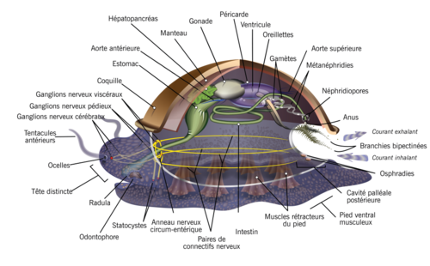
Body plan of a mollusc

Slide 7
The shell
In eumolluscs, mantle glands group together and generally secrete a calcareous shell consisting, from outside to inside, of:
a cuticle, variously colored
a prismatic layer, formed by calcareous prisms perpendicular to the surface;
a lamellar layer, formed by alternating lamellae of calcium carbonate and conchiolin (an organic substance). This inner layer, when the lamellae are thin enough to diffract light, forms nacre and, indirectly, fine pearls.
The subphylum or superclass Aplacophora, possibly paraphyletic, groups worm-shaped molluscs without a shell (but whose mantle secretes a cuticle containing calcareous spicules), divided into two classes:
Caudofoveates, without a ventral groove and foot; microphagous animals buried in sediments;
Solenogastres, with the foot reduced to a ciliated ridge inside a ventral groove; benthic animals that graze on attached metazoans.

Slide 8
Nervous system
The nervous system comprises
  one double periesophageal collar
  3 pairs of cerebral ganglia (which may fuse to form a brain)
  connectives
  one ventral nerve cord

Slide 9
Circulatory system
Circulation is incomplete
Short arteries arise from the heart, but there are neither veins nor capillaries
Cephalopods are an exception among molluscs and have a closed circulatory system with a systemic heart and two branchial hearts.
The blood is colorless, or slightly colored by dissolved hemoglobin or hemocyanin.

Slide 10
Reproductive cycle
The sexes are generally separate
Some common species are hermaphroditic, such as the snail or oyster.
Eggs contain varying amounts of yolk, and hatching occurs after a more or less advanced stage of development.
Early embryonic development involves spiral cleavage or segmentation, which allows molluscs, together with annelids, to be classified among the Spiralia.
When there is a free-living larva (trochophore, veliger), it closely resembles the annelid trochophore.

Slide 11
Classification
Molluscs, one of the most diverse animal groups, are classified into several classes according to their anatomical and physiological characteristics. The main classes are:
Class Gastropoda: This is the largest class of molluscs and includes snails and slugs. They are characterized by a single, generally spirally coiled shell and a body that undergoes torsion during development.
Class Bivalvia: This class includes clams, oysters, mussels and scallops. They are characterized by a shell divided into two hinged parts. They do not possess a radula (a tongue-like organ unique to molluscs).
Class Cephalopoda: This class includes octopuses, squids and cuttlefish. They are characterized by a well-developed head and a set of tentacles. They are the most intelligent and mobile molluscs.
Class Polyplacophora: This class includes chitons. They are characterized by a shell composed of eight overlapping plates.

Slide 12
Class Scaphopoda: This class includes tusk shells (tube-shaped shells). They are characterized by a tubular shell open at both ends and a foot adapted for burrowing in sand and mud.
Class Monoplacophora: This class includes deep-sea species once considered extinct. They are characterized by a single cap-shaped shell and a series of paired muscle scars.
Class Aplacophora: This class includes worm-shaped molluscs without shells. They are characterized by a simple body plan and live in deep-sea habitats.
These classes are further subdivided into orders, families, genera and species based on more specific characteristics.

Slide 13
Class 1: Gastropoda
from Ancient Greek γαστήρ / gastếr, “belly” and πούς / poús, “foot”: belly-foot)
characterized by torsion of their visceral mass
show great diversity of forms but can generally be recognized by their twisted, univalve dorsal shell, characteristic when present
constitute the largest animal group after insects: about 40,000 living species are known,
Found throughout the world, in all environments except polar regions
The smallest gastropods are millimetre-sized and the planktonic larvae of aquatic species are microscopic; the largest known gastropod is the “Australian trumpet”, which exceeds 90 cm and can weigh up to 18 kg!

Slide 14
have a distinct foot and head
foot flattened into a broad ventral sole, used for swimming or crawling
head bears eyes and a radula
very diverse ecology: may be marine, freshwater or terrestrial
Terrestrial gastropods include snails and slugs.

Slide 15
In the old classification, for example that of Johannes Thiele (1929–1935), three subclasses were defined:
  Prosobranchia, mainly marine, with gills at the front of the body, opposite the heart.
  Opisthobranchia, all marine, with gills at the rear of the body, such as pteropods, which are adapted to pelagic life.
  Pulmonata, with a lung instead of gills, although some (for example, lymnaeids) have returned to aquatic life.

Slide 16
Pulmonata
They are so named because, after leaving the aquatic environment, they lost the gill of their ancestors and acquired a lung, an organ of aerial respiration.
This lung corresponds to the highly vascularized pallial cavity, which opens to the outside through a small opening, the pneumostome, and is therefore not homologous to the lungs of vertebrates.
Secondarily, some became aquatic again, colonizing inland freshwater (mainly lymnaeids and planorbids).
Species that remained in terrestrial habitats are generally known as snails and slugs.
They play an important role in ecosystems
  as a food source for their predators (food web)
  by contributing to vegetation control
  as vectors of parasites and diseases, indirectly contributing to the balance of animal and plant populations
  Some are detritivores or participate in saproxylic communities.

Slide 17
They play an important role in ecosystems
  as a food source for their predators (food web)
  by contributing to vegetation control
  as vectors of parasites and diseases, indirectly contributing to the balance of animal and plant populations
  Some are detritivores or participate in saproxylic communities.
Divided into 2 suborders:
  Suborder Stylommatophora: eyes located at the tips of the tentacles:
    Edible species, e.g. Eremina desertorum
    Important crop pests
    E.g.: Helix aspersa = garden snail and H. aperta
  Suborder Basommatophora (freshwater pulmonates): eyes located at the base of the tentacles
    E.g.: Limnaea cailliaudi = freshwater lymnaeid: disease vector

Slide 18
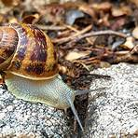
The garden snail (Helix aspersa aspersa)

Slide 19
Class 2: Lamellibranchs
also called Pelecypoda (“hatchet-foot” pelycypods)
includes clams, oysters, mussels, scallops and many other shellfish families.
Their laterally flattened body is covered by a shell consisting of two distinct and more or less symmetrical parts.
They are connected to each other and can open or close.
Most feed by filtering water and have neither a head nor a radula.
The gills, called ctenidia, in addition to their role in respiration, capture nutrients contained in the water and thus play an important role in feeding.
Most bivalves burrow into sediments on the sea floor, where they are protected from predators.
Others live on the sea floor or attach themselves to rocks or other hard surfaces.
Some can bore into wood, clay or stone and live inside these materials. Finally, some bivalves, such as scallops, can swim.
Some edible species: oyster; oyster farming = cultivation of oysters

Slide 20
Les sous-classes et ordres définis sont les suivants :
Subclass Prionodesmacea
  Order Paleoconcha
  Order Taxodonta: Several teeth (such as Nuculida)
  Order Schizodonta: Large bifurcating tooth (such as Trigonia)
  Order Isodonta: Equal teeth (such as Spondylus)
  Order Dysodonta: No teeth; ligaments hold the valves.
Subclass Teleodesmacea
  Order Heterodonta: Different teeth (such as the family Cardiidae).
  Order Pachydonta: Large, different, deformed teeth (such as rudists).
  Order Desmodonta: No teeth at the hinge; held by ligaments (such as the family Anatinidae).

Slide 21
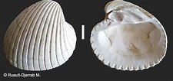
mussels

Slide 22
Class 3: Cephalopods
from Ancient Greek κεφαλή / kephalế, “head”, and πούς / poús (gen. ποδός / podós), “foot”)
marine molluscs whose head bears tentacles, also called arms
includes octopuses, squids, cuttlefish and nautiluses
presence of prehensile tentacles
head, distinct from the visceral mass, contains a true brain enclosed in a cartilaginous skull, highly developed eyes, a chitinous beak, etc.
It bears a peribuccal crown of muscular, protractile arms equipped with suckers and/or hooks.
The contractile ventral mantle, together with the siphon, forms a powerful locomotory organ.
Their size ranges from a few centimetres to about ten metres.
Living cephalopods are marine predators: they feed on other molluscs, fish and crustaceans
They capture prey with their arms and tear it apart with their horny beak.
Some edible species

Slide 23
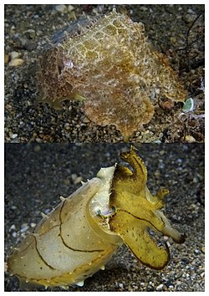
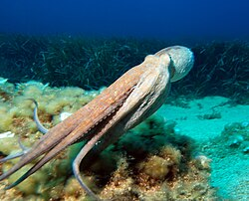
seiche peut passer d'un camouflage brun (en haut) à une coloration jaune avec des reflets foncés (en bas) en moins d‘1 s
Movement of Octopus vulgaris

Slide 24
The class Cephalopoda is divided into 3 groups (only 2 of which survive today)
subclass Nautiloidea, with a few species (appeared in the Cambrian),
subclass Ammonoidea (appeared in the Devonian - became extinct in the Late Cretaceous),
subclass Coleoidea, which includes squids, cuttlefish, octopuses and vampire squids, with more than 700 species (appeared in the Devonian).

