Slide 1
Practical work 2: Study of some typical species of Protozoa
Leishmania major, Leishmania infantum

Slide 2
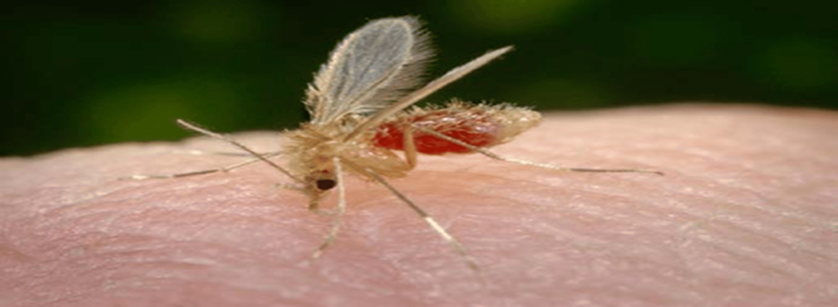
Leishmania is a genus of flagellate protozoa close to trypanosomes belonging to the genus Leishmania (family Trypanosomatidae). It is a parasite of mammals transmitted by the bite of infected female phlebotomine (sand-fly) and responsible for a disease, leishmaniasis. There are more than 20 species of Leishmania.
Leichmaniasis includes various skin or mucosal problems in the nose, mouth, throat or internal organs, such as the liver, spleen and bone purity.
sand-fly
phlebotomine (sand-fly)

Slide 3
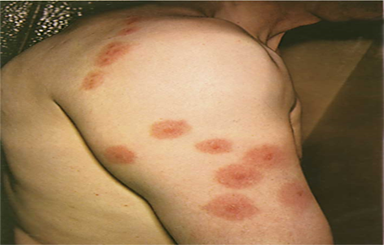
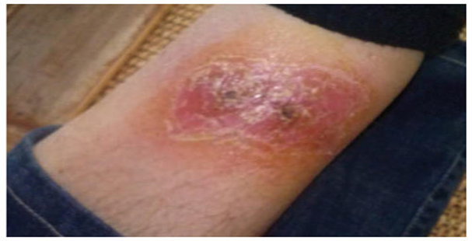
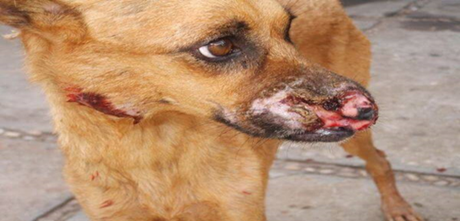

1.Cutaneous leishmaniasis:
Cutaneous leishmaniasis is a parasitic infection caused by a flagellate parasite of the species Leishmania major. It is most often a zoonotic disease transmitted by the bite of sandflies. The reservoirs of the disease are wild or peridomestic animals, most often rodents or dogs. The disease has a wide global distribution in the Americas, Asia, Europe and Africa.

Slide 4
Cutaneous leishmaniasis, most often benign but the most common, is characterized by ulcerated or ulcero-crusting lesions, sometimes very numerous. These lesions are located on exposed parts of the body, and which generally heal spontaneously, leaving scars.

Slide 5
2. Visceral leishmaniasis (VL): Also known as kala-azar, or black fever, is the most severe form of leishmaniasis. It is a disease caused by a parasite of the species Leishmania infantum. Among parasites it is the second biggest killer in the world, after malaria, with 20,000 to 30,000 deaths estimated worldwide each year1.
The parasite migrates into the viscera such as the liver, spleen and bone marrow and, if left untreated, almost always results in the death of the mammalian host. Symptoms include fever, weight loss, anemia, hepatomegaly (large liver) and splenomegaly (large spleen).

Slide 6
Amastigote to promastigote transformation
In the stomach of the female sand fly, the amastigotes quickly transform into a second form called the promastigote. This shape is fusiform, its size is triple that of the amastigote, and it has a simple flagellum which allows it to be mobile. Promastigotes live outside the cells in the sandfly's digestive tract for a few days, reproduce asexually and then migrate to the salivary glands.

Slide 7
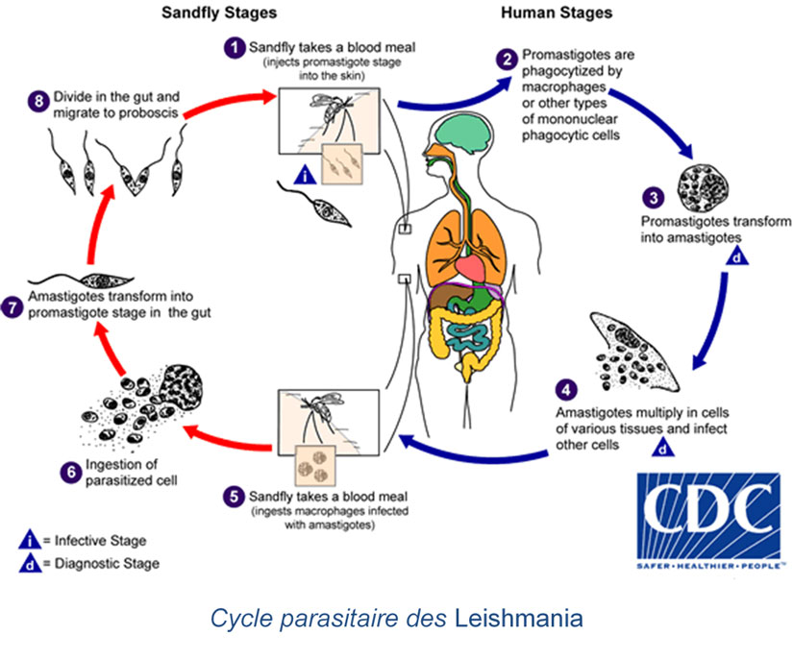

Slide 8
