Slide 1
Pharmacologie générale
Université de Jijel
Faculté des sciences de la nature et de la vie
Département de biologie moléculaire et cellulaire
Chapitre 1: Notions générales de pharmacologie
2. Etapes de recherche d’un médicament

Slide 2
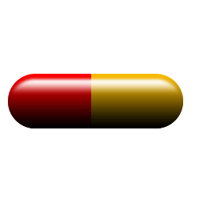
Qu’est-ce que c’est ?
Qu’y a-t-il à l’intérieur ?
Notes:
With a large capsule representing a medicine, ask students:
What is it? What’s inside?
(They will probably know that it’s a medicine):
A medicine consists of an active substance or substances and excipients.

Slide 3
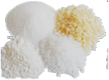
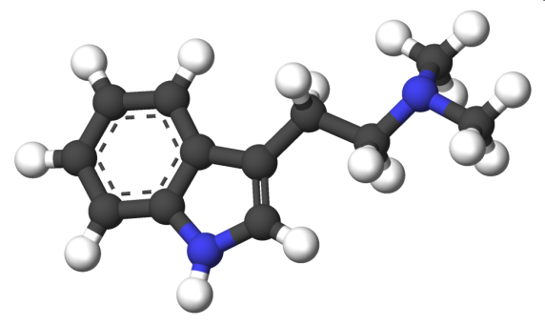

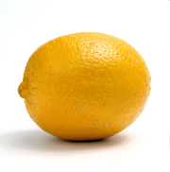
Qu’y a-t-il à l’intérieur d’un médicament ?
Notes:
You then open the capsule, which contains different objects representing the contents of a medicine:
A chemical structure made from molecular models that represents the active substance,
A plastic lemon that represents the aroma,
A small packet of sugar, representing a nice flavour,
A plastic strawberry, representing colour,
Some coloured balls, to improve its appearance,
Some plastic bubbles for protection,
etc…
The most important part of a medicine is the active ingredient, which is the biologically active substance that is capable of altering the metabolism of the cells that it affects. A medicine is a drug, or set of drugs, that have properties capable of preventing, treating, relieving or curing diseases or illnesses.
Excipients are pharmacologically inactive substances. There are many kinds of excipient and their functions are: to improve flavour, colour and appearance, to make the medicine soluble or protect the active substance, etc.

Slide 4

Notes:
Now imagine that the active substance is like a piece of a jigsaw puzzle. Ask:
What do you think that this molecule does when it enters the body?
(Students must think about what happens when we ingest a medicinal capsule and how it arrives at the right place to have an effect [digestive system, circulatory system, etc.]).
The shape of the piece of the jigsaw should help us work out where it fits. If we imagine that it is an arrow, it has to have a target. We can then explain that the drug looks for its “target”, in this case a “therapeutical” target, to have an effect and cure the disease.

Slide 5
Principe actif
médicament
Il cherche la cible thérapeutique pour agir et soigner la maladie
Cible thérapeutique
Notes:
5
The slide shows a drawing of a cell with some of its components.
The purpose of the active substance is to find its therapeutic target, the place where we want the drug to act. In this case, the therapeutic target is a protein found in the cell’s membrane.

Slide 6
Principe actif
Il cherche la cible thérapeutique pour agir et soigner la maladie
Cible thérapeutique
Notes:
6
As soon as the active substance reaches the therapeutic target, a series of reactions occur that provoke the desired cell response that could solve the problem.

Slide 7
Comment les médicaments sont-ils mis au point ?
Notes:
Going back to the initial capsule, we can ask students:
How are medicines developed? What process should a drug follow to reach the market?
How long do you think it takes to launch a medicine on the market?

Slide 8


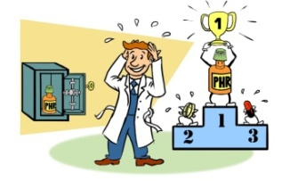

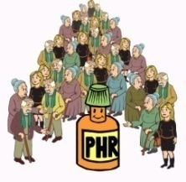
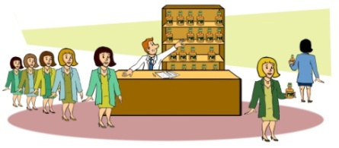
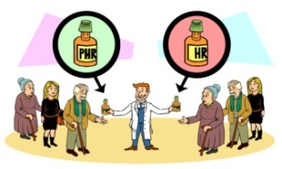
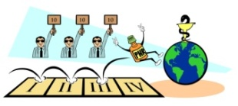

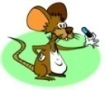
ÉTAPE DANS LA RECHERCHE D’UN MÉDICAMENT
La recherche d’un médicament est un processus long (entre 10 et 25 ans), complexe et coûteux, qui comporte différentes étapes.
R + D
du MÉDICAMENT
(2-10 ans)
DÉVELOPPEMENT CLINIQUE
PHASE I → PHASE II → PHASE III
Lancement
du
médicament
PHASE IV
ÉTUDES
PRÉCLINIQUES
(2-6 ans)
In vitro-In vivo
Notes:
The search for a medicine is a long, complex and very costly process (the phases are then briefly described, as they are explained in detail on the following slides).
Launching a drug on the market is a very long process, taking an average of 20 years. It is very complex and requires huge economic investment. It consists of several stages: the first is the research and development of a possible drug candidate, the aim of which is to find a substance that could be a good active ingredient for the disease being studied. This stage is combined with the preclinical study stage, consisting of testing the drug candidate in cells and animals. If the results of these studies are positive and no side effects are detected, the drug candidate would enter the clinical development stage, which consists of testing it in humans. If this stage is passed, with no or very reduced side effects, the drug will reach the market.

Slide 9
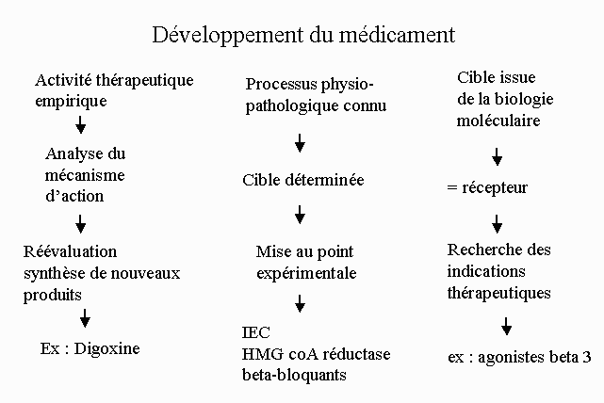

Slide 10
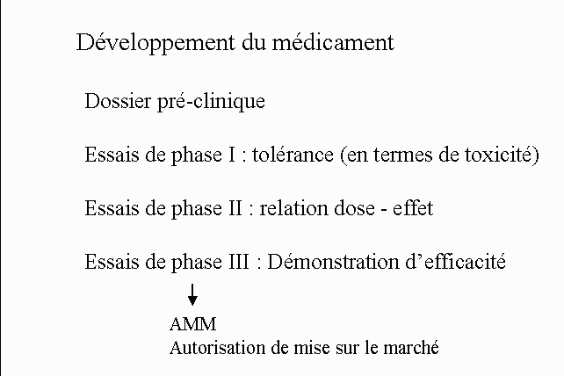

Slide 11
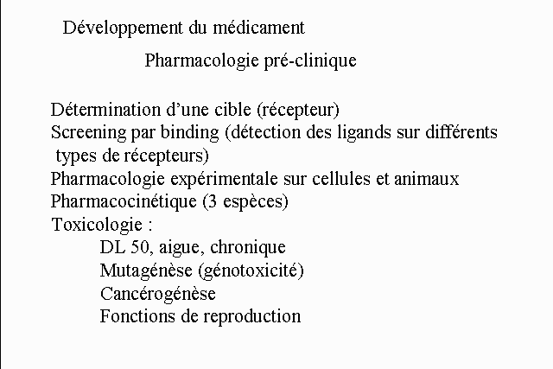

Slide 12
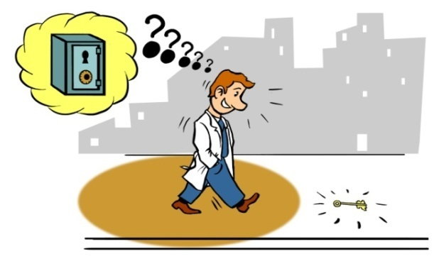

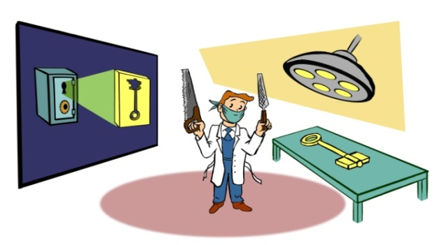

COMMENT DÉCOUVRE-T-ON UN CANDIDAT MÉDICAMENT ?
Un candidat médicament peut être découvert de différentes manières :
Hasard
Sélection de masse
Modification chimique
Conception rationnelle
Notes:
A drug candidate can be discovered in different ways:
One way would be to discover the key by chance or serendipity along the way. In the medicines world, there are many examples of drugs that have been discovered by chance. One example is Viagra. The drug was initially intended to reduce the blood pressure of people with hypertension. When it was tested in patients, it was found that the volunteers were enjoying the tests, despite its low anti-hypertensive effect. It was then discovered that one side effect (erection) was more important than its therapeutic effect. As there was no medicine available for erectile dysfunction at the time, that is how Viagra came about.
Another procedure is massive screening: it consists of testing many different compounds (of animal, marine or vegetable origin, etc.) to see whether any of them are active in the disease under study.
Chemical modification: this would be like having a key that doesn’t fit properly in the lock, but if we modify it (by filing it down or adding a piece, for example) we are able to create the key that opens the safe. Sometimes we want to improve the characteristics of a drug that we know is active, so we chemically modify part of the molecule to obtain the desired effect.
Finally, rational design consists of making a mould of the lock and then making a key to fit it perfectly. In research labs, this can be done by studying the therapeutic target. For example, if we know the structure of the protein affected by the dysfunction, we can design a molecule to fit it.

Slide 13
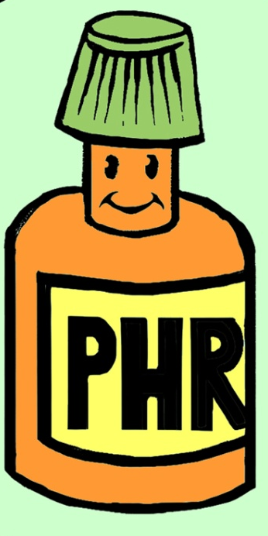
NOUS AVONS MAINTENANT UN CANDIDAT MÉDICAMENT
Notes:
Now that we have a drug candidate,
ask:
Do you think that we can go ahead and give it to patients?
If not, why?

Slide 14
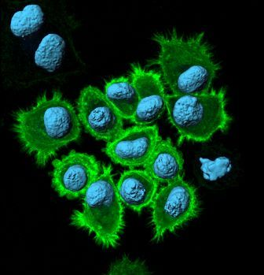

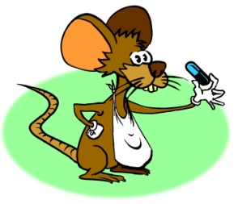

DÉVELOPPEMENT PRÉCLINIQUE
Avant d’essayer un médicament sur des humains, nous devons effectuer une étude préclinique très exhaustive et complète :
Les études précliniques incluent :
  des études de stabilité et de toxicité,
  des essais in vitro (protéines, cellules, tissus et organes),
  des essais in vivo (animaux).
©Parc Científic Barcelona. Author: J. Planagumà
Notes:
Before testing a drug in humans, we have to conduct a thorough and complete preclinical study. This is what we call preclinical development.
All these studies give us an idea of the drug’s efficacy and toxicity, helping us to detect possible undesirable side effects. They will also show us how the drug acts in the body (what the drug does to the body and what the body does to the drug – absorption, distribution, metabolism and the drug’s elimination)

Slide 15
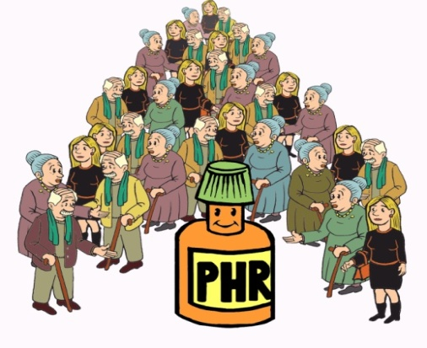


DÉVELOPPEMENT CLINIQUE
Le développement clinique est l’étape la plus longue et la plus chère dans le processus de recherche de nouveaux médicaments. Il comporte trois phases :
PHASE III
PHASE II
PHASE I
Volontaires sains
Malades
(100-300)
(médicament ou placebo)
Malades
(1300-3000)
Sécurité et dose
Efficacité et
effets
indésirables
Effets
à long
terme
Notes:
If the preclinical development phase is successful, the drug is tested in humans in what is called clinical development. This is the longest and most costly stage in the process of searching for new medicines. It consists of three phases:
In Phase I, the drug is tested in healthy volunteers.
Ask:
Why?
(Because this will give us an idea of the drug’s safety and toxicity and the best route of administration. Also, remember that if it causes many side effects in a healthy person, it could be fatal in someone who is ill).
In the second phase, the drug is tested in patients, administering the drug and a placebo at random.
Ask:
Do you know what a placebo is? Why do you think it is used?
(A placebo is the medicine but without the active substance. We can then assess the psychological effects on the patients and discover whether an improvement is really due to the active substance. Short-term side effects are also assessed in this phase).
And in the third phase, the drug is tested in a large number of patients, in different hospitals and countries. The idea is to assess its long-term effects.

Slide 16
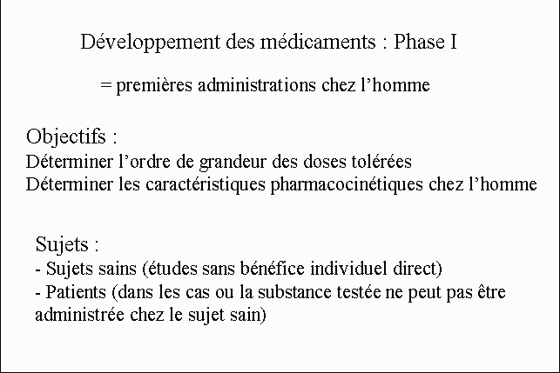

Slide 17
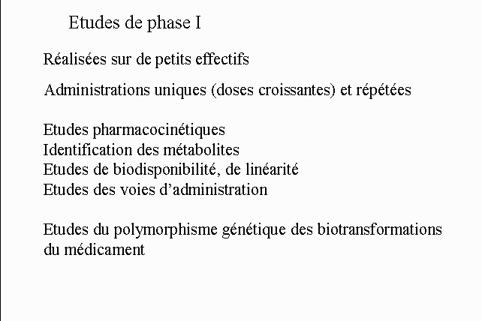

Slide 18
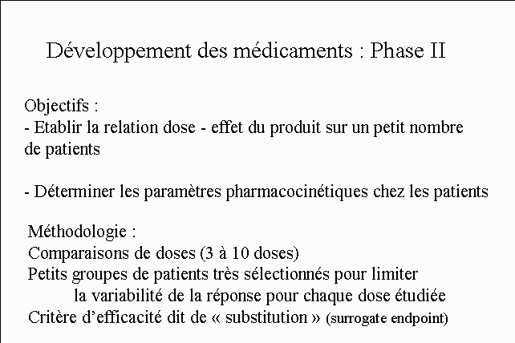

Slide 19
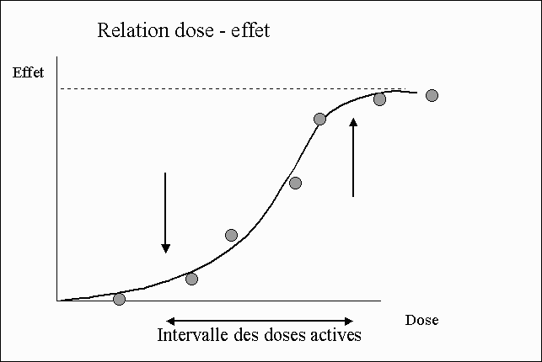

Slide 20
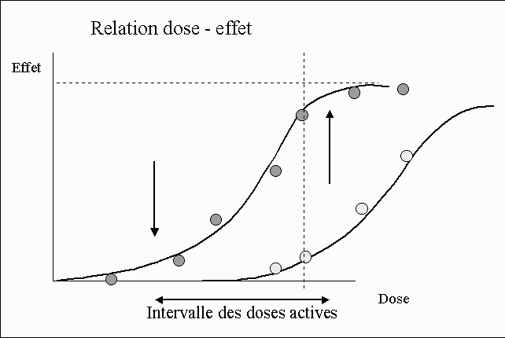

Slide 21
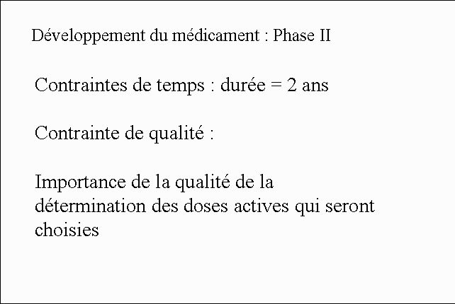

Slide 22
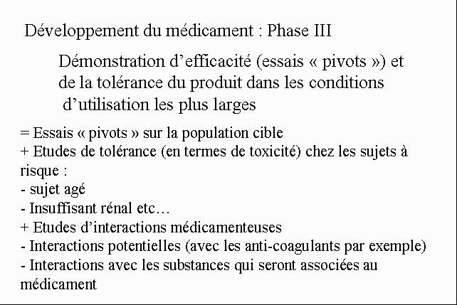

Slide 23
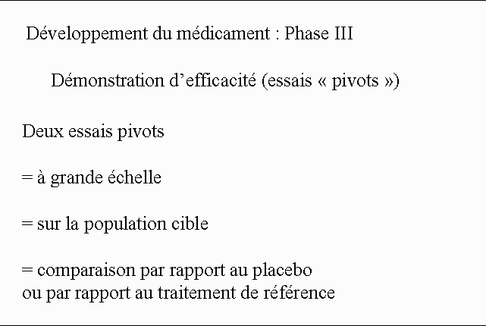

Slide 24



ET ENFIN… LE MÉDICAMENT ARRIVE SUR LE MARCHÉ !
Une fois que le médicament a passé les trois phases cliniques, il est lancé sur le marché, mais l’étude continue encore (Phase IV).
PHASE IV
PHASE III
MARCHÉ
PHASE II
PHASE I
Notes:
The drug will reach the market if these 3 phases are successful.
Once it is marketed, we can forget about it, can’t we?
Ask:
Do you think that we can?
(Answer: NO. It then enters Phase IV, a period in which the long-term side effects will continue to be studied. This is a very important phase. Indeed, some drugs have eventually been found to be unsafe, and they were withdrawn from the market).

Slide 25
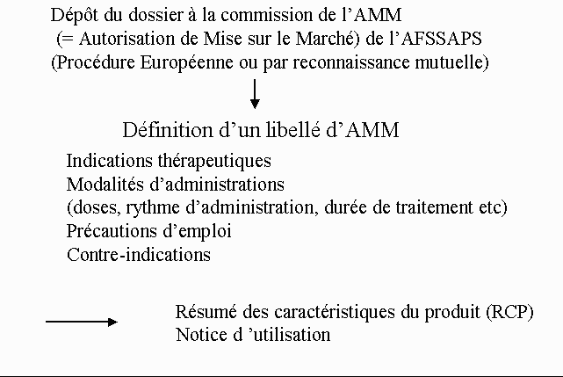

Slide 26
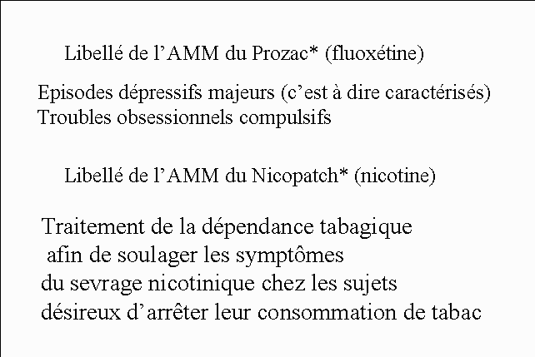

Slide 27
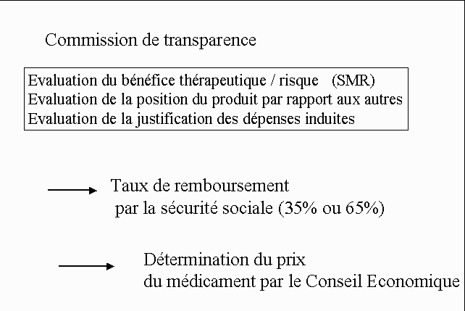

Slide 28
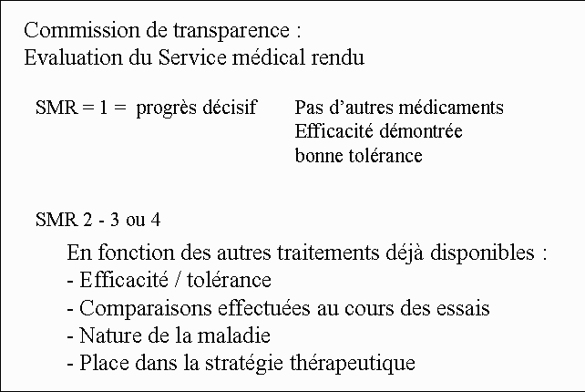

Slide 29
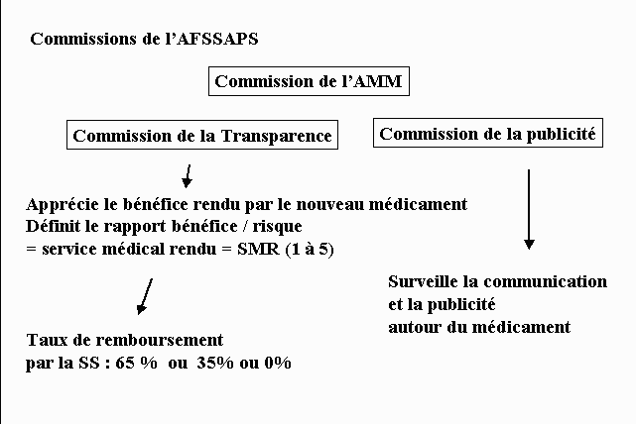

Slide 30
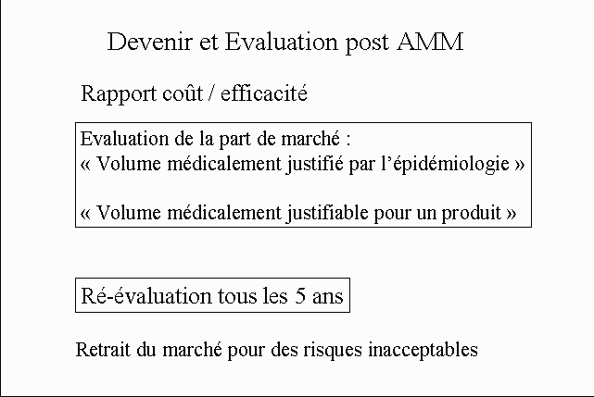

Slide 31
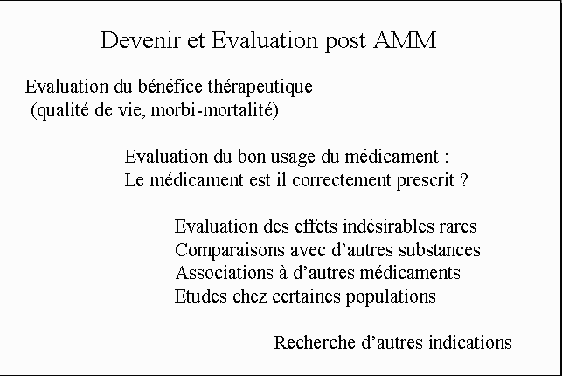

Slide 32
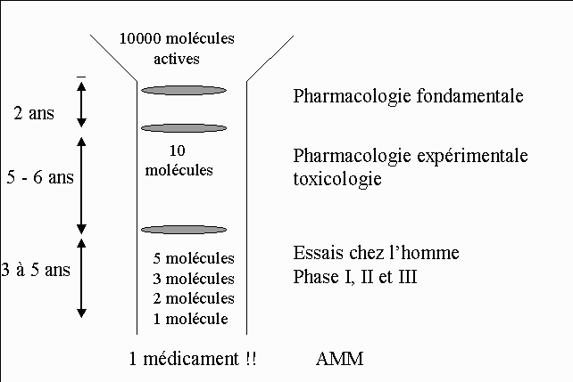

Slide 33
Merci pour votre attention

